Slide 1
Personal Evaluation – to support your academic progress please complete the section below BEFORE submitting your work
What do you consider to be the best aspects of this work? |  |  | The visuals of my poster, I feel it is easy to read and is not congested with too much information.
Which aspects do you consider could have been improved in this piece of work? |  |  | Perhaps the structuring of my poster. However, I feel it is the best representation of how the poster could have turned out.
What have you found most satisfying whilst undertaking this submission? |  |  | Learning how to create the correlation graphs in excel and compiling the data together for presentation.
ASSESSMENT CRITERIA | Learning outcomes |  | GRADE
 |  |  | Poor 0 - 25% | Unsatisfactory 26 - 39% | Satisfactory 40 – 49% | Good 50 – 59% | Very Good 60 – 69% | Excellent 70 – 85% |  | Exceptional 86 – 100%
THE POSTER Introduction & contextualisation (10%) | 1,2, 3
Justification, description and explanation of methods used, including research design diagram where appropriate (40%) | 1,2, 3
Results, main discussion points and conclusion (50%) | 1,2,3
It is expected that students will present work that is proof read and follows the School Reference Guide and Assessment Checklist. Therefore a range of 0 – 10 marks will be deducted for non-completion of any of the points on the checklist below.
TUTOR COMMENTS:
Submission date: 11th May 2020 |  | Return date: (within 1 week of submission date) |  |  | Tutor: Dr Simon Williams |  |  |  | Mark:

Slide 2

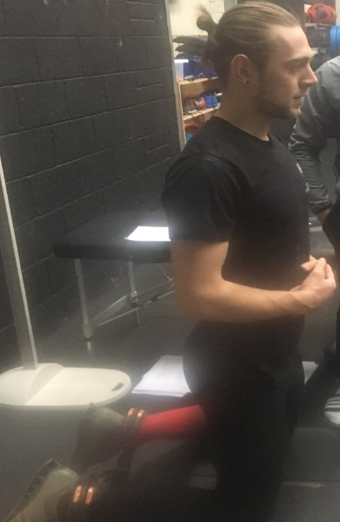
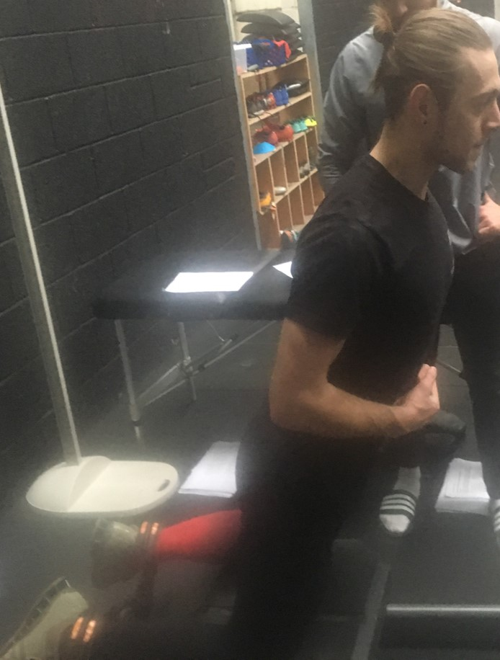


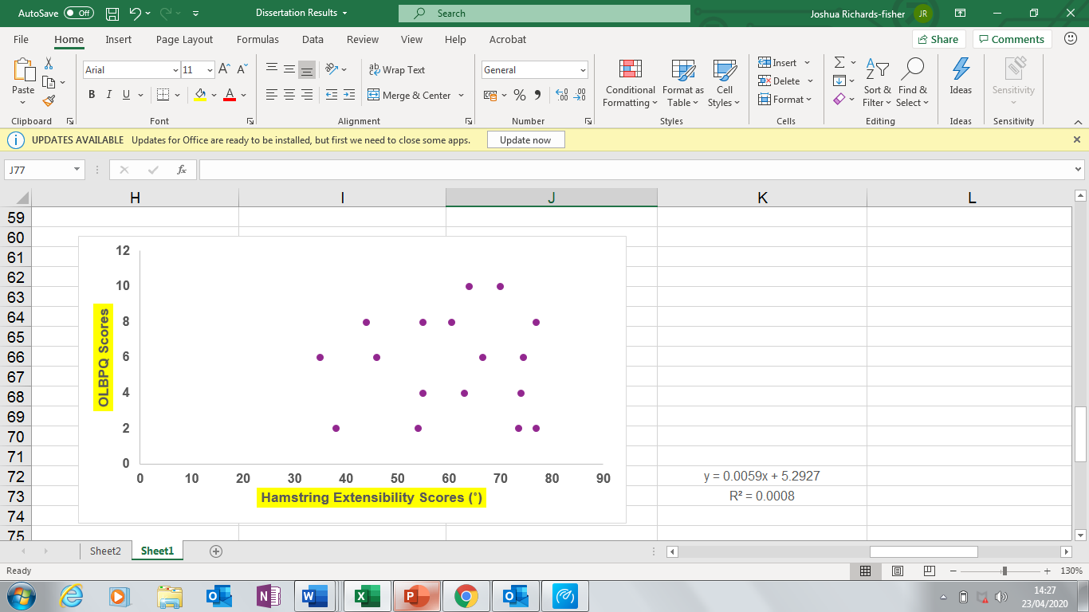
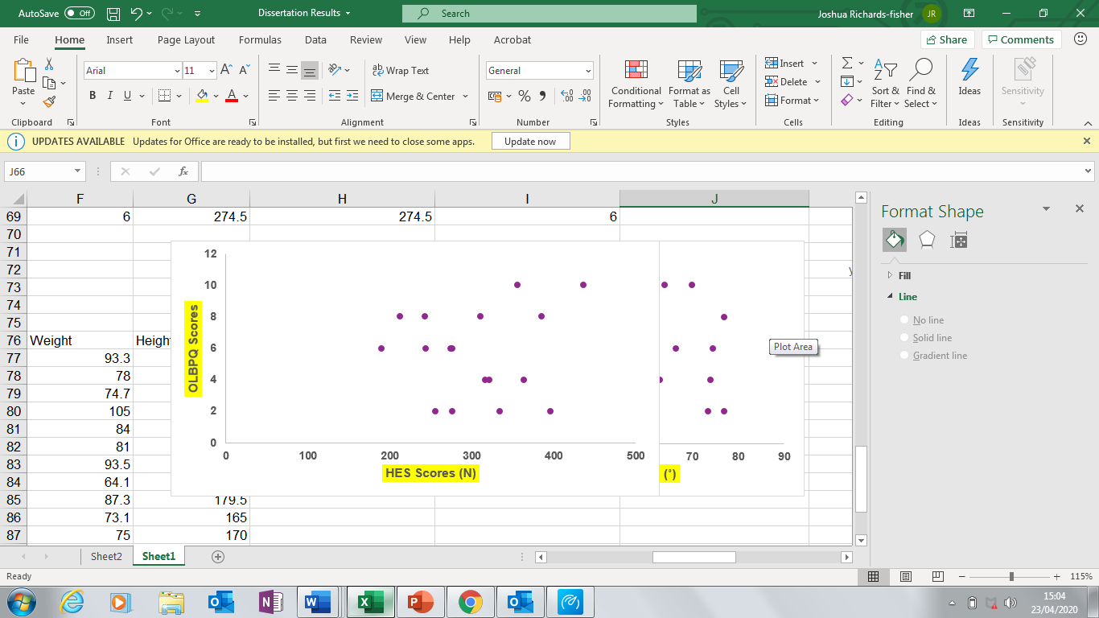
Hamstring Strength and Extensibility on Acute Lower Back Pain in CrossFit Athletes
Joshua J. Richards-Fisher¹
              ¹School of Sport, Health and Outdoor Education, Faculty of Business & Management, University of Wales Trinity Saint David, Carmarthenshire, Wales, United Kingdom.
              ²CrossFit SA1 – Olympic Weightlifting Centre, Swansea, Wales, United Kingdom.
Background: CrossFit encompasses anaerobic, aerobic, and metabolic stresses into a high intensity workout, known as a WOD (Workout of the Day).¹ The incidence of injury is high in the sport and is constantly gaining new members.^{1,2} From limited research, the most frequently injured areas are the shoulders, lower back and knees.^{1,2} The hamstring muscle group (HMG) often pose as a problem in elite sport, as one of the most frequently injured areas across a variety of sports.³ Hamstring extensibility has been shown to have a high correlation with lower back pain and hamstring injuries.^{4,5} Furthermore, hamstring eccentric strength (HES) has been shown to have a direct link to muscle extensibility and lower back pain.^{5,6} The Nordic hamstring exercise (NHE) is the gold standard for applying overload to the HMG.⁷ Values gained from the NHE can educate clinicians on the HMG’s ability to resist mechanical deformation.⁷ The Nordbord is a specialist piece of equipment that requires participants to perform maximal hamstring eccentric contractions which can help identify eccentric strength performance deficits.⁷
Objective: To explore if there is a relationship between hamstring extensibility and HES on acute lower back pain in trained CrossFit athletes.
Methods: Design: This observational cross-sectional design study measured participants in a single session. The Oswestry Lower Back Pain Questionnaire (OLBPQ) was used to assess lower back pain severity. Hamstring extensibility was utilised using the MHFAKE test (Maximal Hip Flexion Active Knee Extension) with an iPhone 6 application (Figure 2.0). Maximal HES was assessed using the Nordbord. Setting: Amateur CrossFit athletes. Participants (or Patients): Seventeen trained CrossFit athletes (1-year experience). Main Outcome Measurements: Both maximal HES using the Nordbord device (Figure 1.0) and hamstring extensibility using a goniometer application, were compared against the OLBPQ.
Results: Descriptive statistics of participants were as follows: Weight (kg’s) 82.3 ± 13.1 Height (cm’s) 173.4 ± 7.5 Age (years) 25.4 ± 4.8. Results gained from both parametric tests revealed non-significant findings in both HES (P = 0.76) and hamstring extensibility scores (P = 0.91) when compared against subjective pain ratings of the OLBPQ. However, the Pearson Correlation Coefficient demonstrated a large positive correlation (r² = 0.81) for HES related to OLBPQ scores. Moreover, a small positive correlation was observed for hamstring extensibility measures (r² = 0.28) when compared against OLBPQ scores. Figures 3.0. and 4.0. provide the spread of data with r² values.
Figure 2.0. Angle Pro Application
Figure 1.0. Maximal HES Nordic Device
y = 0.0059x + 5.2927
= 0.0008
√ = 0.28
R² = 0.28
Conclusion: The results gained from this study are the first of its kind to be conducted. Whilst a non-significant relationship was found for both measures of HES and hamstring extensibility on acute lower back pain scores in trained CrossFit athletes, future research should seek to acquire a larger cohort to have further reliable data.
References:
Feito, Y., Burrows, E.K. and Tabb, L.P. (2018) ‘A 4-year analysis of the incidence of injuries among CrossFit-trained participants’ Orthopaedic Journal of Sports Medicine, 6(10), pp. 1-8.
Montalvo, A.M., Shaefer, H., Rodriguez, B., Li, T., Epnere, K. and Myer, G.D. (2017) ‘Retrospective injury epidemiology and risk factors for injury in CrossFit’ Journal of Sports Science & Medicine, 16(1), pp. 53-59.
Lee, J.W., Mok, K.M., Chan, H.C., Yung, P.S. and Chan, K.M. (2018) ‘Eccentric hamstring strength deficit and poor hamstring-to-quadriceps ratio are risk factors for hamstring strain injury in football: A prospective study of 146 professional players’ Journal of Science & Medicine in Sport, 21(8), pp. 789-793.
Suarez-Arrones, L., Lara-Lopez, P., Rodriguez-Sanchez, P., Lazaro-Ramirez, J.L., Di Salvo, V., Guitart, M., Fuentes-Nieto, C., Rodas, G. and Mendez-Villanueva, A. (2019) ‘Dissociation between changes in sprinting performance and Nordic hamstring strength in professional male football players’ PloS One, 14(3) pp. 1-12.
Hasebe, K., Sairyo, K., Hada, Y., Dezawa, A., Okubo, Y., Kaneoka, K. and Nakamura, Y. (2014) ‘Spino-pelvic-rhythm with forward trunk bending in normal subjects without low back pain’ European Journal of Orthopaedic Surgery & Traumatology, 24(1), pp. 193-199.
McGrath, T.M., Hulin, B.T., Pickworth, N., Clarke, A. and Timmins, R.G. (2019) ‘Determinants of hamstring fascicle length in professional rugby league athletes’ Journal of Science & Medicine in Sport pp. 1-18.
Sannicandro, I., Traficante, P. and Cofano, G. (2019) ‘Hamstring injury prevention: The strength assessment in young soccer players’ MOJ Sports Medicine, 3(2), pp. 28-32.
Figure 3.0. Comparing Hamstring Extensibility with the OLBPQ
y = 0.0033x + 4.6358
= 0.0066
√ = 0.81
R² = 0.81
Figure 4.0. Comparing HES with the OLBPQ
Notes:
2

