Slide 1
Computational Thinking
ACDA4016
Lecture 5
Even More BPMN

Slide 2






Previously…
Previously we looked at a basic set of events, activities and gateways
 | Start event
 | Intermediate time-related event
 | End event
 | Exception (error) event
 | Compensation (undo) event
 | Message-related event

Slide 3






Previously…
 | Task
 | Repeated task
 | Repeated task detailed in a sub-diagram
 | Event-based gateway
 | Decision gateway
 | Parallel gateway

Slide 4
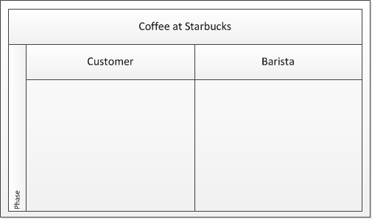
Pools and Swimlanes
A pool is a representation of a large process, showing all of the participants within the process
These may, or may not, work for the same organisation
Multiple sub-processes may be shown in individual swimlanes, each representing the actions performed by a different person or system
Pool title
Swimlane titles
Swimlanes

Slide 5
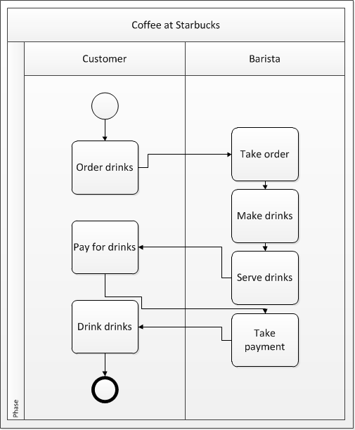
Buying Coffee
For example, consider going into Starbucks to order a coffee (or two)
The pool title describes the overall process
The two swimlanes show how the process passes between the two entities involved (the customer and the barista)

Slide 6
Problem
Draw the BPD for a car park gate security system
Hint:
  How many subprocesses (=swimlanes) are needed?
  What are they?

Slide 7
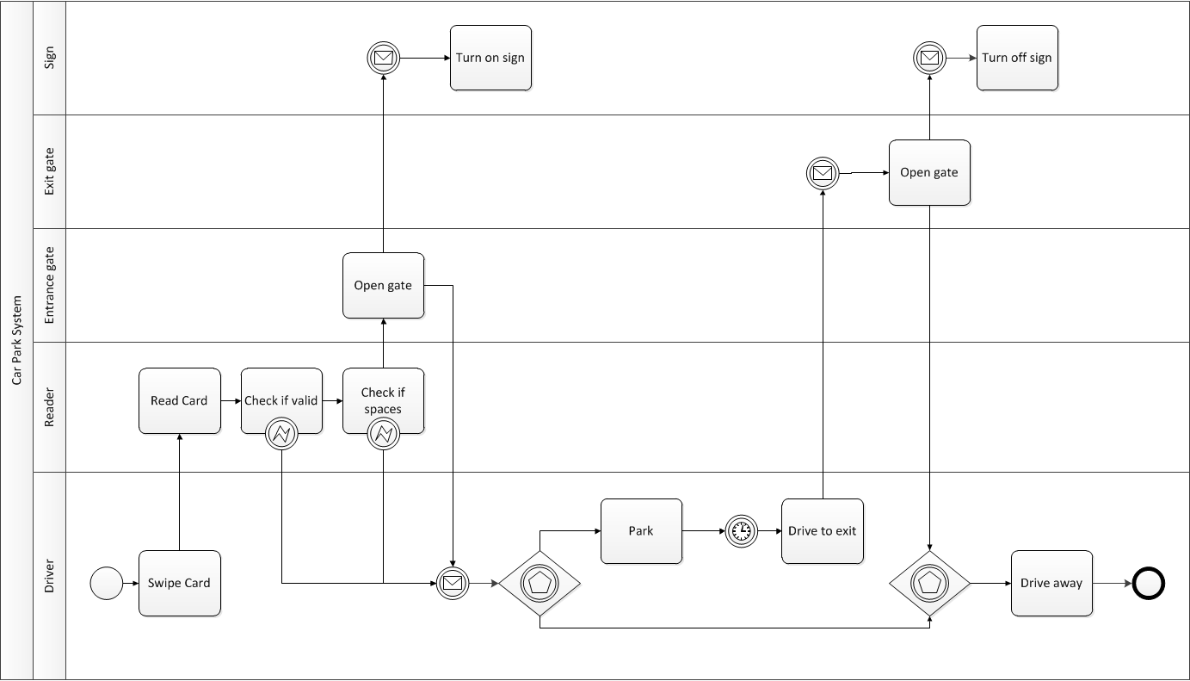
Possible Solution

Slide 8
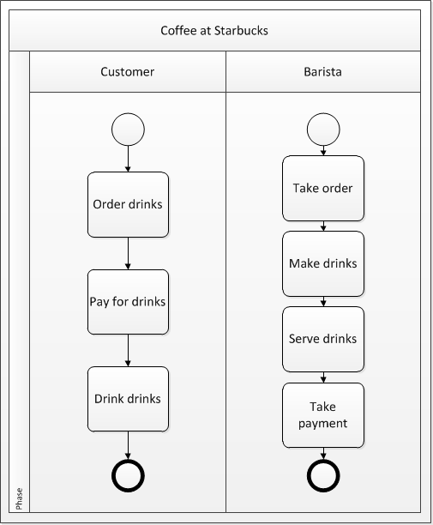
Messages
A different approach is to show the complete processes ‘owned’ by each entity
In this case it is clear that there must be a way to pass information from one entity to another
Information is passed using messages

Slide 9
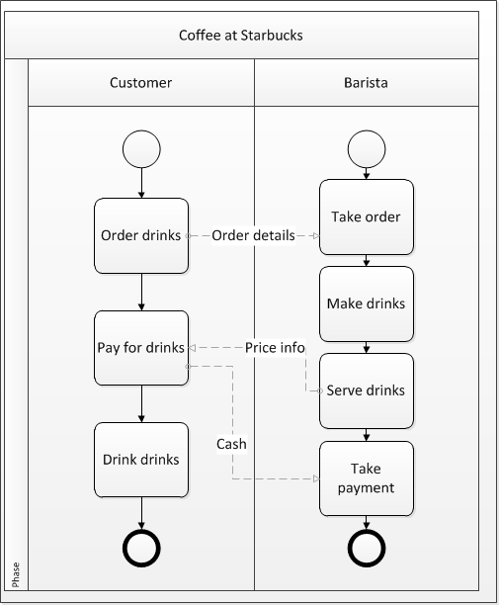

Messages
Messages are generated by one task and feed into another task
All messages should have a title that describes what is in the message
Messages are shown using dashed arrows

Slide 10
Problem
Draw the BPD for a car park gate security system showing any messages passed between different entities within the system
Hint:
  How many messages are needed?
  What are they?
  What sends them, and what receives them?
  What happens to make something send a message?
  What does something do when it receives a message?

Slide 11
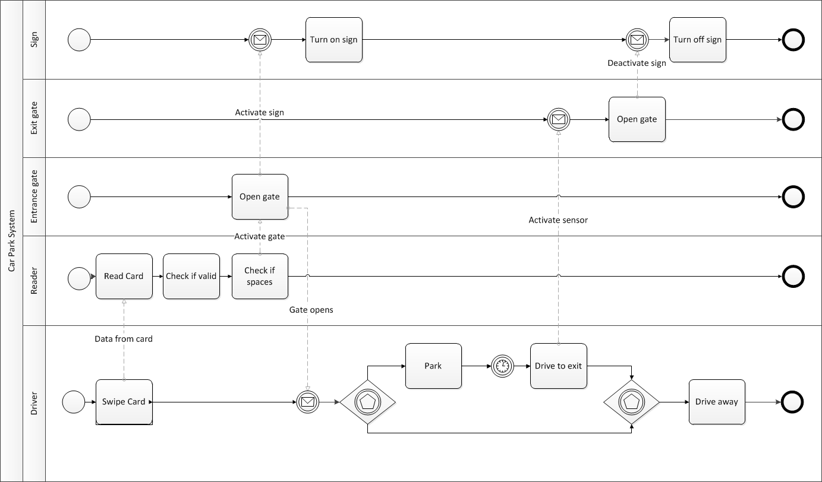
Possible Solution

Slide 12
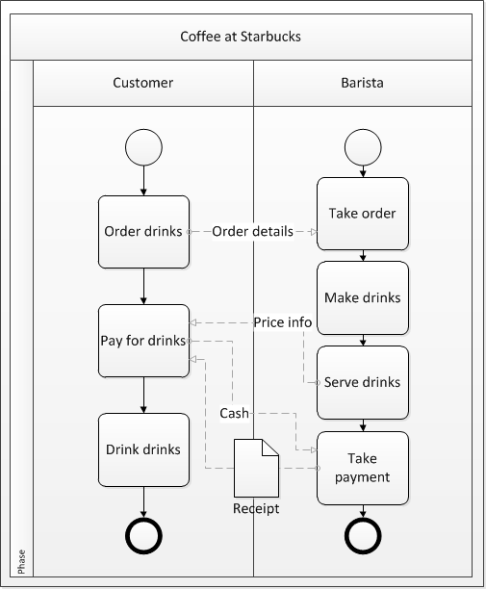

Data Objects
Some messages involve physical copies of data
This may be stored on paper or electronically
These are represented as data objects
Data objects may be required by an activity or produced by an activity

Slide 13
Problem
Draw the BPD for a car park gate security system showing any messages passed between different entities within the system and any data objects used by the system.
Hint:
  What data objects are needed?
  What activities involve using or generating data objects?

Slide 14
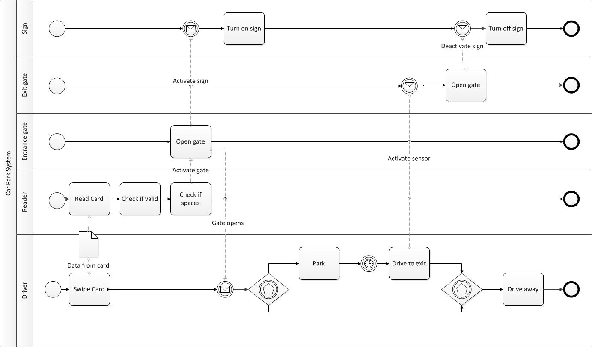
Possible solution

Slide 15
Summary
This week we added
  Pools
  Swimlanes
  Messages
  Data objects
These, together with the symbols covered in the last two lectures, are all of the symbols needed to create Business Process Diagrams suitable for this module
There are other symbols, but their use is unnecessary at this level

Slide 16
Looking Ahead
Next week: Going Beyond BPMN
Homework: Read the Wikipedia article on ‘Business Process Model and Notation’

