Slide 1
Hospitality
Year 1 Tourism and Events

Slide 2
What is Hospitality?
Act of Kindness
Welcoming Guests
Food and Bev
Accommodation
Service
Tangibles v Intangibles

Slide 3
Aims and Objectives
Profit
Public Sector /Private Sector
Secondary Spend
Upselling
Operations
Relationship with Tourism, Travel, Events and Sports Sectors

Slide 4
Concepts
Management and leadership
Operations
Guest Service
Quality
Retail
Convention and Meetings Management
Banquetting
Resort Developments

Slide 5
Characteristics
Intangible
Tangible
Perishable
No such thing as Normal Business Hours!
Shiftwork
Service
Needs

Slide 6
Seven Deadly Sins
Apathy
Ignorance
Coldness
Condescension and lack of respect
Robotics
Rule books
Evasive excuses

Slide 7
Service
Needs
Guest Focus
Roles, Responsibilities and Relationships
Dedication
Service Culture
Management Styles
Thrive on Change

Slide 8
Service Standards
World Class / 5 star
Mid Range
Economy / Lo Cost
Expectations
Standards
Tangibles
Intangibles

Slide 9
Identifying Guests
Leisure Guests
Business Guests
Needs
Relationships
Club Membership Schemes
Yield Management
Good Management/Service = Increased Profits

Slide 10
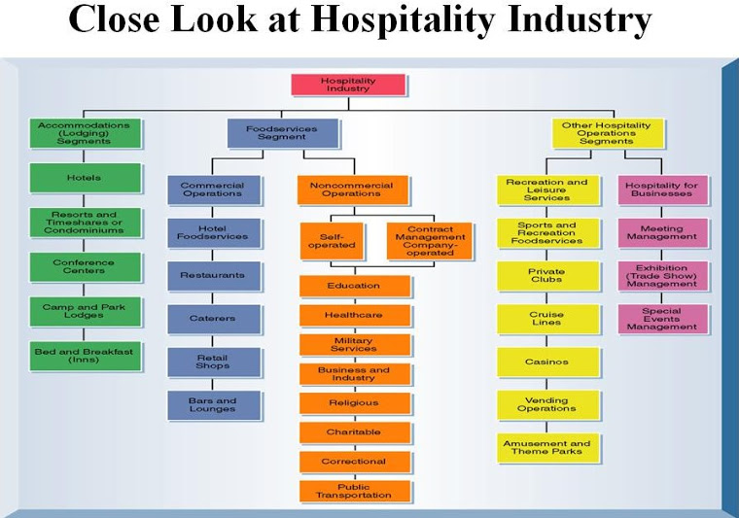

Slide 11
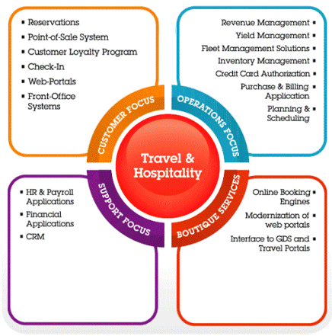
Responsibilities

Slide 12
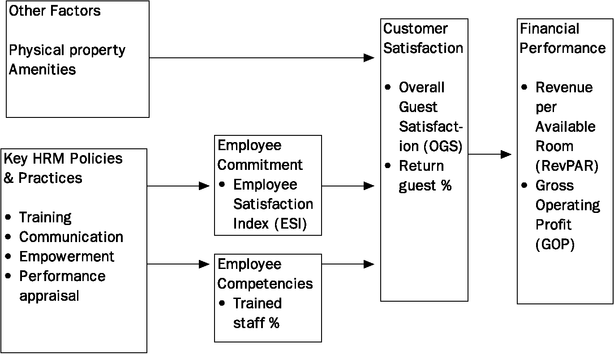
Empowerment

