Slide 1

Key Attributes For Employment
Student Name: Mehrnoosh Amani Tehrani
Student ID Number: 2025025021
Programme: Hospitality And Hotel Management
Module: Business Skills for the International Hotel Industry
Module Code:BM1H4007 /BM1H4007D
Lecturer : Daniel Payne

Slide 2
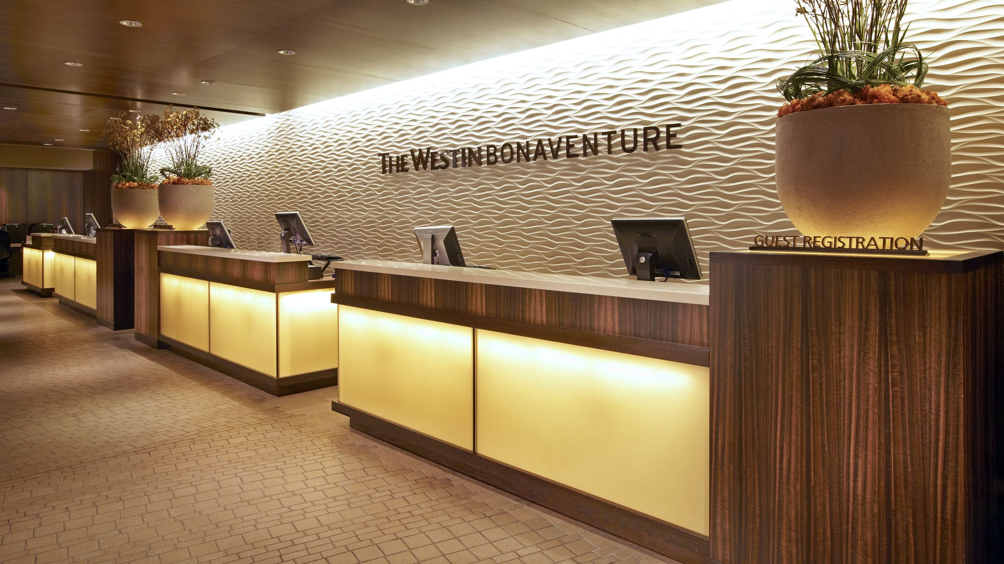
Key attributes for working in the hospitality industry
Introduction:
Indeed, the word hospitality originates from the old French word hospice, which means “to provide care and shelter for travellers”. In my understandings , one of the most famous hospices is hotel- Dieu de Beaune in the Burgundy region of France, which historically, offered care and accommodation for travellers.
Gradually, the hospitality industry has developed since 4,500 B.C.E, evolving overtime into the modern, branded hotels as we see them today. If we imagine hospitality as an umbrella, we can better understand its wide scope, which includes many sectors such as lodging, restaurants, recreation, assemblies, events, travel and tourism. This also highlights the importance of direct human interaction with guests in delivering services and products.
Furthermore, The pineapple has been introduced around the world as a symbol of hospitality and many people know it as a sign of friendliness, graciousness, and cheer.(Walker,2014,pp.12-13)
Study background:
Hospitality industry is a people focused and service-driven sector.
(performance front of the house or heart of the house)
Business success depends on service quality, professional skills, operational excellence, exceptional customer.

Slide 3
Communication skills:
Clear verbal and non-verbal communication with guests.
People who work in hospitality industry have ability to affect the customer experience by creating powerful feelings.
Being capable of anticipating customer needs and wants.
Ability to handle crisis situations and customer complaints professionally.
Active listening.
Ability to communicate effectively through digital channels such as: (email, online platforms, and social media).
Customer service orientation
Ability to create relationships with customers and provide positive and memorable customer experiences.
Well trained employees with high comprehensive knowledge who enjoy helping customers.
Dedicated employees with a positive attitude towards their service roles.

Slide 4

Teamwork
Teamwork is essential in the hospitality industry. It involves combining the efforts of all members in a project or business to ensure tasks are completed efficiently
and on time, while working together to achieve common goals.
As mentioned above, teamworking is vital in all organisations for many reasons such as:
Hospitality relies on co-operation between employees and managers in different sections.
Front office
Food and beverage
Service management and…
Adaptability and cultural awareness
Adaptability does not develop overnight it’s built through practice and mindset.
Here are five ways to strengthen these skills in your career:
Stay aware of changes around you
Develop a growth mindset
Ask for feedback
Step out of your comfort zone.
Practice adaptability to serve international and diverse customers with different cultures and expectations.
In addition: Flexibility to work in different roles or shifts when required.

Slide 5
Professionalism and work ethic
Responsibility and punctual
Professional and organised appearance and logical behaviour.
Positive attitude
Accountability
Reliability and integrity
Professionalism covers everything from communication to how employees present themselves.
Employability skills gained from module:
Confidence in professional environment
Understanding of business operations.
Improved my communication in teamwork and problem solving

Slide 6
Personality & Skills
In fact , I am highly enthusiastic about pursuing an office-based role within the hospitality industry, particularly in hotel environments, like my previous position.
There are several reasons for this interest, which I will express in the following order:
Firstly, I demonstrate strong time management skills , allowing me to prioritise tasks effectively by developing an action before commencing a project or an event.
Secondly, I posses a high level of responsibility towards my commitments and consistently maintain reliability in my professional duties.
Thirdly, based on my experience working as an expert , I am able to dedicate more time to problem solving and to supporting my colleagues in a respectful and professional manner.

Slide 7
Finally, due to my personality and strong positive attitude , I am able to set my personality and skills align to maintain friendliness and excellent communication within hospitality industry , which contributes to enhancing customer loyalty.
Conclusion:
Indeed, During this module journey, I realised:
My own strengths and areas for development.
I enjoy working with people, but I understand that I need to have more positive attitude and I should be enthusiastic to learn new things. As hospitality is a fast- changing and dynamic industry, hence, I must learn sufficient technological knowledge.
Employer expectations
Business knowledge and management
Conclusion

Slide 8
References
Walker, J.R. and Walker, J.T. (2014). Introduction to hospitality management. Harlow Pearson, pp.12, 13.
Youtu.be. (2026). Effective Communication Skills in the Workplace | Communication at Work. [online] Available at: https://youtu.be/QGHBq5OEsBM?si=vjeeZi6D5c9GtI6G [Accessed 9 Jan. 2026].

Slide 9
The End

