Slide 1
NoSQL Databases
Bev Holland

Slide 2
Introduction
NoSql = not only SQL
  Remember this type of database also support SQL type queries
NoSQL isn’t so much an advance in technology however
  It allows for flexibility in terms of schema design beyond tradition relation database design
A way of matching database performance and capability to application demands
  common types of NoSQL databases are key-value, document, column and graph databases.

Slide 3
Definition
NoSQL represents an approach to designing a database that can accommodate a wide variety of data and is fundamental change in the way people think about storing and retrieving data.
Most information being stored in a NoSQL database is either unstructured or semi-structured. This is useful when there is a need to work with large sets of unstructured data.

Slide 4
Example of NoSQL database
Amazon DynamoDB
Google BigTable
Apache Cassandra
MongoDB.
Elasticsearch
Redis

Slide 5
NoSQL Terminology
Node;
Clusters;
Sharding;
Replication;
ACID;
BASE.

Slide 6
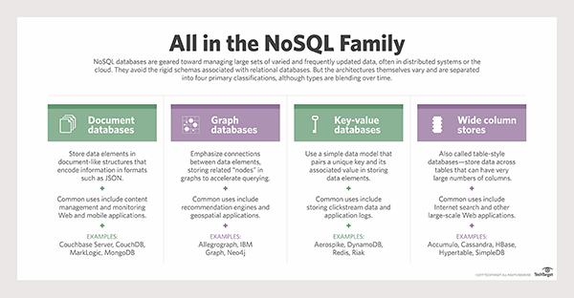
https://searchdatamanagement.techtarget.com/definition/NoSQL-Not-Only-SQL

Slide 7
Node
A Node is a networked computer that offers a:
  Service;
  Local storage;
  Access to a much larger distributed data store.

Slide 8
Cluster
A Cluster is a set of nodes that constitute a single unit.

Slide 9
Sharding / Horizontal Partitioning
Sharding involves partitioning the database on the value of some field.
This is done to equalise the amount of data between nodes.

Slide 10
Replication
Replication is the mechanism that provides database availability.
  Portions of the database are written to multiple nodes so that if:
    one node fails,
    another node contains a replica of the failed node’s data.

Slide 11
ACID
ACID is the acronym for:
  Atomicity;
  Consistency;
  Isolation;
  Durability.
  The same concept as in Relational Databases.

Slide 12
BASE
BASE is the acronym for:
  Basically Available;
    The database may not be available 24/7.
  Soft-state;
    The state of the database may be inconsistent due to the time taken to update all replicated data items.
  Eventually consistent.
    Eventually consistent when all replicated data items are updated.

Slide 13
Types of NoSQL Databases
Key-value;
Document;
Column-family;
Graph.

Slide 14
Key-Value
Key-value databases are the simplest form of NoSQL databases.
The basic data structure is a dictionary or map.
You can store a value, such as an integer, string, a JSON structure, or an array, along with a key used to reference that value.
You can quickly and easily read a given record based on its key.

Slide 15
Key-Value
You cannot search value data across multiple records.
Example:
  Using a URL as the key of a given web page;
  The contents can be expressed as:
    HTML;
    PHP;
    JavaScript;
    Binary data.

Slide 16
Key-value Example Usage
For storing user session data;
Maintaining schema-less user profiles;
Storing user preferences;
Storing shopping cart data.

Slide 17
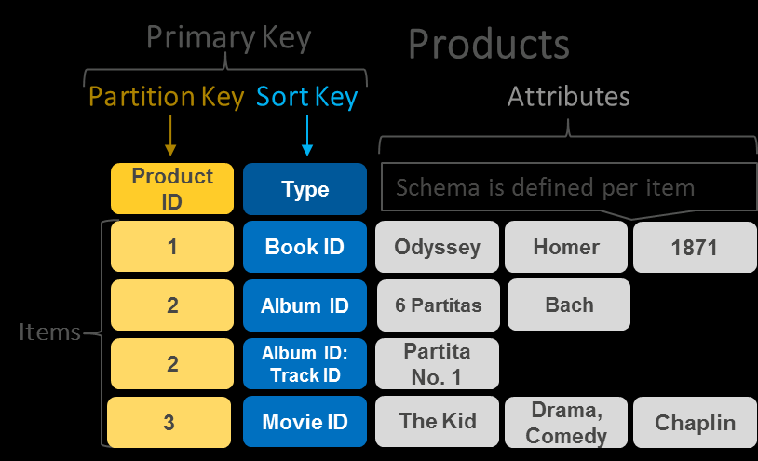
Data stored as key value pairs
Notes:
https://aws.amazon.com/nosql/key-value/

Slide 18
Document/Aggregate
Similar to key-value databases:
  The value associated with the key contains structured or semi-structured data.
Queries against the structure of the document as well as elements within that structure are permissible.
Example:
  Book database in which the title is the key and the value is the book meta data expressed as an XML document.

Slide 19
Document Example Usage
E-commerce platforms
Content management systems
Analytics platforms
Blogging platforms

Slide 20
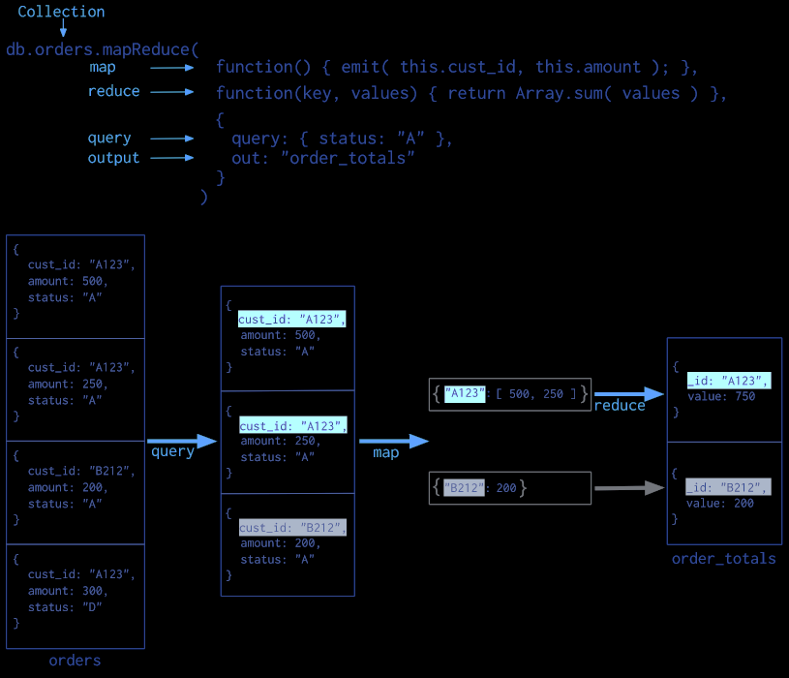
Example of MongoDb map-reduced operation to perform aggregation
Notes:
https://docs.mongodb.com/manual/aggregation/

Slide 21
Column-Family
Mathematicians recognize this type of database as a Sparse Matrix.
Programmers would see this type of database as a Hash Table.
In column-oriented NoSQL databases, data is stored in cells grouped in columns of data rather than as rows of Columns are logically grouped into column families.

Slide 22
Column-family
Column families can contain a virtually unlimited number of columns that can be created at runtime or while defining the schema data.
Read and write is done using columns rather than rows. Column families are groups of similar data that is usually accessed together.

Slide 23
Column-Family Example Usage
Content management systems;
Blogging platforms;
Systems that maintain counters;
Services that have expiring usage;
Systems that require heavy write requests (like log aggregators).

Slide 24
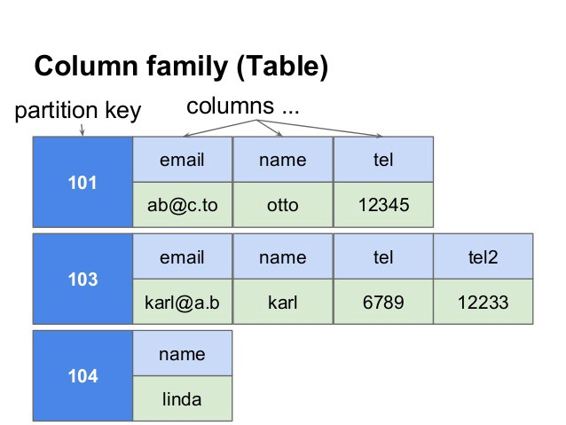
In RDBMS, every entry should have the same number of columns. But in Cassandra, each row can have a different number of columns. As you can see, 104 has name only whereas 103 has email, name, tel and tel2
Notes:
https://www.freecodecamp.org/news/nosql-databases-5f6639ed9574/

Slide 25
Graph
Graph databases are basically built upon the Entity – Attribute – Value model.
Entities are also known as nodes, which have properties.
A graph is composed of two elements – a node and a relationship
It is a very flexible way to describe how data relates to other data.
Nodes store data about each entity in the database, relationships describe a relationship between nodes, and a property is simply the node on the opposite end of the relationship.

Slide 26
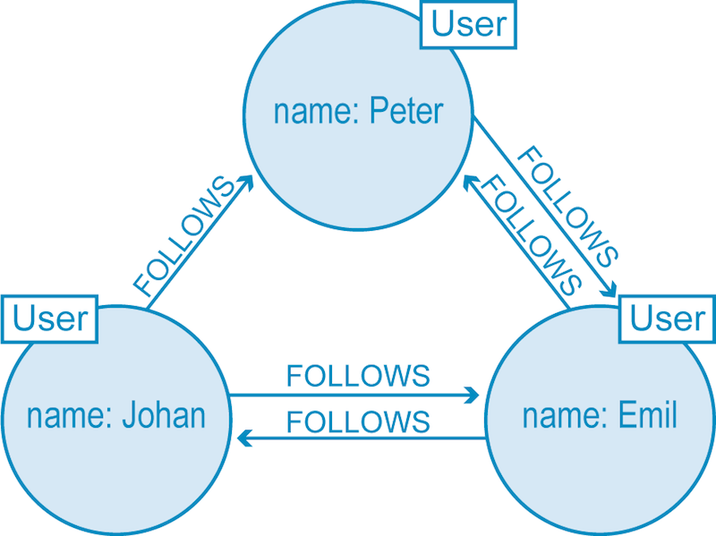
Graph database representation of twitter

Slide 27
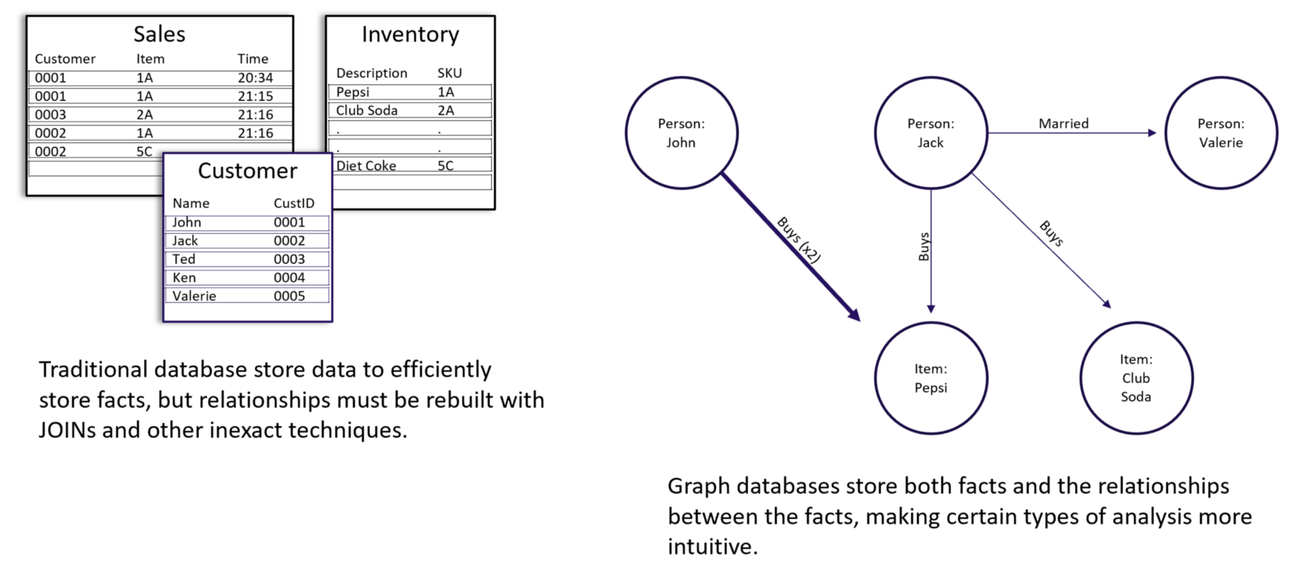
Example of Graph database
Notes:
https://towardsdatascience.com/graph-databases-whats-the-big-deal-ec310b1bc0ed

Slide 28
Graph Example Usage
Fraud detection;
Graph based search;
Network and IT operations;
Social networks.

Slide 29
References
Enterprise NoSQL for Dummies, MarkLogic Special Edition.
https://opensourceforu.com/2017/05/different-types-nosql-databases/

