Slide 1
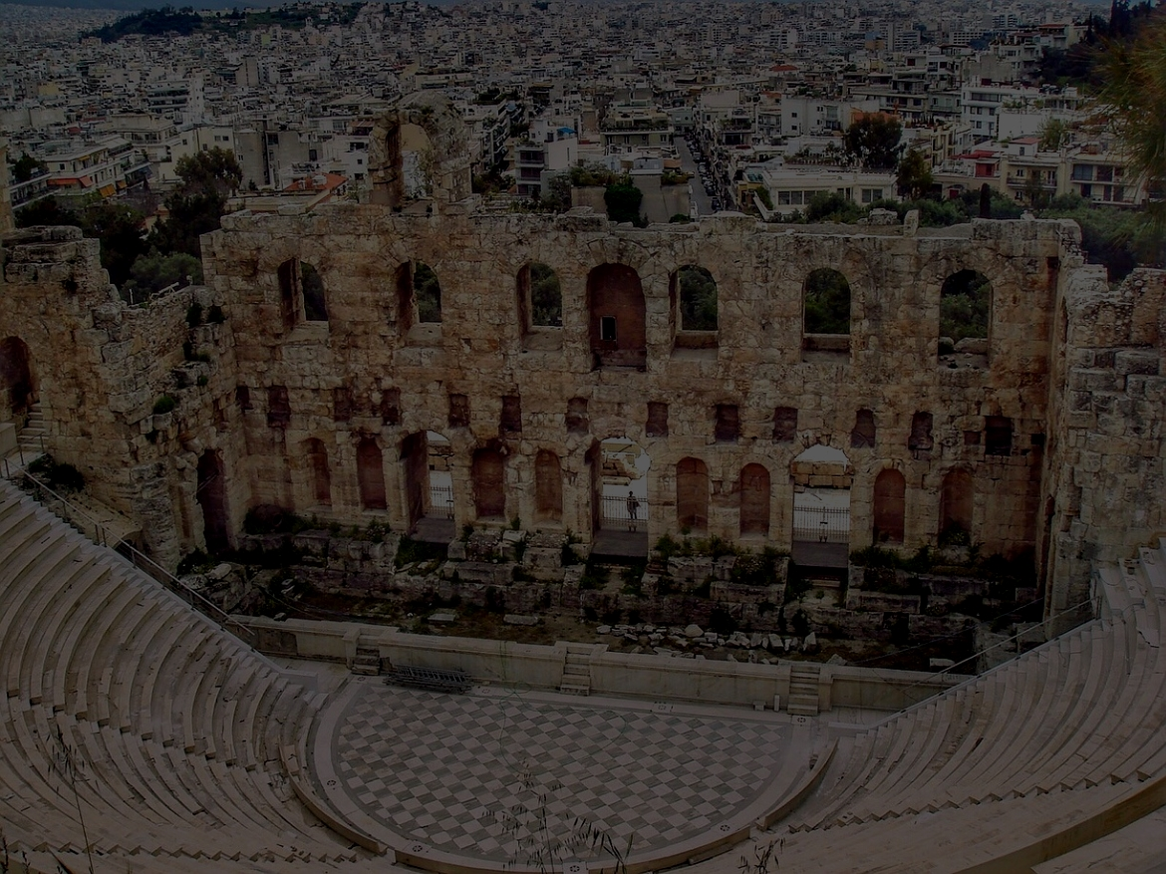
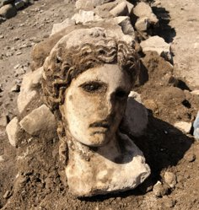
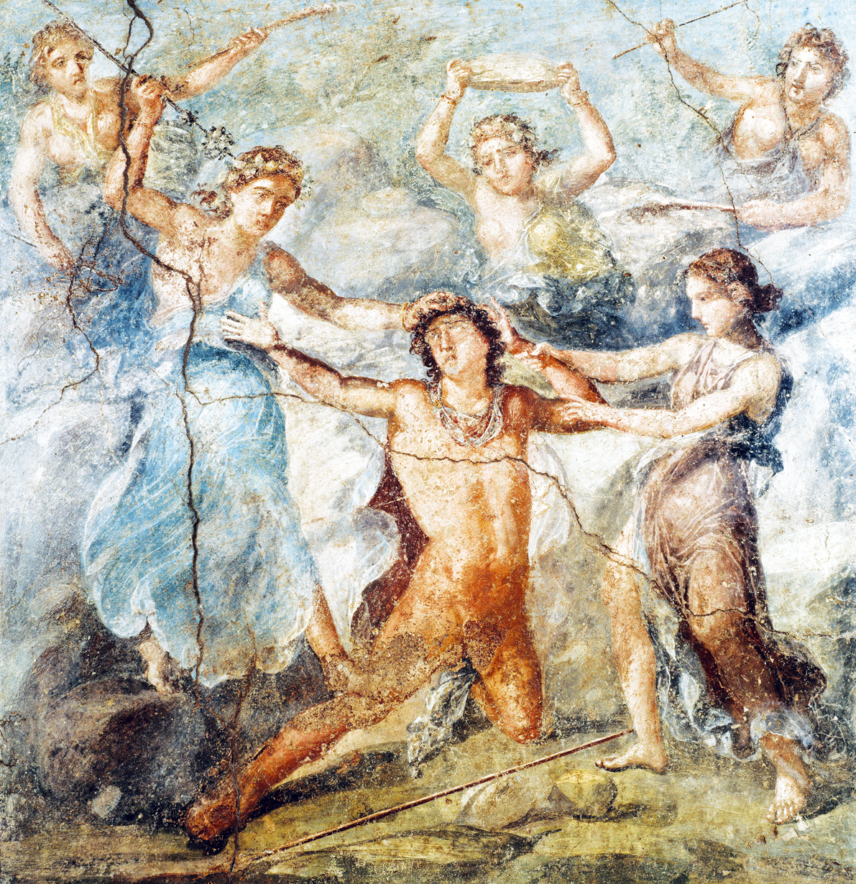

Understanding Gender in Ancient Greece
Ancient Greeks believed that all women possessed an "animal state". These women were drunk and sexually aggressive, were even liable eat anything that would cross their paths, from lions to their child.
"Gender" in
Archaeology
Gender in the current age has had its achievements and new advancements but these are usually forgotten, this is a genealogical lapsus.
The development of gender came from feminism, but now some archaeologists who specialize in gender have avoided mentioning feminism.
Gender has been a debate for three and a half decades and is still a highly debated subject.
Non-Binary
He is the only Greek deity that possesses a gender identity that does not align with his body. Firstly assigned as male, but then lived as a female until adulthood.
He eventually rejected both binaries which caused anxiety for the Greeks.
The Greek people were aware that some men were not "real" or "complete men" because of feminine elements in their soul. He embraced both the masculine and feminine side which made him seem like a threat.
​
Dionysus (or Bacchus in Roman mythology) is known as the God of the grape harvest, of wine and winemaking, fertility, ritual madness, and religious ecstasy, also theatre in ancient Greek religion and myth.
Dionysus
The background is the Dionysus theatre in Athens to the south of the Acropolis. Here is where the first Greek plays were presented. In the 5th century BC plays from Sophocles, Aeschylus, Euripides, and Aristophanes was seen.
Bibliography:
MEROLA, M. (2019). A God Goes Shopping - Archaeology Magazine. [online] Archaeology.org. Available at: https://www.archaeology.org/issues/353-1909/trenches/7928-trenches-italy-rome-dionysus-head [Accessed 6 Oct. 2019].
Brunner, M. (2019). Dionysus, the God of Wine. [online] Mrbrunnersmythology.blogspot.com. Available at: https://mrbrunnersmythology.blogspot.com/2011/04/dionysus-god-of-wine.html[Accessed 6 Oct. 2019].
Bulfinch, T. (1981). Myths of Greece and Rome. 2nd edn. Penguin Group, America. pp 32-33.
Rubio, S.L. (2011). Gender Thinking in the Making. 1st edn. Norwegian Archaeological Review: Routledge.
Engelstad, E. (2007). Much More than Gender. 1st edn. (Published online: J Archaol Method Theory. pp 218-219.
The Death of Pentheus, fresco in Casa dei Vettii, Pompeii, Italy, c. 79.
Maenads
Dionysus travelled followed by satires and mortal women. These women are called Maenads and some would have given up their families and social positions to follow him, they would give themselves to him.
"Dionysus is the only God who had a mortal parent" his mother was Samele (or Persephone in some versions of the myth). And his father was the God Zeus.
Ceilyn Williams
HPAR5010
1801550

