Slide 1
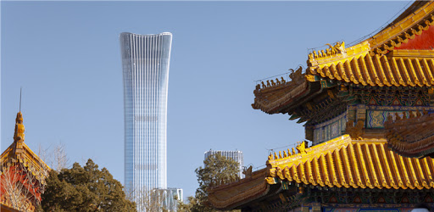
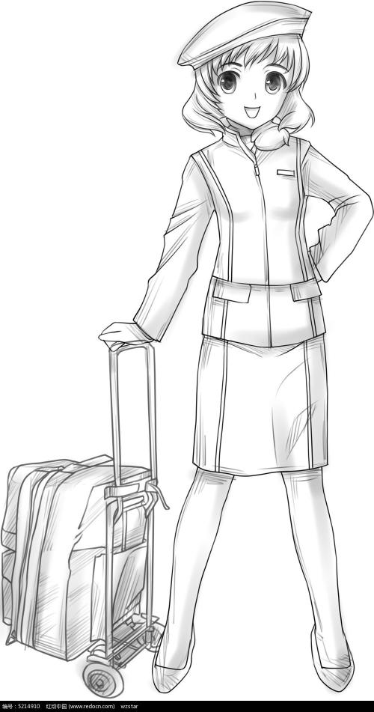
李丽在北京的12天
Lily's 12 days in Beijing
Day 10
all pictures from baidu图片

Slide 2
好久不见 long time no see

Slide 3
The content of Day10
1.Review 怎么样 suggest
2.New words and expression
能 request
3.The Great Wall

Slide 4
Review
怎么样
how is
喝咖啡怎么样？
Drink coffee
好的
OK
他的汉语怎么样？
His Mandarin
马马虎虎
so-so，not so bad

Slide 5
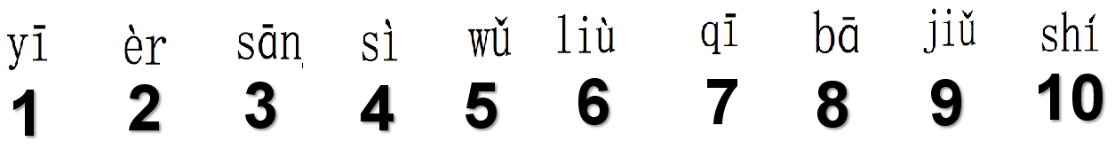
什么时间开始？
What time start?
__月__日__点__分,怎么样？
month day o'clock minute

Slide 6

Review
下午去看电影，怎么样？
Afternoon goto see film, how about?

Slide 7
Review
A:_______，怎么样？
how about?
B:_______。
看电影 去学校 打网球
see filme goto school play tennis
吃披萨 喝茶 听音乐
eat drink tea listen music

Slide 8
大家好，我是____,___岁。我是英国人,我的家
Everybody hello， I am ， years old. I am British My home
在威尔士。我的生日是__月__日。我是一个_____。
is in My birthday is month day . I am a
我喜欢旅游。我有一个愿望，我想去长城。
I like travel . I have an wish , I want to goto the GreatWall
我的汉语怎么样？我觉得马马虎虎。谢谢！
My Mandarin how is ， I think so-so.
self introduction
老师teacher学生student 导演Director 编剧screenwriter作曲家composer

Slide 9
生词
New Words

Slide 10
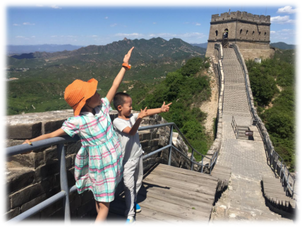
Key Words
长城
Great Wall
长城在哪？
is in where
我想去长城。
want goto

Slide 11
Key Words
有
v. to have,there be
他 有 很多 钱。
He has a lot of money
对不起，我没有时间。
sorry ， I don't have time.
你有种！
You have the guts!

Slide 12
Key Words
男和女
man and woman
和
conj. and
电影和电视
Film and Television
你和我 是 好朋友。
You and me are good frieds.

Slide 13
我能。I can
你 不能 喝酒。You can not drink wine.
Key Words
能
modal verb. can,may
A:我能坐这儿吗？
I can sit here ?
B:请坐 / 对不起
Please / Sorry

Slide 14
1.我能进来吗？May I come in？请进！Please come in!
2.我们能试一试吗？May we try?
3.你能帮助我吗？Can you help me?
4.老板能同意吗？Can the boss agree?

Slide 15
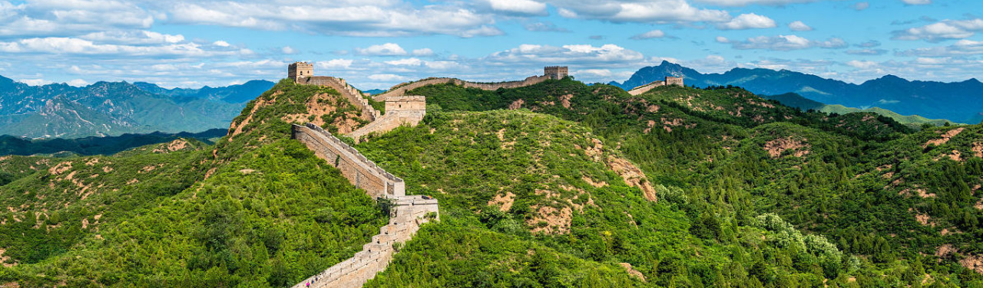
第10天 你和我 明天 能去长城吗?
Can you go to the Great Wall with me tomorrow?

Slide 16
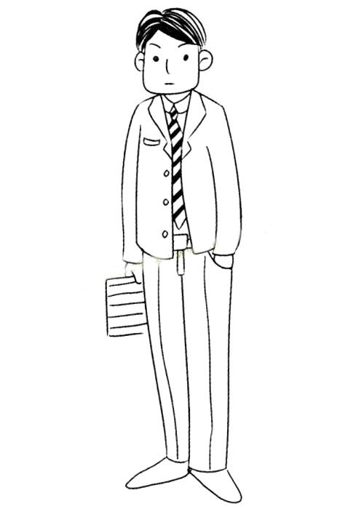
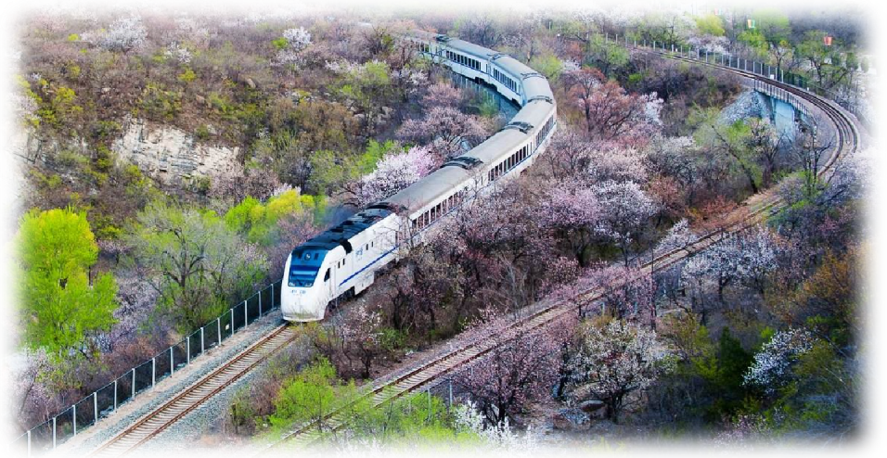
L：北京 有 长城 吗？
have ?
Z：当然。
of course
L：你和我 明天 能去 长城 吗？
you and me tommorrow can go to ?
Z：没问题，我们 坐 火车 去。
no problem ? we sit train go.

Slide 17
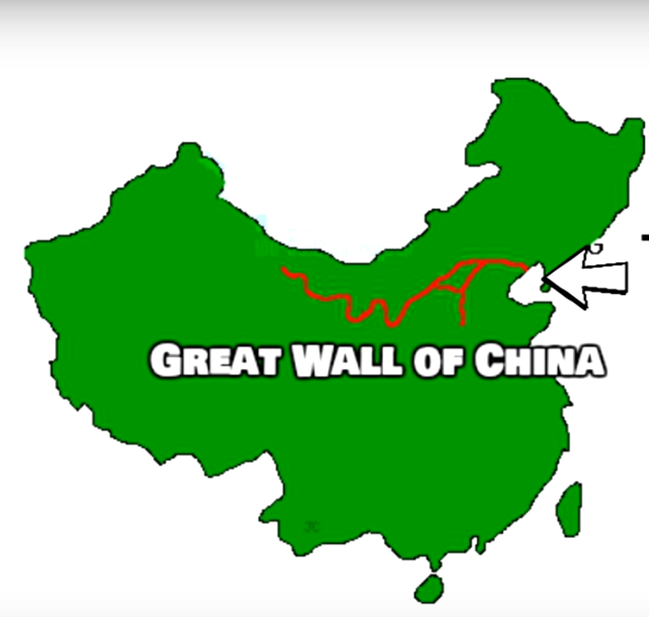
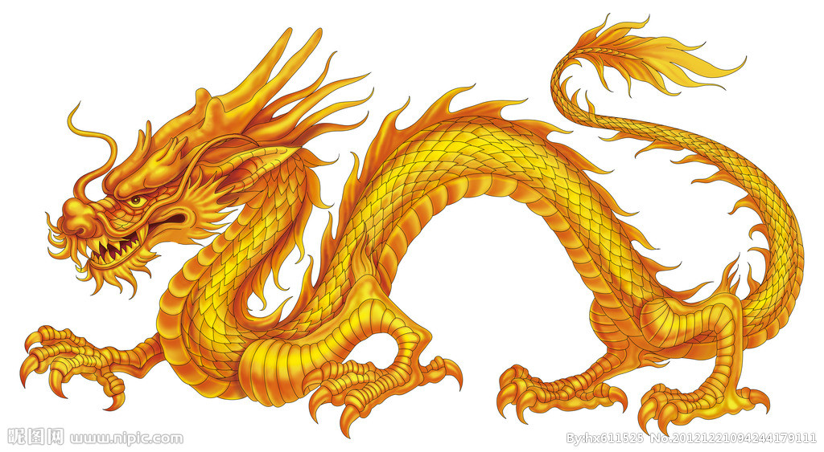
Over 13,171 Miles Long
Biggest structure ever built in the world
Know More About China
长城
The Great Wall

Slide 18
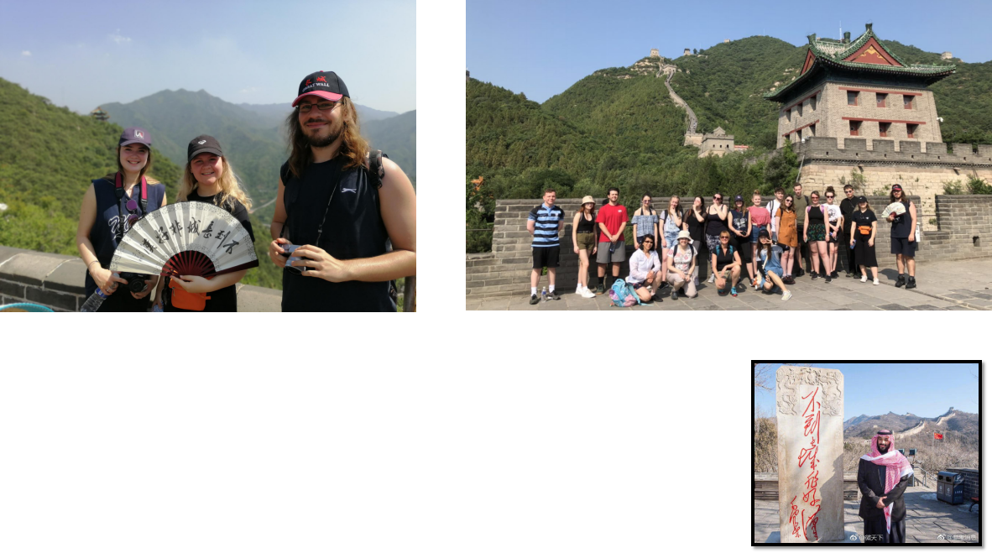
不到长城非好汉
One who fails to reach the Great Wall is not a hero.
2019-8 Sumer Camp, Swansea Uni
2019-8 Summer

Slide 19
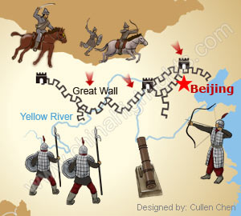
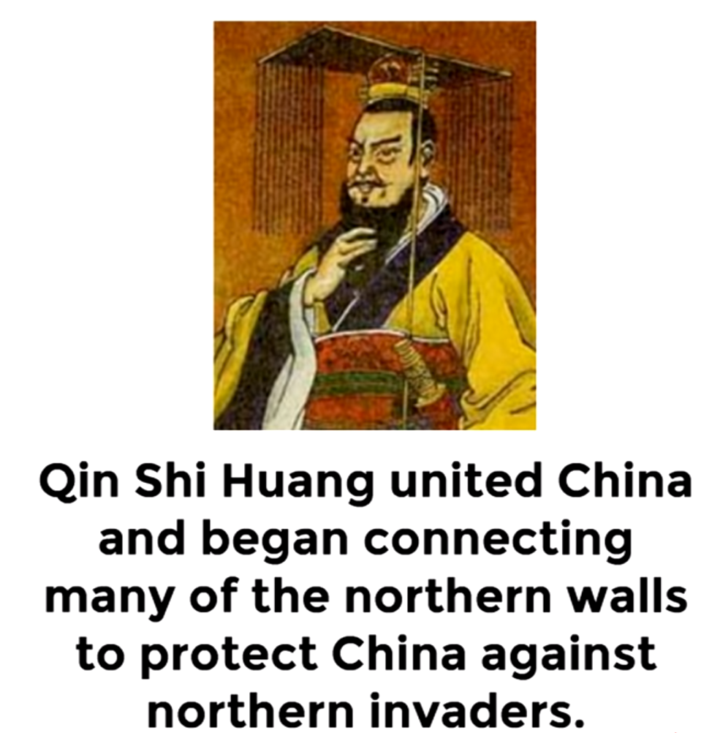
The First Emperor of China
221 B.C.
defense engineering

Slide 20
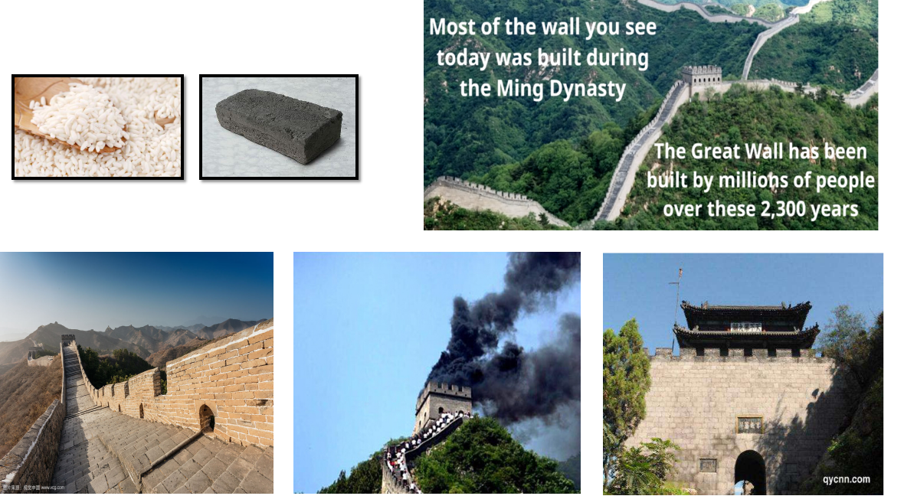
Workers: soldiers, peasants, rebels
walls
Watchtowers
Fortresses

Slide 21
DRONING The GREAT WALL OF CHINA! https://www.youtube.com/watch?v=bfsrzlJ9Vg4

Slide 22
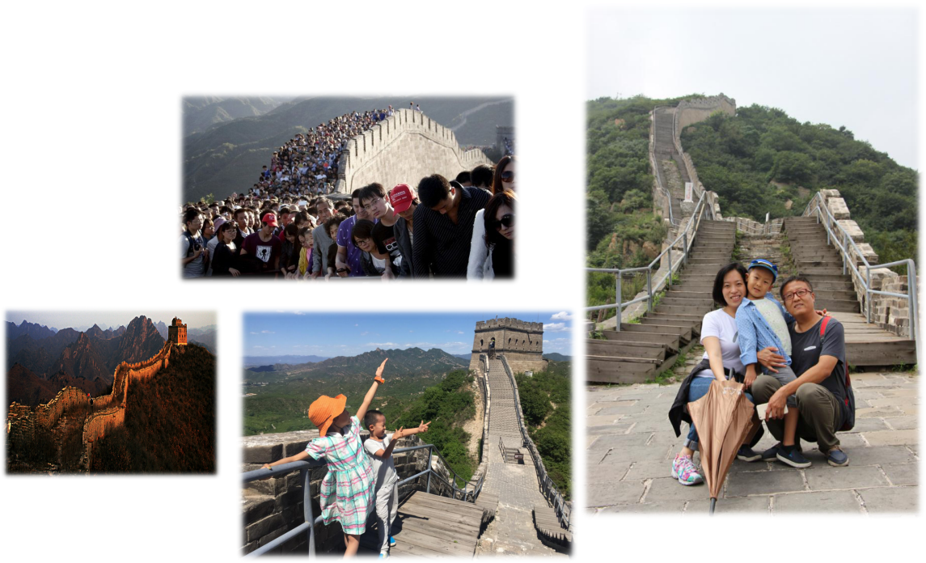
Visit the Great Wall in Beijing

Slide 23
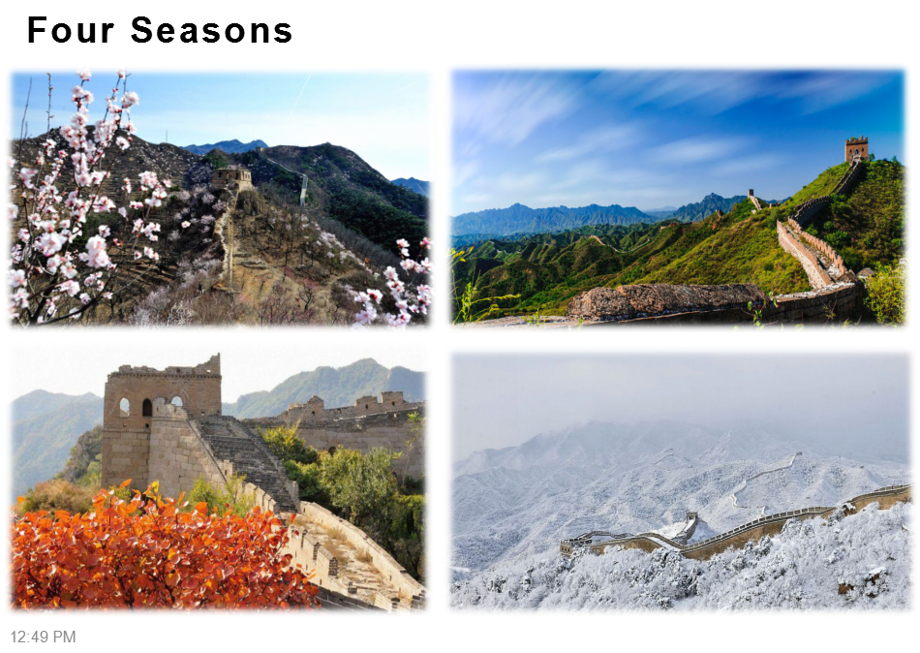

Slide 24
10 things you might not know about the Great Wall of China https://www.youtube.com/watch?v=oWvIjk8Czs8

Slide 25
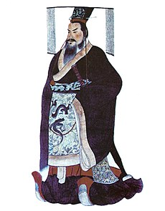
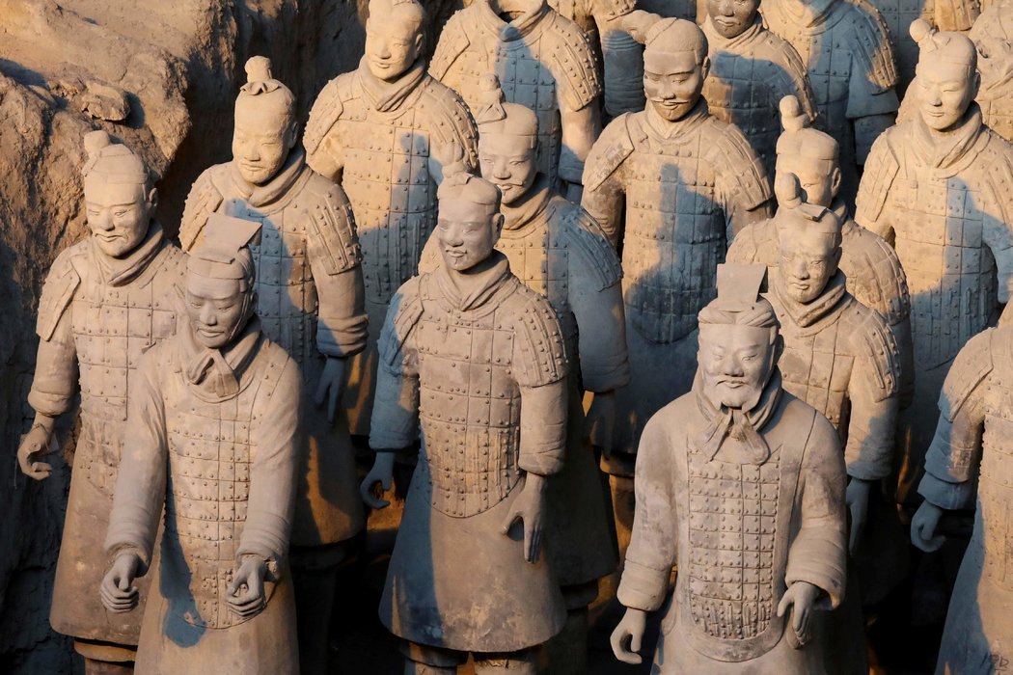
Quin Shi Huang
（259B.C.－210B.C.）
The First Emperor who unified China. He is known for his Terracota Army and the Great Wall of China.
Terracotta Army: The greatest archaeological find of the 20th century - BBC https://www.youtube.com/watch?v=4c_ADqshdSA

Slide 26
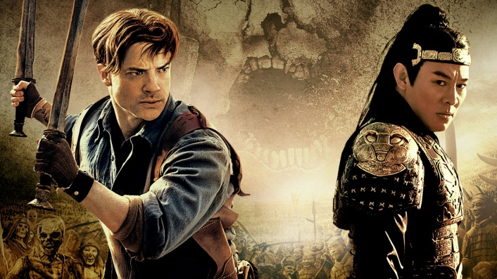
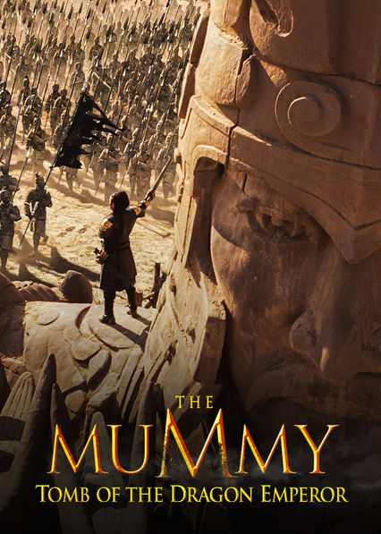
The Mummy: Tomb Of The Dragon Emperor

Slide 27
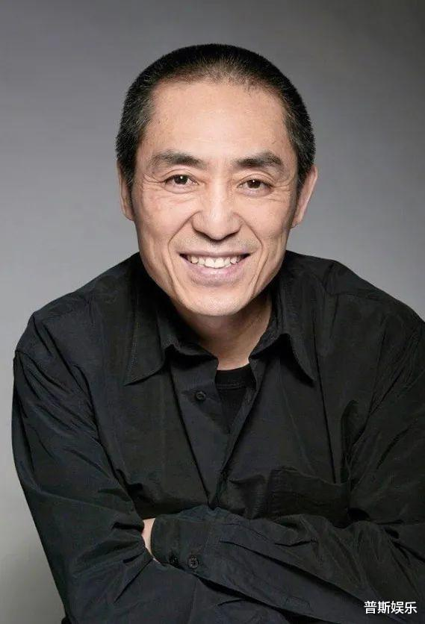
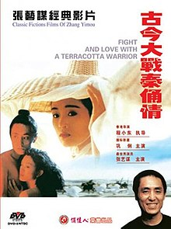
张艺谋
Zhang Yimou
《古今大战秦俑情》
（A Terra-Cotta Warrior），1990

Slide 28
谢谢 再见

