Slide 1
PowerPoint presentation
Modern Floors

Slide 2
Flooring
A floor is defined as a level surface area within a building suitable for, and capable of supporting, the load it is designed to carry.
The design will depend on the type of building – e.g. a house for living purposes, a factory for industrial use, a warehouse for storage use, or a shop. The floors may be constructed from timber, concrete or other materials.

Slide 3
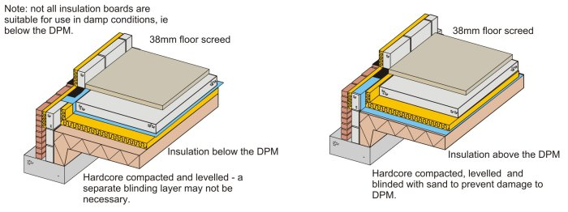
Modern Solid Ground Floors
Since the mid 1990s the Building Regulations have required insulation in ground floors. A variety of manufacturers produce a range of rigid insulation boards which can be laid above or below the slab. Some of the boards have a closed-cell structure and are impervious to both water and vapour. They can therefore be laid under the DPM (the DPM is still necessary to prevent moisture rising between the board joints and penetrating the slab). Where boards are laid under the DPM blinding is not always necessary. Typical construction is shown below.

Slide 4
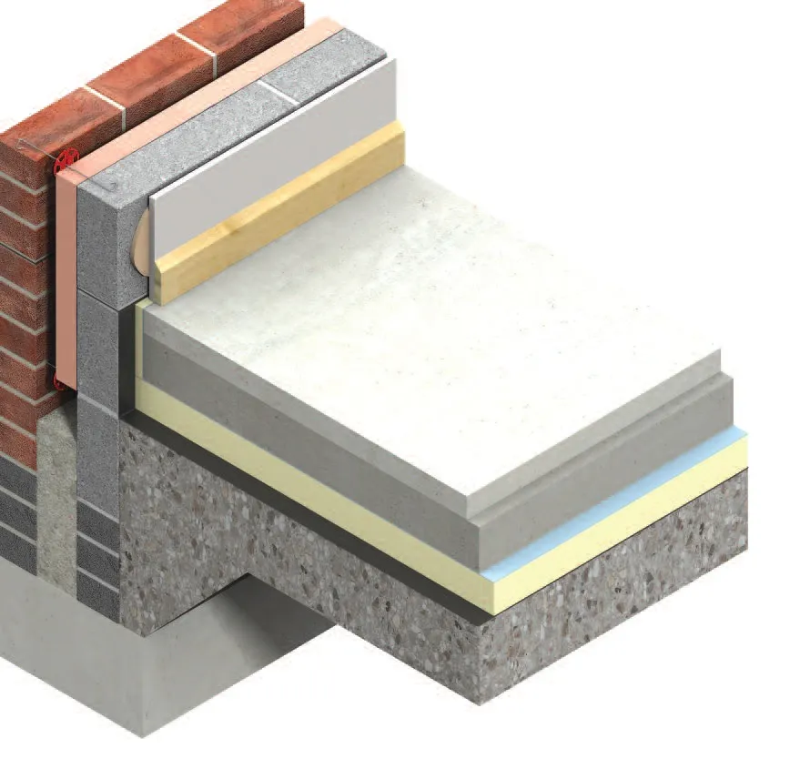
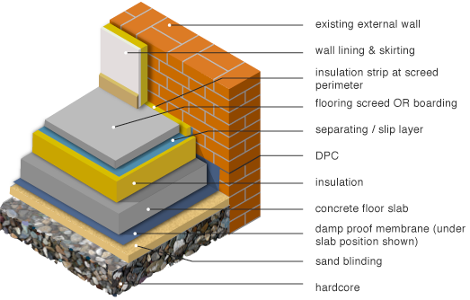
Modern Solid Ground Floors
Solid floors tend to require little maintenance and are less prone to movement. They are often built up from the following components:
Sub-base: Well-compacted building rubble or loose stone-based material.
Hardcore: Suitable filling material to make the required level, and create a solid base.
Damp-proof membrane (DPM): An impervious layer such as heavy duty polythene sheeting.
Concrete bed: Provides a solid level surface.
Insulation to limit heat transfer with the ground.
Screed: Usually a sand and cement mix laid to prepare for the installation of a floor covering.
Finish: Such as carpet, tiles, and so on.
The thicknesses of the layers and their order will depend on the specific use required and the ground conditions.

Slide 5
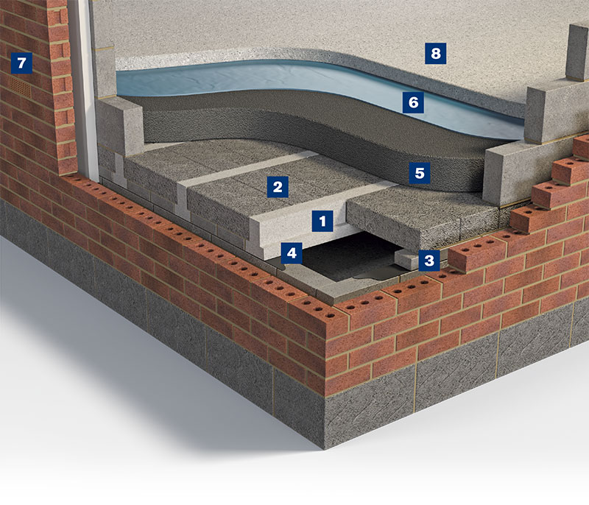
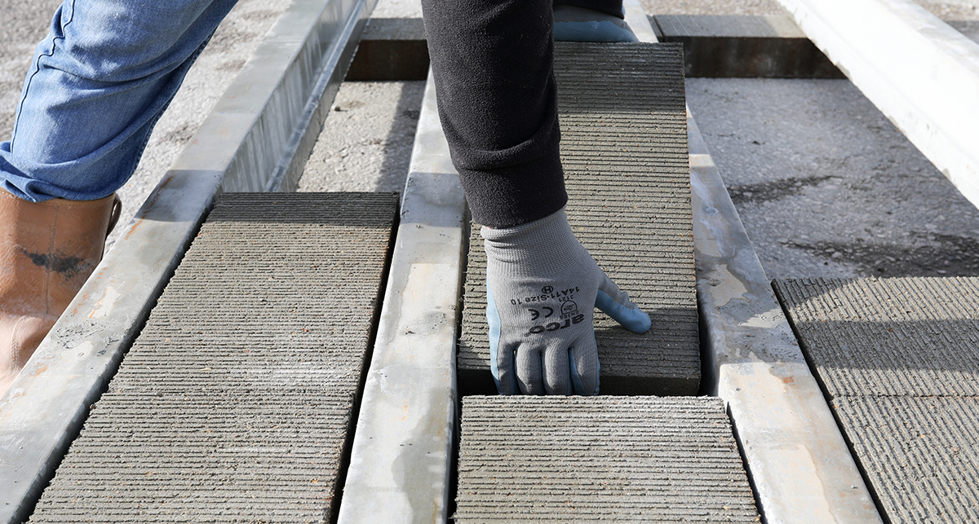
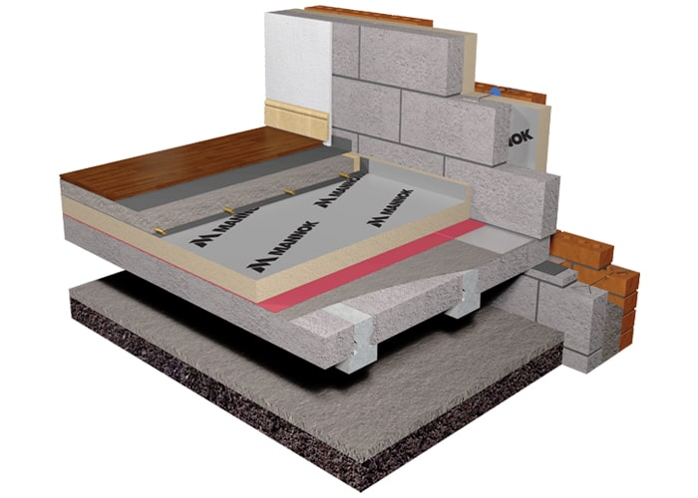
Modern Concrete Suspended Floors
Concrete floors
Precast beams spaced apart with filler blocks in between
https://www.youtube.com/watch?v=rUX19yal5yQ

Slide 6
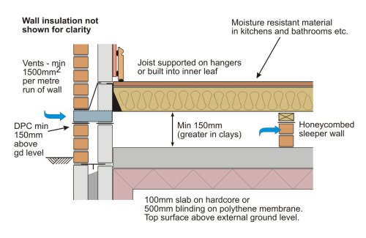
Modern Timber Suspended Ground Floor
In modern construction timber floors are, once again, becoming popular. The construction is similar to that of 70 years ago although there are a few differences:
Joists will be supported on hangers rather than built into the walls.
Timbers are now treated against rot and insect attack.
Rules for ventilation are much stricter than in the past.
Most floors will be finished with chipboard and floors will be insulated.

Slide 7
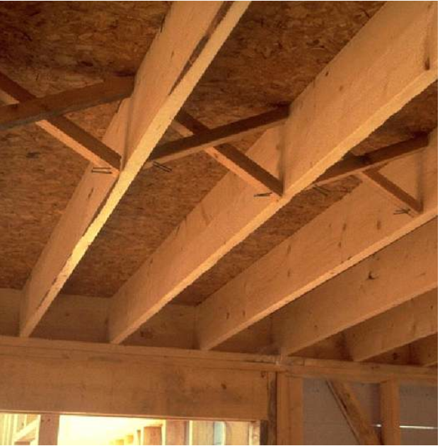
Joists
Modern upper floors don’t have to be concrete, timber joists are still the most common method of floor construction.
Advantages over concrete are that they are lighter, more environmentally friendly and warmer.

Slide 8
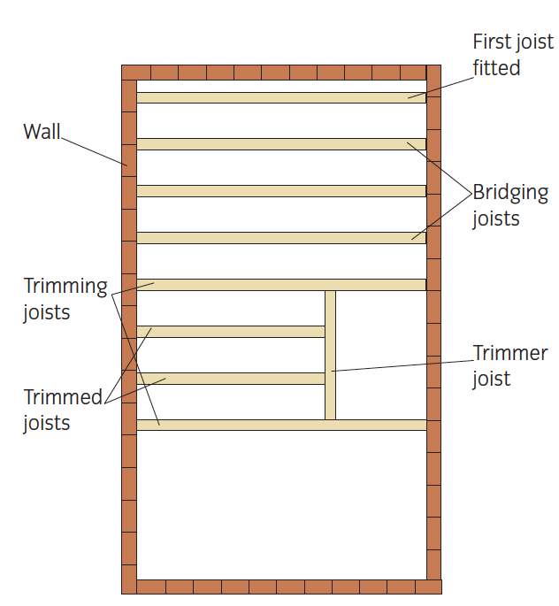
Flooring joists
Joists are usually 50mm thick.
The trimmer joist must be thicker to carry the load to the trimmed joists.
Joists typically run the shortest distance (span)

Slide 9
Services under floor

Slide 10
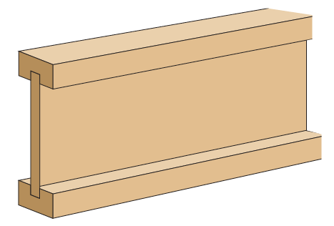
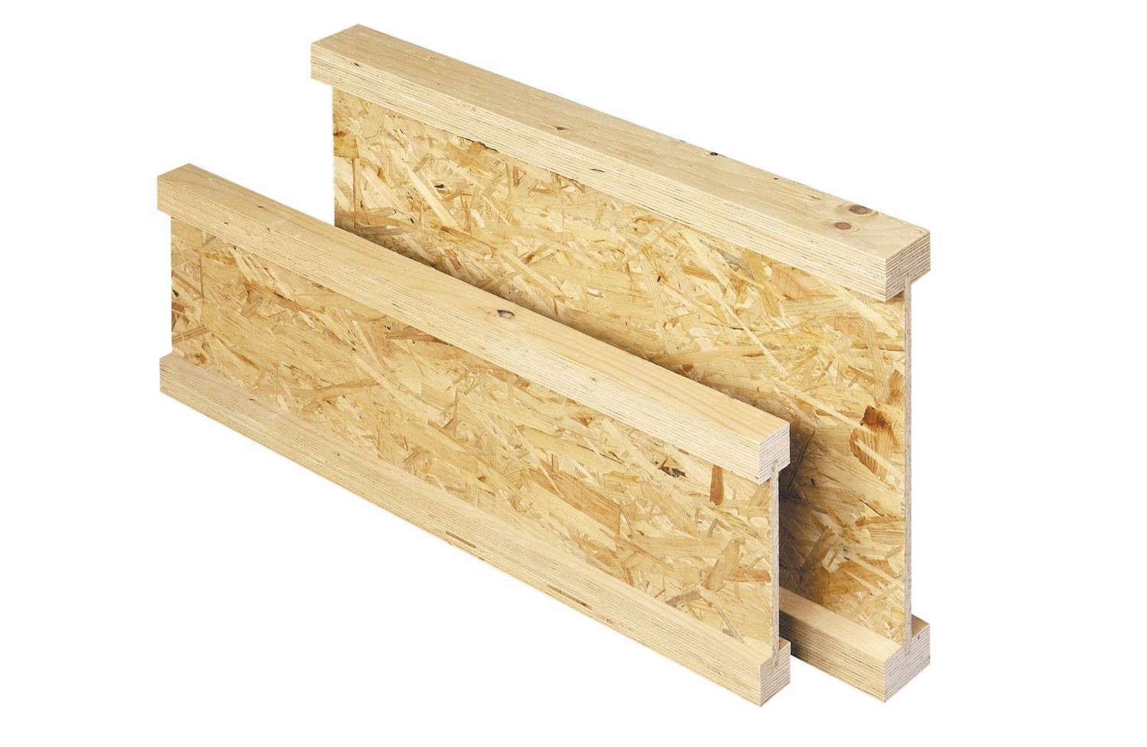
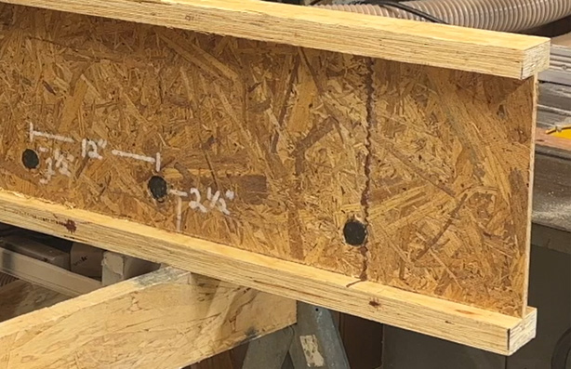
Types of joists
I joists are lighter, usually made with oriented strand board (OSB).
Laminated joists are manufactured from recycled timber.

Slide 11
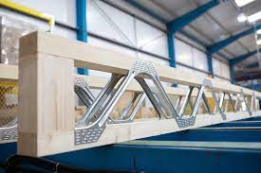
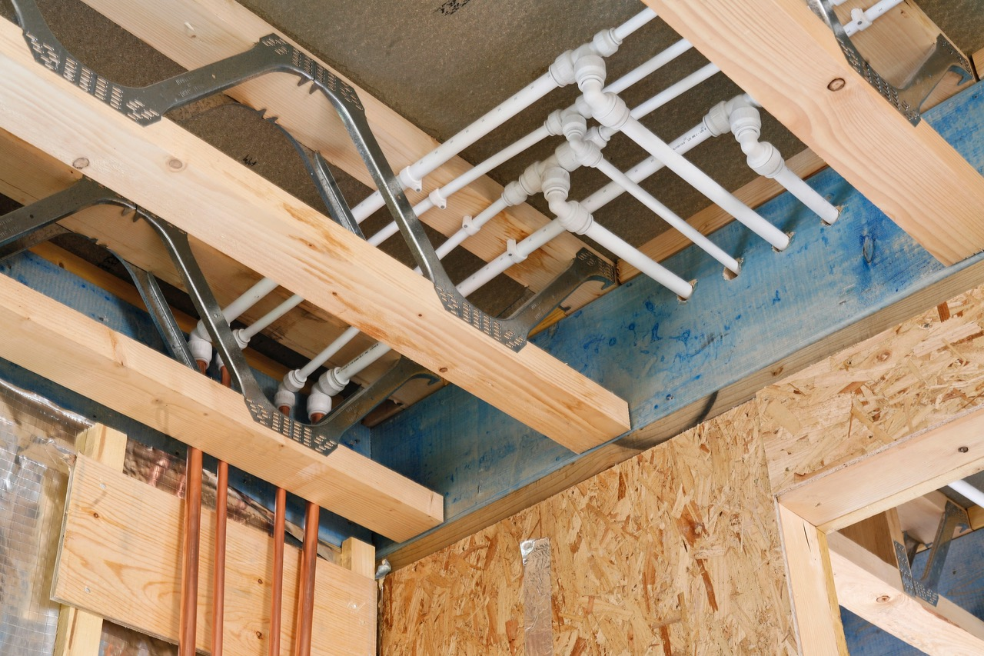
Types of joists
Metal Web Joists
Offer many advantages over other types of joists.
Metal Web Joist Installation Animation | Specification Construction Videos | Specification Online

Slide 12
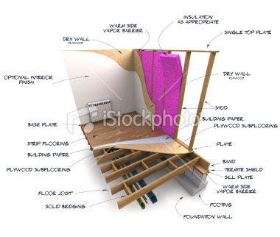
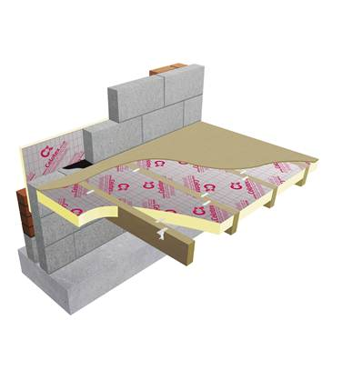
Room Construction

Slide 13
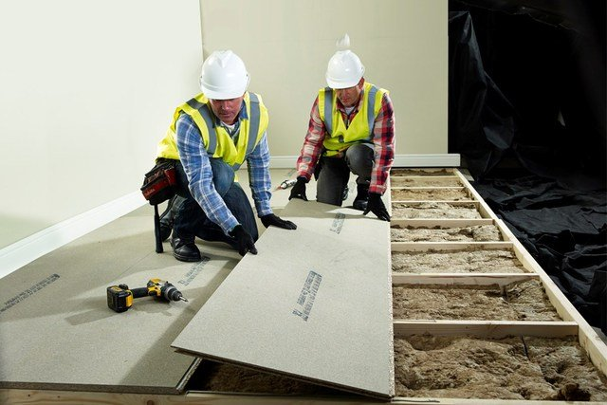
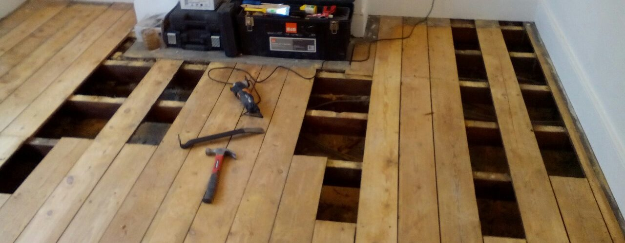
Floor Coverings
Smaller, Traditional Floorboards
Modern timber floors are covered with chipboard floorboard. Typically 600mm x 2400mm with tongue and groove edges and ends.
A green colour denotes that they are moisture resistant.
Boards come in 2 thicknesses, 18mm and 22mm. A general rule is that the 18mm is used when joists are at 400mm centres, and the thicker, 22mm boards are used where joists are at 600mm centres.
These are screwed down to the joists although sometimes a nailgun with annular ringshank nails are used.

Slide 14
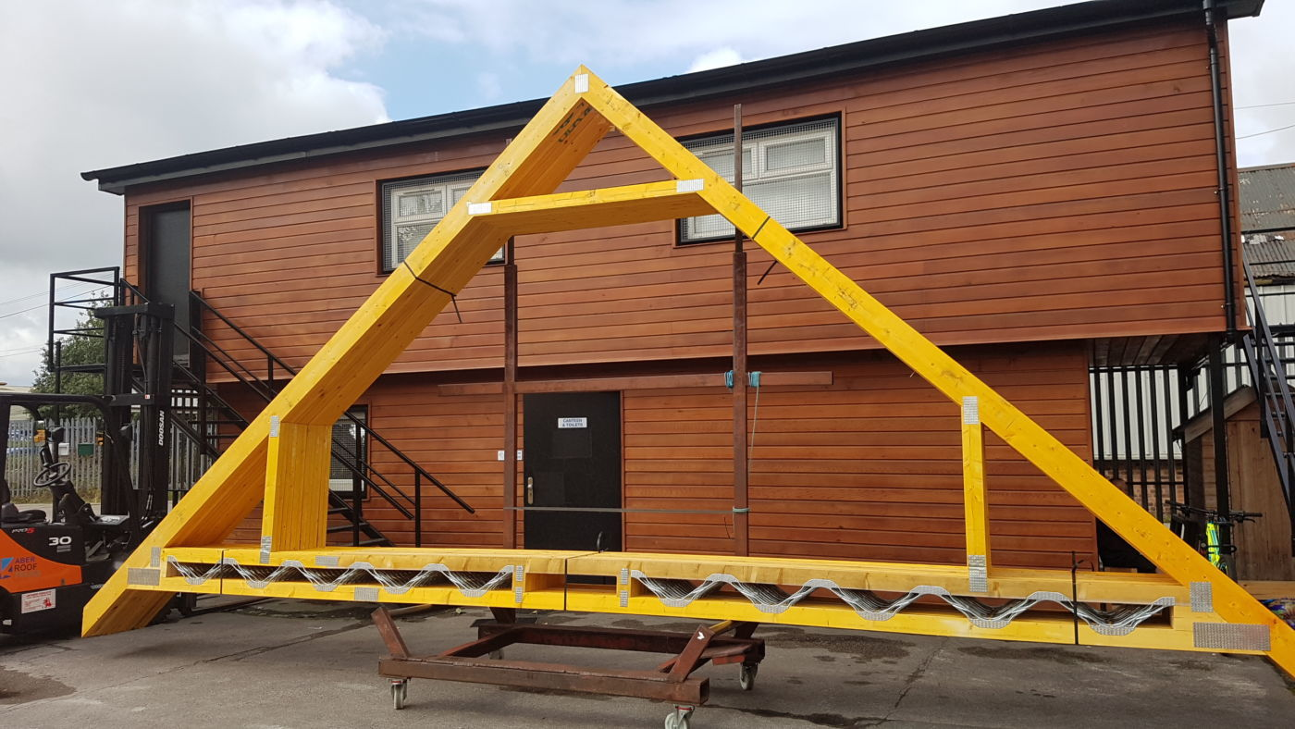
Attic Trusses
Are designed to incorporate a room (and floor) in their design

Slide 15
Terminology
Wall plate: Bedded on top of the support walls, and to which the joist ends are fixed. Cross-section size usually 100mm x 50mm, but may differ according to specification.
Wall bearer: As wall plates, but fixed to a wall face by bolts or other means. Cross-section size as specified to the suit span of the joist.
DPC: Damp Proof Course – a plastic layer in brickwork through which moisture cannot pass.
DPM: Damp Proof Membrane – Similar to DPC but covers a whole floor
Air brick: Honeycombed brick through which air can pass.
Joist hanger: A metal frame (or shoe) fixed into a wall (or to a supporting joist), for supporting the end of a joist. Size to suit joist section size.

Slide 16
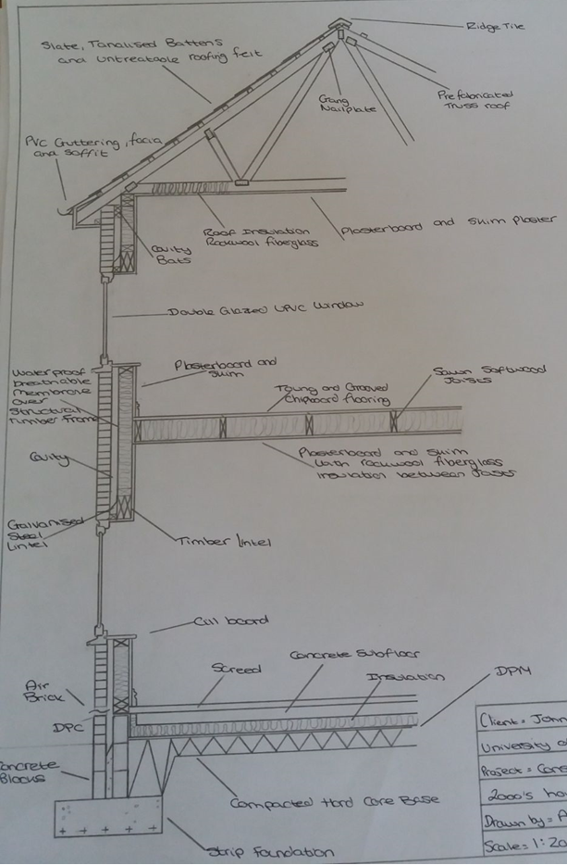

Slide 17
Any questions?

