Slide 1
Preparing and Issuing a Part 7 Claim (Chapter 9 )
Week 5

Slide 2

Aims
The jurisdiction of the court and the allocation of business
Identifying who to bring a claim against
Brief refresher on joint and several liability
What goes in a claim form?
Starting Part 7 proceedings
Serving the Part 7 claim form (and particulars of claim)
Certificates of service
Procedure on service
Service of claims outside the jurisdiction

Slide 3
Litigation as a last resort
If there has been no resolution pre-action or by the use of ADR or your opponent is adopting an entrenched position, litigation becomes the last resort.
When you consider the emphasis on pre action protocols and ADR and the costs that this brings it can be seen that the cases that should end up being litigated are those that are more complex.
They will usually continue because both parties think they have a good case.

Slide 4
Damages Claims Portal
From 4 April 2022, all damages claims which fall within the scope of the scheme must be issued online, using the DCP. If a claim is issued other than in accordance with the DCP (e.g. on paper), then the court can decide whether the claimant should face a sanction for not using the DCP.
The DCP is for use by legal professionals, rather than litigants in person and is broadly for any claim which is for a money remedy only (damages which would ordinarily be issued in the County Court under the Part 7 procedure). The DCP is suitable for claims for a specified sum of money of less than £100,000.

Slide 5
Damages Claims Portal
It is not to be used for a claim:
which could be started using Money Claims Online
for possession
for specific performance of a contract
for a declaration or an injunction
for debt
where any party is known to be a protected party ( someone who lacks capacity e.g under Mental Capacity Act 2005)
against more than two defendants
where a party’s address for service is not in the United Kingdom (for the claimant) or England and Wales (for the defendant).

Slide 6
Claims outside the Damages Claims Portal

Slide 7
Jurisdiction: Reminder - High Court or County Court
‘In the Jurisdiction’ = the courts of England and Wales
PD 7A sets out restrictions on where a Cl may issue a claim form.
Money claims of £100,000.00 or less:
  Most claims include a claim for money, either a specified sum or a claim for damages to be assessed by the court. Where the value of the claim is £100,000 or less, and the claim does not include a claim for personal injuries, the claim must be issued in the County Court.
  Personal injury claims of less than £50,000: where the claim includes a claim for damages for personal injury and the value is less than £50,000, the claim must be issued in the County Court;

Slide 8
The County Court
The County Court deals with the more straightforward cases, including:
  Claims for money only, whether it be for a specific debt of for damages, where the anticipated value of the claim is for £100,000 or less;
  Personal injury for claims less than £50,000
Note – money only claims are started under CPR Part 7 and must be issued centrally in the County Court Money Claims Centre (CCMCC), which is part of Salford Business Centre).
Contested claims are later transferred to a named County Court hearing centre, primarily to assist the defendant.

Slide 9
Issuing in the County Court
There is one single County Court; the County Court Money Claims Centre (CCMCC) which has hearing centres across the country
MONEY CLAIMS
Under para 4A.1 PD 7A, if a claim is:
Started in the County Court under Part 7;
Only for either or both a specified amount of money or an unspecified amount of money; and
Not a claim for which special procedures are provided under CPR
The claim must be sent for issue at the CCMCC.

Slide 10
Issuing in the County Court… continued
A “specified” amount of money speaks for itself.
An “unspecified” amount of money effectively means a damages claim where the court is asked to assess the amount of damages payable to the Cl. This would include claims for breach of contract (other than straightforward debt claims) and claims for damages for PI.
All such claims must be sent directly to the CCMCC for issue and so is relevant to the majority of claims brought in the County Court.
The CCMCC acts as an admin office for the early stages of a case and documents should be sent to its PO Box address. In reality the CCMCC is physically located in Salford but no claims will actually be heard there.
Following the receipt of the defence or admission of liability, the claim is transferred to either the hearing centre local to the D’s home address or to the Cl’s preferred hearing centre.

Slide 11
MONEY CLAIM ONLINE - CCMCC
Cl may start an action electronically at the Money Claim Online website, www.moneyclaim.gov.uk
A claim issued here enables the party to view the progress. If a defence, or part admission, is filed the action will be transferred to the Ds home court. The claims issued in the CCMCC are restricted to specified sums not exceeding £100,000 and are subject to further restrictions in PD 7E.

Slide 12

The High Court
The more complex cases are dealt by the High Court.
The main location is the Royal Courts of Justice (the RCJ) in London but there are District Registries around the country, such as in Birmingham.
The High Court is divided into 3 divisions:-
Queen’s Bench Division (now the King’s Bench Division), which covers actions in contract and tort. This is the one we will be most concerned with;
Chancery division, which is used for disputes over things like wills and inheritance, company law and bankruptcy;
Family division, where family proceedings, including adoption are considered

Slide 13
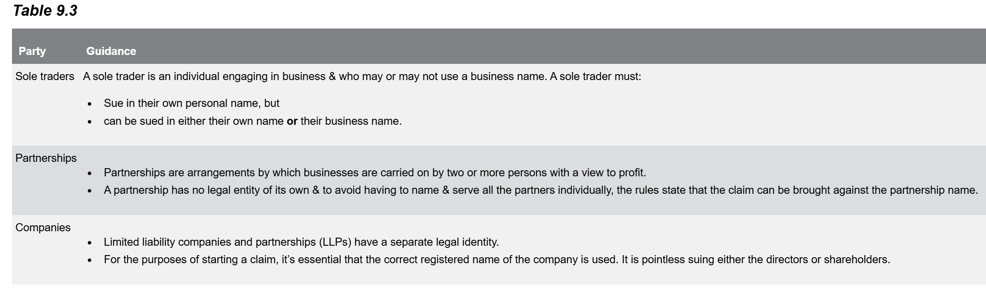
Identifying who to bring a claim against.
Protected parties: those who lack capacity e.g children or patients under the Mental Capacity Act 2005 – must be represented by a litigation friend

Slide 14
Joint and Several Liability - reminder
Principle of joint and several liability: C can choose to pursue the whole claim against any one of those liable (as in joint liability).
As between those liable, the liability is several: any party pursued by the recipient of the liability may seek a contribution from the other parties owing the liability in the share of each of their liability (several liability). This is where the Civil Liability (Contribution) Act 1978 (CLCA 1978) becomes relevant.
Example: asbestos exposure by several employers over the course of the claimant’s working life

Slide 15
CPR 16: What goes in a claim form?
Part 16 of the CPR provides the guidance about what needs to go in a Part 7 claim form.
The claim form itself is labelled N1 and can be found on by accessing https://www.gov.uk/government/publications/form-n1-claim-form-cpr-part-7 and selecting Claim form (CPR Part 7) (Form N1).
Accompanied by a document of explanatory notes for claimants on completing a claim form (N1A).
Overall, the purpose of the N1 claim form is to provide a summary of the main aspects of the claim. The same form is used whether the claim is for a specified sum (where an exact sum of money is claimed), an unspecified amount (where damages to be assessed by the court are claimed) or non-monetary claims (for example, an injunction).

Slide 16
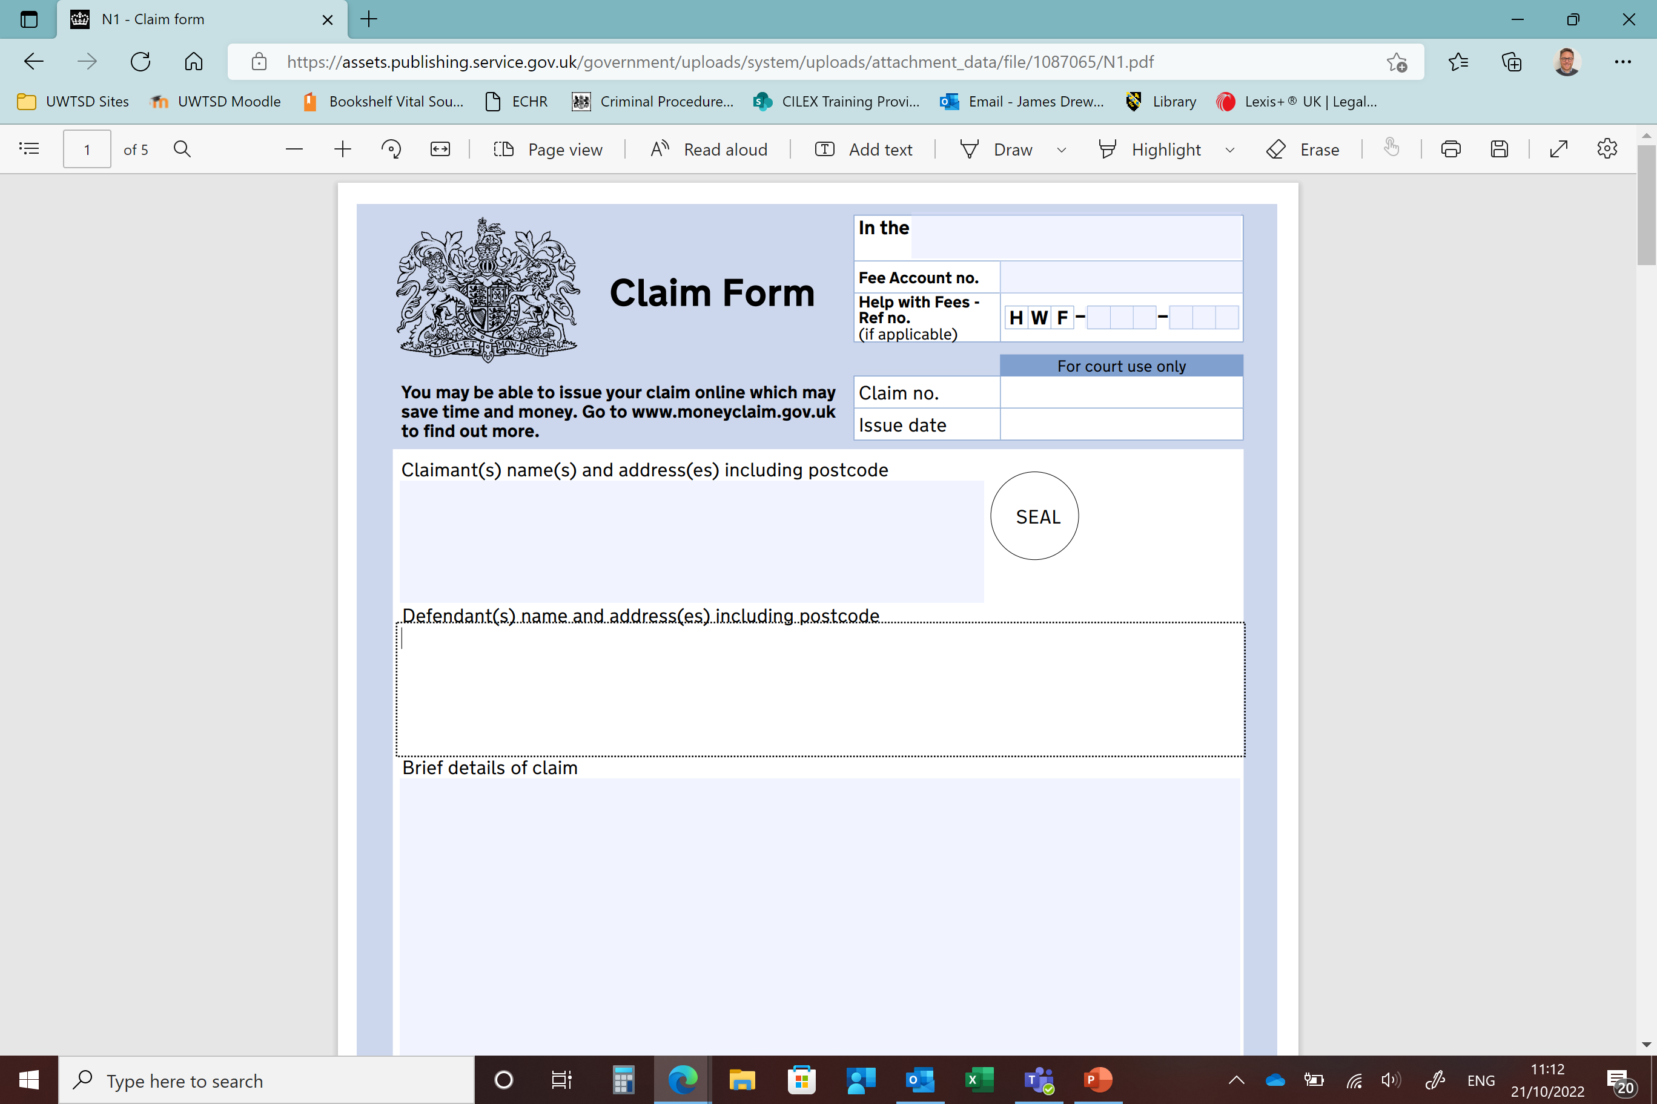
Claim Form N1 – Part 7
https://assets.publishing.service.gov.uk/government/uploads/system/uploads/attachment_data/file/1087065/N1.pdf

Slide 17
Drafting & issuing continued…
Rules on the contents of statements of case generally are set out at Part 16.
Essential requirements:
1. Name of the court: top right hand corner.
  If issuing in High Court you should include the Division and if a District Registry and/or specialist court you should include those details.
  If you are issuing in the CCMCC or the CCBC the claim form should state “in the County Court Money Claims Centre” or “in the County Court Business Centre”.
  If issuing in a County Court hearing centre, the claim form should state “In the County Court at [venue]”.
  If you are issuing in the County Court and the claim relates to Chancery business the claim form must be annotated “Chancery Business” in the top r hand corner.
2. Names and addresses of the parties – (and postcodes)
  Also note the address for service at the bottom.

Slide 18
Drafting & issuing continued…
3. Brief details of the claim
The claim form must contain a concise statement of the nature of the claim. It is good practice to state whether the PD on Pre-Action Conduct and Protocols have been complied with.
This section should give brief details so the court can ascertain what it is about without having to read the Particulars of Claim.
See example below:
The claimant’s claim is for damages for personal injury and consequential loss sustained by the claimant in a road traffic accident at the junction of Nabb Lane and Peter’s Lane in Hopley on 20 February 2018, caused by the negligent driving of the defendant, together with interest pursuant to section 35A Senior Courts Act 1981 [High Court]/s69 County Courts Act 1984 [County Court] at such rate and for such period as this court deems fit.

Slide 19
Drafting & issuing continued…
4. Remedy
The claimant must specify in the claim form the remedy sought (r16.2). This usually goes with details of the claim (eg damages or injunction).
5. Statement of value
R16.2 states that where the Cl is making a claims for money, the claim form must contain a statement of value (ie how much they expect to recover). An indication of the value of the claim will help the court with case management (eg allocating to track).

Slide 20
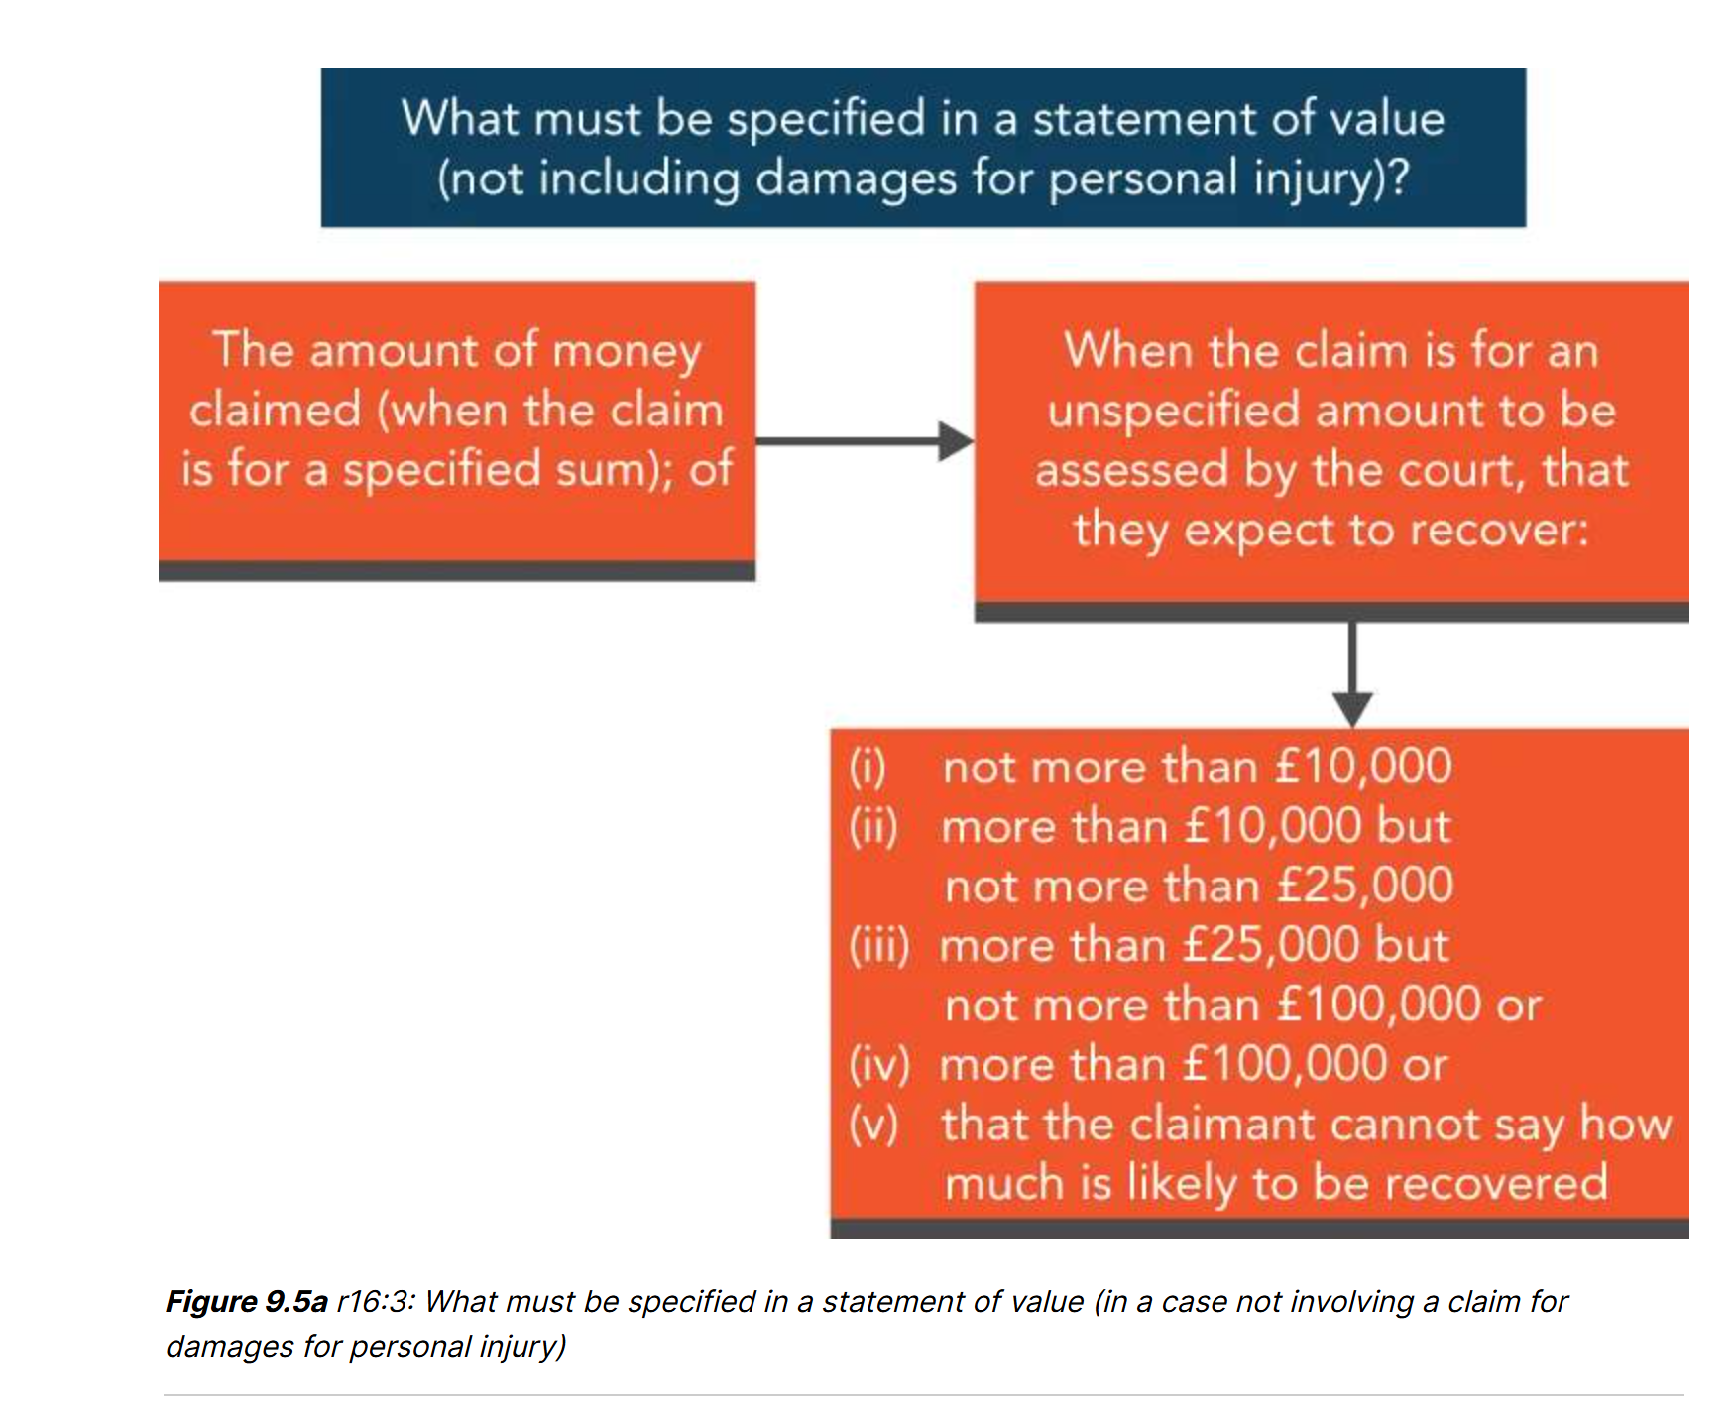
Statement of Value

Slide 21
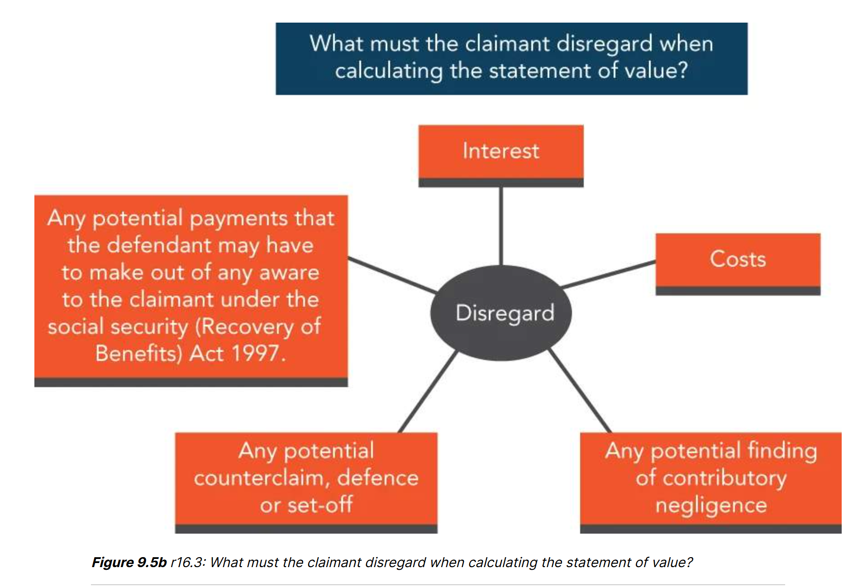
To be disregarded in a statement of value

Slide 22
Statements of value
Personal Injury claims: The rules in relation to personal injury claims are slightly different. Additionally, in claims for damages for personal injuries, in addition to the statement of value described above, additional information should be included in the statement of value.
The claimant must also state in the claim form whether the amount which they expect to recover as general damages for pain, suffering and loss of amenity is:
not more than £1,500; or
more than £1,500.
Where the claim is for damages for personal injuries arising from a road traffic accident which occurred on or after 31 May 2021, there are further requirements in r6.3(3A). These correlate with the somewhat complex rules determining whether a claim falls within the financial threshold for the small claims track to be the normal track for those claims.
High Court Claims: For a High Court claim, to confirm that the correct court has been used to issue the proceedings, the claimant must state that they expect to recover more than:
£100,000 for damages claims (such as for breach of contract) which do not include a claim for damages for personal injury; or
£50,000 or more in total for a claim which includes a claim for damages for personal injury.
The personal injury component itself does not have to exceed £50,000 – what matters is whether the claim includes a claim for damages for personal injury, and whether the total value of the claim is over £50,000. There is no need to provide any further information on value in the statement of value.

Slide 23
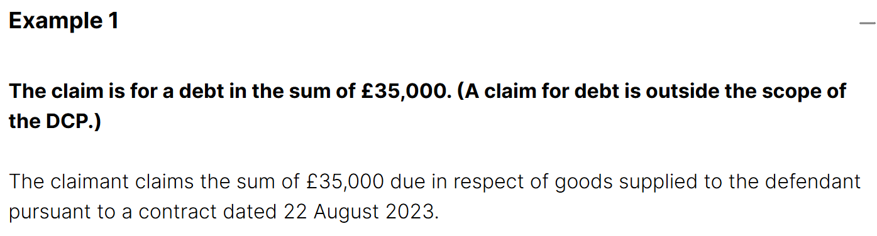
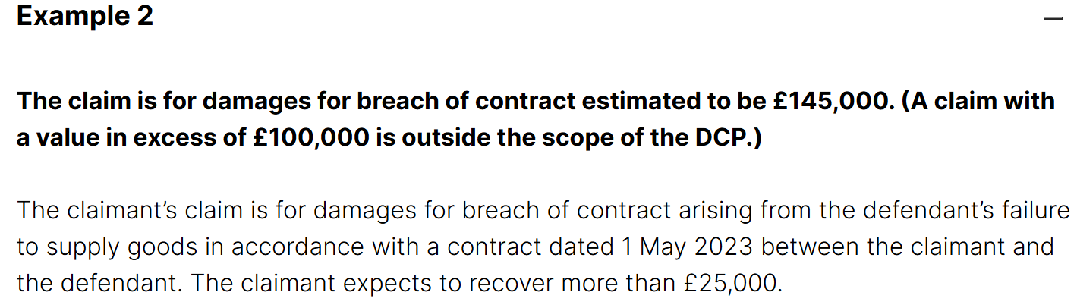
Statements of value: Examples

Slide 24
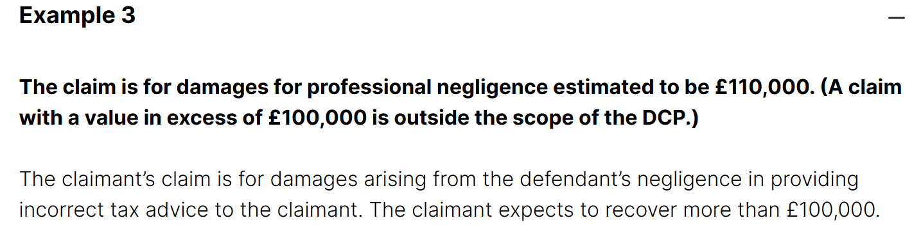
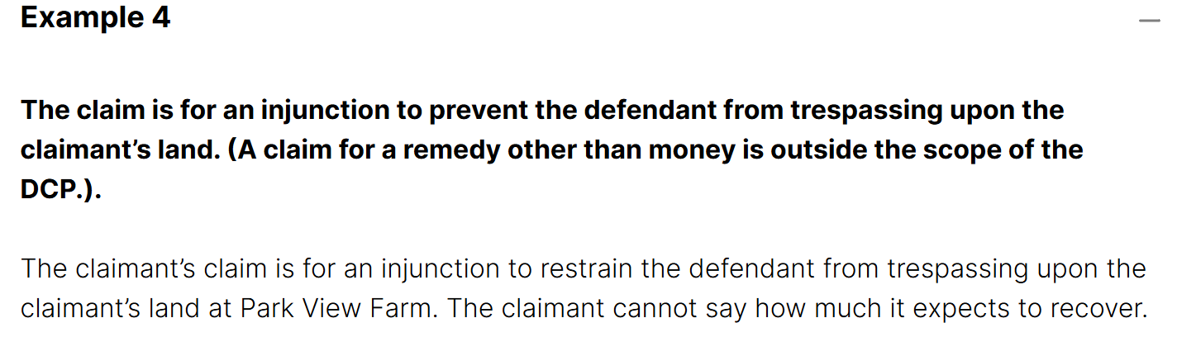
Statements of value: Examples

Slide 25
Drafting & issuing continued…
6. Preferred Court for Hearings:
The claim form must indicate the Cl’s preferred court for hearings.
Remember that all County Court money claims must be issued in CCMCC.
Later in the court process, the court will decide whether to transfer the case. You will consider the location of the Claimant and how easy it will be for them and their witnesses to attend to give evidence when you make your choice.

Slide 26
Drafting & issuing continued…
7. Human Rights Act 1998
A box must be ticked on the reverse of the claim form indicating whether the claim includes any issues under the Human Rights Act 1998.
8. Particulars of claim
We will consider later how to draft these. They are the formal written statement setting out in detail the nature of the Cl’s case together with the nature of the relief or remedy sought from the D. This is either set out on the back of the claim form or marked as “attached” or “to follow”.
9. Court fees
The bottom right hand box of the claim form must be completed as follows:-
Court fee: this is set under the Civil Proceedings and Family Proceedings Fees (Amendment) Order 2015 and depends on the remedy claimed. Where money is claimed, the fee is based upon your valuation of the case and your statement as to value on the face of the claim form.

Slide 27
Drafting & issuing continued…
Amount claimed: for a debt, you would complete the amount of the debt. For a damages claim you would either leave this blank or insert “to be assessed” because, if the Cl is successful, the court will in due course assess the amount of damages. Where the Cl seeks a non-monetary remedy (ie injunction) you would leave this blank.
Legal representative’s costs: where a debt or possession order is claimed, there are fixed costs. You should insert the relevant amount here. Where damages or non-monetary relief (except for a possession order) is claimed, you would either leave this blank or insert “to be assessed” because, if the Cl is successful, the court will assess the amount of costs to be paid.
Compliance with Practice Direction – Pre-Action Conduct and Protocols
Finally, para 13 PD-PACP states that the court expects the parties to comply with the PD or with the relevant pre-action protocol. The court will take into account non-compliance when giving directions and making costs orders.

Slide 28
Drafting & issuing continued…
13. Statement of truth
A claim form must be verified with a declaration by, or on behalf of, the Cl that the facts set out in the form are true. This is required even where the particulars of claim are in a separate document. The statement of truth is pre printed on the form.
If the claimant is a company: someone in a senior position (a director, treasurer, secretary, chief executive or manager) must sign the statement of truth. The signatory to the statement of truth must state the position held.
Wording for a statement of truth:
[I believe] [The party believes] that the facts stated in this [name of the document] are true. I understand that proceedings for contempt may be brought against anyone who makes, or causes to be made, a false statement in a document verified by a statement of truth without an honest belief in its truth.

Slide 29
Drafting & issuing continued…
14. Claimant’s address for service
I.e the address at which documents relating to the case should be sent to the Claimant and it must be within England and Wales. Where the Claimant is represented by a firm of solicitors it will be the firm’s address.

Slide 30
CPR Part 7 : Starting proceedings and what needs to be sent to court
A request to issue a claim form (usually a covering letter)
Appropriate copies of the completed claim form (one for the court and one for each defendant); and
The appropriate court issue fee.

Slide 31
Processing by the Court
Once the claim form is received, the court will check that it is in order and require 1 form to be signed by the person issuing it. The claim form is then date-stamped and sealed, and a claim number written in the top right corner.
A notice of issue will be sent to the cl.
For the purposes of the Limitation Act 1980 a claim is “brought”, and time will stop running, when the Cl delivers the claim form, fee, etc. to the court office.
When a claim form is issued by the court it is date stamped on its face. This may or may not be the date on which the claim was brought, because there may be a delay between the Cl delivering the documents to the court for issue and the court staff actually issuing the claim.
This earlier date may be evidenced by the date stamp on any covering letter from the Cl’s solicitors, which is usually entered by the court staff when they open the post (para 5.2 PD7A)

Slide 32
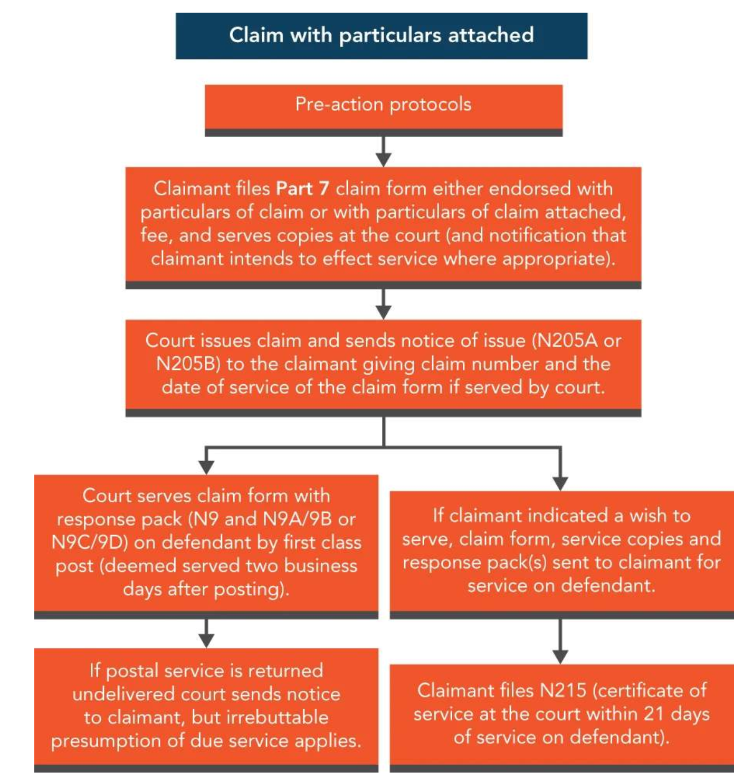
STEPS

Slide 33
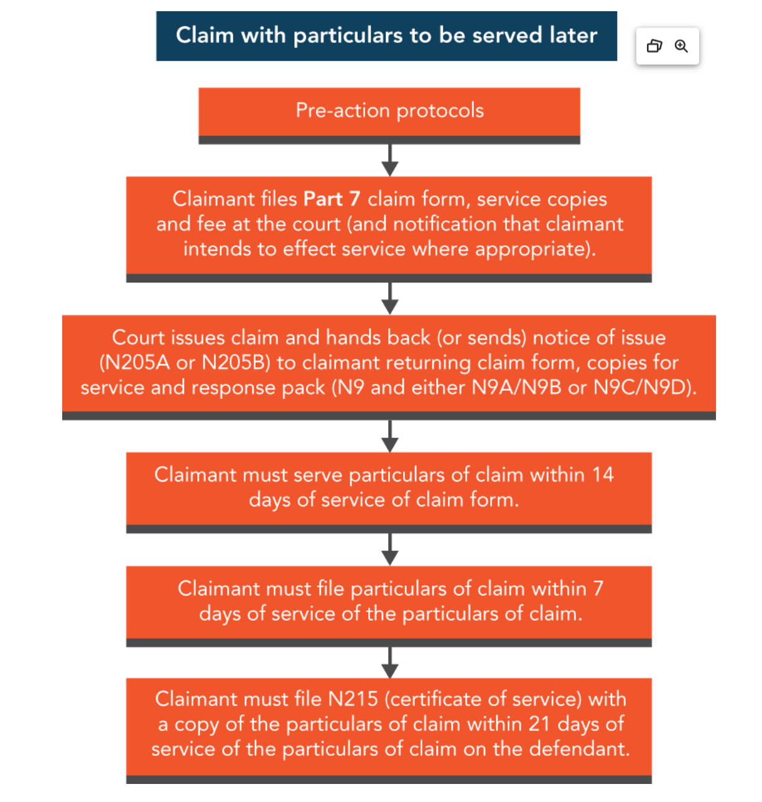
STEPS

Slide 34
CPR Part 6: Formalities involved in serving a Part 7 claim form

Slide 35
Time limit for service of claim form and particulars of claim
Period of validity
Once the claim form is issued (ie the date sealed by the court), it must be served on the D within 4 calendar months after issue (or 6m where it is to be served out of jurisdiction) (r7.5). The parties may agree to extend the life of a claim form, but this will be effective only if it is recorded in writing, typically by an exchange of letters
The particulars of claim should, if practicable, be contained in or served with the claim form. Where they are not they must be served within 14 days after service of the claim form, and certainly no later than the latest time for serving the claim form (ie the 4 calendar month period).
Where the claimant serves the particulars of claim separately from the claim form, they must, within 7 days or service, file a copy of the particulars.
Example
As stated a “month” means a calendar month. So, a claim form issued on 8 August 2022 must be served, within the jurisdiction, on or before 8 December 2022 (4 calendar months, excluding the date of issue).

Slide 36
Seeking an order for alternative service
In certain circumstances, when service may not have been effectively achieved within the period of validity of the claim form, it may be to seek an order that service has in fact been successfully effected by an alternative method.
R 6.15 enables the court, for good reason, to make an order permitting service by an alternative method or at an alternative place. The court may order that steps already taken to bring the claim to the attention of the defendant by an alternative method or at an alternative place have the effect of being good service.
The courts will consider such applications sympathetically when it is quite clear that the defendant has had notice of the proceedings and the failure of good service may have been by some understandable or reasonable misunderstanding. It is thought doubtful, however, that the courts would agree to rectify a position where the claimant (or their legal representative) has failed to serve properly as a result of a basic misunderstanding of CPR.

Slide 37
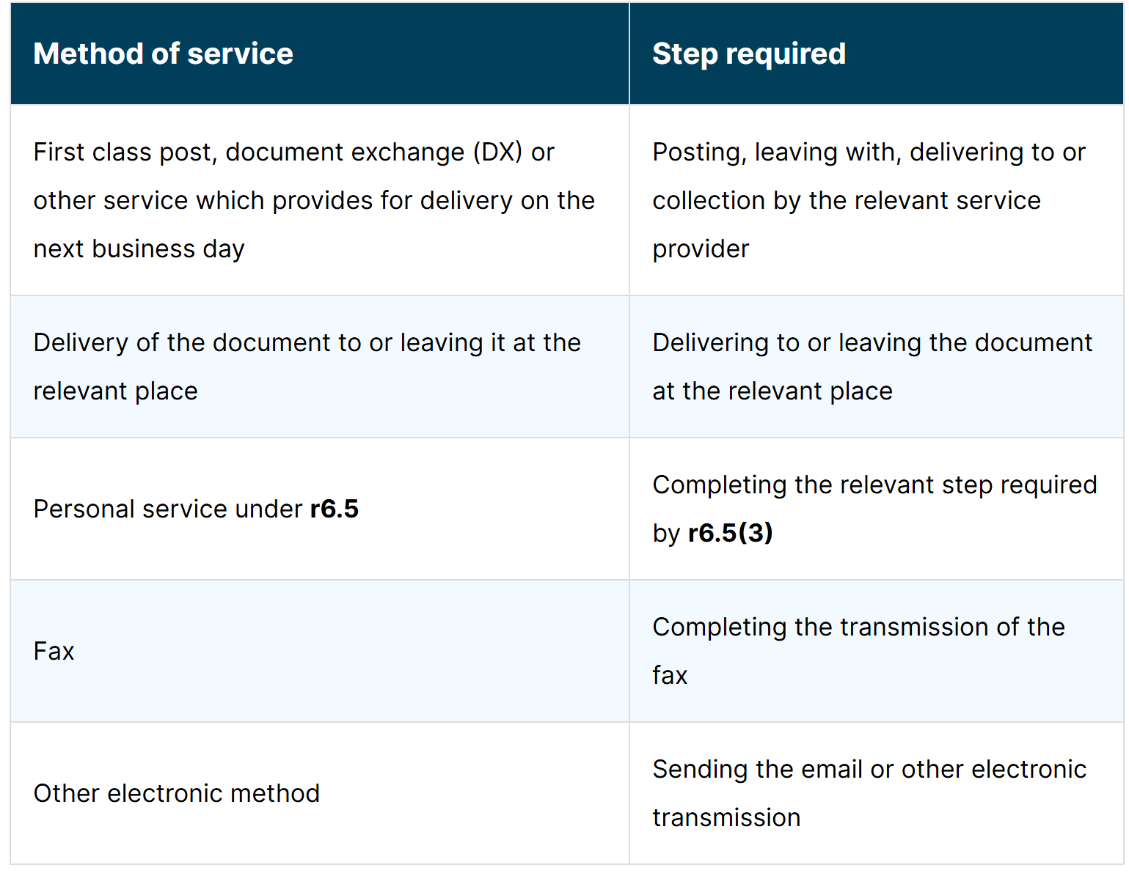
Methods of service: r 7.5

Slide 38
Service…. continued
It is the taking of the step required that is relevant to whether service was effected in time (ie within the period of validity of the claim form), not the date of deemed service.
The deemed date of service is now only relevant when calculating the date on which the defence or acknowledgment of service are due.
If the claim form is posted/dispatched by midnight on any day during the validity of the claim form (4m within jurisdiction) it will be deemed served on the 2nd business day after the “step required” and it will not matter that the deemed date of service is outside the 4m validity period of the claim form.

Slide 39
Personal Service
By r6.5 a claim form is served personally on:
An individual, by leaving it with that individual at their usual residence.
A company or other corporation, by leaving it with a person holding a senior position (defined in PD6A) within the company or corporation.
A partnership (where partners are being sued in the name of their firm), with a partner or a person who, at the time of service, has the control or management of the partnership business at its principal place of business.
Where a Cl has reason to believe that the address of the D (whether they are being served as an individual, or as a partner in an (unincorporated) partnership or in the name of a business) is an address where the D no longer resides or carries on business, the Cl must take reasonable steps (and make reasonable enquiries) to ascertain the D’s current address (r6.9).

Slide 40
Service on nominated solicitors
If the D has given in writing the business address of a solicitor within England and Wales at which the D may be served – or of the solicitor themselves notifies the Cl that they are instructed to accept service - the claim form must be served at the solicitor’s business address (r.6.7).
Service of “other documents”
R6.20 lists the methods of service of documents other than the claim form. R6.26 sets out the deemed date of service, which will depend on the method of service used, as follows.

Slide 41
When is the claim form deemed served?
Under r6.14 a claim served within the UK is deemed to be served on the 2nd business day after completion of a relevant step under r7.5.
The step in r7.5 replicates the permissible methods of service set out in r6.3.
Once the step required in r7.5 has been completed, the claim form will be deemed to be served on the 2nd business day.
This will be presumed correct and cannot be challenged with evidence to the contrary. This is important because the time for the D to respond to a claim started from the date of deemed service.
Note that under r6.2 a “business day” means a day except Saturday, Sunday, bank holiday, Good Friday or Christmas Day.

Slide 42
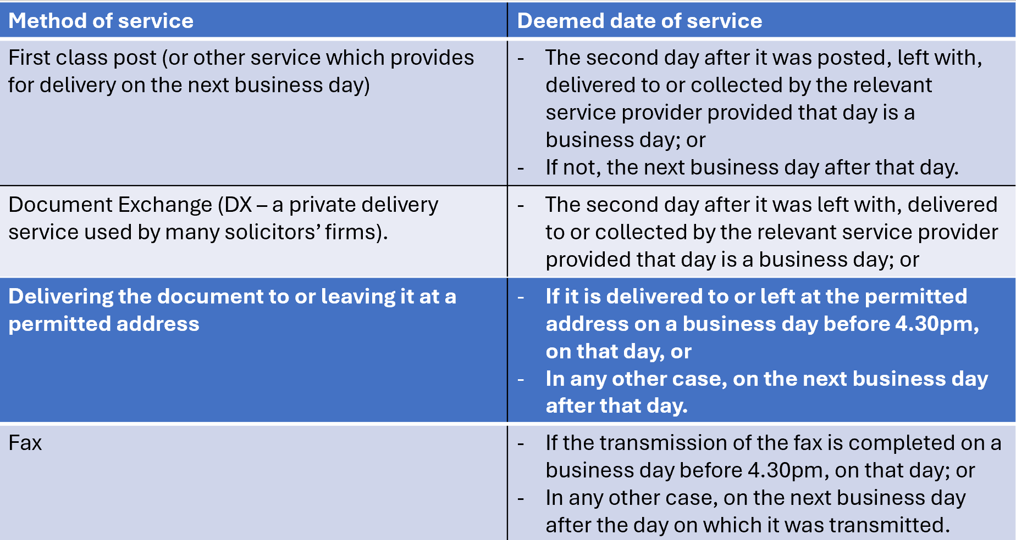

Slide 43
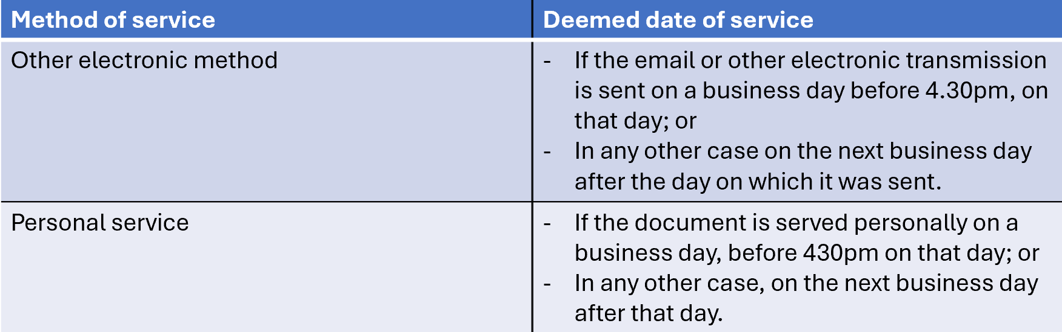

Slide 44
Example:
You are representing Rhodri, who has instructed you to bring a breach of contract claim against Naya. The claim form is sent via first class post, which is collected from your office at 3:00 pm on Friday 10 September 2024. It is therefore deemed served on Naya on Tuesday 14 September 2024.

Slide 45
Service by the court and service by (or on behalf of) a party
Service of the claim form by a court
Under r6.4 the court will serve the claim form except when a rule or Practice Direction provides that the Cl must serve it, or when the Cl has notified the court at the time of issue that they wish to effect service, or when the court orders or directs otherwise.
If Court serves the claim form, the court will choose the method of service but it will generally elect to serve by (1st class) post or it may seek to effect service by court bailiff if the Cl pays the fee for this.
The court will notify the Cl when it has effected service and will inform the Cl if the claim form is returned in the post (or if bailiff service has been used, if service was not effected) (r6.18 and r6.19).
Even where the claim form is returned in the post, it will be deemed to have been served on the D if the address for service is the relevant address – that is, when it is proper to do so (r6.7) – on the Ds solicitors, or at an address given by the D (r6.8) or at an address within the provisions of r6.9.

Slide 46
Service of the claim form by the claimant
By r6.17 where the Cl serves the claim form, the period for filing a certificate of service is extended to 21 days, but no certificate need be filed if all Ds have filed acknowledgments of service within that time.
Service of “other documents” by the court
R6.21 sets out the rules of service of other docs by the court. Generally, the court will serve a document that it has prepared unless a rule or PD provides otherwise or the court orders otherwise or where the party has informed the court that it wishes to serve the document. If the doc has been prepared by a party and the court is to serve it, the party must provide the court with a copy for service.
Documents returned undelivered to the court
Where a document to be served by the court is returned undelivered, the court sends a notice stating that the doc has been returned to the party requesting service (r6.18). In cases where the court has sent the claim form to the D by 1 of the methods permitted by Part 6 (typically this will be 1st class post), service is deemed to have taken place by r6.17 even if the claim form is returned undelivered.

Slide 47
Procedure on Service
Steps required where the court is to serve the claim form
Cl sends or takes ONE copy of the claim form for the court and ONE copy for each D, plus the other relevant docs, plus the issue fee.
The court issues the claim form by entering the issue date on the form, affixing the court seal on the form, giving a claim number. The court then opens its own file (“case management file”), placing 1 copy of the claim form on the file.
The court serves the claim form (unless requested otherwise). The court will decide on the method of service but this will normally be 1st class post.

Slide 48
Procedure on Service
Steps required where the court is to serve the claim form
Where the particulars of claim are contained in the claim form, or are to be served with it, in addition to the documents to be served, the court will send to the Ds the “response pack” , which includes the standard forms for admitting the claim, defending the claim and for acknowledging service (r7.8). Where the particulars of claim are to be served later, these additional documents are served then.
5. At the same time, the court will send the Cl a notice of issue which shows the date on which the claim form is deemed to be served under r6.17.
6. Where the court has posted the claim form and it is returned undelivered the court must send a notice to the Cl, stating that the document has been returned undelivered. Provided it was sent to the correct address, the document is irrebuttably deemed to have been properly served.

Slide 49
What if the D has not provided an address for service?
Under r6.9, where a defendant has not given an address for service and has not nominated a lawyer to accept service, an individual defendant may be served at their last known residence or place of business (as appropriate), but the process set out below must be followed (r6.9(3)–(6)). For example, where the defendant is an individual, at their usual or last known address. The address at which the defendant is to be served depends on the nature of the defendant to be served.
Where a claimant has reason to believe that the address of the defendant is an address at which the defendant no longer resides or carries on business, the claimant must take reasonable steps to ascertain the address of the defendant’s current residence or place of business, known as the current address.

Slide 50
What if the claimant can’t locate the D’s current address?
If the claimant has reason to believe that the address of the defendant (whether they are being served as an individual or as a partner in an (unincorporated) partnership or in the name of a business) is an address where the defendant no longer resides or carries on business, the claimant must take reasonable steps (and make reasonable enquiries) to ascertain the defendant’s current address (r6.9).
The claimant must consider whether there is an alternative place or method by which service may be effected. If there is, the claimant should apply to the court under r6.15 to use that place or method. If not, the claimant can serve on the defendant’s last known address.

Slide 51
Steps required where the Cl is to serve the claim form
The Cl must notify the court that they wish to serve the papers (otherwise the court will).
If the Cl does wish to serve the following steps must be taken:
They must take or send to court appropriate copies of the claim form, relevant documents and issue fee.
The court issues the claim form
The Cl’s copy of the claim form and copies for service on the D(s) will be retuned to the Cl for service, as requested. The court will also send a notice of issue.

Slide 52
Steps required where the Cl is to serve the claim form
The Cl will effect service in one of the ways specified in r6.3. Where the particulars of claim are contained in the claim form, or are served with it, the response pack must accompany the documents which are served on the D(s). Where the particulars are to be served separately later, these additional documents are served then.
The Cl must file a certificate of service within 21 days of serving the particulars of claim, confirming the method of service and date of posting or transmission (if served by fax), date of delivery (if DX)(ie the information required by r6.17).
Serving the particulars of claim
They must be served within 14 days of service of the claim form, and during the 4 or 6 month period of the validity of the claim form.

Slide 53
Certificates of service
A certificate of service (Form N215) is the form that is filed at court by a party (or their legal representative) to tell the court which documents have been served, who the documents have been served upon, and when, where, and the method by which the documents were served. If you are representing a claimant and effect service of a claim form on their behalf, then you must file a certificate of service within 21 days.
If a claimant serves a claim form, then the claimant may not obtain any default judgment unless and until a certificate of service has been filed (r6.17).
Where a rule, Practice Direction or court order requires a certificate of service, it must include the details in r6.17 and as set out in Table 9.9.

Slide 54
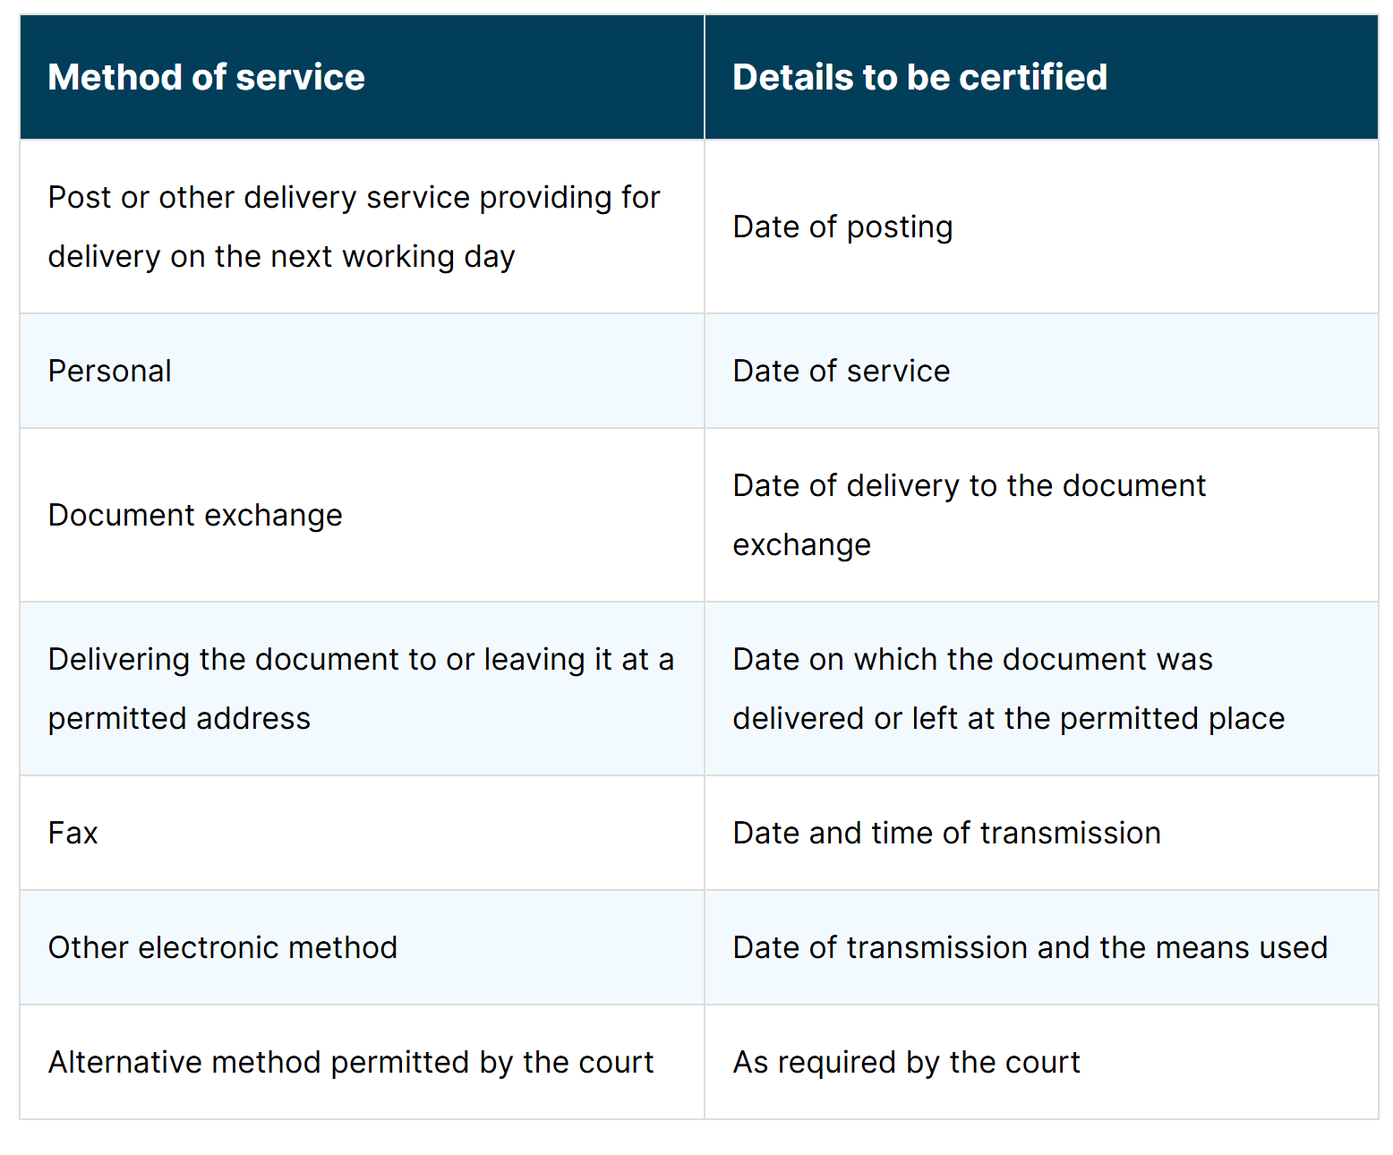

Slide 55
What if documents are returned undelivered to the court?
Where a document to be served by the court is returned undelivered, the court sends a notice stating that the document has been returned to the party requesting service (r6.18).
In cases where the court has sent the claim form to the defendant by one of the methods permitted by Part 6 (typically this will be first class post), service is deemed to have taken place by r6.17, even if the claim form is returned undelivered.

Slide 56
Overview: Procedure on service
The claimant sends or takes one copy of the claim form for the court, and one for each defendant, plus the other relevant documents (e.g. a copy of the CLS funding certificate, or the litigation friend documents), plus the issue fee.
The court issues the claim form by entering the issue date on the form, affixing the court seal on it and also gives it a claim number. The court then opens its own case management file, placing one copy of the claim form in the file.
The court serves the claim form (unless requested otherwise). The court will decide upon which method of service to use, but it will normally be by first class post

Slide 57
Overview: Procedure on service
Where the particulars of claim are contained in the claim form or are to be served with it, in addition to the documents to be served, the court will send to the defendant(s) the response pack, which includes the standard forms for admitting the claim, defending the claim and for acknowledging service (r7.8). Where the particulars of claim are to be served later, these additional documents are served at that stage instead.
At the same time, the court will send the claimant a notice of issue, which shows the date on which the claim form is deemed to be served under r6.17.
Where the court has posted the claim form and it is returned undelivered, the court must send a notice to the claimant, stating that the document has been returned undelivered. Provided it was sent to the correct address, the document is deemed to have been properly served.

Slide 58
Steps required where the claimant is to serve the claim form
**Remember: Claimant must notify the court if they wish to serve the papers, otherwise the court will serve**
If Claimant wishes to effect service themselves, they must follow certain steps.
(1) They take or send to court appropriate copies of the claim form, relevant documents and issue fee.
(2) The court issues the claim.
(3) The claimant’s copy of the claim form and copies for service on the defendant(s) will be returned to the claimant for service, as requested. The court will also send a notice of issue.

Slide 59
Steps required where the claimant is to serve the claim form
(4) The claimant will effect service in one of the ways specified in r6.3. Where the particulars of claim are contained in the claim form or are served with it, the response pack must accompany the documents which are served on the defendant(s). Where the particulars are to be served separately later, these additional documents are served then.
(5) The claimant must file a certificate of service within 21 days of serving the particulars of claim, confirming the method of service and date of posting or transmission (if served by fax), date of delivery (if by DX) (i.e., the information required by r6.17).
Serving the particulars of claim
As mentioned above, the particulars of claim must be served within 14 days of service of the claim form and during the four or six-month period of validity of the claim form.

Slide 60
Part 8 Claim Form
Part 8 procedure is an alternative procedure, aimed at disputes where a claimant is seeking the court’s decision on a question which is unlikely to involve a substantial dispute of fact.
Where the Part 8 procedure is used, the claim form must be accompanied with an acknowledgment of service form, and any written evidence on which the Cl using the Part 8 procedure intends to rely must be served on the D with the claim form.
The court will usually effect service by 1st class post, although the Cl may serve the documents if they notify the court of their wish to do so.
No further study of Part 8 procedure is required for this module

Slide 61
Service of claims outside of the jurisdiction
If an individual or company based in a different country is involved in a dispute the relevant rules are to be found within CPR Part 6; This section contains rules about service of the claim form (and other documents) out of the jurisdiction, when the permission of the court is required and how to obtain that permission, and the procedure for service.
This section is supplemented by a Practice Direction 6B – Service out of the jurisdiction which you will also need to refer to when dealing with service of a claim form outside the jurisdiction.
The Practice Direction also refers to the Foreign Process Section.
When is the court’s permission needed for service outside of the jurisdiction?
If a claim does not fit within r6.32 or r6.33, then permission must be sought under r6.36. Permission may be given if the claim fits within one of the 20 jurisdictional gateways set out at PD 6B 3.1.
Permission from the court is not required to serve a claim form outside the jurisdiction in the circumstances set out in r6.32 and r6.33.

Slide 62
Summary
Most claims under £25k should be commenced in the County Court.
PI claims under £50k must be commenced in the County Court
Most other claims can be started in either the High Court or the County Court at the option of the Cl.
Court proceedings are commenced by issuing a claim form. This is a single page, double sided court form. The Cl enters certain essential information on the form, broadly aimed at simply identifying what the claim is about.
The claim form is issued by the court when it is sealed (stamped) with the court’s official seal. On issuing a claim form; the Cl has to pay the court’s fee; the limitation period stops running (or slightly earlier when the claim is “brought”), the time for service of the claim form (4 calendar months if within jurisdiction) starts running.

Slide 63
Summary….. continued
Documents that might have to be filed with the claim form include where appropriate: a certificate of suitability if the Cl is a child or a protected party; particulars of claim (if to be served with the claim form); a schedule of past and future loss and expense (in PI claims); a medical report (in PI claims).
The detailed allegations against the D are contained in the particulars of claim;
The POC, if simple, can be endorsed on the reverse side of the claim form. Otherwise they are presented as a separate document, which often runs to several pages, which is wither stapled to the claim form or served separately.
If the POC are served separately from the claim form they must, in any event, be served within 4m of the date of issue. An extension of time is possible in which to serve the poc separately outside the 4m, provided an application is made to the court before the 4m period expires. There is no good reason why the claim form may not be served within 4m and it should always be served within this period.

Slide 64
People served with court docs are not always honest about receiving them. Therefore the rules governing service do not insist on proof of receipt. They work instead by proving that docs were dispatched, and deeming receipt at prescribed times from dispatch.
The following are prescribed methods of service: personal service – which involves leaving the document with the person being served; postal service, delivering the document at the appropriate address for service, using the DX system, by fax, by electronic methods.
There are prescribed deemed dates for each method of service. For 1st class post, service is deemed to take place on the 2nd business day after posting.
The deeming provisions give rise to irrebuttable presumptions of due service. This means that evidence that the docs did not arrive, or arrived late, is not admissible. So even if everyone knows that they could not or did not arrive, the court must assume that they did.

Slide 65

Any questions?

Slide 66
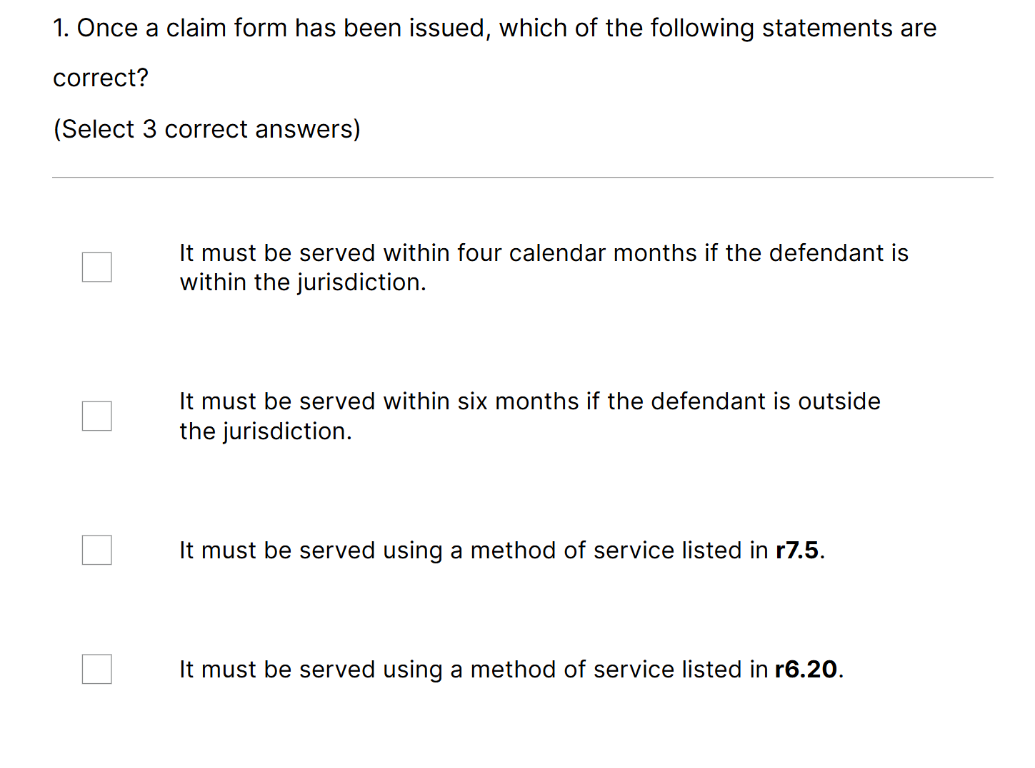

Slide 67




Slide 68
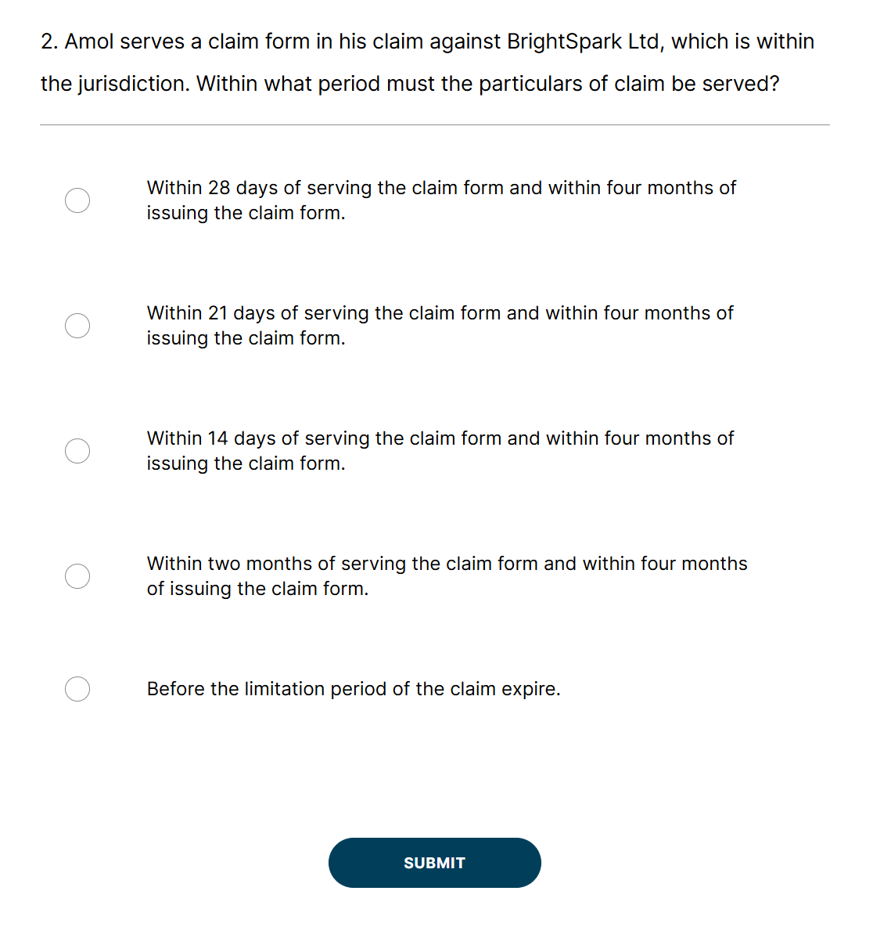

Slide 69


Slide 70
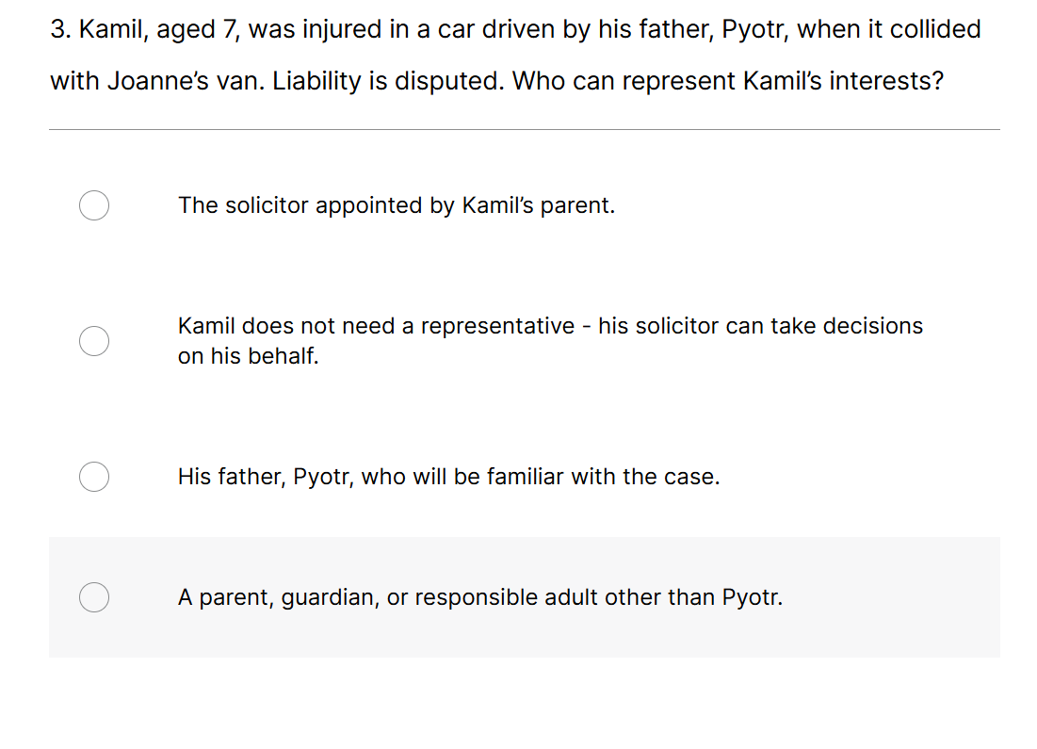

Slide 71


