Slide 1
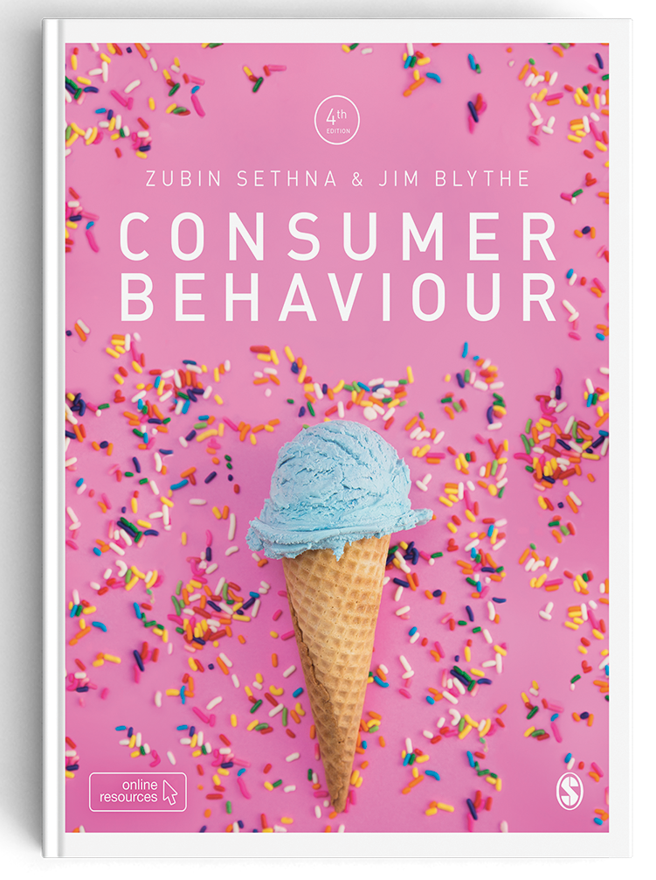
Consumer Behaviour
Zubin Sethna & Jim Blythe

Slide 2
Chapter 3
Innovation and digital technologies

Slide 3
Session objectives
Explain how the product life cycle drives innovation.
Describe some of the characteristics of innovators.
Show how innovators are not necessarily innovators under all circumstances.
Describe different types of innovation.
Explain the role of mavens in the adoption of innovation.
Explain how resistance to innovation can happen, and formulate some ideas for dealing with this problem.

Slide 4
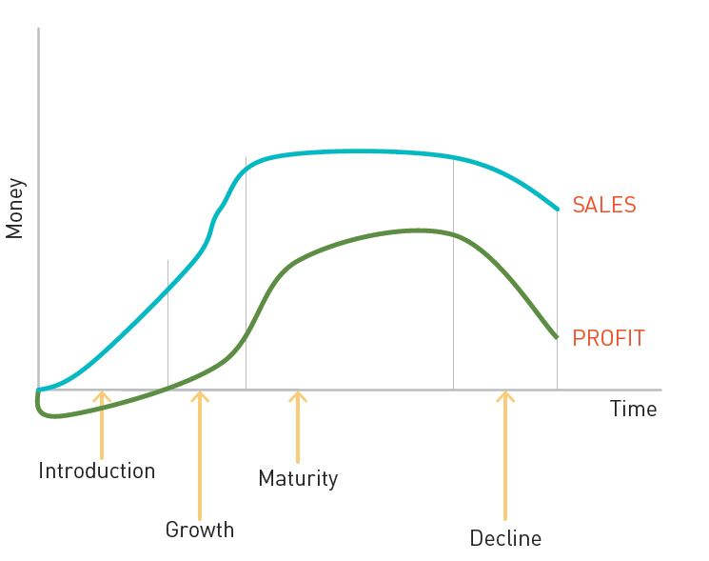
The product life cycle
Illustrates the process of introduction, growth, maturity and obsolescence in products.
What are its strengths and weaknesses?

Slide 5
Adoption of innovation
Everett M. Rogers (1983) postulated that products would be adopted if they possessed most of the attributes shown in Table 4.1

Slide 6
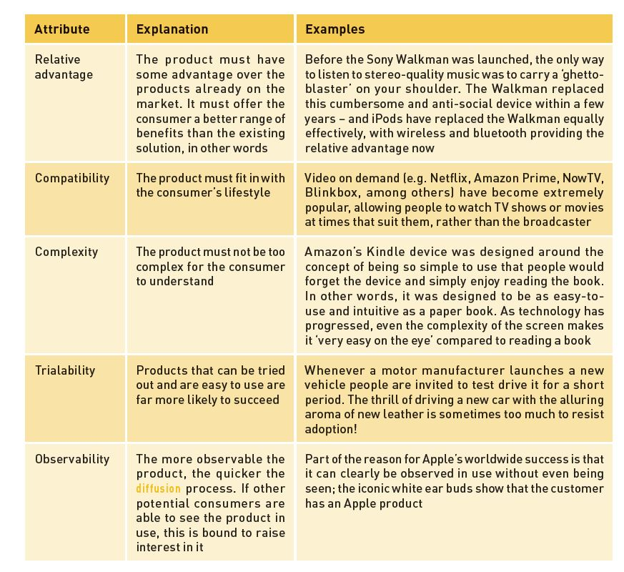
Adoption of innovation

Slide 7
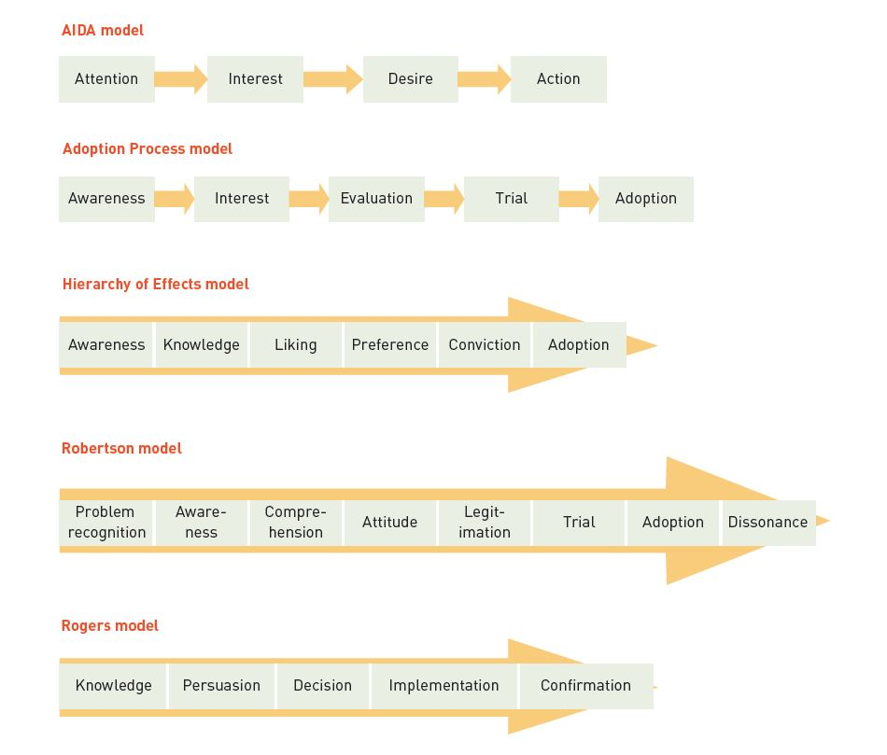
Models describing the adoption process

Slide 8
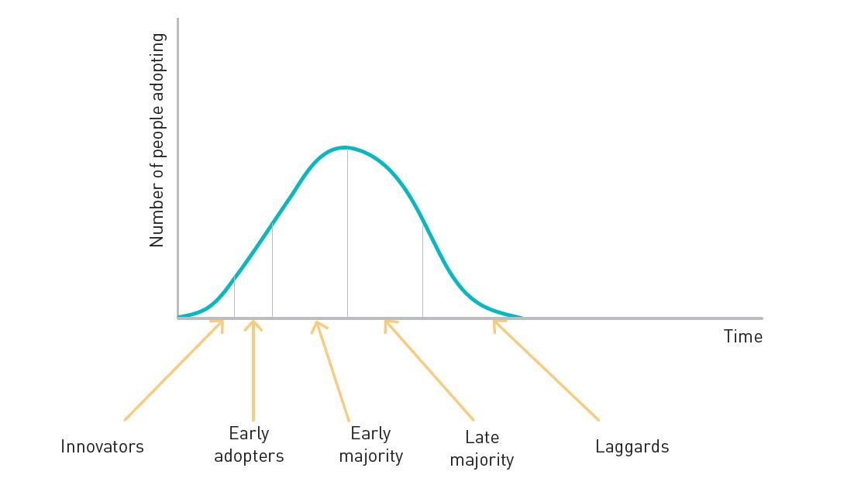
Categories of innovation adopters

Slide 9
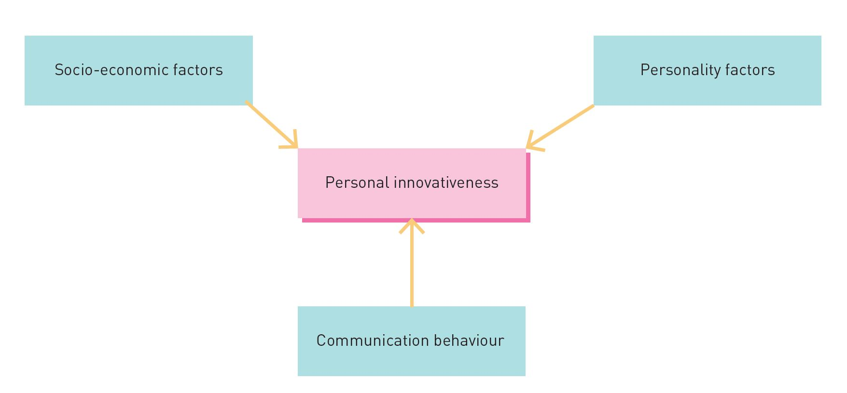
What is innovativeness?
‘…the degree to which a person tends to adopt innovations earlier than other people’

Slide 10
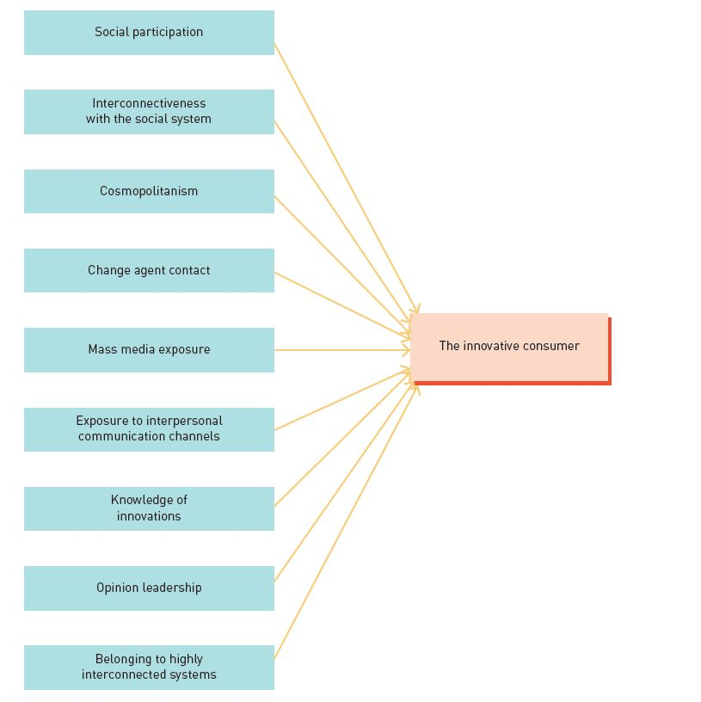
Communicating innovativeness

Slide 11
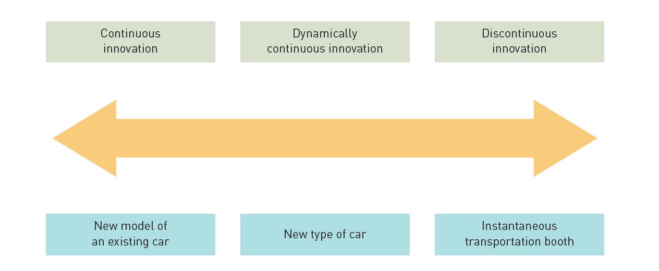
Innovative products
Continuous innovation
Dynamically continuous innovation
Discontinuous innovation

Slide 12
Marketing approaches to new product launches
Need recognition
Pre-purchase activities
Evaluation and purchase decision
Act of purchase and consumption
Post-purchase evaluation
Is ‘mass customisation’ an option?

Slide 13
Resistance to innovation
A positive attitude towards change.
An advanced technology and skilled labour force.
A general respect for education and science.
An emphasis on rational and ordered social relationships rather than on emotional ones.
An outreach perspective, in which members of the system frequently interact with outsiders.
A system in which members can easily see themselves in different roles.

Slide 14
Three key technological trends
(Tata group of companies)
Digital assistants
Aggregators
Commercial drones

Slide 15
Brand experiences
Digital innovation has touched our life in many ways but the jury is out still out on whether we actually want innovation or are just looking for improvement.
‘Immersive VR’ (virtual reality) which is creating new inroads for companies to reach their audiences.
The practical application of such AI is fascinating and could give brands an even deeper dataset to work with.

Slide 16
Summary
The product life cycle shows that all products eventually become obsolete and must be replaced.
Innovators for one product category are not necessarily innovators for any other product category.
The most successful products are often me-too’s or continuous innovations.
Mavens have a high level of interest in specific product categories, and enjoy airing their knowledge.
Innovation can be continuous, dynamically continuous or discontinuous.
Resistance to innovation can come from many sources.

