Slide 1
Contemporary Mental Health- Case Study
Marnie Elizabeth Griffiths
1802698
ECHC5001

Slide 2
Case Study:
“Presentation
Blossom is a 20-year-old telesales operator who feels that she is ‘going mad’
with anxiety.
Past history
Blossom has no significant past medical or mental health history.
On examination
Blossom describes feeling anxious most of the time. The problem started when
she was studying for her GCSEs, when she describes being incapacitated
with anxiety. Despite wanting to enter higher education she felt that she would
be unable to cope with the pressure and left school aged 16. Her family was
disappointed about this. Blossom describes not being able to make decisions
as she worries too much about what would happen if she made the wrong
decision. She also describes a low mood but has no suicidal thoughts.”
(National Institute for Health and Clinical Excellence, 2011)

Slide 3
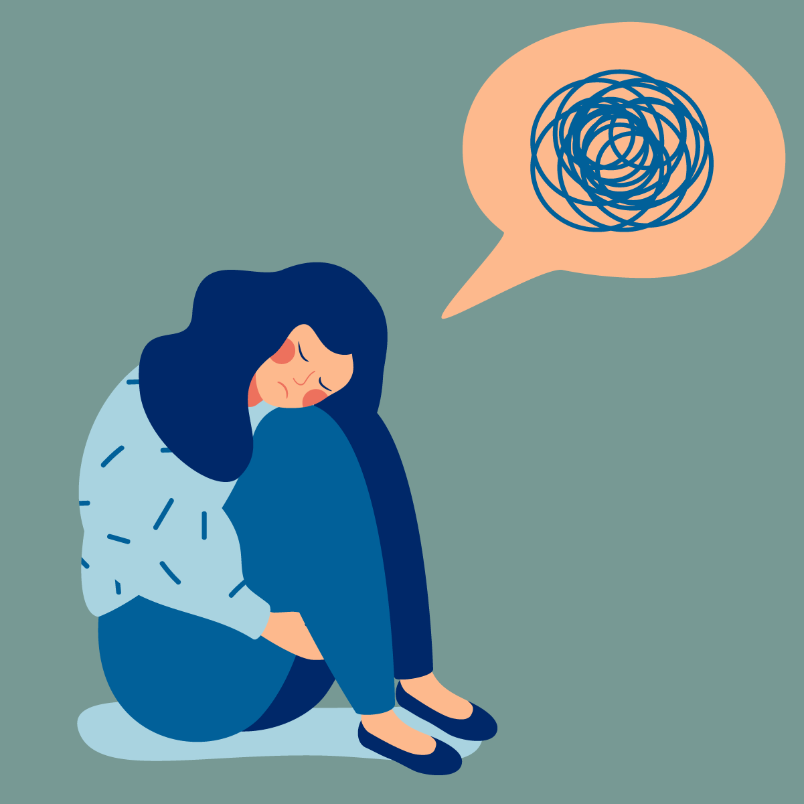
So what is anxiety?
Body responding to stress.
Feeling of apprehension or fear.
Extreme feelings of anxiety lasting a longer period of time (6 months) and affecting life- anxiety disorder.
Can affect anyone at any age
Different types of anxiety disorders
(Healthline, 2018). (Craske, 2016, p.3049)

Slide 4
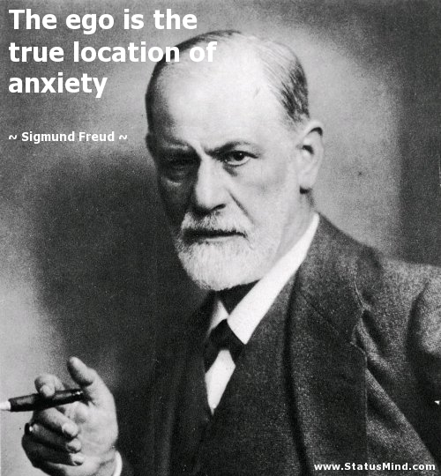
Theories of Anxiety:
Freud’s Danger Signal Theory
Three basic types of anxiety:
Objective anxiety
Neurotic anxiety
Moral anxiety
Freud described anxiety as…
“a specific state of unpleasure accompanied by motor discharge along definite pathways . . . a signal of danger.. . . Symptoms are created in order to remove the situation of danger”
(Levitt, 2016, p.18) (Freud, 1936, p.70)

Slide 5
Theories of Anxiety:
Neo-Freudian Theory
Karen Horney's Neo-Freudian Theory of Personality:
“Basic anxiety refers to the maladaptive patterns that develop when children are exposed to basic evil or any environment that does not meet their basic needs. Basic anxiety results in the formulation of interpersonal strategies of defence, or rigid ways of relating to others that may be understood in terms of whether they move toward, against, or away from others”.
(Levitt, 2016, p.21) Camille Harris (2016)

Slide 6

A Current Theory on Anxiety (Psychodynamic & Cognitive)
Conflict between ID & EGO
Objective of understanding underlying conflict
“tendency to overestimate the potential for danger”
(Bhatt, 2019)

Slide 7
Modern Approaches Used to Help with Anxiety:
Cognitive Behavioural Therapy (CBT)
E-interventions (computer assisted/ internet based treatments)
Early prevention
Mindfulness
Medication
(Aderka, 2012, p.393) (Craske, 2016, p.3053)
(Spurgeon, 2010, p.547-52) (Craske, 2016, p.3052) (Conner, 2010, p.531)

Slide 8


Medication VS. Therapy for the Treatment of Anxiety:
Pharmacological treatment VS. Psychotherapy
Mostly cognitive behavioural therapy
“NICE (National Institute for Health and Care Excellence) guidelines provide recommendations for evidence based psychological and pharmacological treatment for anxiety disorders”
(Craske, 2016, p.3054)

Slide 9
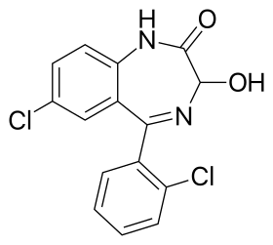

The Effects of Medication on Therapeutic Relationship:
Side effects:
‘light-headedness
blurred vision
drowsiness
confusion
unsteadiness
muscle weakness
dizziness
slurred speech
memory problems
dry mouth
constipation
nausea’
(Home Health UK, 2019) (Zilcha-Mano, 2015, p.177)
(Mind UK, 2016)

Slide 10
So, back to blossom…
What approaches would be acceptable, appropriate and effective for Blossom suffering with crippling anxiety?
Medication VS. Therapy for blossom or both?
What factors must be taken into consideration?
What are the risks for blossom?

Slide 11
Helping Blossom:
Marijuana…
Medication
Therapy
Cognitive Behavioural Therapy
Self Help
Exercise regularly
Avoid caffeine
Learn to relax
Support groups
Avoid smoking/ drinking
(Anxiety.org, 2019) (Cognitive Behavioural Therapy Los Angeles, 2019)

Slide 12

Thankyou for listening to my presentation… any questions?

Slide 13
References:
Aderka, I.M. et al. (2012) ‘Functional impairment in social anxiety disorder’, 26(3), pp.393-400. DOI: 10.1016/j.janxdis.2012.01.003
Anxiety.org (2019) Is cannabis an effective treatment for anxiety disorders? Available at: https://www.anxiety.org/is-cannabis-an-effective-treatment-for-anxiety-what-research-shows (Accessed: 7 December 2019).
Bhatt, V.N. (2019) What are the psychodynamic and cognitive theories of anxiety?. Available at: https://www.medscape.com/answers/286227-14519/what-are-the-psychodynamic-and-cognitive-theories-of-anxiety (Accessed: 1 December 2019).
Cognitive Behavioural Therapy Los Angeles (2019) CBT Treatment for Generalized Anxiety Disorder (GAD). Available at: http://cogbtherapy.com/generalized-anxiety-disorder-treatment (Accessed: 7 December 2019).
Conner, K.O. et al.(2010) ‘Mental health treatment seeking among older adults with depression: the impact of stigma and race’, The American journal of geriatric psychiatry: official journal of the American Association for Geriatric Psychiatry, 18(6), pp. 531-43. DOI:10.1097/JGP.0b013e3181cc0366
Craske, M.G. & Stein, M.B. (2016) ‘Anxiety’, The Lancet, 388(10063), pp.3048–3059. DOI: DOI:10.1016/S0140-6736(16)30381-6
Freud, S. (1936) The Problem of Anxiety. New York: W.W. Norton & Co.

Slide 14
References Continued:
Harris, C. (2016) ‘A Description of Karen Horney's Neo-Freudian Theory of Personality’, Owlcation [blog]. 22 December. Available at: https://owlcation.com/social-sciences/A-Description-of-Karen-Horneys-Neo-Freudian-Theory-of-Personality-and-Psychopathology (Accessed: 1 December 2019).
Healthline (2018) Everything you Need to Know About Anxiety. Available at: https://www.healthline.com/health/anxiety#types (Accessed: 31 November 2019).
Home Health UK (2019) Benzodiazepines. Available at: https://homehealth-uk.com/benzodiazepines/ (Accessed: 5 December 2019).
Levitt, E.E. (2016) The psychology of anxiety. 2nd Ed. London: Routledge.
Mind UK (2016) What side effects can benzodiazepines cause? Available at: https://www.mind.org.uk/information-support/drugs-and-treatments/sleeping-pills-and-minor-tranquillisers/side-effects-of-benzodiazepines/#.Xe1zwOj7TIU (Accessed: 5 December 2019).
National Institute for Health and Clinical Excellence (2011) Generalised anxiety disorder and panic disorder (with or without agoraphobia) in adults. Available at: https://www.nice.org.uk/guidance/cg113/resources/clinical-case-scenarios-pdf-136292509 (Accessed: 31 November 2019).
Spurgeon, J.A (2010) ‘Computer-assisted cognitive-behavioural therapy’, 12(6), pp.547-52. DOI: 10.1007/s11920-010-0152-4.
Zilcha-Mano, S., Roose, S. P., Barber, J. P., & Rutherford, B. R. (2015) ‘Therapeutic alliance in antidepressant treatment: cause or effect of symptomatic levels?’, Psychotherapy and psychosomatics, 84(3), pp. 177–182. DOI:10.1159/000379756

