Slide 1

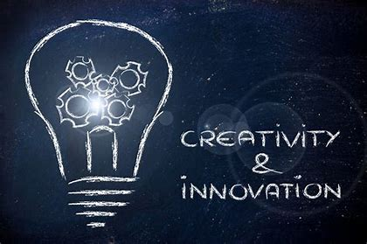

By: Leighton Fernandes

Slide 2



Contents
Gibbs Reflective Cycle
What is Innovation
What is Creativity
Innovation Matrix
Open and Closed Innovation
Innovation Process
4Ps of Innovation
Lewin Force Field Analysis
Leadership and Management
Conclusion
Reference list

Slide 3
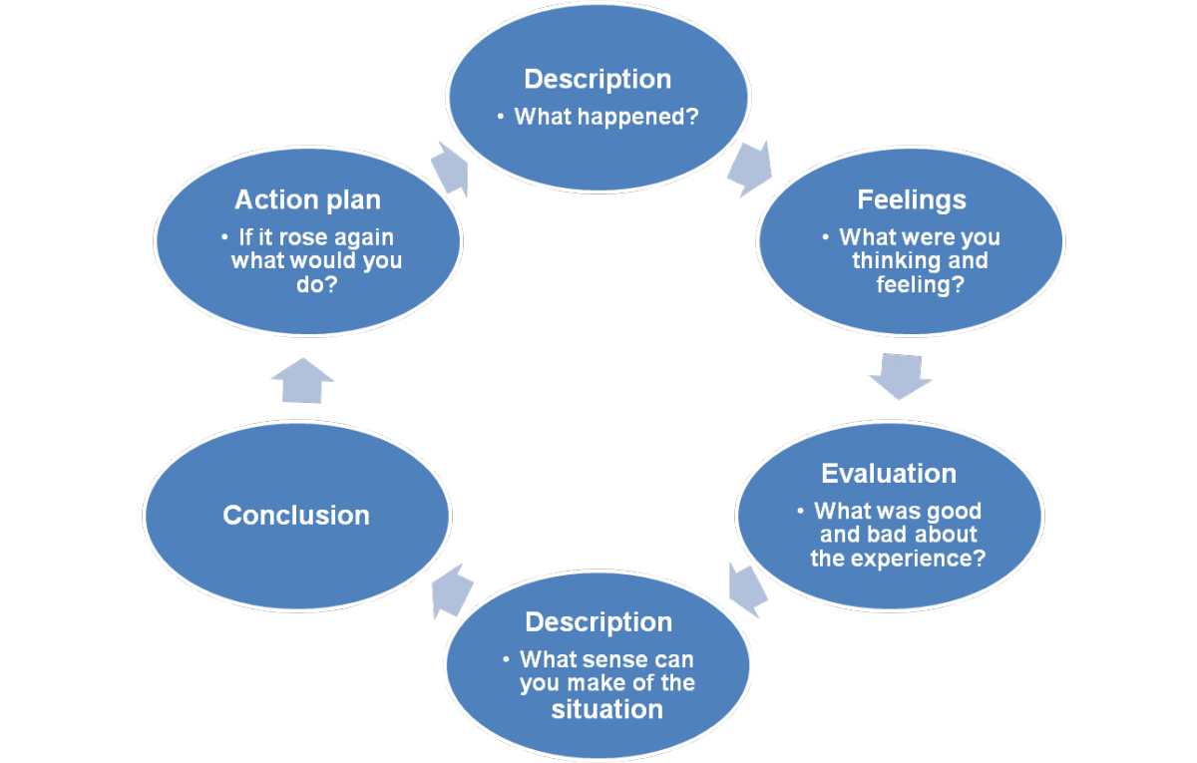
GIBBS REFLECTIVE CYCLE
Gibbs (1998)

Slide 4




What is Innovation
By innovation, we mean changing your business model and making changes in the existing environment to deliver better products or services.
Amabile (1998)

Slide 5


What is Creativity
Henry (1994)

Slide 6
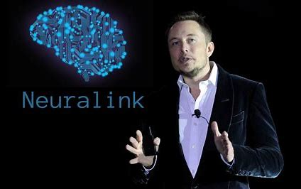
INNOVATION MATRIX
TECHNOLOGY INNOVATION | RADICAL INNOVATION
BUSINESS MODEL INNOVATION | INCREMENTAL INNOVATION
Neuralink (2022)

Slide 7
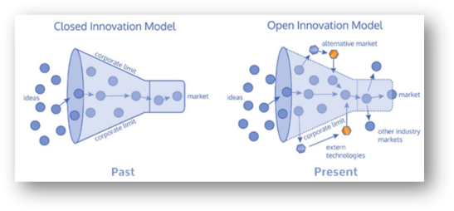
Open and Closed Innovation Model
Fried. (2022)

Slide 8
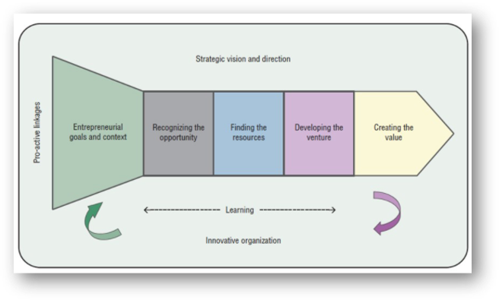
INNOVATION PROCESS
Tidd & Bassant (2018)
Cambridge International (2014)

Slide 9
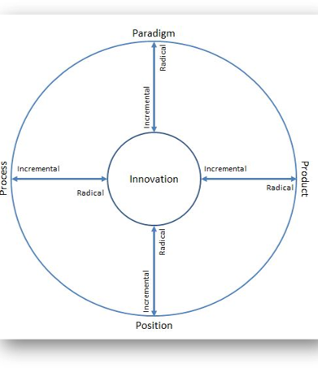
4PS OF INNOVATION
TIDD & BESSANT (2013)
Michigan State University (2019)

Slide 10
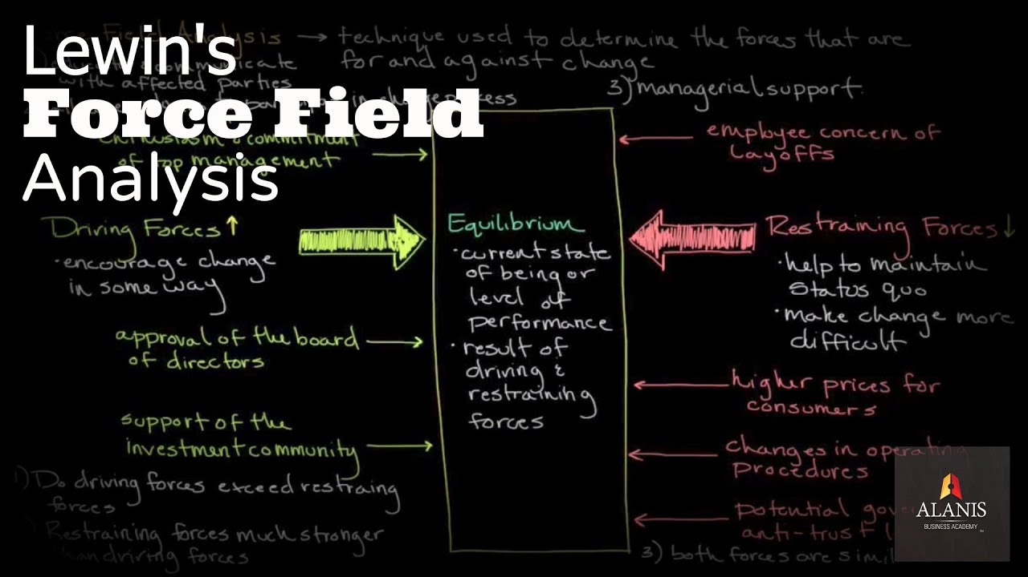
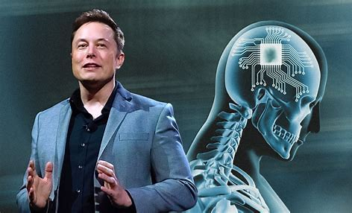
Timeline
Lewin (2013)

Slide 11

LEADERSHIP & MANAGEMENT
Mullins (2016)

Slide 12

Does Innovation and Creativity Provide a Business Advantage?

Slide 13

Reference List
K Lewin. (2013). The Conceptual Representation and the Measurement of Psychological Forces. United States: Martino Fine Books. pp.70-90.
L J Mullins. (2016a). Management and Organisational Behaviour. 11th ed. London: Pearson Education. pp.10-22.
L J Mullins. (2016b). Management and Organisational Behaviour. 11th ed. London: Pearson Education. pp.33-42.
L J Mullins. (2016c). Management and Organisational Behaviour. 11th ed. London: Pearson Education. pp.15-29.
L J Mullins. (2016d). Management and Organisational Behaviour. 11th ed. London: Pearson Education. pp.45-51.
M Boyles. (2022). INNOVATION IN BUSINESS: WHAT IT IS & WHY IT’S SO IMPORTANT. [Online]. Harvard Business School Online. Last Updated: 08 MAR 2022. Available at: https://online.hbs.edu/blog/post/importance-of-innovation-in-business [Accessed 2 December 2022].
Michigan State University. (2019). Implementing the 4 “Ps” for Healthcare Innovation. [Online]. Michiganstateuniversityonline.com. Last Updated: 30 August 2019. Available at: https://www.michiganstateuniversityonline.com/resources/healthcare-management/applying-4-ps-for-heal [Accessed 11 December 2022].
Miro. (2022). Innovation Matrix: How to elevate product development within your company. [Online]. Boardofinnovation.com. Last Updated: 15 July 2022. Available at: https://miro.com/blog/innovation-matrix/ [Accessed 6 December 2022].
Neuralink. (2022a). Breakthrough Technology for the Brain. [Online]. Neuralink.com. Last Updated: 2022. Available at: https://neuralink.com/ [Accessed 6 December 2022].
Neuralink. (2022b). Breakthrough Technology for the Brain. [Online]. Neuralink.com. Last Updated: 2022. Available at: https://neuralink.com/ [Accessed 6 December 2022].
Neuralink. (2022c). Expanding Our World. [Online]. Neuralink.com. Last Updated: 2022. Available at: https://neuralink.com/about/ [Accessed 13 December 2022].
Neuralink. (2022d). Innovation pushing the boundaries of neural engineering. [Online]. neuralink.com. Last Updated: 2022. Available at: https://neuralink.com/approach/ [Accessed 09 December 2022].
Neuralink. (2022e). A Direct Link Between the Brain & Everyday Technology. [Online]. Neuralink.com. Last Updated: 2022. Available at: https://neuralink.com/applications/ [Accessed 07 December 2022].
Oxford. (2022). OVERVIEW Creativity. [Online]. Oxford Reference. Last Updated: 2022. Available at: https://www.oxfordreference.com/display/10.1093/oi/authority.20110803095646664;jsessionid=C9EA78204C [Accessed 2 December 2022].
Peter Drucker. (2012). The Practice of Management. Great Britton: Taylor & Francis. pp.252-272.
S Peek. (2022). Creativity Is Not Innovation (But You Need Both). [Online]. Business News Daily. Last Updated: 03 August 2022. Available at: https://www.businessnewsdaily.com/6848-creativity-vs-innovation.html [Accessed 4 December 2022].
T Davila, M Epstein, R Shelton. (2006b). Making Innovation Work How to Manage It, Measure It, and Profit from It. United States: Tim Moore. pp.12-22.
T Davila, M Epstein, R Shelton; Wharton School. (2006a). Making Innovation Work: How to Manage It, Measure It, From It, and Profit. [Online]. Moodle.uwtsd.ac.uk. Last Updated: 2006. Available at: https://moodle.uwtsd.ac.uk/pluginfile.php/374351/mod_resource/content/0/Davila%20et%20al%2C%20%28200 [Accessed 1 December 2022].
T Smith. (2020). A Scientist and Engineer Explain Everything Elon Musk’s Neuralink Can (and Can’t) Do. [Online]. onezero.medium.com. Last Updated: 17 September 2020. Available at: https://onezero.medium.com/a-scientist-and-engineer-explain-everything-elon-musks-neuralink-can-and- [Accessed 12 December 2022].
W Purcell. (2021). The Importance of Innovation in Business. [Online]. Northeastern.edu. Last Updated: 31 October 2021. Available at: https://www.northeastern.edu/graduate/blog/importance-of-innovation/ [Accessed 6 December 2022].

Slide 14
THANK YOU
FOR
LISTENING

