Slide 1
BA in Leadership and Management Skills for the Workplace
Workplace culture and its impact on organisational efficiency
(BMSW 5105)
Determinants of a successful organisational Culture and culture change

Slide 2

Previously…..
Define organisations
Explore the organizational environment
Explored tools used to analyse the environment
Identified organizational structures and cultures
Discussed how organizational culture is created and sustained

Slide 3
In this session…..
We will;
Identify the factors affecting the success of organizational culture?
Explore how organizational culture can be changed
Analyse organisational culture using cultural web

Slide 4
External factors
Factors affecting the culture of an organisation
Factors that we have discussed during week 1 and 2 (PESTEL / Porter’s 5 forces)
Internal factors
We will use the McKinsey’s 7’s frame work to analyse the internal factors

Slide 5
McKinsey’s 7’s frame work
McKinsey 7s model was developed in 1980s by McKinsey consultants Tom Peters, Robert Waterman and Julien Philips with a help from Richard Pascale and Anthony G. Athos.
Since the introduction, the model has been widely used by academics and practitioners and remains one of the most popular strategic planning tools.
The model can be applied to many situations and is a valuable tool when organizational design is at question. The most common uses of the framework are:
  To facilitate organizational change.
  To help implement new strategy.
  To identify how each area may change in a future.
  To facilitate the merger of organizations.

Slide 6
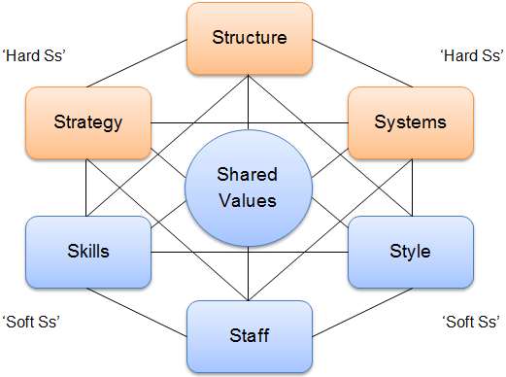
McKinsey’s 7’s framework

Slide 7
Strategy
Strategy is a plan developed by a firm to achieve sustained competitive advantage and successfully compete in the market.

Slide 8
Structure
Structure represents the way business divisions and units are organized and includes the information of who is accountable to whom.
In other words, structure is the organizational chart of the firm. It is also one of the most visible and easy to change elements of the framework.

Slide 9
Systems
Systems are the processes and procedures of the company, which reveal business’ daily activities and how decisions are made.
Systems are the area of the firm that determines how business is done and it should be the main focus for managers during organizational change.

Slide 10
Skills
Skills are the abilities that firm’s employees perform very well. They also include capabilities and competences.
During organizational change, the question often arises of what skills the company will really need to reinforce its new strategy or new structure.

Slide 11
Staff
Staff element is concerned with what type and how many employees an organization will need and how they will be recruited, trained, motivated and rewarded.

Slide 12
Style
Style represents the way the company is managed by top-level managers, how they interact, what actions do they take and their symbolic value. In other words, it is the management style of company’s leaders.

Slide 13
Shared values
Shared Values are at the core of McKinsey 7s model. They are the norms and standards that guide employee behaviour and company actions and thus, are the foundation of every organisation.

Slide 14
Group Activity 6.1
Identify the 7 S elements of the scenarios below.
Do you think the 7 elements are aligned in each scenario?

Slide 15
Scenario 1
We’ll start with a small startup, which offers services online. The company’s main strategy is to grow its share in the market. The company is new, so its structure is simple and made of a very few managers and bottom level workers, who undertake specific tasks. There are a very few formal systems, mainly because the company doesn’t need many at this time.
Notes:
Instructions for Lecturers: - Possible explanation available on Moodle.

Slide 16
Scenario 2
The startup has grown to become large business with 500+ employees and now maintains 50% market share in a domestic market. Its structure has changed and is now a well-oiled bureaucratic machine. The business expanded its staff, introduced new motivation, reward and control systems. Shared values evolved and now the company values enthusiasm and excellence. Trust and teamwork has disappeared due to so many new employees.
Notes:
Instructions for Lecturers: - Possible explanation available on Moodle.

Slide 17
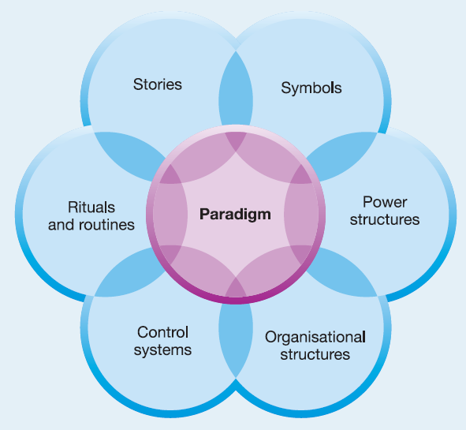
The CULTURAL WEB of an Organisation

Slide 18
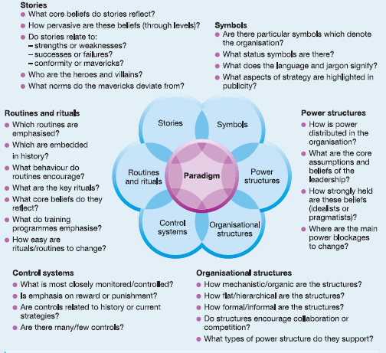

Slide 19
Changing the organisational culture

Slide 20
Lewin’s Three-Step Model
Kurt Lewin argued that successful change in organizations should follow three steps: unfreezing the status quo, movement to a desired end state, and refreezing the new change to make it permanent.

Slide 21
Kotter’s Eight-Step Plan
John Kotter of the Harvard Business School built on Lewin’s three-step model to create a more detailed approach for implementing change.

Slide 22
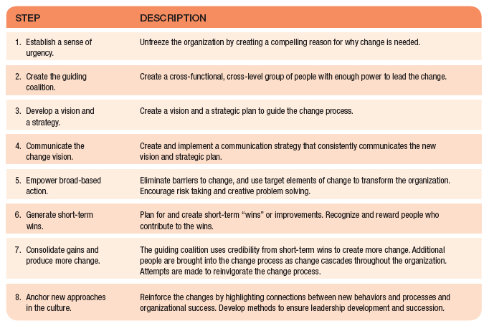

Slide 23
Group Activity 6.2
Prepare and present a plan for change assuming that UWTSD London needs to undergo change.
Tip: Use Kotter’s Model to base your plan

Slide 24


Summary
Can you explain;
The factors affecting the organisational culture?
How to change organisational culture?

Slide 25

Next session
The barriers to effective functioning of an organisation

