Slide 1
“evaluating the use of digital technology, tools, and techniques to enhance efficiency at Sunrise residential care home”

Slide 2

Module Title: Digital Skills And Research Methods
Module Code: LCHS4007_BIRM
Lectures Name: HAJRA, MUSTASIM
Group Members Name | Student Number
Mason Tobias | 2506377
Neelam Shehzadi | 2508687
Andleeb Saeed | 2506509
Jermaine Gamble | 2504604

Slide 3

TOPIC:
Choose one MS 365 communication or collaboration tool (MS Teams, OneDrive, or Outlook) and evaluate its usage within the Sunrise residential care home. Discuss the benefits and limitations of the chosen application.
Presented by: Neelam Shehzadi

Slide 4

What is MS Outlook?
Microsoft Outlook is an email client and personal information management software that helps users manage their emails, calendars, contacts, and tasks. It's a tool that enables individuals and teams to stay organized, communicate effectively, and prioritize tasks.

Slide 5

Benefits:
Microsoft Outlook in Care Homes:
Outlook helps care homes like Sunrise Residential Care Home stay organized and communicate effectively.
Manage Emails:
Outlook helps staff respond to emails quickly and
efficiently.
Schedule Appointments:
Outlook's calendar feature helps staff schedule appointments and care activities.
Track Tasks:
Outlook's task feature helps staff stay on top of care activities.

Slide 6

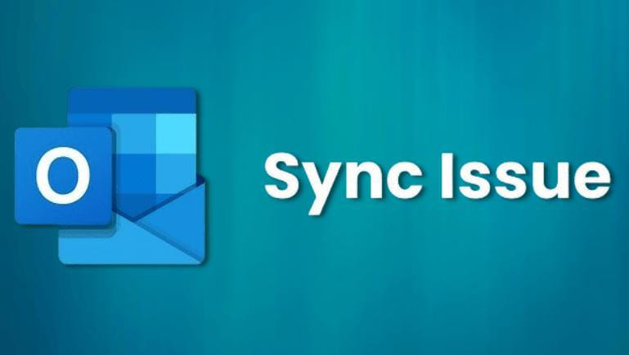
Challenges:
  Too Many Emails:
  Staff might get overwhelmed with emails and struggle to prioritize.
  Technology Issues:
  Staff need access to technology to use Outlook, which can be a problem in areas with poor internet.
  Security:
  Care homes must protect sensitive resident information.

Slide 7

Uses in Care Homes:
Communicate with Families:
Outlook helps staff keep families informed about care plans and updates.
Coordinate Care:
Outlook helps staff schedule care activities and meetings.
Manage Care Plans:
Outlook can help staff track medication schedules and care activities.

Slide 8
TOPIC:
Explain the impact of limited digital skills (digital literacy) among staff in the Sunrise residential care home. Consider how this may affect care delivery, communication and teamworking.
Presented by: Andleeb Saeed

Slide 9
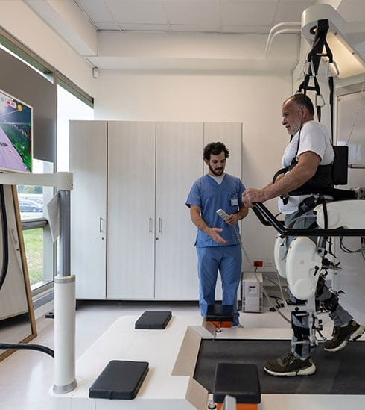
What Is Digital Literacy In Care Home?
Digital literacy in care homes means using technology to improve care, communication, and well-being. For residents, it's about staying connected with loved ones and accessing fun activities. For staff, it's about efficient record-keeping, safe medication management, and better communication. It helps us deliver better care, saves time, and keeps everyone connected.

Slide 10

Impact on Care Delivery
Inaccurate Or Delayed Documentation:
Staff lacking digital skills may struggle with record-keeping, risking care quality.
Monitoring Resident’s Health Irregularly:
Staff cannot use digital health tools correctly, harder to monitor resident health indicators like Blood Pressure, weight, blood sugar.
Error in electronic care planning and records:
Staff at Sunrise need to use computers well for digital records to avoid mistakes like wrong medicine doses.
Reduced efficiency in accessing resident information:
Staff trouble with digital platforms , slower access to resident information, affecting response time, specially in emergencies.

Slide 11
Impact on Communication
Internal Communication:
Staff not familiar with digital tools may miss updates, causing misunderstandings.
Talking To Doctor:
General Practitioner offices, hospitals, and pharmacies share information electronically. Staff technological issues might affect coordinated care.
Communication With Family:
Families use digital tools to check on residents' health; staff technical struggles can lead to isolation & unhappiness.
Barriers To External Professional Collaboration:
Limited digital literacy among Sunrise staff can hinder collaboration with external professionals like doctors or hospitals.

Slide 12

Impact on Teamworking
Unequal workload distribution:
Tech-savvy staff end up doing all technological work, leading to dissatisfaction & exhaustion.
Less collaboration:
Digital tools for shift handovers and documents might limit teamwork due to
information sharing issues.
Lower staff morale:
Low staff morale can happen if employees feel uncomfortable with technology, leading to feelings of humiliation, stress, or being under appreciated.
Reduced trust and team cohesion:
When technological issues disrupt digital communication, team trust and collaboration suffer.

Slide 13
Reference list:
Broadbent, E., & Pantic, D. (2016). Digital Health Skills in Care Homes. Journal of Gerontology, 71(5), 633-638.
Damant, J., & Knapp, M. (2018). Digital Technology in Care Homes: A Rapid Review. International Journal of Care and Caring, 2(1), 7-24.
Kingsley, P., & Babic-Illman, N. (2020). The Role of Digital Literacy in Supporting Care Home Staff. Journal of Adult Protection, 22(3), 147-158.
McClean, S., & Fitzpatrick, D. (2019). Digital Health Technologies in Care Homes: Benefits and Barriers. Journal of Aging Science, 7(2), 1-9.
Waller, S., & Goodman, C. (2017). Embedding Digital Technology in Care Homes: Challenges and Opportunities. Journal of Care Services Management, 10(1), 15-25.

