Slide 1
Student: Azra Bi
Student ID: 2312900
Lecturer: Parese Ahmed
Module: Health, Wellbeing and Sustainable Development
Module code: BMHP6030
Assignment title: Component 1: Presentation

Slide 2
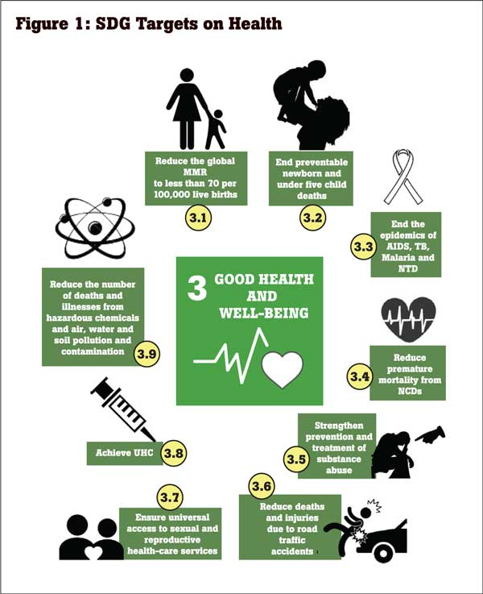
INTRODUCTION
❑Integration of health, wellbeing and sustainable
development improves population outcomes
(Lakioti et al., 2025).
❑These concepts reduce inequalities and
strengthen long term system resilience
effectively (Ugwu et al., 2025).
❑Sustainable Development Goal (SDG) 3
promotes universal coverage, prevention and
wellbeing influencing United Kingdom policy
(UN, 2025).
❑Focus shifts from reactive care toward
preventive and holistic healthcare delivery
approaches.
(Daily Mirror, 2025)

Slide 3
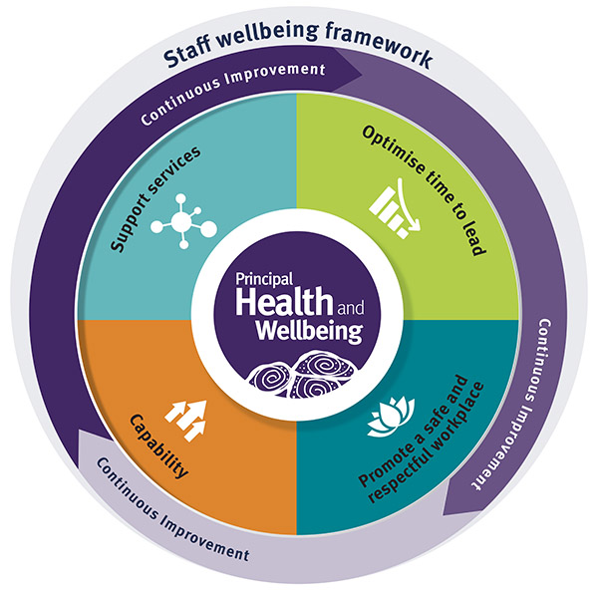
DISCUSSION OF KEY CONCEPTS
HEALTH
WELLBEING
Sustainable
Development
• Complete
physical mental
social wellbeing
not merely
disease absence
(Viziteu 2024).
• Holistic person
centred care
supports
inclusive needs
based provision
(Bellert et al.,
2025).
• Dynamic
functioning
enabling growth
stress
management and
community
participation
(Gautam et al.
2024).
• Policy integrates
emotional
psychological
social and
physical health
outcomes (Skills
for Health, 2025).
• Meeting present
needs without
compromising
future
generations
capacity (Circular
Ecology, 2025).
• Healthcare
promotes
resource
efficiency
environmental
responsibility and
system
sustainability
(UN, 2025).
(Queensland Government, 2023)

Slide 4
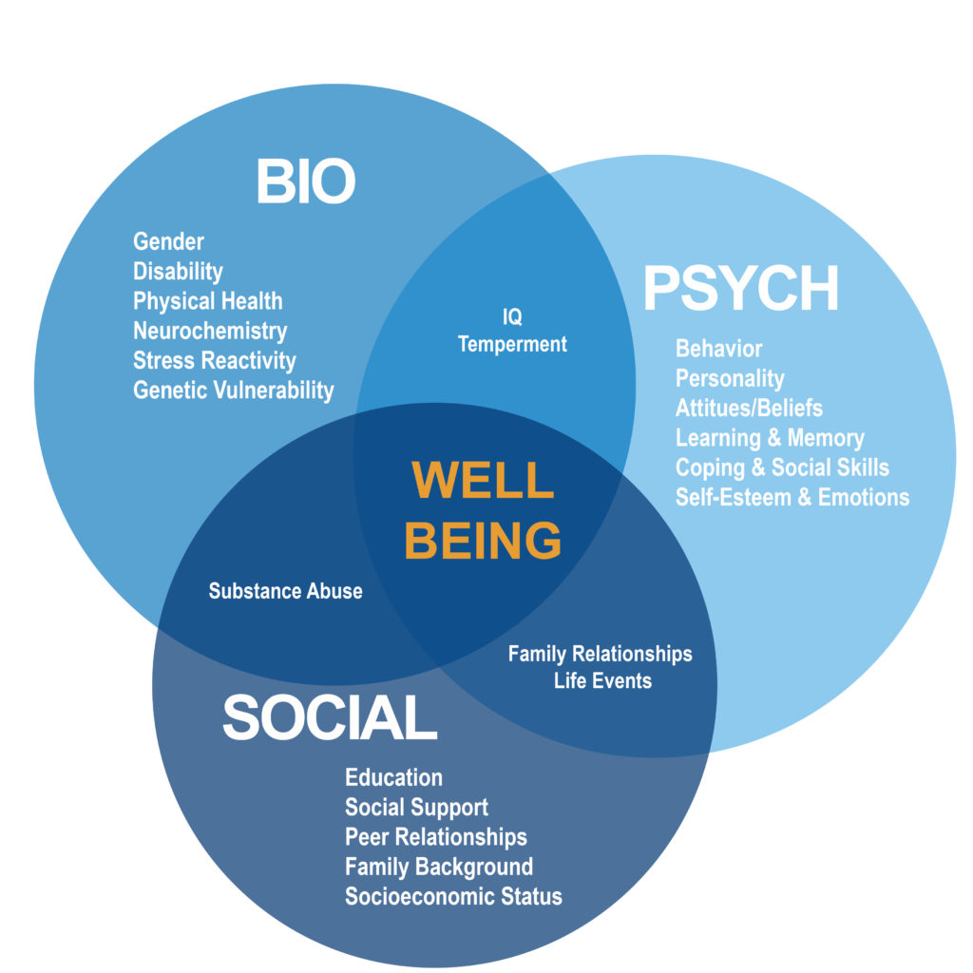
INTEGRATION OF HEALTH AND WELLBEING APPROACHES
❑Person centred integrated care coordinates
physical psychological and social services (NHS
England, 2025).
❑Biopsychosocial model links biological
psychological and social factors influencing health
outcomes (Rahman et al., 2024).
❑Social prescribing connects communities reducing
clinical burden and improving wellbeing (WHO,
2024).
❑Health in All Policies promotes equity sustainability
and cross sector collaboration (Lakioti et al., 2025).
(Sigma Nutrition, 2026)

Slide 5
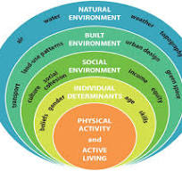
THEORETICAL PERSPECTIVES
❑Biopsychosocial model explains interaction of
biological psychological and social health factors
(Gautam et al., 2024).
❑Ecological model shows layered environmental
social and policy influences on health outcomes
(Ugwu et al., 2025).
❑Models support SDGs through multisectoral action
reducing inequalities and improving wellbeing
(Marmot 2020).
❑Implementation challenges include workforce
shortages resource limits and coordination across
agencies (UNDP, 2025).
(Prasad and Rao, 2022)

Slide 6
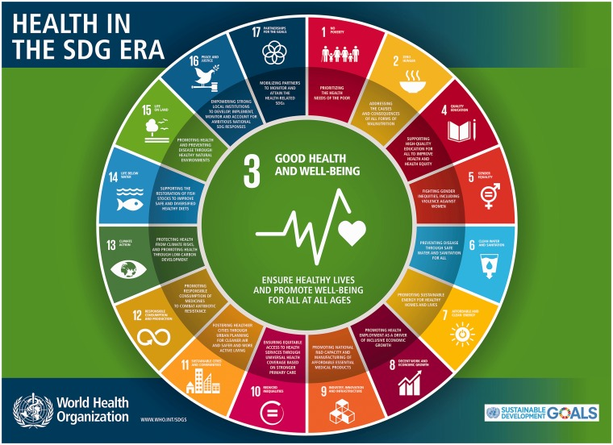
SUSTAINABLE DEVELOPMENT GOALS AND FRAMEWORK
❑United Nations SDGs address health inequalities
through prevention and equity systems globally
(UN, 2025).
❑SDG 3 targets universal health coverage reduced
mortality and improved prevention outcomes
(WHO, 2024).
❑Health in All Policies integrates cross sector
action improving equity and sustainability (Health
Policy Watch, 2025).
❑NHS Long Term Plan prioritises prevention digital
transformation and early intervention care (NHS
England, 2025).
(Brizuela and Tunçalp, 2017)

Slide 7

POLICY AND GOVERNANCE
❑NHS Long Term Plan WHO frameworks and
policies support integrated health delivery
(Bellert et al., 2025).
❑Policies promote preventive mental health
digital and community based healthcare
services (The King's Fund, 2025).
❑Integrated Care Systems improve coordination
efficiency continuity and service delivery (The
King's Fund, 2025).
❑Funding shortages workforce gaps and policy
fragmentation reduce healthcare effectiveness
(Viziteu, 2024).
(NHS Foundation Trust , 2025)

Slide 8
SERVICE DELIVERY
❑Integrated wellness telehealth and community
programmes improve care accessibility continuity
(Circular Ecology, 2025).
❑NHS virtual wards expanded capacity to fifty
thousand beds reducing admissions (NHS England
2025).
❑Telehealth during COVID 19 improved access and
maintained service continuity (UNDP, 2025).
❑Social prescribing referrals reduce secondary care
demand and improve prevention outcomes (Lakioti
et al., 2025).

Slide 9
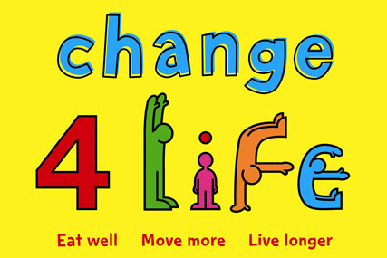
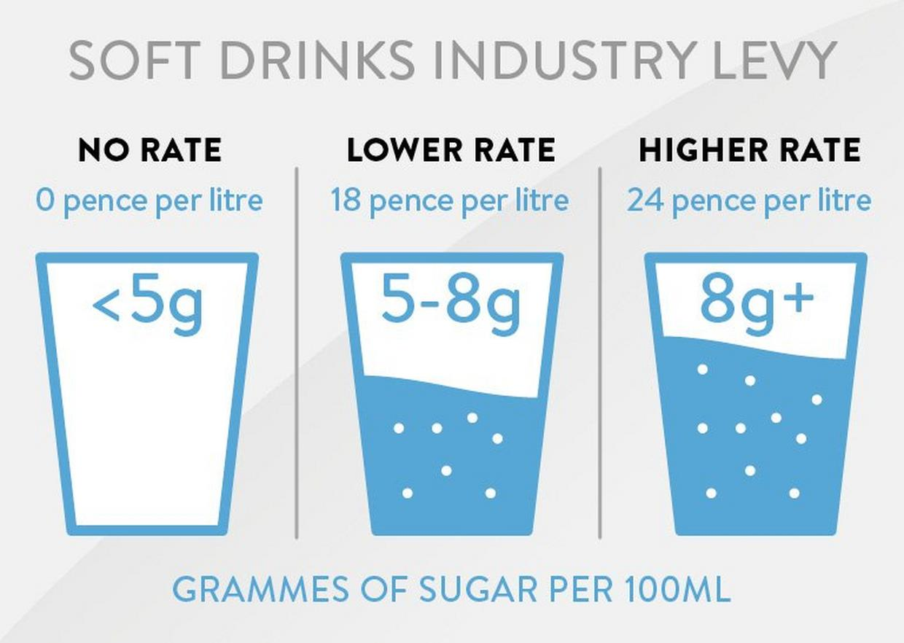
PUBLIC HEALTH INITIATIVES
❑UK public health strategy promotes healthy
lifestyles environments and prevention focus
(Skills for Health, 2025).
❑Change4Life campaign supports dietary
improvement and reduces childhood obesity
behaviours (Public Health England, 2026).
❑Soft Drinks Industry Levy reduced sugar content
by twenty nine percent nationally (UK
Government, 2025).
❑Smoking ban policies improved cardiovascular
and respiratory health outcomes population wide
(OECD, 2026).
(Campaign, 2025)
(Brakes ,2023 )

Slide 10
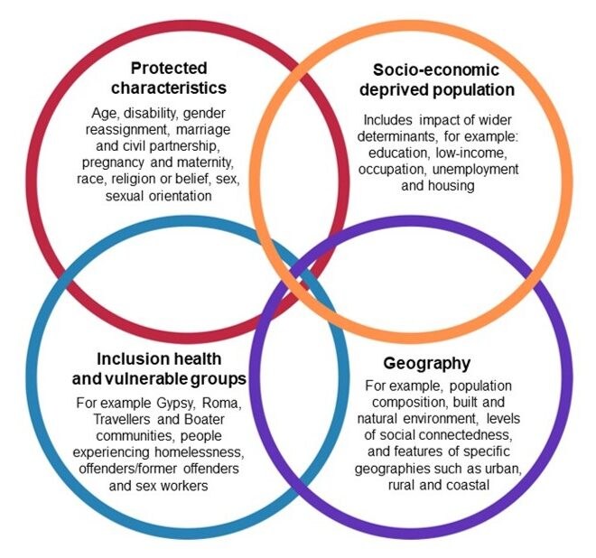
EQUITY AND ACCESS
❑Health inequalities vary across socioeconomic
ethnicity geographic and digital exclusion factors
(WHO, 2024).
❑Life expectancy gap reaches nineteen years
between deprived and affluent UK areas (Bellert
et al., 2025).
❑Universal health coverage and outreach
programmes improve equitable access and
engagement (The King's Fund, 2025).
❑Social determinants including housing income
and education strongly shape health outcomes
(UNDP, 2025).
(ACCM UK, 2024)

Slide 11

CONCLUSION
❑Integration of health, wellbeing, and sustainable
development builds equitable and resilient care
systems.
❑Theoretical models, SDGs, and policy frameworks
support holistic and preventive care delivery
structures.
❑Reducing inequalities, strengthening integration,
and focusing on prevention improves healthcare
sustainability outcomes.
❑Coordinated and inclusive systems enhance
outcomes, sustainability, and quality of life for
diverse populations.
(Make-A-Wish, 2026)

Slide 12
REFERENCES
❑ ACCM UK (2024). Reaching Communities and Tackling Health Inequalities» ACCM (UK). [online] ACCM (UK). Available at: https://accmuk.com/reaching-communities-and-tackling-health-inequalities/ [Accessed 4 Jun. 2026].
❑ Bellert, A., Bonyhady, B., Cleveland, B., Cohn, E., Eadie, T., Harrison, M., ... and Tesar, M. (2025). Submission to the House Standing Committee on Health, Aged Care and Disability inquiry into the Thriving Kids initiative: Joint submission by the University of Melbourne.
❑ Brakes (2023). Soft Drink Industry Levy | Brakes Foodservice. [online] www.brake.co.uk. Available at: https://www.brake.co.uk/news/industry/soft-drink-industry-levy [Accessed 4 Jun. 2026].
❑ Brizuela, V., and Tunçalp, Ö. (2017). Global initiatives in maternal and newborn health. Obstetric medicine, 10(1), 21-25.
❑ Campaign (2025). Government reveals Change4Life cutbacks. [online] Campaignlive.co.uk. Available at: https://www.campaignlive.co.uk/article/government-reveals-change4life-cutbacks/1014833 [Accessed 4 Jun. 2026].
❑ Circular Ecology (2025). Sustainability and Sustainable Development. [online] Circular Ecology. Available at: https://circularecology.com/sustainability-and-sustainable-development.html [Accessed 4 Jun. 2026].
❑ Daily Mirror (2025). Achieving inclusive health in Sri Lanka through SDGs. [online] Dailymirror.lk. Available at: https://www.dailymirror.lk/print/columns/Achieving-inclusive-health-in-Sri-Lanka-through-SDGs/235-120590 [Accessed 4 Jun. 2026].
❑ Gautam, S., Jain, A., Chaudhary, J., Gautam, M., Gaur, M., and Grover, S. (2024). Concept of mental health and mental well-being, it's determinants and coping strategies. Indian journal of psychiatry, 66(Suppl 2), S231-S244.
❑ Health Policy Watch (2025). Addressing Health As A Shared Responsibility Across Government Can Reduce Spending - Health Policy Watch. [online] Health Policy Watch. Available at: https://healthpolicy-watch.news/addressing-health-as-a-shared-responsibility-across-government-can-reduce-spending/ [Accessed 4 Jun. 2026].
❑ Lakioti, E., Pagonis, N., Flegkas, D., Itziou, A., Moustakas, K., and Karayannis, V. (2025). Social factors and policies promoting good health and well-being as a sustainable development goal: current achievements and future pathways. Sustainability, 17(11), 5063.
❑ Make-A-Wish (2026). Good Health and Well-Being. [online] Available at: https://worldwish.org/about-us/sustainability/good-health-and-well-being/ [Accessed 4 Jun. 2026].
❑ NHS England (2025). NHS England» Provision of person-centred holistic care delivered by neighbourhood multidisciplinary teams (high intensity use focused). [online] England.nhs.uk. Available at: https://www.england.nhs.uk/long-read/provision-of-person-centred-holistic-care-delivered-by-neighbourhood-multidisciplinary-teams-high-intensity-use-focused/ [Accessed 4 Jun. 2026].
❑ NHS Foundation Trust (2025). NHS Long Term Workforce Plan published. [online] Harrogate and District NHS Foundation Trust. Available at: https://www.hdft.nhs.uk/news/nhs-long-term-workforce-plan-published/ [Accessed 4 Jun. 2026].
❑ OECD (2026). Health expenditure on prevention and primary healthcare: Health at a Glance 2025. [online] OECD. Available at: https://www.oecd.org/en/publications/health-at-a-glance-2025_8f9e3f98-en/full-report/health-expenditure-on-prevention-and-primary-healthcare_e65bf24a.html [Accessed 4 Jun. 2026].
❑ Prasad, R., and Rao, B. C. (2022). Embracing our Larger Role: Family Physicians as Catalysts of Social and Planetary Well-Being: R. Prasad, BC Rao. Journal of the Indian Institute of Science, 102(2), 831-839.
❑ Public Health England (2026). New Change4Life Campaign Encourages Parents to ‘Be Food Smart’. [online] gov.uk. Available at: https://www.gov.uk/government/news/new-change4life-campaign-encourages-parents-to-be-food-smart [Accessed 4 Jun. 2026].
❑ Queensland Government (2023). Health and wellbeing. [online] Education. Available at: https://education.qld.gov.au/initiatives-and-strategies/health-and-wellbeing/workplaces/health-wellbeing [Accessed 4 Jun. 2026].
❑ Rahman, R., Reid, C., Zwiggelaar, R., and Thomas, A. (2024). Informing adoption of a social model of health and wellbeing: A systematic review of literature.
❑ Sigma Nutrition. (2026). A Better Paradigm for Health Professionals: The Biopsychosocial Renaissance. [online] Available at: https://sigmanutrition.com/biopsychosocial/ [Accessed 4 Jun. 2026].
❑ Skills for Health (2025). Person Centred Care Meaning & Implications. [online] Skills for Health. Available at: https://www.skillsforhealth.org.uk/article/person-centred-care-meaning-implications/ [Accessed 4 Jun. 2026].
❑ The Kings Fund (2025). Improving Clinical Coordination Of Multiple Long-Term Conditions | The King’s Fund. [online] The King’s Fund. Available at: https://www.kingsfund.org.uk/insight-and-analysis/long-reads/improving-clinical-coordination-multiple-long-term-conditions [Accessed 4 Jun. 2026].
❑ Ugwu, C. N., Ugwu, O. P. C., Alum, E. U., Eze, V. H. U., Basajja, M., Ugwu, J. N., ... and Uti, D. E. (2025). Sustainable development goals (SDGs) and resilient healthcare systems: Addressing medicine and public health challenges in conflict zones. Medicine, 104(7), e41535.
❑ UK Government (2025). Strengthening the Soft Drinks Industry Levy consultation. [online] GOV.UK. Available at: https://www.gov.uk/government/consultations/strengthening-the-soft-drinks-industry-levy/strengthening-the-soft-drinks-industry-levy-consultation [Accessed 4 Jun. 2026].
❑ UN (2025). Goal 3: Ensure healthy lives and promote well-being for all at all ages. [online] United Nations. Available at: https://sdgs.un.org/goals/goal3 [Accessed 4 Jun. 2026].
❑ UNDP (2025). Sustainable development goals. [online] United Nations Development Programme. Available at: https://www.undp.org/sustainable-development-goals [Accessed 4 Jun. 2026].
❑ Viziteu, P. (2024). What Is the Impact of Health Definition? A conceptual framework for Health and Health Status. In European Financial Resilience and Regulation 25 Years United under Euro-Proceedings of the International Conference EUFIRE-RE 2024 (pp. 412-417). Editura Universităţii» Alexandru Ioan Cuza «din Iaşi.
❑ WHO (2024). Promoting Health in All Policies and intersectoral action capacities. [online] world health organization. Available at: https://www.who.int/activities/promoting-health-in-all-policies-and-intersectoral-action-capacities [Accessed 4 Jun. 2026].

