Slide 1
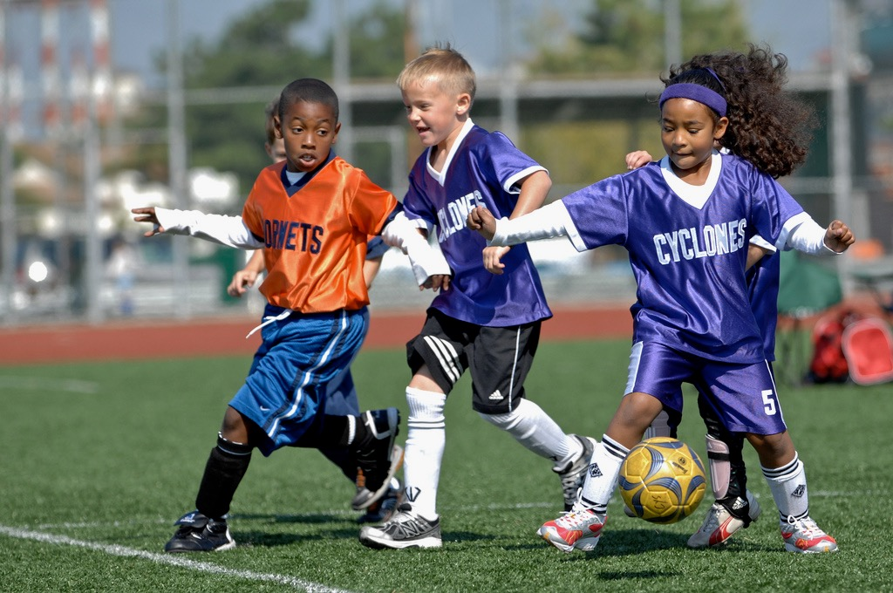
Motivation:
A Self Determination Approach
Image: USAG- Humphreys
Notes:
Motivation is involved in all aspects of our lives – work, exercise, development, etc

Slide 2
Climate Created by Coach
Motivation
Outcomes

Slide 3
Climate Created by Coach
?
Motivation
Outcomes

Slide 4
Plan
What is Motivation
Intrinsic Motivation
  Cognitive Evaluation Theory
Extrinsic Motivation
  Organismic Integration Theory
Basic Psychological Needs
  Need support/thwarting
The Coaching Climate (Practical Application)

Slide 5
WHAT IS MOTIVATION?
Notes:
Motivation is a term we use a lot...as coaches, referring to athletes/participants (e.g., So and so is really motivated).
The concept of motivation is not always well understood. It is more complicated concept than first meets the eye.
Whole group interaction - Ask the students what they think the term motivation means.
Motivation is what causes us to act or not act. Drive to strive, the why of our behaviour. Why do we participate in sport? Motivation is reflected in how athletes’ behave, how they think, how they feel about sport.

Slide 6
WHAT IS MOTIVATION?
The word ‘motivate’ means ‘to move’
The “why” of participation
Reflected in how participants behave, think and feel about participation in sport/activities
Notes:
Motivation is a term we use a lot...as coaches, referring to athletes/participants (e.g., So and so is really motivated).
The concept of motivation is not always well understood. It is more complicated concept than first meets the eye.
Whole group interaction - Ask the students what they think the term motivation means.
Motivation is what causes us to act or not act. Drive to strive, the why of our behaviour. Why do we participate in sport? Motivation is reflected in how athletes’ behave, how they think, how they feel about sport.

Slide 7
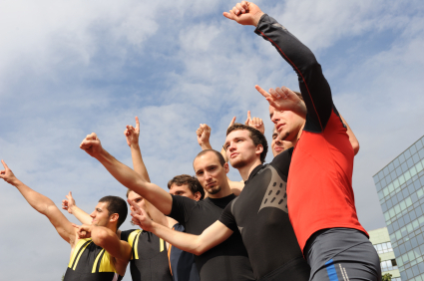

QUANTITY OF MOTIVATION
HIGH
LOW
Notes:
Quantity is often the component of motivation we typically refer to/capture when we use this word. We might describe a pupil being high or low in motivation, based on what we see in recent classes.
(Give example of high motivation and low motivation)…e.g., little Paul has been performing well recently, and is trying hard is all his lessons. He’s into the activities, being active in class - therefore we might consider him highly motivated.
But what we ‘see’ at any moment in time might not tell the whole story. Just because we can see that the pupil has high motivation right now, we do not know whether this highly motivated child is motivated because he is enjoying PE. What we see right now in terms of performance does not tell us whether the pupil is developing a life long interest in sport/physical activity. When all we can see is how much motivation there is, we do not know how the pupil thinks and feels about PE and what effect the experience of PE is having on the young pupil in question. In other words, knowing “how much” motivation one has does not tell us anything about why that pupil is motivated.
Returning to our example - Little Paul is performing well and engaged in all the activities……....not because he enjoys it but because he feels anxious about letting his parents down OR because the only thing that matters to him is winning, being the star pupil, etc . So, he does have high motivation but perhaps we would not consider this to be good “quality motivation”.
Just because someone (like little Paul) has quantity (a lot) of motivation, this doesn’t mean they have quality of motivation.

Slide 8
QUANTITY OF MOTIVATION
HIGH
AT THE MOMENT, DOES THE PLAYER…
PERFORM OK or NOT?
SEEM “INTO IT” or NOT?
LOW
Notes:
Quantity is often the component of motivation we typically refer to/capture when we use this word. We might describe a pupil being high or low in motivation, based on what we see in recent classes.
(Give example of high motivation and low motivation)…e.g., little Paul has been performing well recently, and is trying hard is all his lessons. He’s into the activities, being active in class - therefore we might consider him highly motivated.
But what we ‘see’ at any moment in time might not tell the whole story. Just because we can see that the pupil has high motivation right now, we do not know whether this highly motivated child is motivated because he is enjoying PE. What we see right now in terms of performance does not tell us whether the pupil is developing a life long interest in sport/physical activity. When all we can see is how much motivation there is, we do not know how the pupil thinks and feels about PE and what effect the experience of PE is having on the young pupil in question. In other words, knowing “how much” motivation one has does not tell us anything about why that pupil is motivated.
Returning to our example - Little Paul is performing well and engaged in all the activities……....not because he enjoys it but because he feels anxious about letting his parents down OR because the only thing that matters to him is winning, being the star pupil, etc . So, he does have high motivation but perhaps we would not consider this to be good “quality motivation”.
Just because someone (like little Paul) has quantity (a lot) of motivation, this doesn’t mean they have quality of motivation.

Slide 9

QUANTITY OF MOTIVATION
PERFORMING OK?
SEEMS “INTO IT”?
Notes:
In other words, when we can see that a athlete is performing OK and seems to be ‘into it’, we may only be seeing the tip of the iceberg.

Slide 10
Seeing that a participant has high motivation right now only shows us the tip of the iceberg…
… we do not know why the participant is motivated
QUANTITY OF MOTIVATION
PERFORMING OK?
SEEMS “INTO IT”?
Notes:
In other words, when we can see that a athlete is performing OK and seems to be ‘into it’, we may only be seeing the tip of the iceberg.

Slide 11
PERFORMING OK?
SEEMS “INTO IT”?
QUANTITY
Q U A N T I T Y
Is how much
motivation a participant has
Q U A L I T Y
Notes:
Like the part of an iceberg that is visible above the water, considering quantity (how much) motivation an athlete has gives only a small glimpse of the whole picture. There is a lot we cannot see…
When we think about the quality of an athletes’ motivation we are thinking about differences in why he/she tries hard or not. Does little Paul “play” because he wants to/enjoys his sport? OR....Does he do his sport because he would feel guilty if he didn’t/feels he must? We can still see that little Paul seems to be highly motivated, but as a coach, this does not seem like the quality of motivation I would like for my athletes…. Perhaps the same for you? Differences in the quality of each athletes’ motivation are associated with other important differences between athletes.... And these things we may not be able to see.

Slide 12
PERFORMING OK?
SEEMS “INTO IT”?
QUANTITY
Q U A N T I T Y
Is how much
motivation a participant has
QUALITY
Is the reasons why the participant is motivated
Q U A L I T Y
Notes:
Like the part of an iceberg that is visible above the water, considering quantity (how much) motivation an athlete has gives only a small glimpse of the whole picture. There is a lot we cannot see…
When we think about the quality of an athletes’ motivation we are thinking about differences in why he/she tries hard or not. Does little Paul “play” because he wants to/enjoys his sport? OR....Does he do his sport because he would feel guilty if he didn’t/feels he must? We can still see that little Paul seems to be highly motivated, but as a coach, this does not seem like the quality of motivation I would like for my athletes…. Perhaps the same for you? Differences in the quality of each athletes’ motivation are associated with other important differences between athletes.... And these things we may not be able to see

Slide 13
Intrinsic Motivation
Participating in an activity for its inherent satisfaction (Ryan & Deci, 2000)
  Interest
  Spontaneous Enjoyment
  Occurs in the absence of reward
  Curiosity
  Challenging?
  Couched with innate Psychological Needs
Notes:
Is there anything we can do as coaches to make athletes more intrinsically motivated?
Does anything we do make them less intrinsically motivated.

Slide 14
Using Rewards
Intrinsic Motivation & Extrinsic Rewards
    Pre-school children (Lepper et al., 1973)
      Free play with coloured pens
      Randomly assigned to:
        Expected reward condition
        Unexpected reward condition
        No reward condition
    By rewarding people for participating in an intrinsically interesting task, subsequent involvement in the task is reduced when the reward is no longer available (Biddle, Mutrie and Gorley, 2015)
Notes:
Children given opportunity to freely play. Those who seemed most engaged were selected then split into three groups. Groups were taken out and either told there was a reward for how well/much they played, received a reward afterwards without expecting it, or were not told about rewards at all, just left to play.
Returned on a different day and just observed to see how they played. No reward played most, expected reward played least.
Think about when you should reward (e.g.

Slide 15
Cognitive Evaluation Theory
Deci (1975), Deci & Ryan (1980; 1985)
How various external events (and later internal events; Ryan, 1982) enhance or diminish intrinsic motivation
Rewards, feedback, evaluations, and ways of communicating
Intrinsic Motivation (interest, enjoyment, free persistence)

Slide 16
Cognitive Evaluation Theory
Informational
  Increase intrinsic motivation
Controlling
  Decrease intrinsic motivation
Notes:
Good – you did this well…

Slide 17
Extrinsic Motivation
Organismic Integration Theory (Deci & Ryan, 1985)
Notes:
Another of the mini-theories of SDT

Slide 18
Extrinsic Motivation
External Regulation
Notes:
Motivated by external goals – money, fame, winning, etc – motivated by external factors.
Might be useful to get people started if they are amotivated, but without the external factor the motivation will disappear

Slide 19
Extrinsic Motivation
External Regulation
Introjected Regulation
Notes:
Motivated by feelings of guilt/self esteem etc – motivated to move away from bad feelings

Slide 20
Extrinsic Motivation
External Regulation
Introjected Regulation
Identified Regulation
Notes:
We identify with the benefits of certain behaviours – moving towards a pleasureable feeling, as opposed to moving away from negative feelings. More positive than the previous, but still extrinsic

Slide 21
Extrinsic Motivation
External Regulation
Introjected Regulation
Identified Regulation
Integrated Regulation
Notes:
Align behaviours with our identity – I climb because I am a climber, I keep fit because I identify as a fit person,

Slide 22
Extrinsic Motivation
External Regulation
Introjected Regulation
Identified Regulation
Integrated Regulation
Controlled Motivation
Notes:
Controlling, externally regulated on right – more autonomous motivation on right.,

Slide 23
Extrinsic Motivation
External Regulation
Introjected Regulation
Identified Regulation
Integrated Regulation
Controlled Motivation
AutonomousMotivation
Notes:
Controlling, externally regulated on right – more autonomous motivation on right.,

Slide 24
Extrinsic Motivation
External Regulation
Introjected Regulation
Identified Regulation
Integrated Regulation
Self Determination
Controlled Motivation
AutonomousMotivation
Notes:
Moving towards a more Self-Determined form of motivation, rather than external

Slide 25
Extrinsic Motivation
External Regulation
Introjected Regulation
Identified Regulation
Integrated Regulation
Self Determination
Controlled Motivation
AutonomousMotivation
Internalisation
Organismic Integration Theory (Deci & Ryan, 1985; Ryan & Deci, 2000)
Notes:
The process of moving across the spectrum from right to left is termed internalistion

Slide 26
Extrinsic Motivation
External Regulation
Introjected Regulation
Identified Regulation
Integrated Regulation
Intrinsic Motivation
Amotivation
Self Determination
Controlled Motivation
AutonomousMotivation
Notes:
Aim is to try to move people down this continuum from amotivation, all the way to Intrinsic Motivation

Slide 27
Climate Created by Coach
?
Motivation
Outcomes
Controlled Motivation
Autonomous Motivation
Notes:
So to return to our initial model.
What can we do at the ? To try to move them down the spectrum from Controlled to Autonomous

Slide 28
Climate Created by Coach
Psychological Needs (Autonomy, Competence, Relatedness)
Motivation
Outcomes
Controlled Motivation
Autonomous Motivation
Notes:
This is where the basic psychological needs model comes in.

Slide 29
Basic Psychological Needs Theory
Autonomy
Relatedness
Competence
Notes:
Innate needs – regardless of background, gender, ethnicity etc, we all have these innate needs.

Slide 30
Autonomy
The need to experience activities as self-endorsed and choicefully enacted
Notes:
If our behviour is controlled by someone else, this thwarts our autonomy
What can we do to get our athletes to self-endorse their behaviours in our sessions?
Choices…

Slide 31
Relatedness
The need to feel close, connected, and cared for with important others
Notes:
Valued as individuals – by the coach, by fellow athletes,
What can you do to encourage the development of relatedness –
- MTB – chain gang speed dating
- peer coaching - reciprocal
- working in pairs/groups

Slide 32
Competence
The need to interact effectively within an environment
How do we know if we are competent?
  How to judge success?
Notes:
Judging success – process goals, self-referenced goals – could we judge success on how much we have improved, rather than comparisons with others.
Differentiated tasks – coach sets the environment with regards to what is judged as competent

Slide 33
Climate Created by Coach
Psychological Needs (Autonomy, Competence, Relatedness)
Motivation
Outcomes
Controlled Motivation
Autonomous Motivation

Slide 34
Support need for
Autonomy,
Competence,
Relatedness
Climate Created by Coach
Motivation
Outcomes
Thwart need for
Autonomy,
Competence,
Relatedness
Notes:
Analogy to growing a plant made by researchers– light pathway supports growth (light, water, nutrients), no pathway – leave the plant to it’s own devices, dark pathway – actually hinders the growth of the plant.
Is what we are doing as a coach supporting or thwarting the development of our athletes??

Slide 35
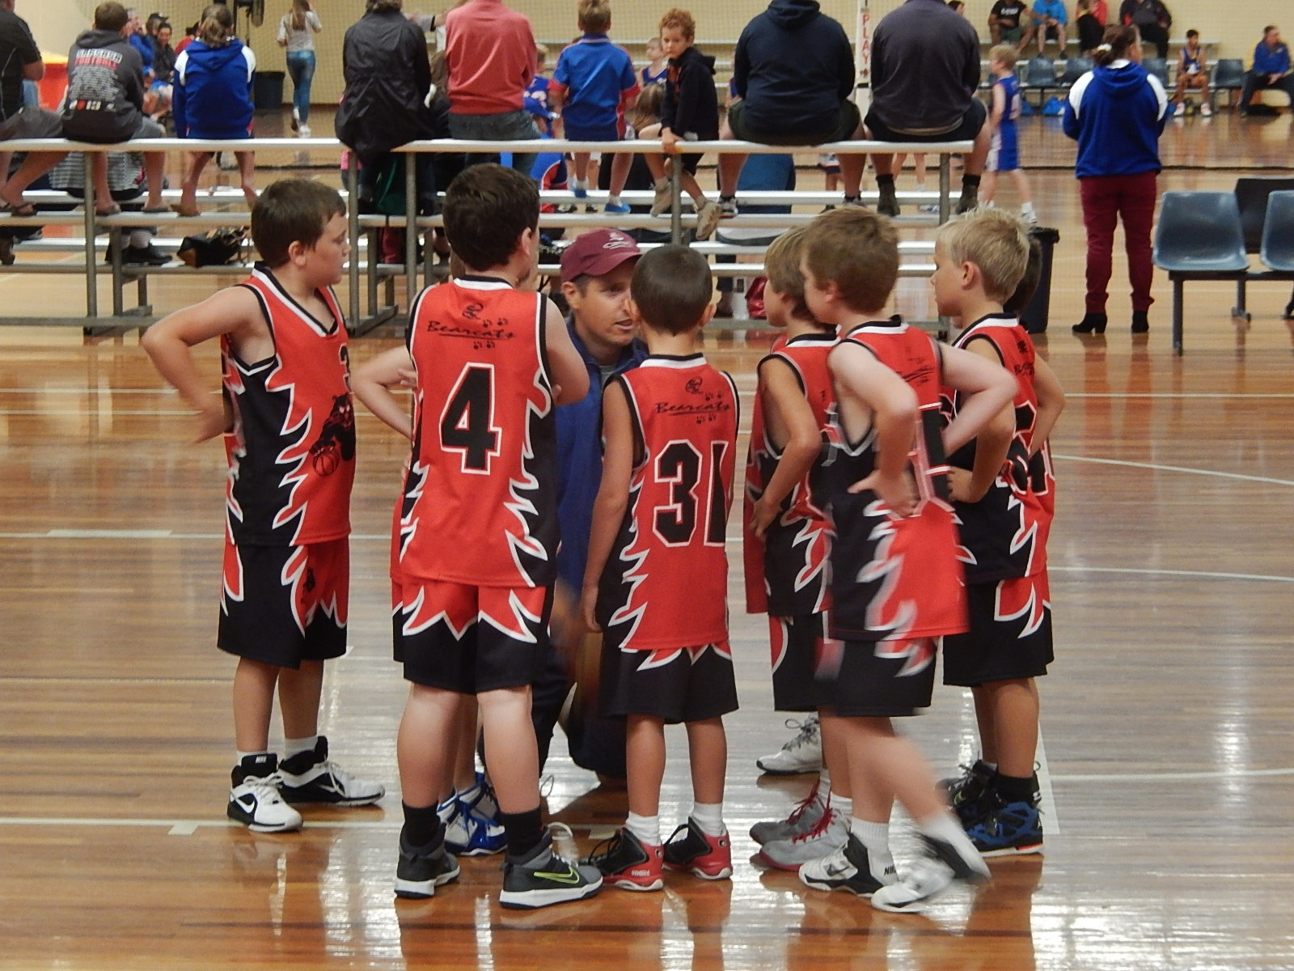
The Coaching Climate
Texas A&M University-Commerce Marketing Communications Photography (2010)
Notes:
What we do as a coach can create a climate that supports or thwarts motivation.

Slide 36
Coaching Behaviours
1. Selecting a player of the game
3. Providing positive feedback after good performances
4. Using the iPad to film performance in a training/practice session
2. Only selecting athletes that attend training
5. Using differentiated activities within training sessions
6. Fitness testing all athletes
8. Giving all players specific targets to improve on
7. Using a squad rotation system
9. Letting the participant decide what to do in practice
Notes:
Think of these strategies – are these creating an environment that supports or thwarts?

Slide 37
Autonomy Supportive Climate
Support need for
Autonomy,
Competence,
Relatedness
Motivation
Outcomes
Controlling Climate
Thwart need for
Autonomy,
Competence,
Relatedness

Slide 38
Coaching Climate
Autonomy Support v Controlling Climate
Autonomy Supportive Climate
TARGET (Ames, 1992; Epstein)
Task, Authority, Recognition, Grouping, Evaluation, Time
Notes:
Task – suitable level of challenge, authenticity of task, value of task
Autonomy – give students some choices
Recognition – use it appropriately – think about when it might de-motivate
Grouping - cooperative, competitive, and individualistic
Evaluation – affected by how they are grouped above
Time – allow different amounts of time for different athletes

Slide 39
How to Create a Need Supportive Climate
Competence
Feedback, structure, optimal challenge
Autonomy
Meaningful rationale, allow athlete input, shared decision making, choices
Relatedness
Group tasks, cooperative learning, praise good teamwork, coach involvement

Slide 40
References
Deci, E.L. and Ryan, R.M (2000) ‘The “What” and “Why” of Goal Pursuits: Human Needs and the Self-Determination of Behavior’, Psychological Inquiry, vol. 11, no. 4, pp. 227–268
Biddle, Mutrie and Gorley (2015) Psychology of Physical Activity: Determinants, Well-Being and Interventions, Third Edition, Oxon: Routledge
Ntoumanis, N. (2012) A Self-Determination Theory perspective on motivation in Sport and Physical Education: Current Trends and Posible Future Research Directions, In Roberts, G. C. and Treasure, D. C. ‘Advances in Motivation in Sport and Exercise’
www.selfdeterminationtheory.org
Standage, M. and Ryan, R. M. (2012) Self Determination Theory and Exercise Motivation: Facilitating Self-Regulatory Processes to Support and Maintain Health and Well-Being, In Roberts, G. C. and Treasure, D. C. ‘Advances in Motivation in Sport and Exercise’
Weinberg, R. S. and Gould, D. (2015) Foundations of Sport and Exercise Psychology, Sixth Edition, Champaign, IL: Human Kinetics

Slide 41
Image References
USAG- Humphreys
Available: https://www.flickr.com/photos/usaghumphreys/6206013520/in/photolist-asprB7-asmM8n-edBKHV-a6DN2Z-a6DRun-9VtAw1-asmpD4-a6Djrg-aspoYN-ebrqYH-asm29v-8YJEcv-asmscr-fCWeuQ-fT4dZe-asmDJZ-btapg1-ffyY3B-a6G8ty-asmMCa-dWEP1j-9VqLsa-4U26jT-ee94gu-LqjCG-ffP6oQ-asoYXb-ffz2E8-9Lg6Ln-kQqkWa-dZBMt9-on2mmw-bnhkry-8hV8q9-9vFCzp-bXMupE-Lqfg9-asmVBX-bXMWoA-nGeEva-paP1vJ-asmd9k-oVNq9W-aspksG-9LiTfU-84jdRK-bysoWB-9NnpbC-omWVHP-dmjdmE
Texas A&M University-Commerce Marketing Communications Photography
Available: https://www.flickr.com/photos/tamuc/15503799676/in/photolist-pC22uY-bi3fbi-a7kvnN-cFedZ7-5BD37T-2ZT4As-9xMiSC-aspxjh-pDMDbi-9Tq1FT-89DGRL-fLCsHv-evLZ9L-bUMhWx-bUMhnz-bV42ap-cc9wtd-bV42pH-bV42ji-bV3WRP-bUMhYR-ccqgkC-cc9rHW-bV42gr-bV41y8-bV42fv-cc9s5N-bV42u4-bV3WCM-bUMi3M-ccmxJf-ccmyYC-bUZk5V-ccmzxw-bUZhN4-bUZjjK-bUZk1Z-5pi3NL-hraik9-8WNx8M-cc9vum-cc9sXS-bV3Ybv-cc9xhy-7G4hXK-awztW9-5BHufC-bnEbLb-bUMh5P-cc9rYS

