Slide 1
Software Design

Slide 2
Objectives
List the three levels of software design
Articulate the process undertaken in each of the above
Outline use cases with descriptions
Outline use cases with diagrams

Slide 3
Design Abstraction
Architectural Design – Overall system design (Conceptual)
High-Level Design – Sub-system design
Detailed Design – function level design

Slide 4
Architectural Design
The design of the system as a whole
Follows directly on from requirements analysis
Is the highest level of design in the process
Identification of the system as a whole and who does what

Slide 5
High-Level Design
Modular elements of the system considered
The way in which these modular elements interact with one another
The passing of data between each of the modules must be considered
The interfaces between the overall system and the modules must be considered

Slide 6
Detailed Design
Module responsibilities identified and formally specified
Any constraints on module and its interaction specified
Internal data components specified

Slide 7
Over Specification
Should not include specific reference to one programming language
  Links to one language and one architecture specifically, language may not be available to the desired architecture
Use of only natural language should also be provided
  Possible elements of ambiguity introduced
Solutions to such flaws:
  Diagrams
  UML

Slide 8
Design and UML
Unified Modelling Language
Utilised for system design (and many other uses)
Can span architectural to detailed

Slide 9
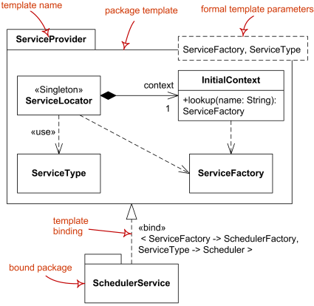
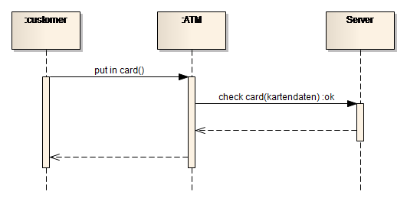
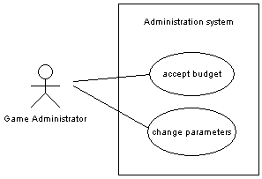
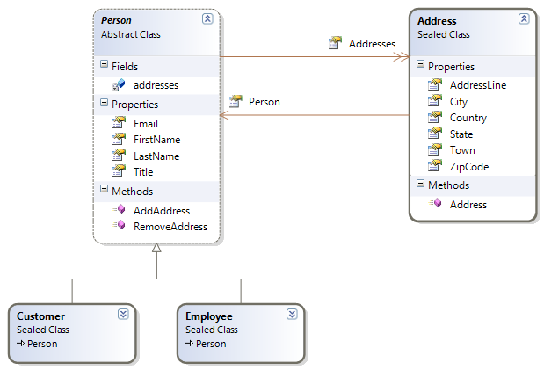
UML diagram Examples
Use-Case
Sequence Diagram
Package Diagram
Class Diagram

Slide 10
Structural Diagrams
Class Diagram
Object Diagram
Component Diagram
Deployment Diagram

Slide 11
Behavioural Diagrams
Use Case Diagram
Sequence Diagram
Collaboration Diagram
Statechart Diagram
Activity Diagram

Slide 12
Use Cases
system from user’s standpoint
relationship between system and environment
actor represents user or other system e.g. external hardware
observable result, value to user

Slide 13
Use Cases
sequence of actions carried out by system with an observable outcome
scenarios within use case
labels
  active verb and noun
  noun phrase
actor
  role performed
  many physical entities

Slide 14
Use Cases
use case 1
Actor 1
use case 2
Actor 2

Slide 15
Use Cases
textual description, use case description
  describe sequence of activities
  activity of actor, response of system
associations
  generalisation, use cases and actors
    shared actions
    unfilled arrow head
    abstract use case, italicised

Slide 16
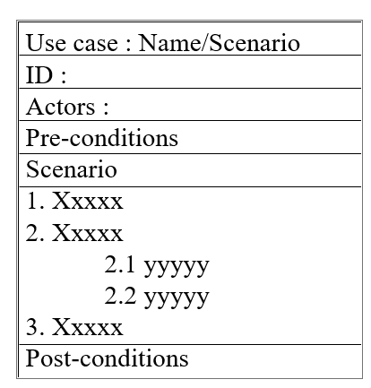
Use Case Description

Slide 17
Use Cases
relationships
  include
    functionality of one included in another use case
    dashed line, open arrow, guillemets <<...>>
  extend
    optional inclusion

Slide 18
On-line book store
Submit order
DatabaseSystem
Check stock
Credit controller
Update customer records
customer
Check credit
<<includes>>
data entry clerk
Check/update order status
supervisor
Monitor transaction

