Slide 1
Child Exploitation
By Adam, Rachael, Ruth, Toby.

Slide 2
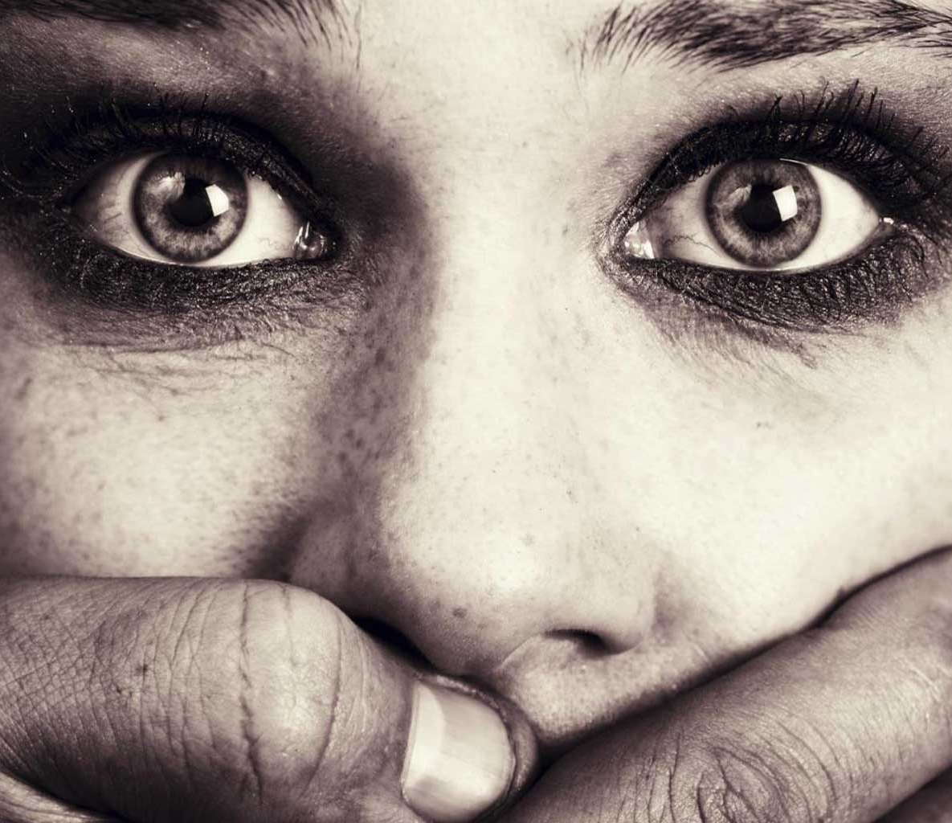
Hello and Welcome to our Presentation Where we will be.....
Presenting an advisory leaflet for parents and guardians, specifically focusing on issue that young people maybe facing in contemporary society.
We will be discussing child exploitation, giving examples, signs of exploitation and abuse, what to do, and where to go for help.
Also, we will demonstrate how youth workers can best support at risk young people.

Slide 3
Who are we?
Ruth James – Today I will be covering child exploitation and what it is and county lines further along the presentation. I am currently on placement at The Wallich in Llanelli which is a young person's homeless accommodation project.
Adam Kaps – Student Youth Worker on placement with Barnardos Better Futures Cymru, a servicer for young people with sexualised histories (including victims of CSE and those who may display Harmful Sexual Behaviour) and had an input into the review of the Welsh Statutory Guidance tackling for Child Sexual Exploitation. For more information on Adam look at www.adamrichardkaps.co.uk
Toby
Rachel

Slide 4

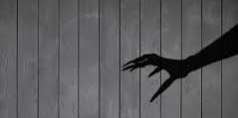
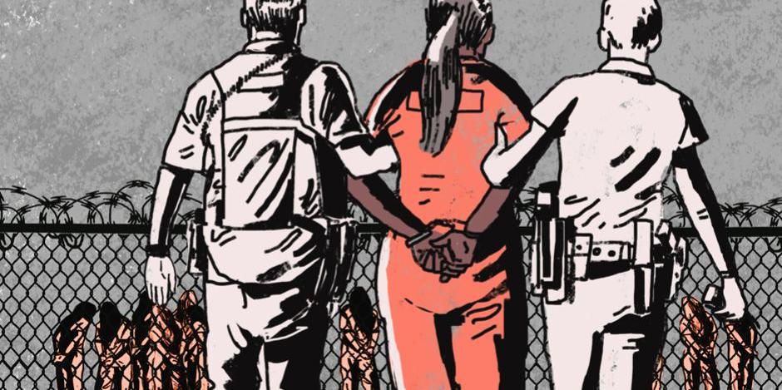

Child Exploitation.
It is a type of abuse faced by a child or young person.
It can happen at any age.
Regardless of sexual orientation, gender, background, race, or family situation anyone can be targeted.
Similarly, the same applies for perpetrators, they can also come from a variety of backgrounds, but will typically target those who are easily influenced or vulnerable (NSPCC, No date).
Child exploitation has been around for many years and comes in many forms.
CHILDREN CAN BE PERPERTRATORS AS WELL AS VICTIMS.
(Dyfed Powys Police. 2022)

Slide 5


Some Common Types of Child Exploitation.
Modern Slavery.
Child Criminal Exploitation (CCE). County Lines
Child Sexual Exploitation (CSE).
Child Exploitation Through a digital Context
Notes:
Add – For the purpose of this seminar I will firstly discuss Child criminal exploitation.

Slide 6
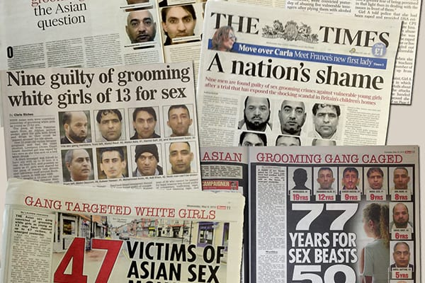
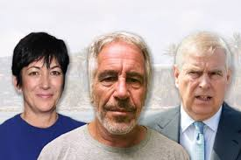
Examples of Historical
Child Exploitation
The Rotherham child sexual
exploitation cases.
Jeffrey Epstein
Ghislaine Maxwell
Prince Andrew scandal.
(Socialist Worker. 2020)
(Rolling Stones. 2021)

Slide 7
Child Criminal Exploitation
What is it?
According to the Welsh Government, child criminal exploitation is:
'Is a form of child abuse which involves criminal exploitation and requires a safeguarding response
Involves a child
Involves enticement and/or force'
(Welsh Government, No Date).
Also, the Logal Government Association defines it as:
'CCE activity can include children being forced to work in cannabis factories, being coerced into moving drugs or money across the country, forced to shoplift or pickpocket, or to threaten other young people'.
(Local Government Association. 2021)

Slide 8
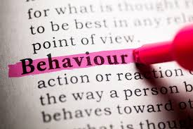



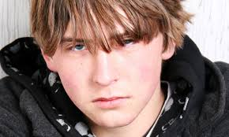
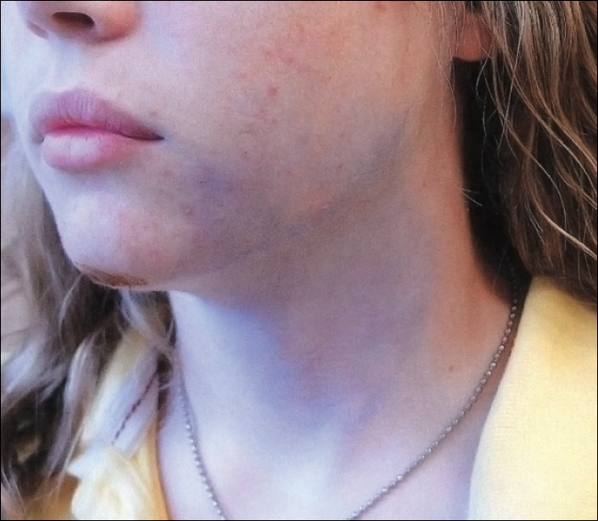
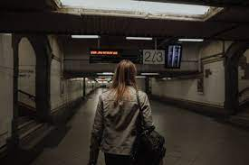

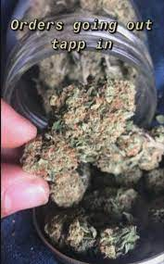
SIGNS YOUR CHILD IS BEING EXPLOITED

Slide 9
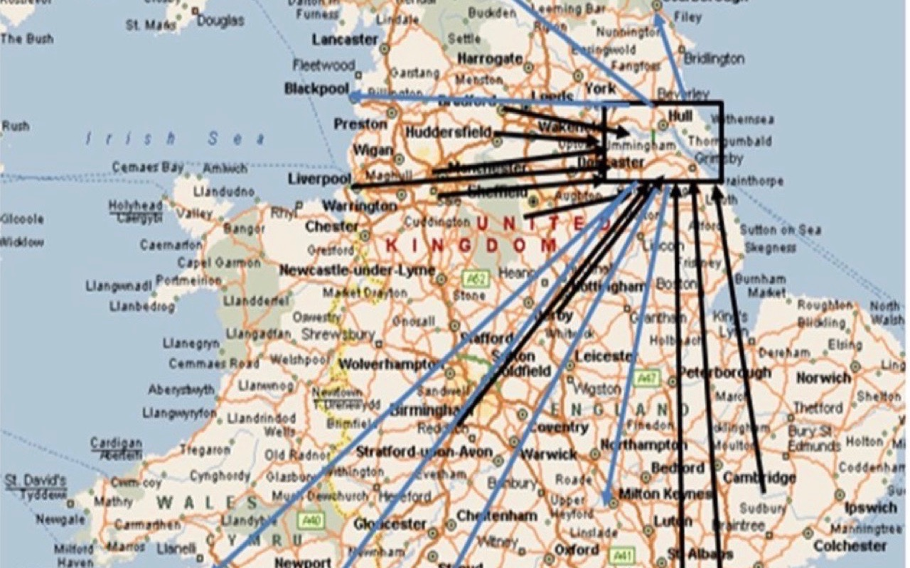
County Lines
NPCC definition of a County Line
The 2018 Home Office Serious Crime Strategy states the NPCC definition of a County Line is a term used to describe gangs and organised criminal networks involved in exporting illegal drugs into one or more importing areas [within the UK], using dedicated mobile phone lines or other form of “deal line”. They are likely to exploit children and vulnerable adults to move [and store] the drugs and money and they will often use coercion, intimidation, violence (including sexual violence) and weapons.
(National Crime Agency. No Date)
(Turner. 2019)

Slide 10
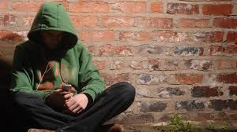
Why Young People ?
An article in Youth and Policy states that:
The young people who deliver the drugs are typically aged between 12 and 17. These youngsters are often known to Children’s Services and Youth Offending Teams (…) The gangs use children and younger adolescents because they are easier to control and, being young and having few, or no, previous convictions, they are less likely to be known to the police.
(Andell and Pitts. No Date).

Slide 11
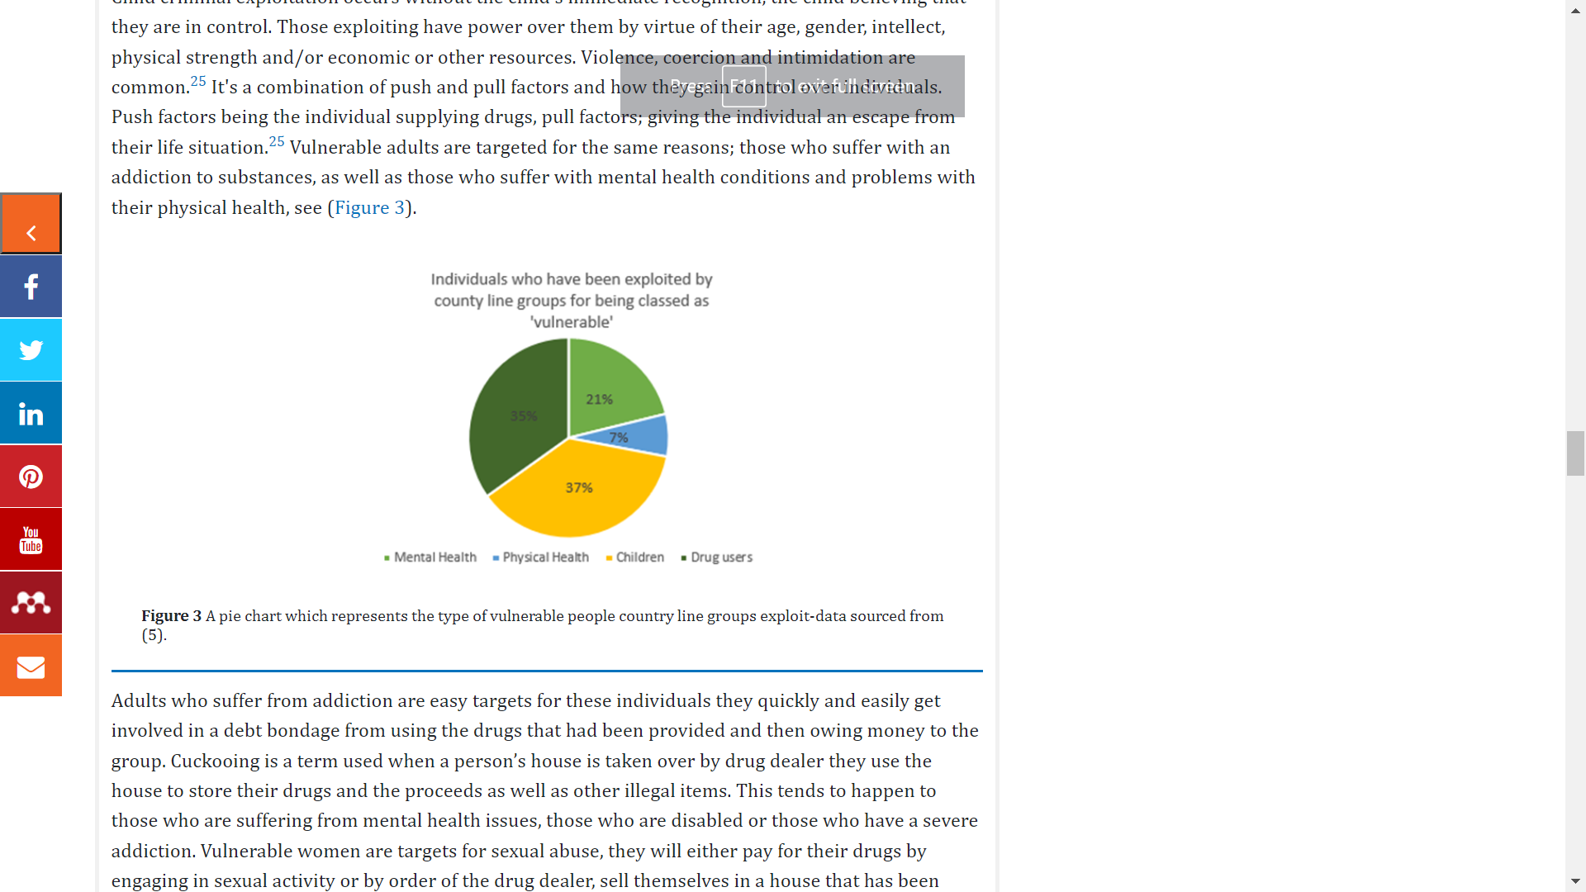
County Line- Easy Targets!
(O’Hagan. Et.al. 2019)

Slide 12
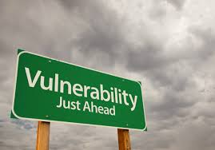
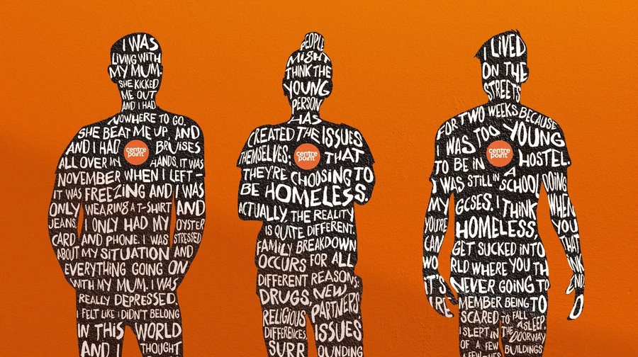
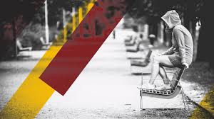
EASY TARGETS
'Factors affecting the vulnerability of children include poverty, family breakdown, social care intervention, frequent missing episodes, behavioural and development disorders and exclusion from main-stream schooling'
(O’Hagan. & Edmundson. 2021).
(Centre Point. 2021).

Slide 13
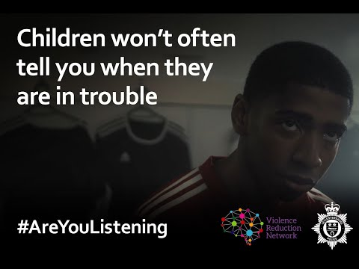
(Leicestershire Police, 2020)

Slide 14

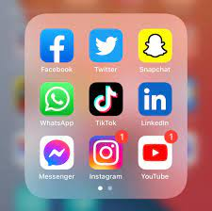
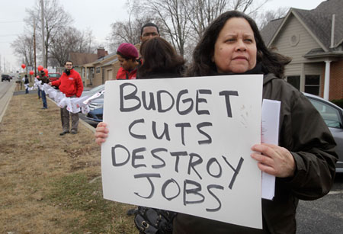
The Face of Contemporary Society
The COVID 19 Pandemic
Rise in online activity
Auaterity

Slide 15

How Can Youth Workers Help?
The National Occupational Standards states:
'Building purposeful relationships with young people is at the heart of good youth work. It is important to know how to initiate such relationships and also the ways in which they can be maintained in order for young people to learn and develop'
(CLD, Standards Council Scotland. 2019)
Outreach work can also enable youth workers to work with young people in their territory. The youth worker can assess the environment and initiate support based on their findings. This can include access to key multidisciplinary teams and services. Having a positive trusting relationship can buffer them from high risk factors that can affect their wellbeing and mental health.
(Sharma,et.al. 2019).

Slide 16



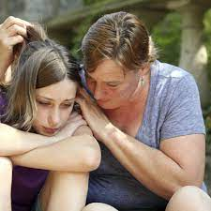


WHAT CAN YOU DO AS A PARENT?
Remember you are not to blame.
Talk to your child or young person you are concerned about.
Gather evidence such as car number plate, descriptions of the people they are meeting or train and bus receipts.
Report any concerns you have to 101, 999 or speak to your local safeguarding team. In Carmarthenshire it is Call Delta Wellbeing on 0300 333 2222 (available 24hrs, 7 days a week).
If you are worried your child or young person will be facing criminal charges, get legal advice, they may have a legal defence to those charges under the Modern Slavery Act.

Slide 17
References.
Familyfriendspoems. (2022) Abuse Poems by Teens. Available at: https://www.familyfriendpoems.com/poems/teen/abuse/ (Accessed on 22nd February 2022).
NSPCC. (No Date). Criminal exploitation and gangs. Available at: https://www.nspcc.org.uk/what-is-child-abuse/types-of-abuse/gangs-criminal-exploitation/ (Accessed on 22nd February 2022).
Welsh Government. (No Date) (All Wales Practice Guide) Safeguarding children from Child Criminal Exploitation (CCE) Available at: https://www.safeguarding.wales/chi/c6/c6.p1.html (Accessed on 22nd February 2022).
National Crime Agency (No Date). Available at: https://www.nationalcrimeagency.gov.uk/what-we-do/crime-threats/drug-trafficking/county-lines (Aceessed on 7th March 2022).
O’Hagan A, Edmundson CJ. County lines: The exploitation of vulnerable members of society. Forensic Res Criminol Int J. 2021;9(2):47‒57. DOI: 10.15406/frcij.2021.09.00340
Centre Point. (2021). Young people didn’t cause this housing crisis. Available at: https://twitter.com/centrepointuk/status/1197123499720159233 (Accessed on 7th March 2022).
O’Hagan A, Long A. The socioeconomic effects of organised crimes county lines on the United Kingdom community. Forensic Res Criminol Int J.2019;7(5):274-280. DOI: 10.15406/frcij.2019.07.00293
Crowshaw. S (2020). YOUTUBE. County Lines - basic awareness film by PC 1942. Available at: https://www.youtube.com/watch?v=auoICT45nac (Accessed on. 9th March 2022).
Sharma, S., Mustanski, B., Dick, D. et al. Protective Factors Buffer Life Stress and Behavioral Health Outcomes among High-Risk Youth. J Abnorm Child Psychol 47, 1289–1301 (2019). https://doi.org/10.1007/s10802-019-00515-8

