Slide 1
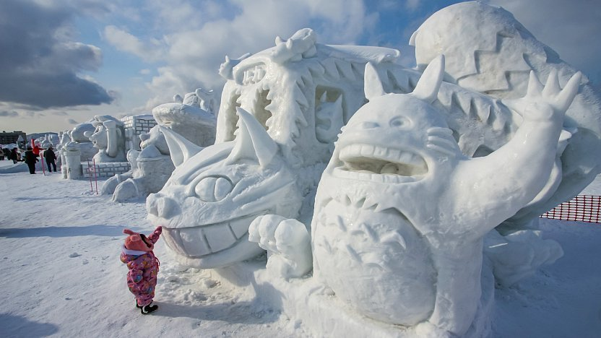
Event Content and Context for “Winter Odyssey Festival”
Student Name: Cristina-Valentina Preda
Student number: 2207491
Module title: International Meetings Management
Module code: BMIH6007
Lecturer's Name:Kathryn Flynn
Date: 14/10/2024

Slide 2

AI Use Acknowledgement
I confirm that I have not used any AI tools in the research and creation of this presentation.
I confirm that I have not presented any AI generated materials as my own work.
I confirm I have copies of my drafts, notes, and other resources I used, which I may be asked to provide in evidence.

Slide 3
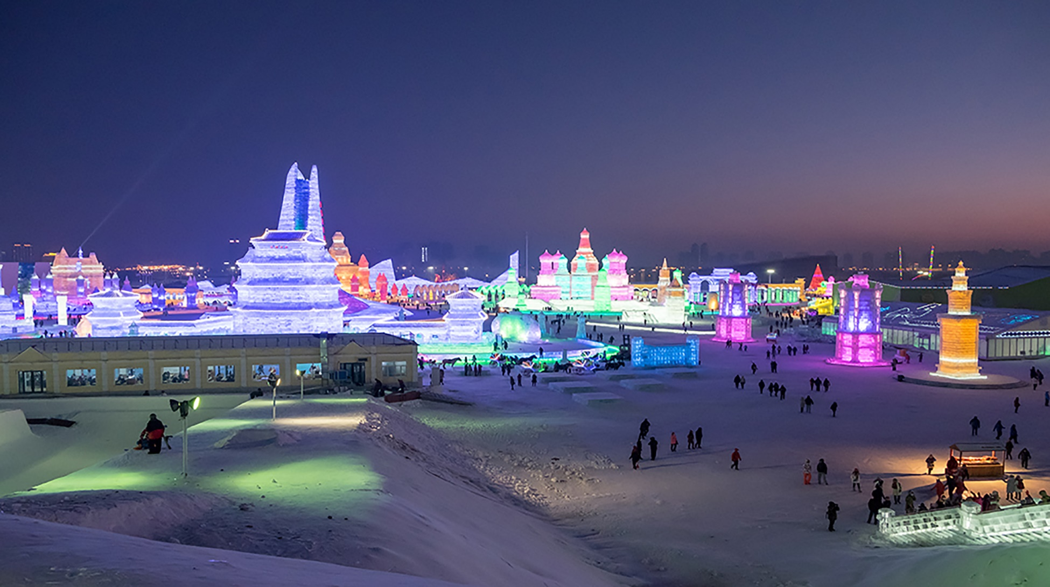
Event Content and Context
Proposed Focus for the Event: Celebrating worldwide winter traditions and highlighting the variety of winter celebrations from all around the globe, the
Winter Odyssey Festival will be hosted. The event seeks to provide attendees with a unique experience involving cultural exhibits, performances and interactive seminars.

Slide 4
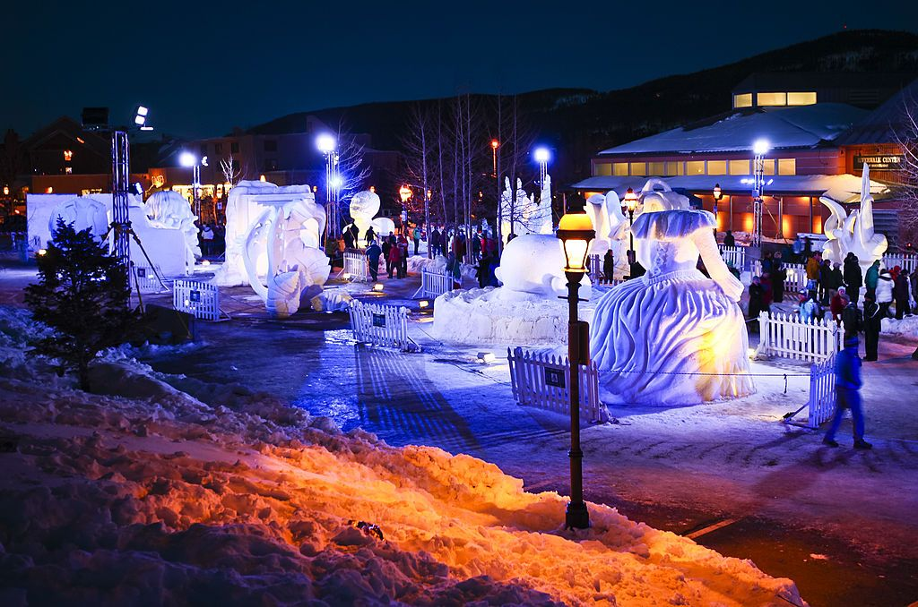
Type and Nature of the Event
Type
It is a cultural event and a seasonal festival event
This event is family-friendly and appropriate for all ages
This event is market-themed with a combination of theatre performances
Nature
Celebratory: A joyful environment stressing communal spirit and happiness throughout the winter.
Educational: Workshops and displays covering many winter-related cultural practices and customs will educate the visitors.
Interactive: Including people actively using craft-making, cooking lessons, and narrative sessions.
Community-focused: Aimed at bringing together local inhabitants and foreign guests, community-oriented projects promoted ties and cultural respect.
This celebration of winter events will also help to promote harmony and understanding among many different cultures (Meng and Asma, 2024).

Slide 5
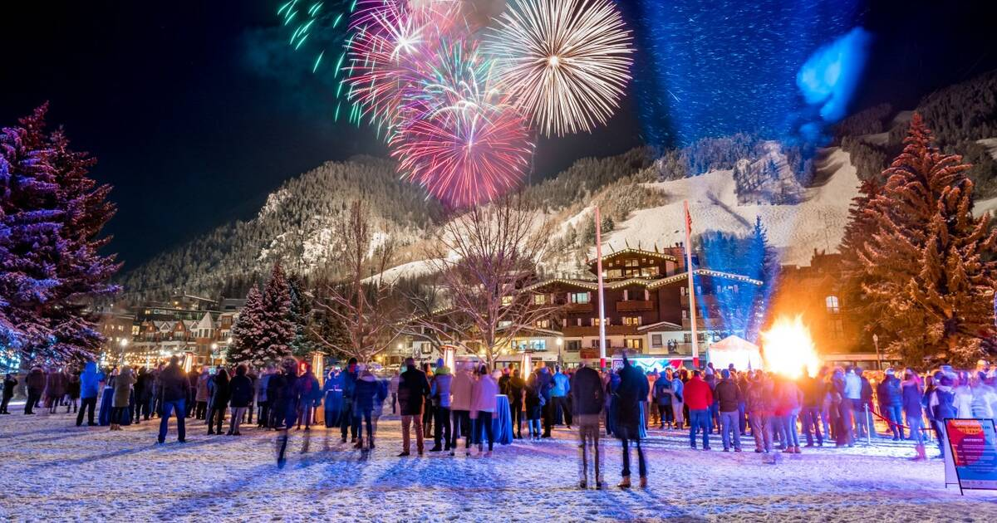
Market factors
Target Market
Demographics:
Families including kids searching for seasonal events.
Neighbours and visitors looking for unique winter activities.
Institutions and educational organisations seeking field excursion opportunities
“Marketing is concerned with satisfying consumer needs and wants by exchanging goods, services or ideas for something of value” (Bowdin et al 2011, P366)

Slide 6
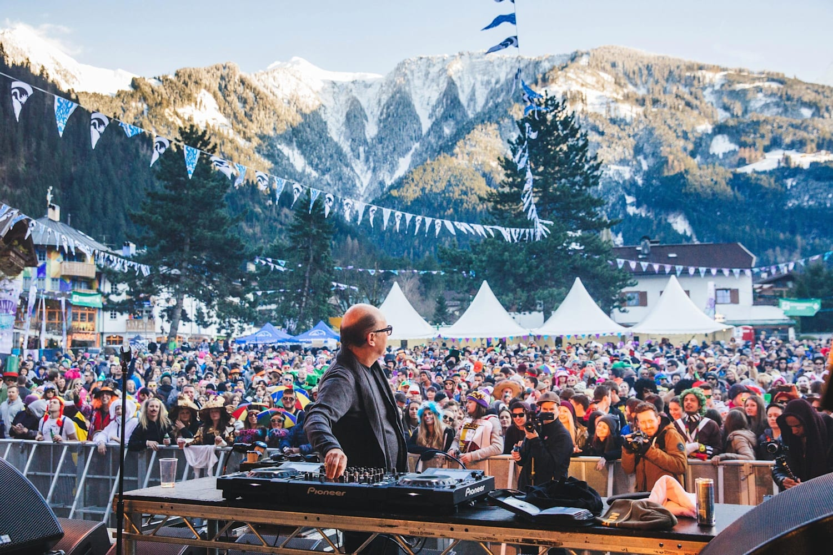
Demand
Market Research
Growing curiosity in cultural events supporting diversity and inclusiveness (Hunt and Dolan, 2020).
Particularly in winter, seasonal activities draw families and communities seeking joyful experiences (Middleton and Harper, 2020).
High turnout for past winter celebrations suggests great demand for these events.
Trends
The increasing popularity of experience events allows attendees to interact personally with different cultures.
Improved exposure and appeal by more social media interaction and sharing around local events (Chae, 2021).

Slide 7
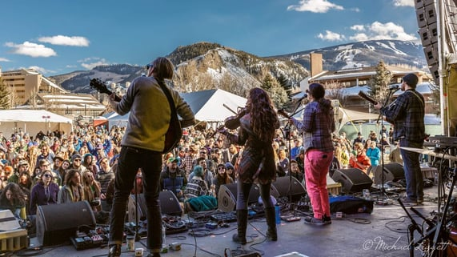
Supply
Resources Needed
Venue space for pavilions and outdoor events, for example Central Park.
Vendors provide global foods, handcrafted goods, and cultural encounters.
Artists from many backgrounds entertain us.
Staff members and volunteers for logistical and event management

Slide 8
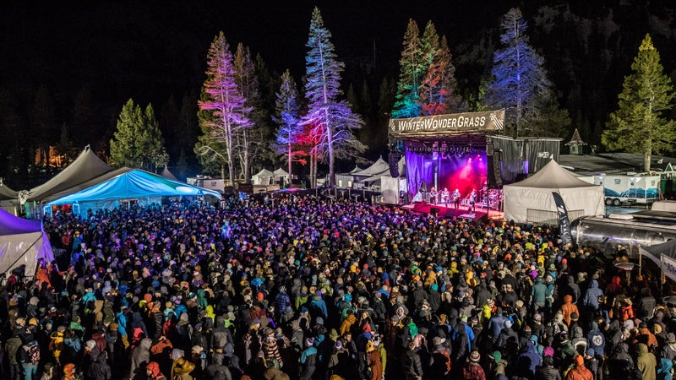
Competition
Direct Competition
Other neighbourhood winter celebrations or holiday markets are scheduled alongside.
Seasonal activities held in surrounding towns draw the same target market.
Indirect Competition
Other forms of entertainment include theatre, concerts, and winter sports activities.
Local attractions (such as holiday light displays or ice-skating rinks) can turn off possible guests (Johnson and Winkle Van, 2022).

Slide 9
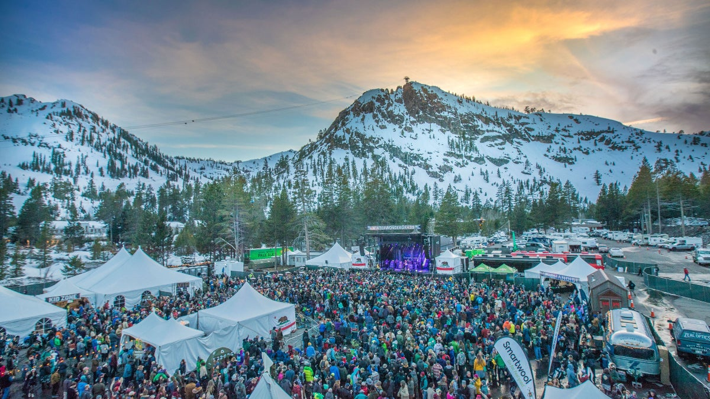
Marketing Activity
Promotional Strategies
Share interesting content including sneak previews, cultural highlights, and countdowns to the event on Facebook, Instagram, and TikTok.
For cross-promotional events and group discounts, work with nearby companies, cultural organisations, and schools.
Local advertising can reach a larger audience using community boards, newspapers, and local radio stations (Myers and Harford, 2020).
Work with local influencers that fit the target audience to advertise the festival via their outlets.
Understanding these market elements will help the Global Winter Fest to strategically position itself to draw a varied audience, guarantee high attendance, and hence minimise competition

Slide 10
Operational factors
Proposed Location
Venue: Central Park (London)
Suitability:
Popular for seasonal events, Central Park has enough area for many pavilions and activities (Albright, 2020).
Convenient for participants since it is within walking distance of metropolitan conveniences and accessible by public transportation.
Venue Availability
Availability:
To prevent scheduling problems with other events, seek availability for the suggested dates; January 15–20, 2025.
In advance, reserve the site to get local authorities' necessary licenses and permissions.

Slide 11
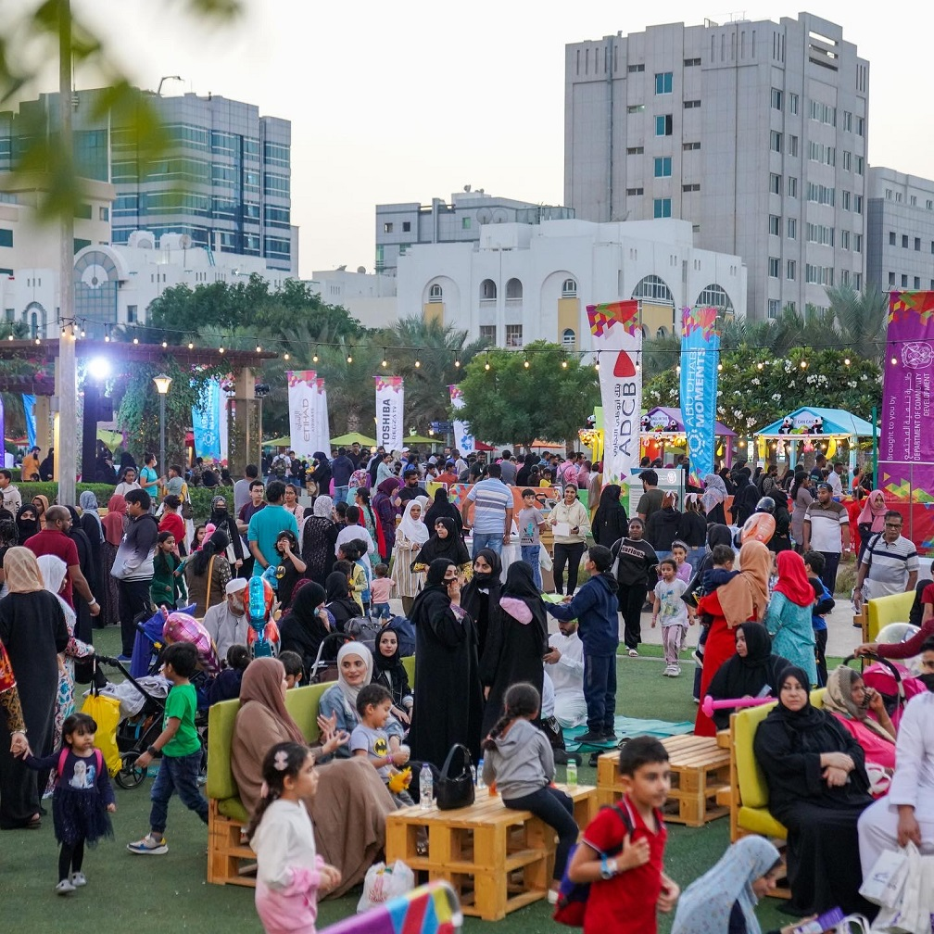
Suitability of the Venue
Space Requirements
Enough outside space for a winter market, performance space, and cultural pavilions.
Areas set aside for classes, food vendors and seats
Infrastructure
Facilities like parking, bathrooms and are accessible to every guest.
Capacity to develop structures such as (stages, and tents) for various events.
Staffing Requirements / Skill Sets
Event Manager
Oversee general planning, coordination and event implementation.
Volunteer Coordinators
Control volunteer schedules, training, and recruiting for different projects.
Cultural Representatives
People from a range of backgrounds make sure that culture pavilions and workshops are authentic.
Technical Staff
Someone with the right skills needs to set up the lighting, sound and lighting for shows.
Food and Beverage Managers:
Experienced staff will be in charge of managing the vendors and catering, making sure that high standards are met and that health rules are followed

Slide 12
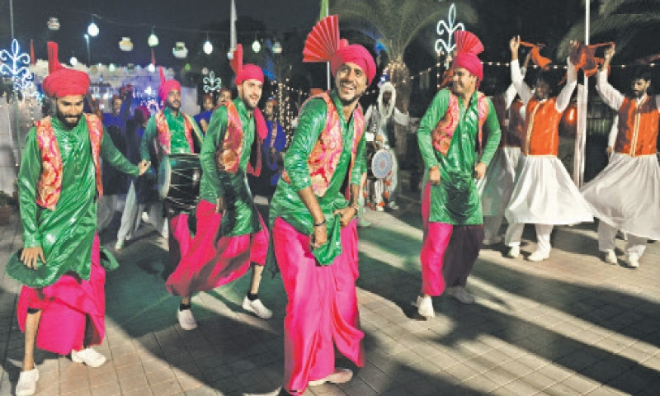
Suitability of the Venue
Likely Resource Allocations
Catering
Collaborate with local food sellers, and local food trucks that provide a wide range of foods to diverse cultures.
Consider big allocations for food stands to ensure that all the participants have access to the food stands.
Lighting
To make a place feel warm and welcoming, especially for shows and performances in the evening, hire a professional lighting company.
Cultural pavilions and market areas will look better with decorative lights.
Parking Facilities
Talk to the local government about setting aside parking spots and, if necessary, shuttle services.
Put up clear signs about where to park and how to get there.
Seating
For the ease of the attendees, put seating areas near the performance stages and dining areas.
Use picnic tables and benches to make the area feel more like a community.

Slide 13
Financial Factors for Global Winter Fest
Predicted Breakdown of Costs and Revenues
Possible Table of Income and Expenses
Item | Estimated Costs ($)
Venue Rental | 10,000
Marketing and Promotion | 4,000
Performer Fees | 8,000
Catering/Vendor Fees | 5,000
Setup and Decorations | 6000
Lighting and Sound | 4000
Permits and Insurance | 3000
Staffing and Volunteers | 3000
Miscellaneous Expenses | 2000
Total Estimated Costs | 45,000

Slide 14
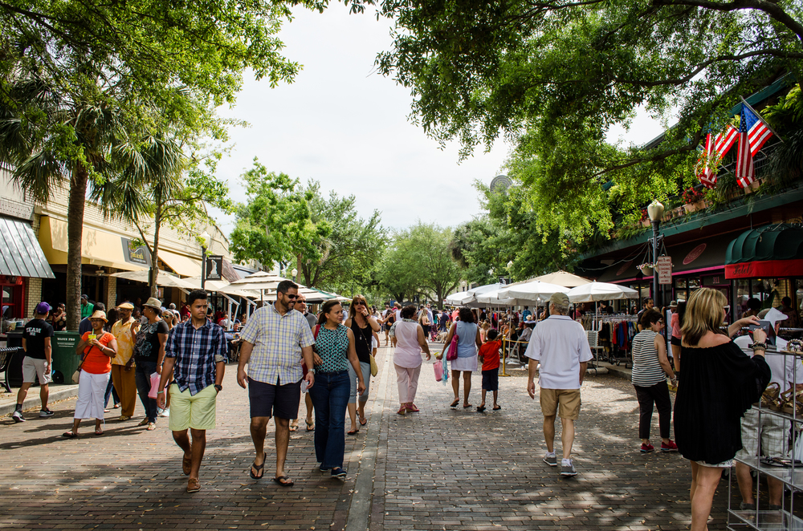
Funding Sources
Funding Sources
The event will consider selling tickets as a major source of funds. Each ticket has been priced at £12. Selling 3000 tickets will give them even enough funds
Sellers fees: Crafts and food sellers will be required to pay £150 to get permission to set up their stands. With a prediction of 20 sellers, this will give the event funds.
Sponsorships: Ask local businesses and cultural groups to fund the event. The cost of the event will be covered by the sponsorships, and the event will get more attention.
Merchandise Sales: To make extra money, selling event-related items like T-shirts and mugs.
Revenue Generation Strategies
Early Bird Tickets: Give discounts for people who will make their ticket purchases earlier
Group Discounts: Give discounts for people buying tickets in groups, for instance families and groups
Local Partnerships: Work with other businesses to do cross-promotions that can get more people to come and get sponsors.
Social media promotions: To reach people who might want to attend and increase ticket sales, use focused ads and interesting content.
Financial Summary
It is expected that the Global Winter Fest will bring in £47,000 which will be higher than its estimated £45,000 costs. This will leave a profit of £2,000. This plan makes sure that the event can continue to make money and gives guests a memorable experience.

Slide 15
Reference List
Albright, K.(2020) 3. Open-Air Pavilion Markets.
Bowdin, G., Allen, J., O’Toole, W., Harris, R. and McDonnell, I. (2023) Events Management. Oxford: Elsevier
Chae, M.J. (2021) Driving consumer engagement through diverse calls to action in corporate social responsibility messages on social media. Sustainability, 13(7), p.3812.
Hunt, V., Prince, S., Dixon-Fyle, S. and Dolan, K. (2020) Diversity wins. McKinsey.
Johnson, A.J. and Winkle Van, C. (2022) Successful Winter Tourism Destinations. Tourism Case Studies, (2022), p.tourism20220018.
Meng, L.K., Zaidi, H.J. and Asma, A. (2024) Celebrating cultural diversity through sports for global peace and understanding. In Globalisation, Cultural Diversity and Human Rights (pp. 11-39). Cham: Springer Nature Switzerland.
Middleton, J., Cunsolo, A., Jones-Bitton, A., Shiwak, I., Wood, M., Pollock, N., Flowers, C. and Harper, S.L. ( 2020) “We're people of the snow:” Weather, climate change, and Inuit mental wellness. Social Science & Medicine, 262, p.113137.
Myers, M. and Harford, N. (2020) Local Radio Stations in Africa: Sustainability or Pragmatic Viability? Washington, DC: Center for International Media Assistance.

