Slide 1

DSAW 7003 Research Methods for Work-Based Learning
Day 1: Session 2 & 3 : Introduction to Social Research Methodology

Slide 2
Why Research in the Social Context?
Inform Policy
  Political slant
To Inform Practice….
  your own…
  Social Work,
  Education,
  Nursing,
  Community Development,
  Evidence based practice etc……….

Slide 3
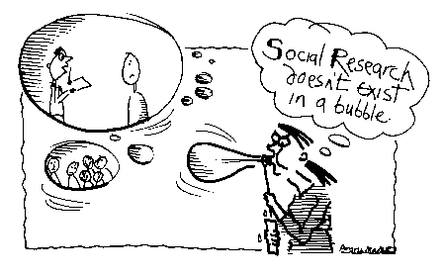
Real world enquiry
‘Social research does not exist in a bubble’
(Bryman 2001)

Slide 4
Sut beth yw Ymchwil Cymdeithasol?
What does Social Research Look like?
Ystyriaethau ymarferol Practical considerations
Moeseg
Ethics
Methodoleg Methodology
Ymchwil Cymdeithasol
Social Research
Gwerthoedd
Values
Damcaniaeth
Theory

Slide 5
Methodology vs. Method
Methodology
The theoretical framework that outlines the rules to follow in a study.
Method
The actual tools/steps taken by which you conduct research into a subject or a topic.

Slide 6
Different Approaches to Research Equate to Different Paradigms
A paradigm is
  a ‘worldview 'or a set of assumptions about how things work.
  There are different paradigms to choose from when choosing research (your methodological choice).
  A set of rules or axioms underpin different positions

Slide 7
A Paradigm Constitutes the following:
Ontology The fundamental beliefs we have about the world. These can be: | Objectivism Social phenomena and their meanings have an existence independent of social actors Constructivism Social phenomena and their meanings are constructed through social interaction and therefore are in a constant state of revision
Epistomology The theory and study of knowledge | There is a distinction between ‘true’ and ‘false’ knowledge – what standard of evidence is sufficient to make a judgement? This also encompasses issues of validity and reliability which are discussed later. The types of evidence can include faith, trust, experience, logic, empiricism – depending on what philosophy you subscribe to.
Ontology The fundamental beliefs we have about the world. These can be: | Objectivism Social phenomena and their meanings have an existence independent of social actors Constructivism Social phenomena and their meanings are constructed through social interaction and therefore are in a constant state of revision
Epistomology The theory and study of knowledge | There is a distinction between ‘true’ and ‘false’ knowledge – what standard of evidence is sufficient to make a judgement? This also encompasses issues of validity and reliability which are discussed later. The types of evidence can include faith, trust, experience, logic, empiricism – depending on what philosophy you subscribe to.
Ontology The fundamental beliefs we have about the world. These can be: | Objectivism Social phenomena and their meanings have an existence independent of social actors Constructivism Social phenomena and their meanings are constructed through social interaction and therefore are in a constant state of revision
Epistomology The theory and study of knowledge | There is a distinction between ‘true’ and ‘false’ knowledge – what standard of evidence is sufficient to make a judgement? This also encompasses issues of validity and reliability which are discussed later. The types of evidence can include faith, trust, experience, logic, empiricism – depending on what philosophy you subscribe to.

Slide 8
A Background to Research Methods
Which ontological position do you think you come from?
How might this impact on your research?
Our fundamental beliefs are likely to impact on our research choices

Slide 9
Quantitative and Qualitative

Slide 10
Methods Of Data Collection: Qualitative and Quantitative
Quantitative
Involves experiments, surveys, testing, and structured content analysis, structured interviews, and observation.
Qualitative
Involves semi / unstructured interviews, observation, focus groups and content analysis, participatory methods of data collection.

Slide 11
Combining Quantitative and Qualitative Methodologies
Mixed methodology and mixed approaches often regarded as a practical solution to research.
E.g Often you may engage in a Qualitative research design but use some quantitative data and vice versa

Slide 12
Social Research Design Strategies
Qualitative Examples
Quantitative Examples
Case Study
Ethnography
Phenomenology
Grounded Theory
Life History
Historical Methods
Clinical Research
Action and applied research
Participatory research
Surveys: requires large sample sizes for statistical analysis
Experimental designs : requires a control group

Slide 13
Social Research as an extension of practice
Think about an area of your current practice that you would like to research or evaluate:
  solving a problem,
  improving practice,
  evaluating a new initiative to see if it works……

Slide 14
Social Research as an extension of practice
What would be your preference for carrying out this research qualitative / quantitative?

Slide 15
Social Research as an extension of practice
Applied research
  Participatory research
  Action Research
Practitioners: ownership of the research process
Democratic
Reflection: engenders personal or organisational change.

Slide 16
Social Research as an extension of practice
Insider Researcher
  Consider the questions on your hand-out.
  Discuss in pairs.

Slide 17
Summary
What do you now understand as social research?
Are you able to begin see the links to your own practice?

Slide 18
Research Methods – you tube video links
http://www.youtube.com/watch?v=ddx9PshVWXI
http://www.youtube.com/watch?v=4oZAIUGFTOk
Notes:
Any initial observations/comments/concerns/questions?

Slide 19

Moeseg

Slide 20

http://www2.carleton.ca/psychology/ethics/

Slide 21
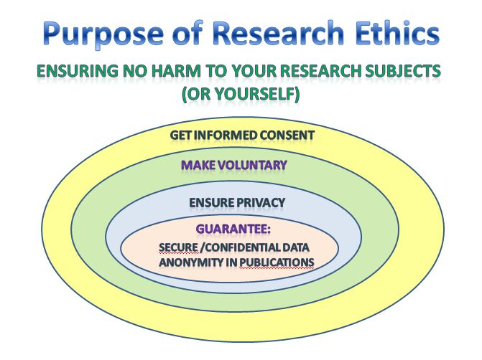

Slide 22
GROUP ACTIVITY
What are the ethical considerations linked to each picture?

Slide 23
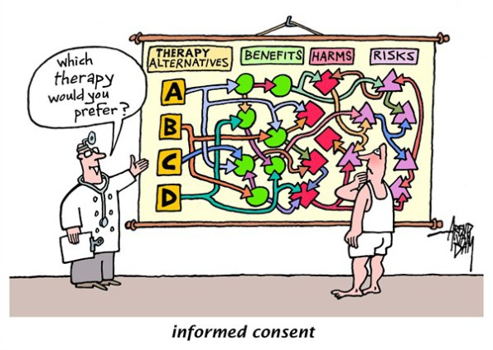
(* Cartoon from the Cagle Post by Arend van Dam)

Slide 24
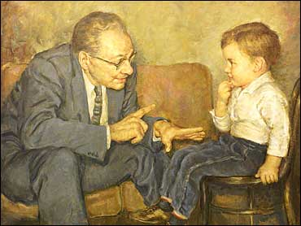

Slide 25
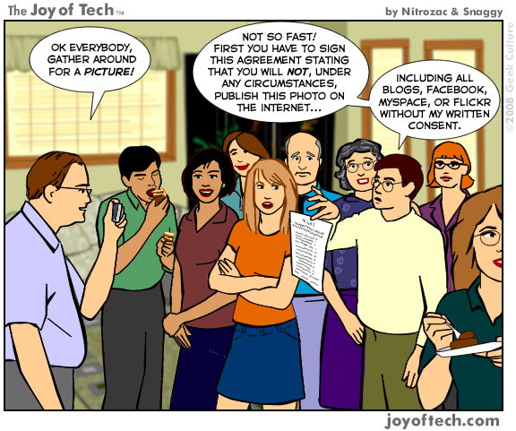
http://doblepescador.wordpress.com/2011/03/19/would-you-like-some-ethics-with-your-burger/

Slide 26


Slide 27
Research Ethics
Research Ethics see :
  Individual Task
  Power point on ethics
  UWTSD Ethics proposal
  Ethical Guidelines
        (Electronic Copies available on Moodle)

Slide 28
Agreeing next steps
Action Plan (see Hand-out)
Date of next session
TIMESHEETS!

Slide 29
Agreeing Next Steps: Directed Study
Begin to outline your assessment 1 to discuss with the group in the next session
Read around the subject, there are a number of hand-outs available for you and resources on Moodle.

Slide 30
Summary of Day
An introduction to the module and assessment
An introduction to social research methods
Research as an extension of practice
Ethics
Directed Study

Slide 31
Pulling the module together
Working in pairs discuss for 10 minutes your initial thoughts and questions arising.
Discussion
Summary and closing comments

