Slide 1
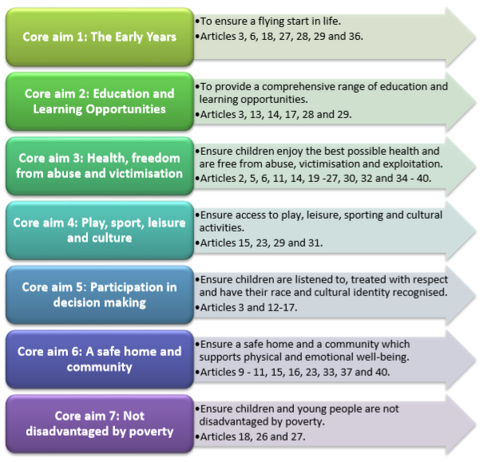




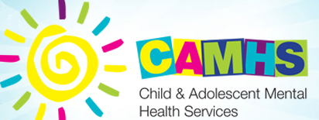
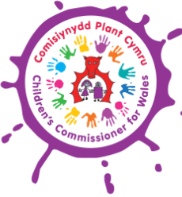


Rights to Action (2004)
By Sinead Cherrington
The Welsh Assembly Government stated that they wanted to ensure children and future generations enjoy healthier prospects in life, and are not landed with a legacy of difficulties left by them and therefore they have revised the United Nations Convention on the Rights of the Child as the foundation of their work for children and young people in Wales (Welsh Assembly Government, 2004). There are seven core aims.
Welsh Assembly Government set out recommendation for health and social services in react to Lord Laming’s report on the death of Victoria Climbie and appointed the Commission for Health Audit and Improvement to do a review of child protection procedures in the National Health Service in Wales (Welsh Assembly Government, 2004).
The Children first programme is crucial to providing better outcomes for children most in need. As a result of Children First less children are leaving care without a minimum of one basis GSCE qualification, an appropriate care plan was made for most 16-year olds leaving care and more child protection cases have been getting reviewed (Welsh Assembly Government, 2004).
Aim 6 is a safe home and community that supports physical and emotional wellbeing (Welsh Assembly Government, 2004).
The Welsh Assembly Government established a ten-year plan, Everybody’s Business which is supported by CAMHS implementation group. Mental health services are not solely the duty of the health services and the advancement of the social services part of CAMHS is a priority in the Children First Programme for local authorities (Welsh Assembly Government, 2004).
Aim 3 is the best possible health free from abuse, victimisation, and exploitation (Welsh Assembly Government, 2004).
Since the production of these aims the welsh assembly created an independent Children’s Commissioner for Wales to advocate for children’s rights within Wales (Welsh Assembly Government, 2004).
The assembly government have set out a National Homeless Strategy to help prevent young people from becoming homeless. One goal that this strategy has is to enhance combined working among housing and social services in local authorities to support care leavers. In addition, local authorities have an obligation to stay connected with all care leavers until the age of 21 or 25 if they are in education or training (Welsh Assembly Government, 2004).
The Assembly Government has put a ban on smacking in Wales and have funded a public education programme of advice so that parents and carers are provided with alternative ways to handle their child’s behaviour (Welsh Assembly Government, 2004).

Slide 2
References
European Commission. (2019). ESPN publishes reports on national strategies to fight homelessness and housing exclusion. [image] Available at: https://ec.europa.eu/social/main.jsp?catId=1135&furtherNews=yes&langId=en&newsId=9456 [Accessed 11 May. 2020].
Fairhholme Primary School. (2020). Child protection and safeguarding. [image] Available at: https://www.fairholme.hounslow.sch.uk/about-our-school/child-protection-safeguarding-and-well-being/child-protection-and-safeguarding [Accessed 11 May. 2020].
Holland, S. (2017). Know Your Rights. [pdf] Children’s Commissioner for Wales. Available at: https://www.childcomwales.org.uk/wp-content/uploads/2017/01/6331-CCfW-A2-Rights-Poster-AW-1.pdf [Accessed 27 Apr. 2020].
Kovalchik, J. (2016) Children First Logo. [image] Available at: https://jillkovalchik.myportfolio.com/children-first-logo [Accessed 11 May. 2020].
Moseley, M. (2019). Smacking ban offers the chance to educate parents and carers. [image] Available at: https://rcni.com/primary-health-care/opinion/comment/smacking-ban-offers-chance-to-educate-parents-and-carers-149271 [Accessed 11 May. 2020].
Peeker Health. (2019). Child Abuse Types, Causes and Treatment. [image] Available at: https://peekerhealth.com/child-abuse-types-causes-and-treatment/ [Accessed 11 May. 2020].
Thomas, S. (2017). The Children’s Commissioner’s Annual Report 2016-17. [image] Available at: https://seneddresearch.blog/2017/11/06/the-childrens-commissioners-annual-report-2016-17/ [Accessed 11 May. 2020].
Welsh Assembly Government. (2004). Children and Young People: Rights to Action. Cardiff: Welsh Assembly Government, pp. 1-48. Available at: https://dera.ioe.ac.uk/7717/1/090415rightstoactionen.pdf [Accessed 21 Apr. 2020].
Welsh Government. (2015). Programme for Children and Young People. [image] Available at: https://gov.wales/sites/default/files/publications/2019-06/seven-core-aims-for-children-and-young-people.pdf [Accessed 11 May. 2020].
Whitaker, J. (2017). Supporting wellbeing during exams. [image] Available at: https://www.parenthub.co.uk/supporting-wellbeing-during-exams/ [Accessed 11 May. 2020].
Young Healthy Minds. (2013). CAMHS. [image] Available at: https://www.younghealthymindsni.co.uk/ [Accessed 11 May. 2020].

