Slide 1

Homicide
Notes:
Quick Introduction

Slide 2

Last session
County Lines- Guest speaker Carole Hopkins (Swansea Youth Justice Team)
Its prevalence in Swansea
How drugs are transported
The reasons why
Notes:
Read the slide

Slide 3

Learning Objectives
By the end of the session, you should be able to:
What is the definition of Homicide
What are the causation?
How homicide could be prevented?
Notes:
Read the objectives on slide

Slide 4

Definition of Homicide
Homicide is a legal term for the killing of one person by another.
In the UK, it is covered under the Homicide Act of 1957.
  This act was a partial reform of the common law offence.
  Restricted the use of the death penalty before its abolition.
  Introduced the partial defences of diminished responsibility.
  Abolished the doctrine of constructive malice (except in limited circumstances).
Amendments were made in the Coroners and Justice Act 2009.
  Added S52 which adds partial defence to homicide of diminished responsibility.
Notes:
It is a legal term for the killing of one person by another
In the UK, homicide is covered under the homicide act of 1957
This act was a partial reform of the common law offence
Restricted the use of the death penalty before the abolition
Introduced the partial defence of diminished responsibility
Abolished the doctrine of constructive malice (except in limited circumstances)
Amendments were made in the Coroners and Justice Act 2009
Added S52 which adds partial defence to homicide of diminished responsibility

Slide 5
Murder vs Manslaughter
In the UK, Homicide is a blanket term for both Murder and Manslaughter.
Murder
Manslaughter
The crime of murder is committed, where a person:
  Of sound mind and discretion.
  Unlawfully kills (not self-defence).
  Any reasonable creature.
  With the intent to kill or cause grievous bodily harm.
Manslaughter is primarily committed in one of three ways:
  Killing with the intent but where a partial defence applies.
  Conduct that was grossly negligent given the risk of death.
  Conduct taking the form of an unlawful act involving a danger of some harm that resulted in death.
Notes:
Homicide is a blanket term for both murder and manslaughter
Murder
The crime murder is committed, where a person:
Of sound mind and discretion
Unlawfully kills (not self defence)
Any reasonable creature
With the intent to kill or cause grevious bodily harm
Manslaughter
Manslaughter is primarily committed in one of three ways:
Killing with the intent but where a partial defence applies
Conduct that was grossly negligent given the risk of death
Conduct taking the form of an unlawful act involving a danger of some harm that resulted in death

Slide 6
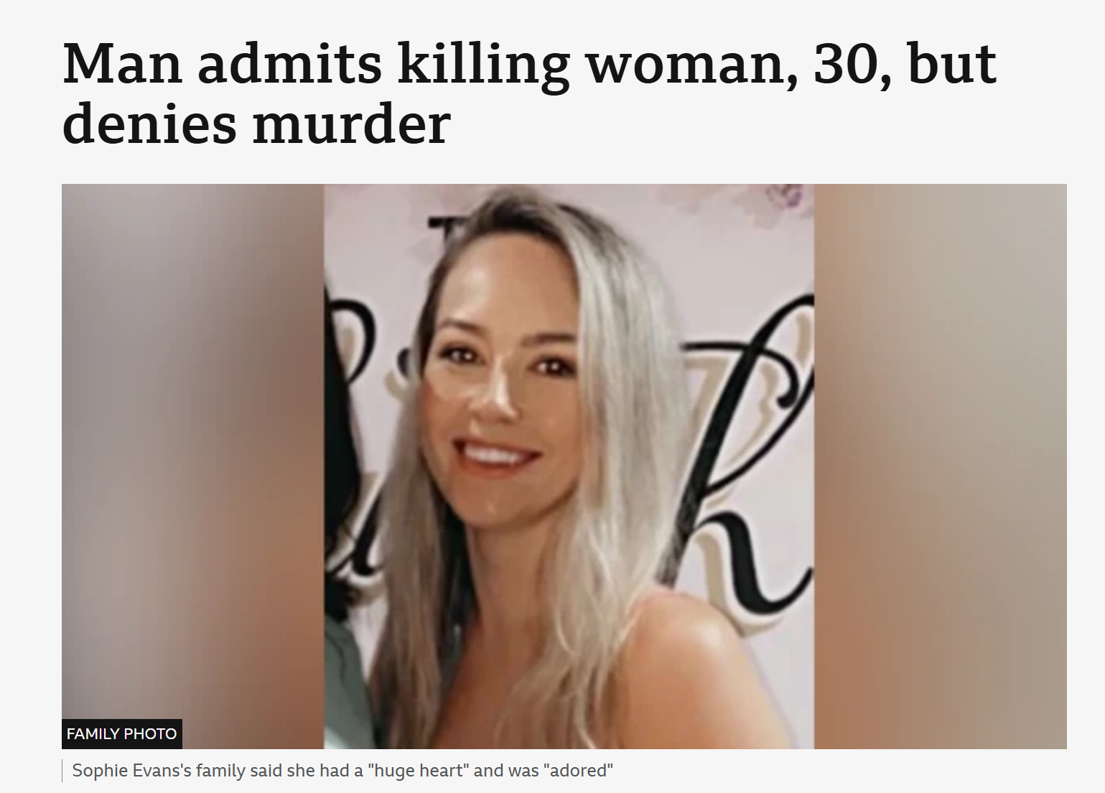
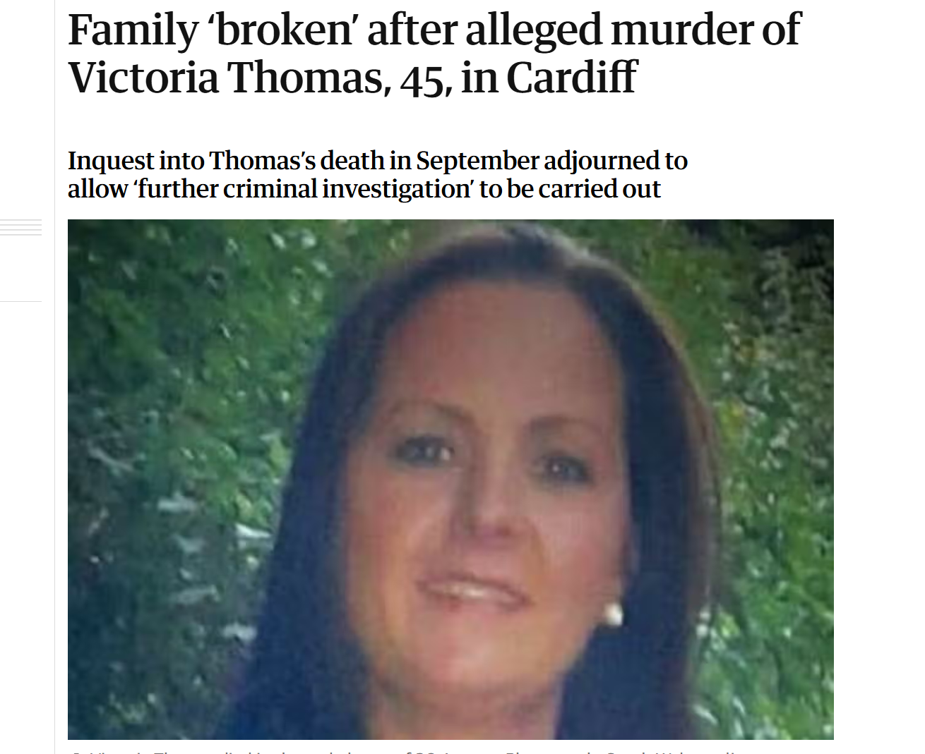
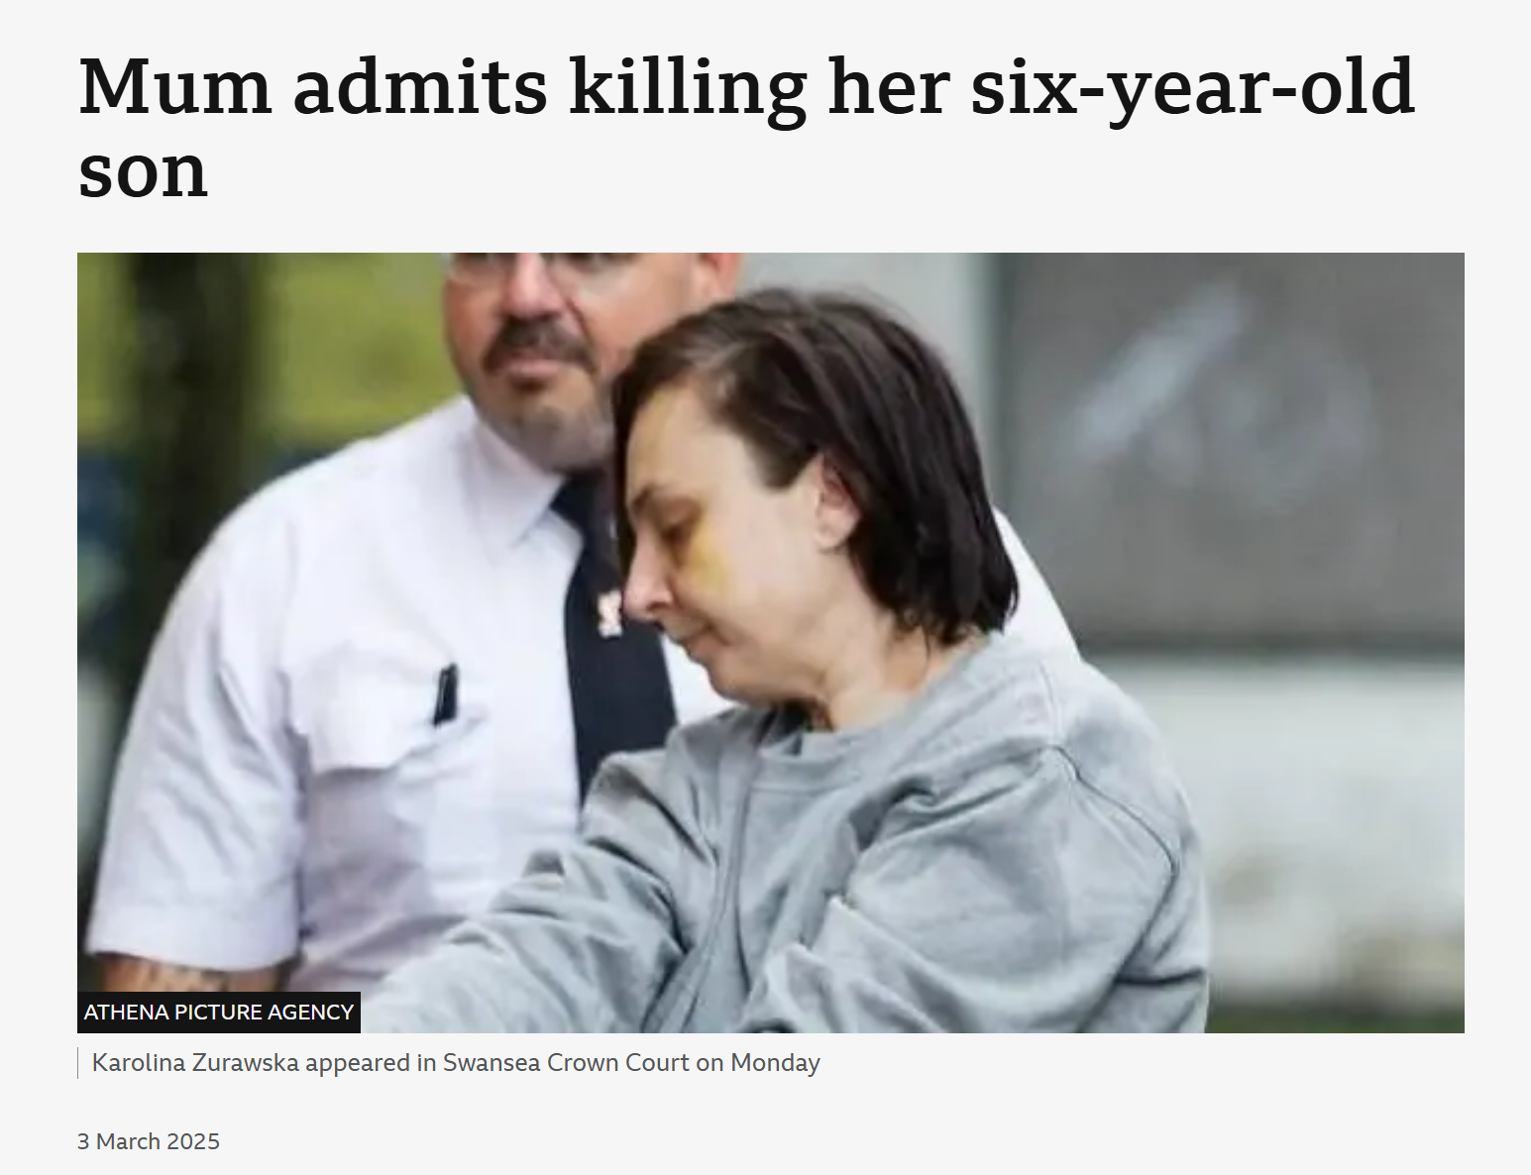
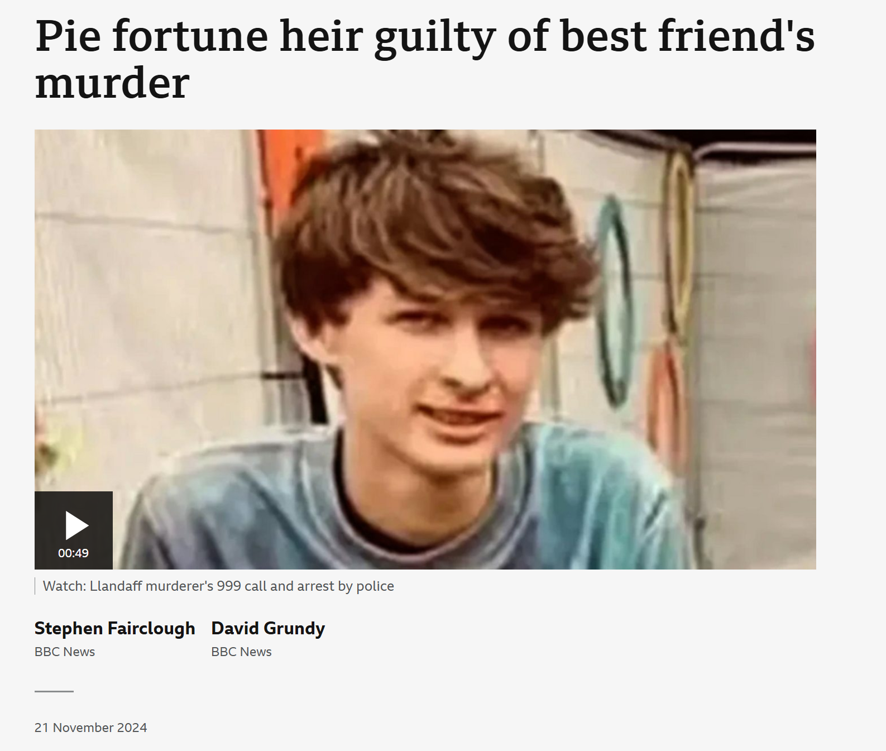
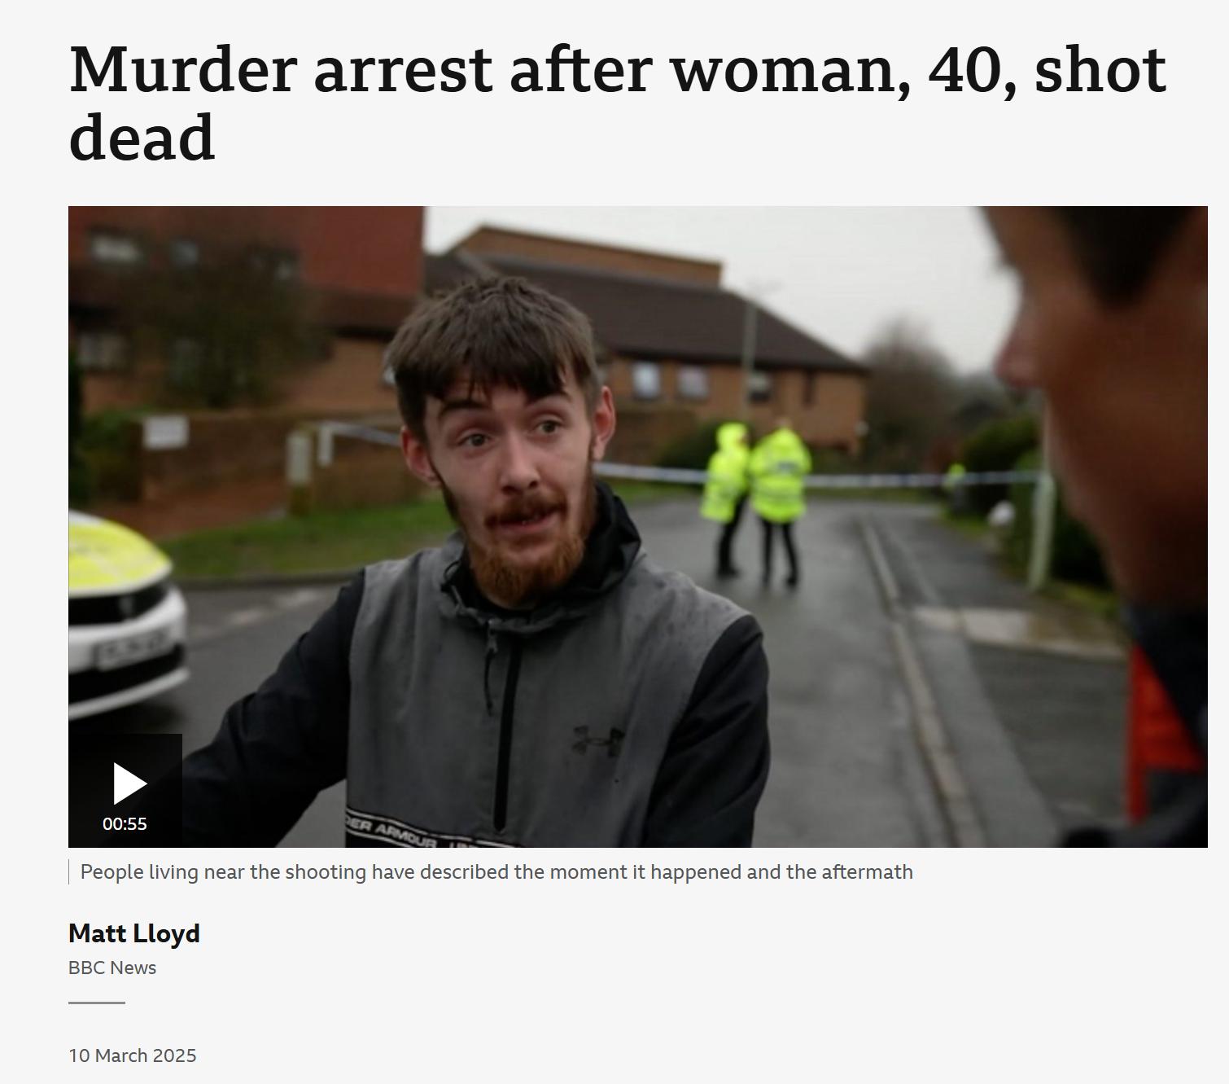
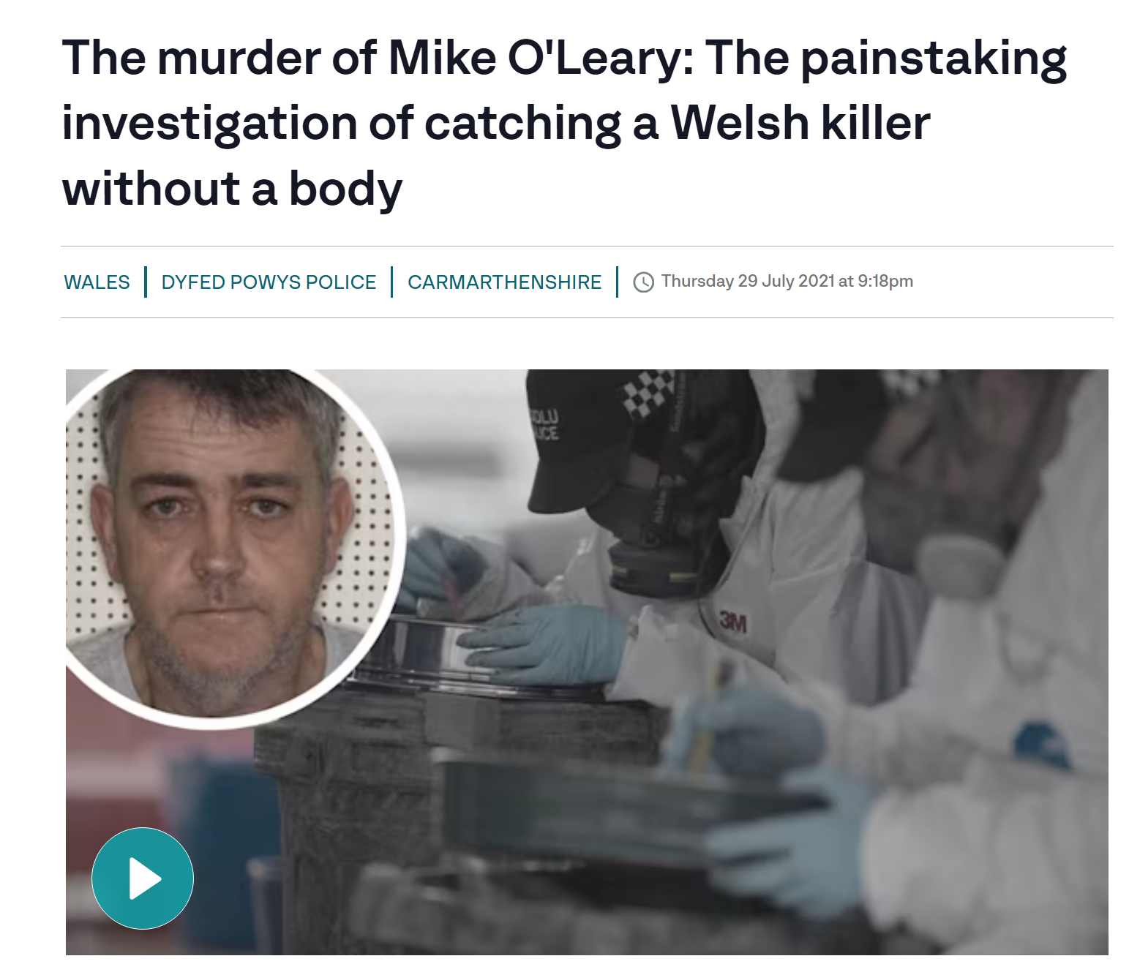

Slide 7
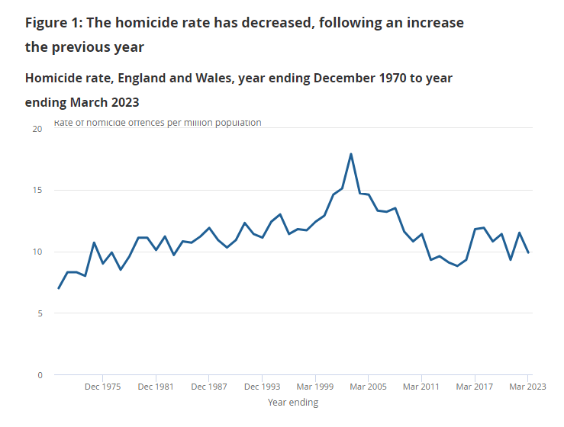
Statistics in the UK
Notes:
These are the homicide statistics ending in March 2023.

Slide 8
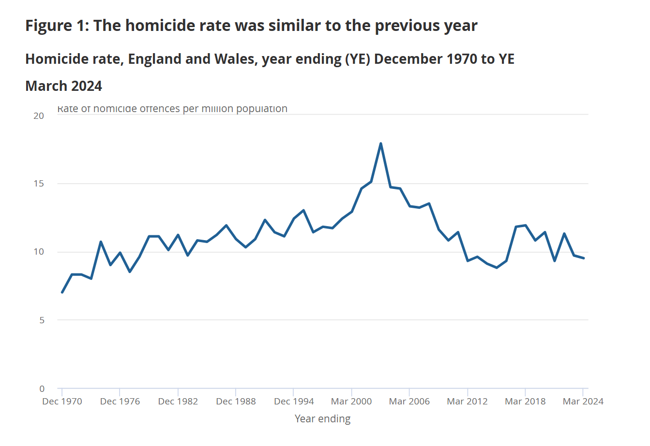
Homicide rates
Notes:
YE ending March 2001 includes 58 Chinese nationals who suffocated in a lorry on the way into the UK.
YE ending March 2003 includes 173 victims of Doctor Harold Shipman.
YE ending March 2004 includes 20 cockle pickers who drowned in Morecambe Bay.
YE ending March 2006 includes 52 victims of the 7 July London bombings.

Slide 9
Task
Research into the spike in homicides between 2000-2006

Slide 10
Spike in homicide year 2000-2006
YE ending March 2001 includes 58 Chinese nationals who suffocated in a lorry on the way into the UK.
YE ending March 2003 includes 173 victims of Doctor Harold Shipman.
YE ending March 2004 includes 20 cockle pickers who drowned in Morecambe Bay.
YE ending March 2006 includes 52 victims of the 7 July London bombings.

Slide 11
Possible Drivers of Homicide
Alcohol
Drugs
Criminal Justice System (CJS)
Availability of guns
Character
Profit
Notes:
Alcohol
There is a strong correlation between homicide and alcohol consumption
Not clear to what extent this casual and to what extent alcohol is a correlate of other drivers
Alcohol policies can reduce homicide in these circumstances
Drugs
Good evidence that Illicit drug markets can drive serious violence
Individuals and groups resorts to violence to avoid being taken advantage of in the market
Illicit drugs seem particularly important in driving the short, sharp increase in homicide trends
Studies found that the crack epidemic to be a driver of homicide spikes seen in many US cities in the 1980’s.
CJS
It seems unlikely that changes to clearance rates or the severity of punishment have driven homicide trends in England and Wales
Studies in the US suggested that increased incarceration reduced homicide, However studies in other countries found no effect.
Levels of police resources and the activities pursued can drive homicide trends but haven’t always done so.
Some researchers suggests that trust in the police and other state institutions is a strong driver of homicide trends, but the evidence is not clear
Availability of guns (Opportunity)
Appears to be a factor in explaining differences in rates between nations but generally does not explain trends within nations
2018, 4% of homicides in England and Wales were by shooting
Previous legislation to tighten supply did not have noticeable effects on homicide
Character
Changes to individuals' characteristics and beliefs may have been an important downward pressure on homicide over the long term
Increase of self-restraint and decreased belief in honour
The need to defend that honour with violence when ‘disrespected’
Profit
There is spatial link between homicide and deprivation, but a temporal link is more elusive
The average homicide rate per population in the 10% most deprived areas is about seven times greater than the rate in the 10% least deprived.
Economic conditions do not correlate well with homicide trends
More deprived areas have more gangs, but gangs seem to exert upward pressure on homicide rates over and above the effects of deprivation
The strong evidence that disruption in illicit drug markets can drive homicide trends also suggests a link to gangs and organised crime groups, given their function in those markets.
https://assets.publishing.service.gov.uk/media/5e5f912fe90e077e3477e49a/trends-and-drivers-of-homicide-main-findings-horr113.pdf

Slide 12
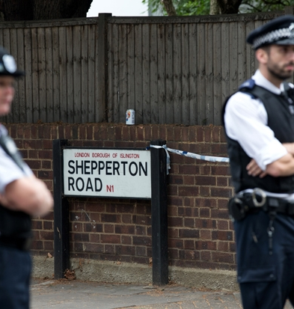
Murders involving Gangs in London
30 male teenagers killed in London during 2021.
Knives accounted for 74% of all homicides in 2021.
8% involved the use of a firearm.
Predominantly male teenagers were victims.
  Significant number were from ethnic minorities and from impoverished areas.
The number of homicides in London was at a 10 year high in 2019.
One in three gangland murders in London linked to drill music.
Notes:
30 male teenagers were killed in London during 2021.
Knives accounted for 74% of all homicides in 2021
8% involved the use of a firearm
Predominantly male teenagers were victims
Significant number were from ethnic minorities and from impoverished areas
The number of homicides in London was at a 10 year high in 2019
One in three gangland murders in London linked to drill music

Slide 13
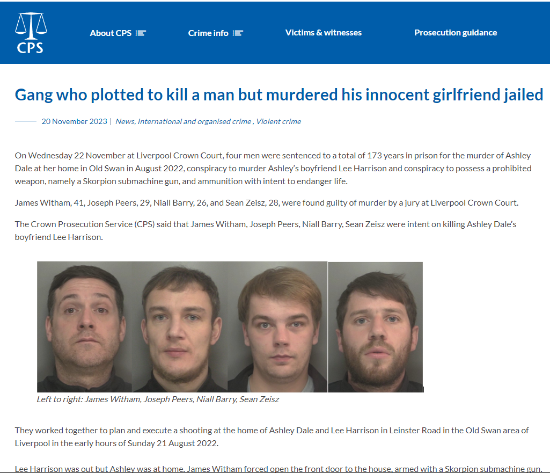
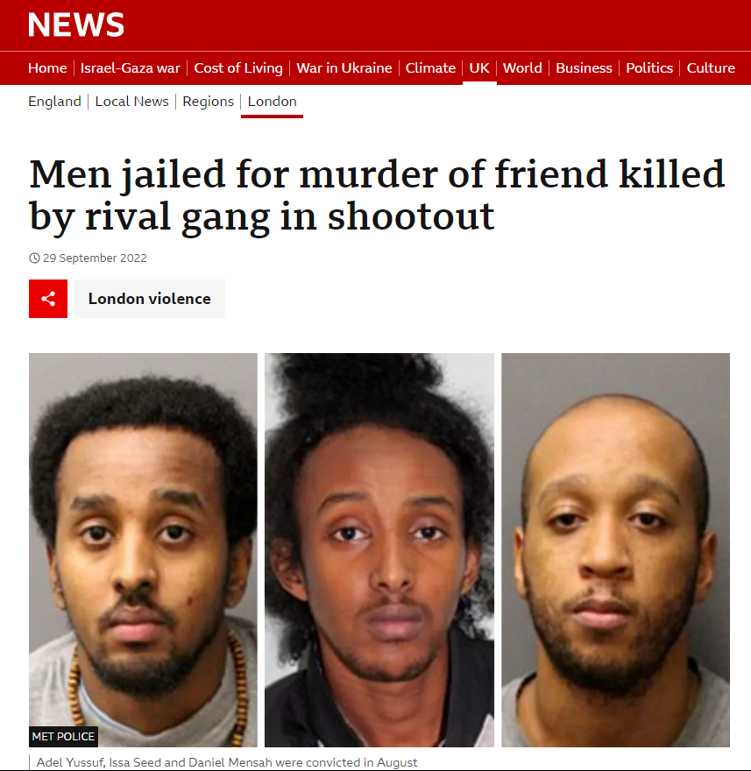
Examples
Notes:
Picture 1
4 men planned to kill a but murdered his girlfriend instead
James Witham, Joseph Peers, Niall Barry and Sean Zeisz
Planned to kill a man called Lee Harrison however they killed Lee’s Girlfriend Ashley Dale
James Witham forced the door open while the Ashley was there, and he killed her by shooting her 10 times
All 4 men were found guilty
Zeisz got a minimum term of 42 years
Barry got a minimum of 47 years
Peers got a minimum term of 41 years
Witham got a minimum of 43 years
The 4 were also charged with other charges, with the intent to supply class A and B drugs.
Picture 2
3 men were jailed for at least 29 years, for the murder of their friend killed by rivals in a shootout
Issa Seed, Adel Yussuf and Daniel Mensah
Found guilty after prosecutors argued that these 3 men opened fire on their rivals knowing that the other gang would retaliate.

Slide 14
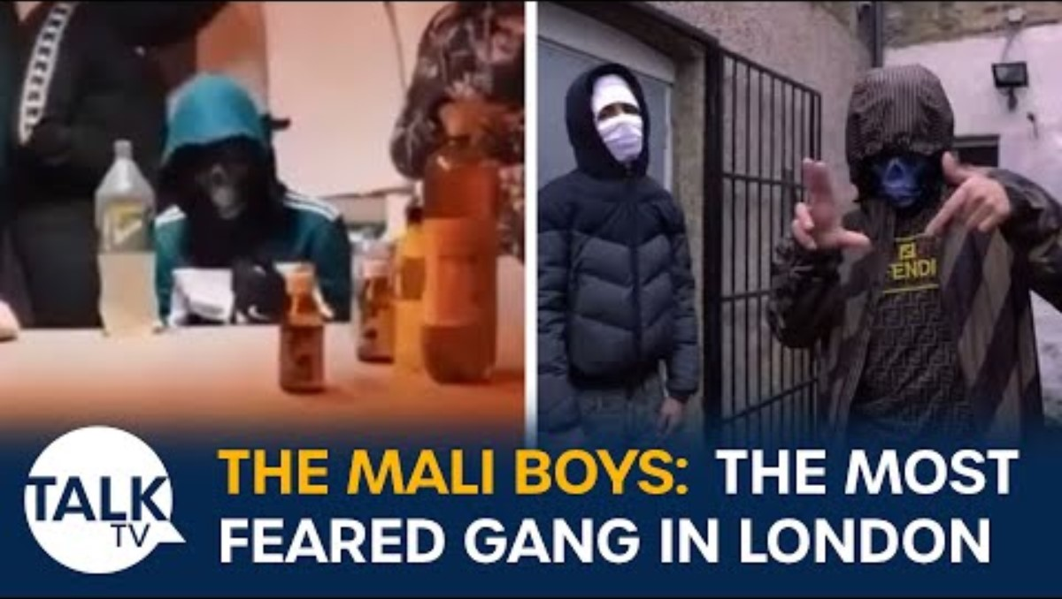
Notes:
https://www.youtube.com/watch?v=KrLRw3BG6f0

Slide 15
Serious violence strategy
Building resilience, critical thinking and life skills.
Positive alternatives through employment.
Support for parents, teachers and schools.
Targeted interventions
  Early interventions youth fund
  Young people and mental health
  Trusted relationships
  Troubled families programme
  Trauma based policing model and in formed youth justice services
Notes:
https://assets.publishing.service.gov.uk/government/uploads/system/uploads/attachment_data/file/698009/serious-violence-strategy.pdf#:~:text=The%20Serious%20Violence%20Strategy%20represents%20a%20very%20,wrong%20path%2C%20encouraging%20them%20to%20make%20positive%20choices.

Slide 16

Wales Violence Prevention Unit
Notes:
Violence Prevention Unit Wales believes that violence is a public health challenge that can be predicted and prevented.
They offer Programmes, Projects and Response
Programmes – Work with service providers in Wales to deliver evidence-informed programmes to prevent violence
Projects – Carry out research and evaluation projects to support partners and service providers in Wales to deliver programmes and interventions that work for Wales.
Response provide knowledge, capacity and capability
Example of a Programme
Custody Suite Intervention (CSI)
For children aged 10-17 years old who have been arrested for serious violence-relate offences
Divert children away from becoming further involved in serious violence
Use of a motivational interview is considered a ‘teachable moment’, this will be done at a vulnerable point when the individual may be more willing to engage with professionals and accept support from services to change behaviour

Slide 17
Beating Crime Plan
The Government want to embark on the largest building programme, with 18,000 additional prison places.
The Government will be asking Police Forces regularly how they are deploying new recruits and what results they are having.
Want everyone in England and Wales to have digital access to the Police through a national online platform.
Develop league tables for answering calls, so that the public know what are the response like for their force when they are called for help.
Maximise capacity across courts so that they can reduce the caseload that had built up during the pandemic.
Notes:
The government will ask police forces regularly how they are deploying new recruits and what results they are having.
Why could this be an issue?
Want everyone in England and Wales to have digital access to the Police through a national online platform
Range of interactive police service that is coordinated in one place, includes the details about their neighbourhood police officers and their contact details
Why could this be a problem?
Develop league tables for answering calls
This is to let the public know how effective their force is at responding to calls
Why could this be an issue for the Police force?
Maximise the capacity of the courts so that they can reduce the caseload that had built up during the pandemic

Slide 18
Recap of the Session
In today’s session, we have learnt about:
We have defined what is Homicide
What are the causations
How could these homicides could be prevented
Notes:
Read the slide and ask questions

Slide 19

Any Questions?

Slide 20

Next Week
Cyber Crime- Guest speaker
Michelle Hill
In the meantime, if you have any questions please contact the PM, Martin Jones (Martin.jones@uwtsd.ac.uk)
Notes:
Tell the students what is happening next week.

