Slide 1
Six Sigma
6σ
Vincent Sheldrake

Slide 2





Implementation
Define: What is important to the business?
Measure: How are we doing with the current process?
Analyse: What is wrong with the current process?
Improve: What needs to be done to improve the process?
Control: How do we guarantee performance over time?
McCarty, 2005

Slide 3

Pros
Directly reduces the high, hidden costs of quality control measures.
Secures sales satisfaction and so prevents crises in customer confidence.
Fosters a customer-centric set of metrics for success within the organisation.
Keller, 2011; McCarty, 2005

Slide 4

Cons
Leadership need to be open to change to remedy issues and produce results
Distrust of management’s motives or abilities from staff hinders success rate
Intensive monitoring and training can cost the lion’s share of any new savings
Difficult to assert in an organisation’s workplace culture over the long-term
Keller, 2011; McCarty, 2005

Slide 5
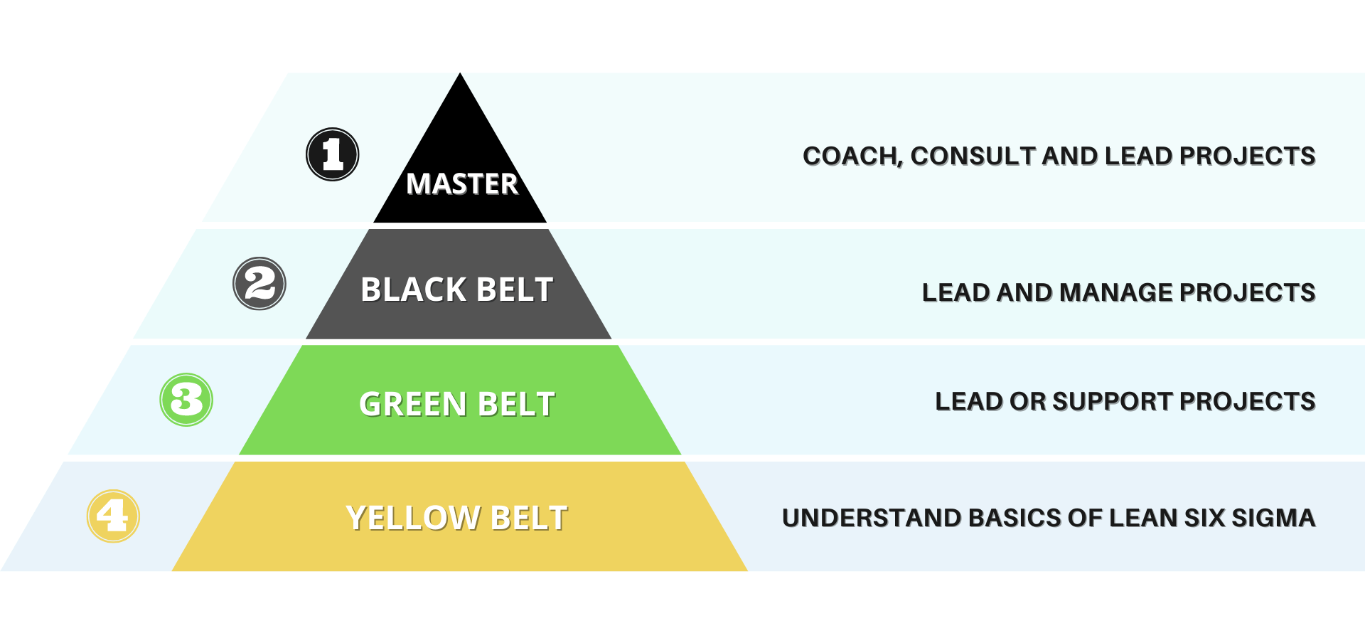
References
Keller, Paul A. (2011) Six Sigma Demystified. New York: McGraw-Hill
McCarty, Tom. (2005) The Six Sigma Black Belt Handbook. New York: McGraw-Hill
Sanchez, J., and Valles-Chavez, A. (2011) ‘Successful Projects from the Application of Six Sigma Methodology’ in Six Sigma Projects and Personal Experiences. IntechOpen.

