Slide 1
Living ‘without’ water
The Giriama, Bore Koromi, Kilifi, Kenya

Slide 2
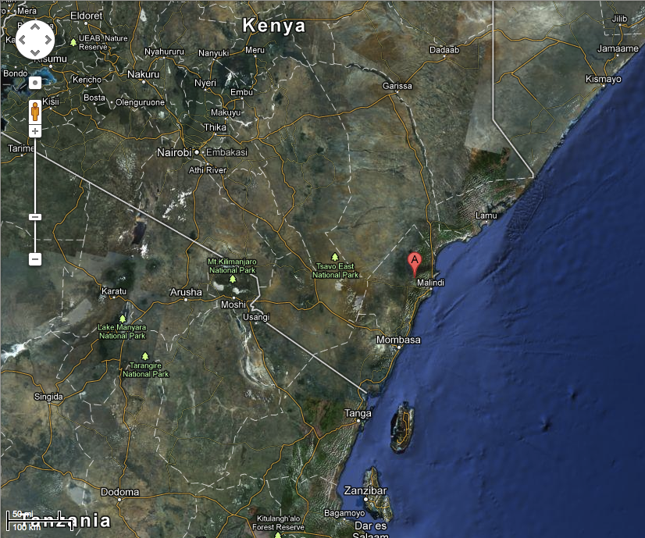
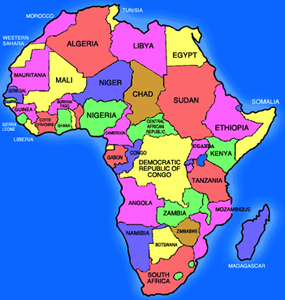
Location/Fieldsite
Bore, Kenya
⬅
⬅
⬅

Slide 3
My role?
To explore the role water plays in current experiences
To study the social, economic and political consequences of piped water coming into a community for the first time
Through years of participant observation I have learnt the meanings of water for these people, as well as learnt from water.

Slide 4
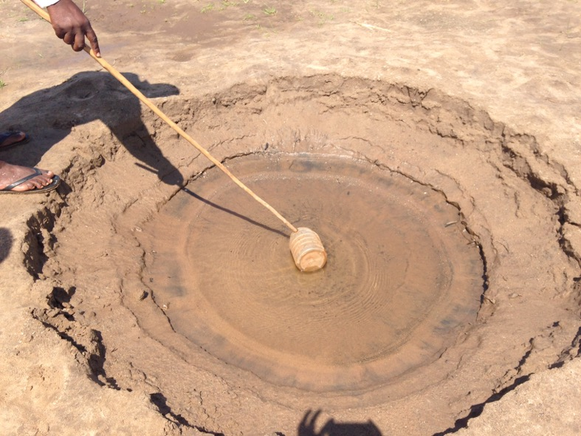
The region
East coast of Kenya
Designated ASAL (arid, semi-arid land) region due to annual rainfall, high air temps and sandy soil
Water sources: seasonal river with water basins
Populations are familiar with drought and have adaptations.

Slide 5
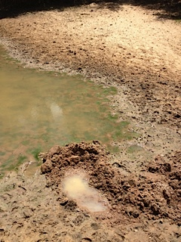
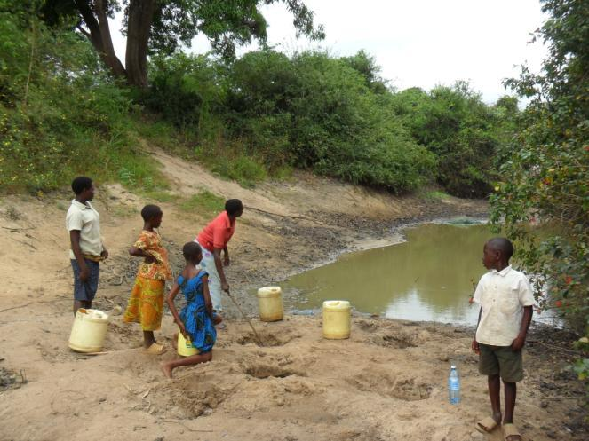
The local water source in 2009
Seasonal river bed of River Koromi
Waiting for the rains to return and fill the basin

Slide 6
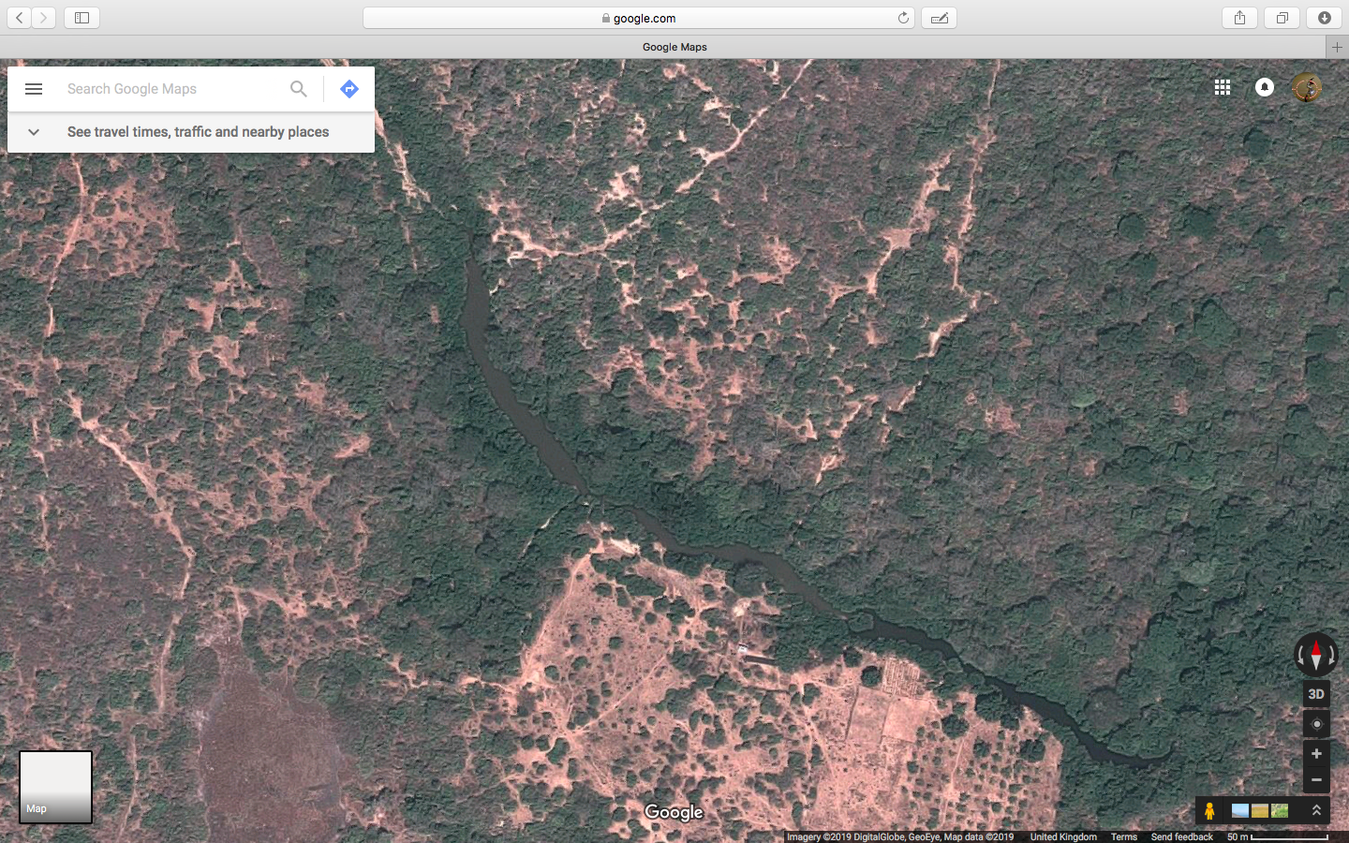

Slide 7
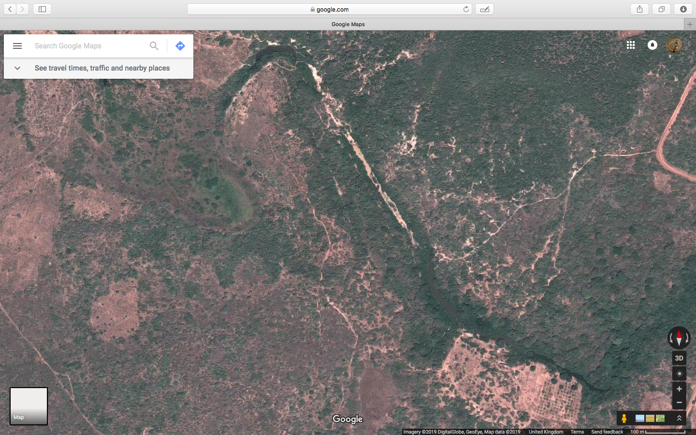

Slide 8
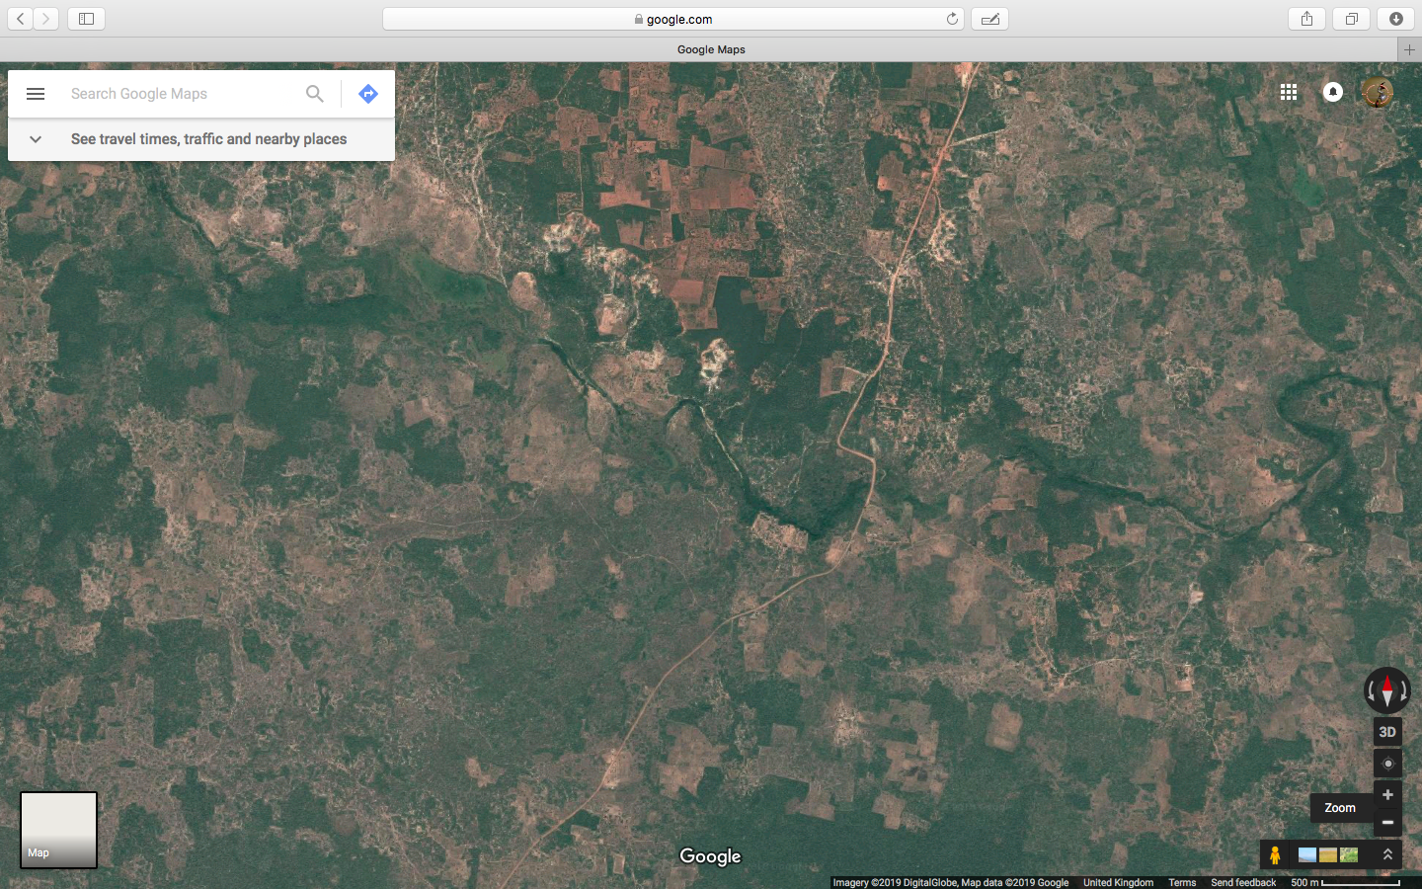

Slide 9
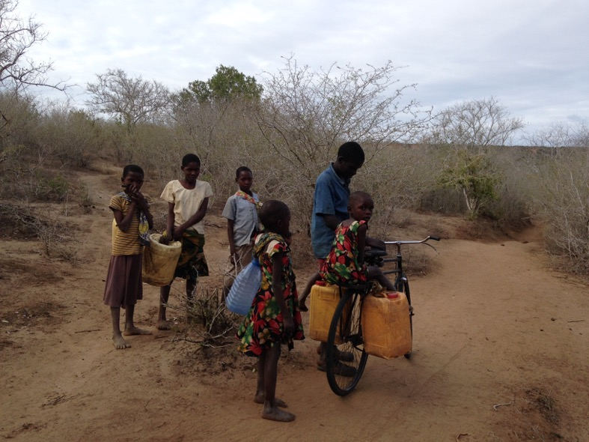
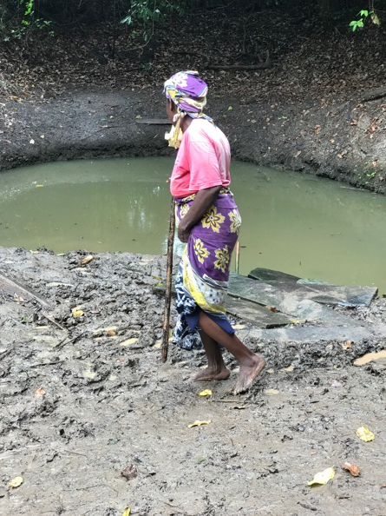
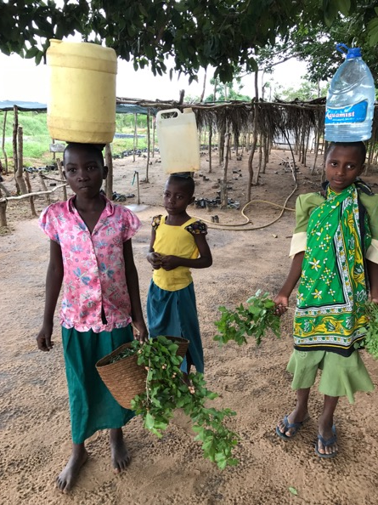
Water must be sought and collected many times a day

Slide 10
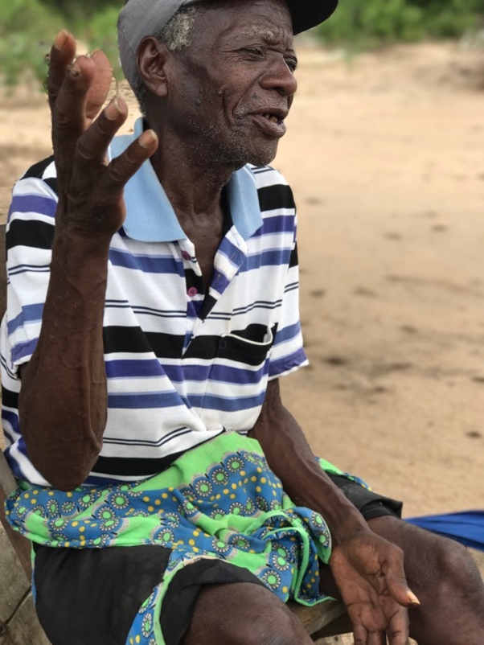
Being Giriama
Subsistence horticultural/pastoralists
Anecdotes state they migrated into the area 400 years ago from an unknown location because of conflict.
“Looking for water is Giriama. We do other things – children, goats, maize – but looking for water is being Giriama” Kusungu Mare, May 2017, pers. comm.)
Kusungu Mare

Slide 11
Water and authenticity
To migrate and retain their culture, the Giriama specialists produced a medicine that held their essence, secrets, powers within it. Stored in a pot they carried it on their travels to ensure they had their authentic selves with them. When the pot smashed, the journey was over because their authentic selves soaked into the soil.
Water is used to produce outcomes as fisi oaths (potions). Ritual practitioners relate to water and bring or ‘hold’ the rain.

Slide 12
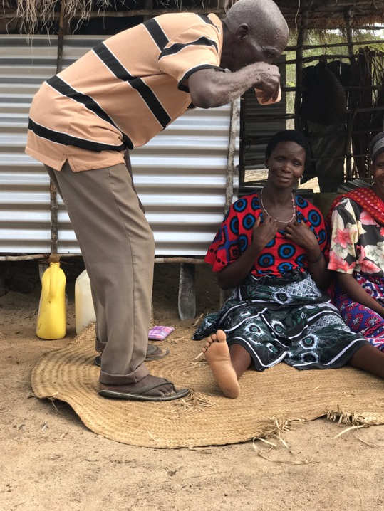
How water Is used and What water can do
Water is used for cooking, cleaning and negotiating with the spirits (potions etc)
Water is used for blessings because it makes the blessing visible; water breaks curses by ‘cooling’.
Water reorders social life when taboos might have been broken, but water also harbours dangers and can bring misfortune if not treated correctly.
Water supplies must be used not stored/held because m’pepo can live in contained water
Mavingane ritual

Slide 13
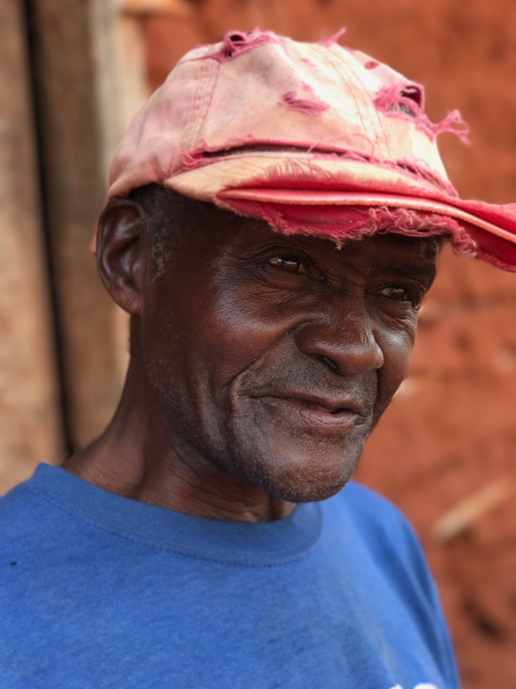
How water behaves shapes Giriama social life
Fu ha mwengA – we are one
Fu ha mwenga is a phrase that punctuates daily conversation. Using it makes people ‘the same’.
It is used to indicate that people are part on a collective. Like water that can be a drop or a stream, the Giriama are individuals together.
“Fu ha mwenga applies here. Water is many, so it is like one as many” (Stephen Ngumbao, May 2017 pers. comm.)
Stephen Ngumbao

Slide 14
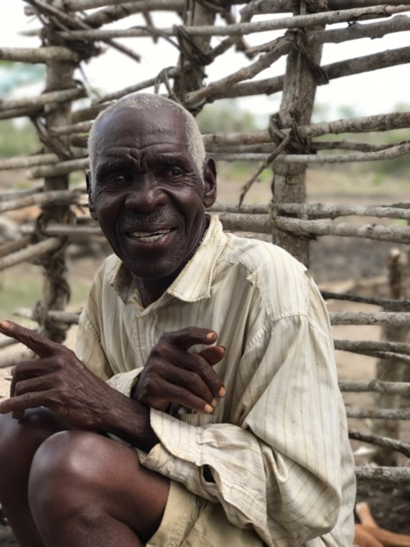
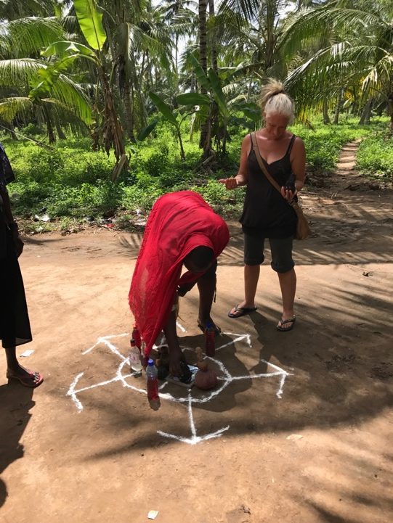
Past practices with water
Daniel, retired m’ganga
In the very recent past, water would be called to the area through ritual as rain.
Rain falls communally and equally.
The power to control water lay in the hands of the m’ganga and elders. Today, as a result of Missionary activities, most m’ganga have stopped working.
Water, therefore, acted as a leveller but was also the control of the water lay in the hands of community members.
Ali Tumbo, current
practitioner

Slide 15
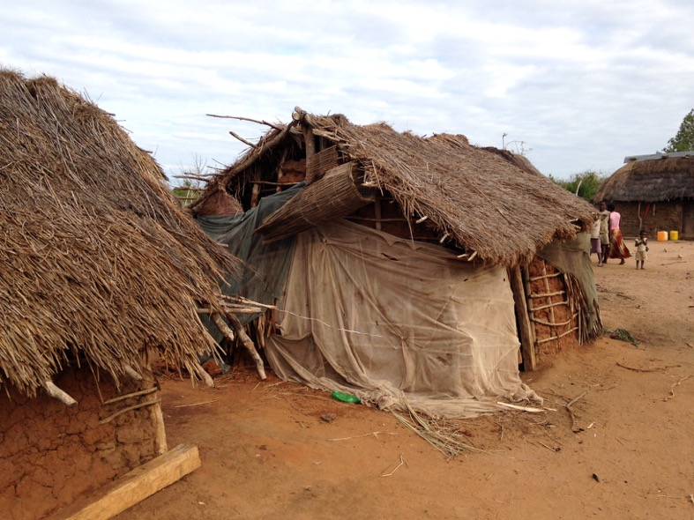
Climate change And the water in Kenya
Regular drought cycles have shortened from 10 years (50 yrs ago) to every 2/3 years meaning populations can’t recover
  Dehydration of all animals
  Harvests are impacted
    Humans fight with baboon population
  Hygiene problematised
  Water borne diseases

Slide 16
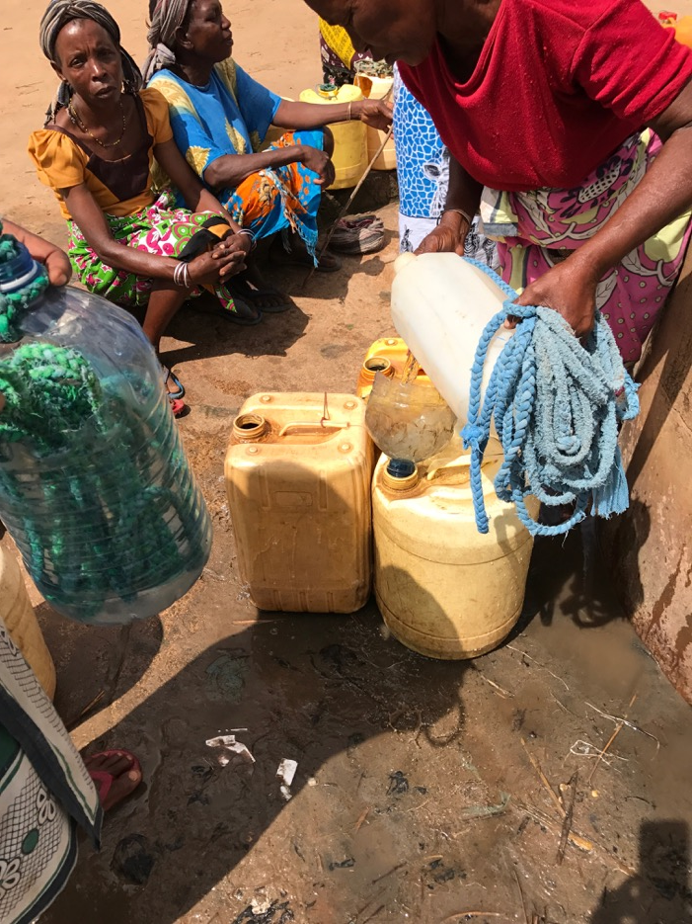
Solution?
Bring a pipeline of water with regular kiosks into the area. (Development paid for by WorldVision American Charity)
Kiosks can be managed for a fee
Water is clean
Water costs per 20l jerry can

Slide 17
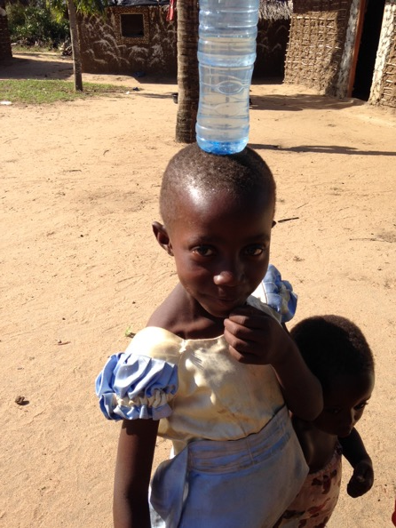
Consequences – economic, social and cultural
In an area without regular wage labour finding cash to buy water is producing difference.
Walking to the river or the kiosk advertises one’s economic abilities.
Where equality and similarity was previously sought (fu ha mwenga) the pipeline encourages individuality – those that can pay and those that can’t.
The power to control water has shifted to MAWASCO (the water company) from the elders.
Ritual crying to the spirits has changed to phoning MAWASCO for water.
Less sickness in young
Some families walk less distances and therefore spend less time collecting water

Slide 18
Conclusion
The implementation of a pipeline of clean water should be hailed as a triumph. However, the construction and running of the system employs the methods of the global north and therefore demand the local population bend to capitalist ideas and methods.

