Slide 1

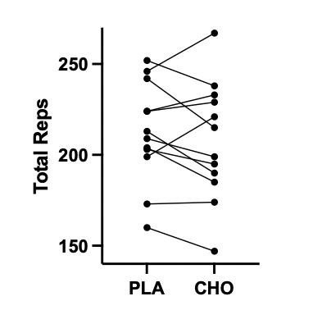
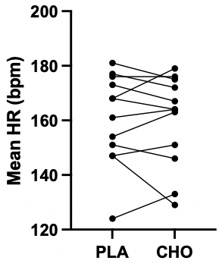
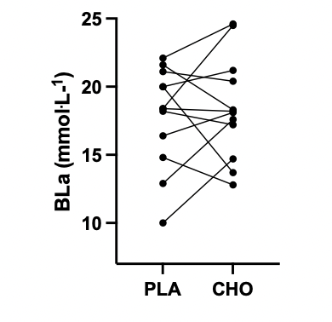
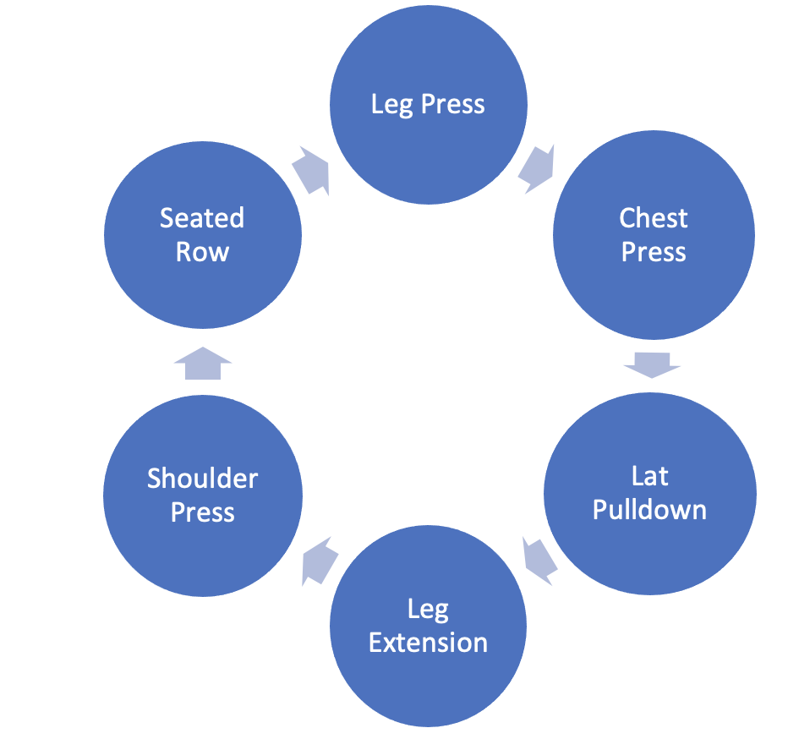
The effect of carbohydrate mouth-rinse on resistance training performance.
Geraint Forster, University of Wales Trinity Saint David
INTRODUCTION
METHODS
RESULTS
The prevalence of morbid obesity in Wales is projected to increase from 3% to 11% between 2015 and 2035 (Keaver et al., 2020). Interventions to combat obesity generally involve creating a caloric deficit. Chronic periods of caloric deficit tend to result in a loss of bone and muscle mass (Wherry et al., 2021).
Maintaining muscle mass during periods of weight loss is important both for health and for maintaining a lower weight in the long-term. Resistance training is the most effective method of maintaining or increasing muscle mass (Wherry et al., 2021).
Periods of energy deficit can increase fatigue and perception of effort, potentially reducing exercise performance and volume.
Studies in endurance exercise have demonstrated that rinsing a carbohydrate (CHO) solution in the mouth without ingesting it can increase exercise performance without increasing caloric intake (Jeukendrup and Chambers, 2010). Some recent studies have suggested that CHO mouth-rinse may also enhance resistance training performance, however results have been equivocal. A meta-analysis by Rodrigues Oliveira-Silva et al. (2022) concluded that more research needed to be performed in this area.
With institutional ethical approval, a double-blind, placebo-controlled, crossover design study was conducted in a counter-balanced manner involving 12 (4 female) recreational resistance training participants (age 28 ±10.8 yrs, height 174 ±9.7 cm, body mass 75.5 ±10.9 kg).
An initial familiarisation session involved determining the 10RM load for each individual for the six resistance exercises illustrated in figure 1.
Participants were then randomly allocated into two groups and attended the facility on two separate occasions 7 days apart, having not consumed any food for at least 2 hours prior.
On each occasion, following a standardized warm-up, participants were given a 25ml mouth rinse of either CHO or PLA and then performed a workout involving 3 continuous circuits (fig 1) performing each exercise to momentary muscular failure, 90 seconds apart. The primary outcome was total repetitions performed in the session, with secondary measures as follows:
Heart Rate on final rep of each set
RPE for each set
Post-session blood lactate (BLa)
Post-session Felt Arousal Scale
Post-session Feeling Scale
A paired-samples t-test was performed on all outcomes to determine any difference between CHO and PLA conditions using a 95% confidence interval (p<0.05)
No significant difference (p>0.05) was found between CHO and PLA conditions for any of the outcome variables. Table 1 shows mean values for each outcome variable. Figures 2-4 illustrate the range of individual variation.
Table 1: Mean (±SD) results of all outcome variables for CHO and PLA.
 | Total Reps (n) | Mean HR (bpm) | Mean RPE (1-10) | BLa (mmol.L⁻¹) | FAS (1-6) | FS (-5 ­- +5)
PLA | 212 (±27) | 161 (±16) | 9.3 (±0.4) | 17.9 (±3.6) | 4.6 (±1) | 0.2 (±2.7)
CHO | 208 (±31) | 160 (±16) | 9.4 (±0.4) | 18.4 (±3.6) | 4.7 (±0.9) | -0.3 (±2.5)
Figure 2: Individual differences in total reps between conditions
Figure 3: Individual differences in mean HR between conditions
Figure 4: Individual differences in blood lactate between conditions
CONCLUSIONS
Findings from this study suggest that a CHO mouth rinse had no effect on resistance training performance or a range of physiological and perceptual outcomes in comparison to a PLA mouth-rinse.
.
OBJECTIVES
To determine if CHO mouth-rinse increased resistance training performance in comparison to a placebo (PLA) mouth-rinse.
To determine if CHO mouth-rinse affected physiological and perceptual measures in comparison to a PLA mouth-rinse during a resistance training session.
REFERENCES
Jeukendrup, A.E. and Chambers, E.S. (2010) 'Oral carbohydrate sensing and exercise performance', Current Opinion in Clinical Nutrition & Metabolic Care, 13(4), pp. 447-451.
Keaver, L., Xu, B., Jaccard, A. and Webber, L. (2020) 'Morbid obesity in the UK: A modelling projection study to 2035', Scandinavian Journal of Public Health, 48(4), pp. 422-427.
Rodrigues Oliveira-Silva, I.G., dos Santos, M.P.P., Learsi da Silva Santos Alves, Sara Kely, Lima-Silva, A.E., Araujo, G.G.d. and Ataide-Silva, T. (2022) 'Effect of carbohydrate mouth rinse on muscle strength and muscular endurance: A systematic review with meta-analysis', Critical reviews in food science and nutrition, , pp. 1-12.
Wherry, S.J., Miller, R.M., Jeong, S.H. and Beavers, K.M. (2021) 'The ability of exercise to mitigate caloric restriction-induced bone loss in older adults: a structured review of RCTs and narrative review of exercise-induced changes in bone biomarkers', Nutrients, 13(4), pp. 1250.
Figure 1: Sequence of exercises in resistance training circuit.

