Slide 1

National Early Warning Score
(NEWS)
The aim of NEWS was to improve patient outcomes with acute illness or deterioration and the impact on outcomes.
(Williams, 2022)

Slide 2
Aims
Explore the function of a NEWS chart.
Examine each section of the NEWS chart and consider any contributing factors which could affect scoring.
Discuss what actions are required after a score is calculated.

Slide 3
Learning Outcomes
Successfully be able to input information into a NEWS chart and calculate a score.
Be able to understand that there are contributing factors that can affect a NEWS score.
Demonstrate what are the next steps, once you have calculated a score and where to find the information.

Slide 4
Respiratory Rate
‘The normal respiratory rates are 12 to 20 respirations per minute for a resting adult.’
(Rodríguez-Molinero A et al. 2013)
What can affect this?
- Medication
High Respiratory Rate: Tachypnoea.
Low Respiratory Rate: Bradypnea.
- Environmental Factors
- Medical Conditions
Let's Score It
- Respiratory Rate: 14

Slide 5
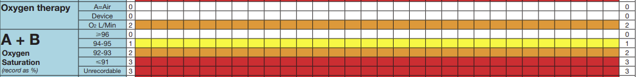
Oxygen and Saturations
Normal blood oxygen levels in humans belong to the range of 95–100%. (Chuiko, G et al 2019)
What can affect this?
Low Oxygen Levels: Hypoxemia
- Medications
- Environmental Factors
- Medical Conditions
Let's score it
- Oxygen Saturations: 97% on Room Air

Slide 6
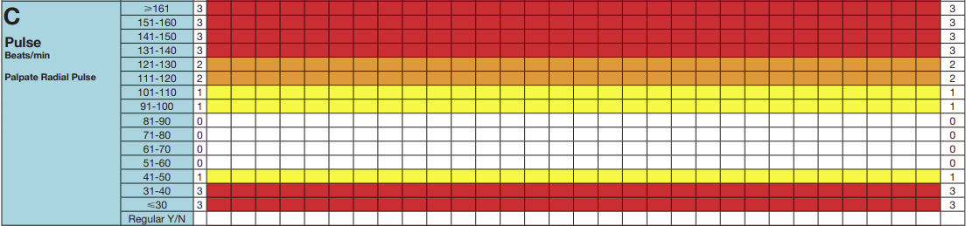
Heart Rate
A normal resting heart rate should be between 60 to 100 beats per minute,
but it can vary from minute to minute. (British heart foundation, 2021)
What can affect this?
High Heart Rate: Tachycardia
Low Heart Rate: Bradycardia
- Medications
- Environmental Factors
- Medical Conditions
Let's score it
- Heart Rate: 66bpm

Slide 7
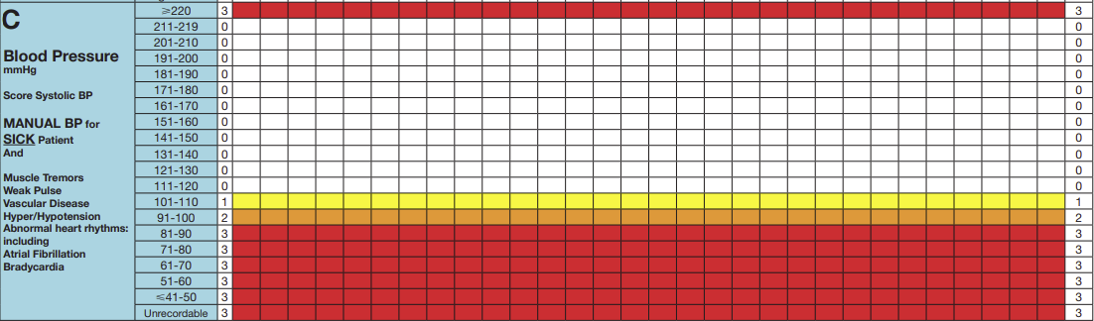
Blood Pressure
NHS (2022) states ‘Blood pressure is measured in millimetres of mercury (mmHg) and is given as 2 figures:
Systolic pressure – the pressure when your heart pushes blood out.
Diastolic pressure – the pressure when your heart rests between beats.
Ideal blood pressure is considered to be 120/80.’
What can affect this?
High Blood Pressure: Hypertension
Low Blood Pressure: Hypotension
- Medications
- Environmental Factors
- Medical Conditions
Let's score it
- Blood Pressure: 131/80

Slide 8
ACVPU
“The patient’s ACVPU status should be assessed. ACPVU stands for alert, confusion (new), response to voice, painful stimuli, and unconscious”. (Cathala X, Moorley C. 2020)
What can affect this?
- Medications
- Environmental Factors
- Medical Conditions
Let's score it
Patient is Alert.

Slide 9
Temperature
NHS(2023) Defines a fever as above 38C and a low temperature is 35C and below.
What can affect this?
High Temperature: Hyperthermia
Low Temperature: Hypothermia
- Medications
- Environmental Factors
- Medical Conditions
Let's score it
- Temperature: 36.4C

Slide 10
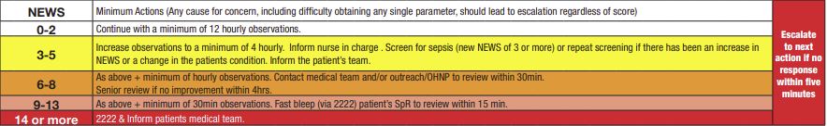
Scoring Guide
Let's Add Up

Slide 11
Parameters
These are acceptable target ranges for patient with chronic conditions.
They must be signed by a Dr, or they are invalid.

Slide 12
Activity
You start your shift and begin to conduct your observations. You come across Mr Jones in bed 2. You conduct his NEWS.
He has a Respiratory Rate of 20.
He is not on any Oxygen and has Saturations of 93%.
His Heart Rate is 84bpm.
His Blood Pressure is 104/73.
He is alert and orientated, showing no signs of confusion.
And his Temperature is 37.2C
What is Mr Jones NEWS score and what do we do next?
His NEWS is 3
Minimum 4 hourly Observations.
Complete Sepsis Screen.

Slide 13
Reference List
WILLIAMS, B. (2022) The National Early Warning Score: from concept to NHS implementation, Clinical Medicine, 22(6), pp. 499-505.
Rodríguez-Molinero A, Narvaiza L, Ruiz J, Gálvez-Barrón C. (2013) Normal respiratory rate and peripheral blood oxygen saturation in the elderly population. J Am Geriatr Soc, 61(12), pp. 2238-2240.
Chuiko, G., Dvornik, O., Darnapuk, Y. and Krainyk, Y. (2019) ‘Oxygen saturation variability: Healthy adults’, International Scientific and Practical Conference on Electronics and Information Technologies, pp. 72-75.
British Heart Foundation (2021) “What is a normal Pulse rate?,” https://www.bhf.org.uk, 6 May. Available at: https://www.bhf.org.uk/informationsupport/heart-matters-magazine/medical/ask-the-experts/pulse-rate#Heading1 (Accessed: September 19, 2023).
NHS (2022) “What is blood pressure?” www.nhs.uk, Available at: https://www.nhs.uk/common-health-questions/lifestyle/what-is-blood-pressure/ (Accessed September 19, 2023).
Cathala X, Moorley C. (2020) Performing an A-G patient assessment: a practical step-by-step guide. Nursing Times,16 (1), pp.53-55.
NHS (2023) “Hypothermia” www.nhs.uk, Available at https://www.nhs.uk/conditions/hypothermia/ (Accessed September 16, 2023)
NHS (2023) “High temperature (fever) in adults” www.nhs.uk, available at https://www.nhs.uk/conditions/fever-in-adults/ (Accessed September 16, 2023)

