Slide 1
ECES5020C
Ymchwil Addysgol
Education Research
Sesiwn 5/ Session 5

Slide 2
Nodau'r Modiwl / Module Aims
Archwilio ystod o ddulliau ymchwil addysgol.
Datblygu dealltwriaeth o ddylunio a gweithredu ymchwil.
To examine a range of educational research methods.
To develop an understanding of research design and implementation.

Slide 3
Deilliannau Dysgu/ Learning Outcomes
Gwerthuso oblygiadau moesegol cynnal ymchwil gyda phlant a phobl ifanc mewn amrywiaeth o gyd-destunau addysgol.
Evaluate the ethical implications of carrying out research with children and young people in a variety of educational contexts.

Slide 4
Deilliannau Dysgu/ Learning Outcomes
Demonstrate a critical awareness of various research methodologies that are relevant to education and their strengths, weaknesses and limitations.
Dangos ymwybyddiaeth feirniadol o amrywiol fethodolegau ymchwil sy’n berthnasol i addysg, a’u cryfderau, eu gwendidau a’u cyfyngiadau.

Slide 5
Gorolwg / Overview
Ymchwil Addysgol
Dulliau Meintiol
Beth?
Sut?
Educational Research
Quantitative Methods
What?
How?

Slide 6
Ymchwil meintiol
Ffocws ar ddata rhif i fesur beth mae pobl yn gwneud, dweud, agweddau ac yn y blaen.
Quantitative Research
Focus on numerical data to measure people’s actions, speech, attitudes and so on

Slide 7
e.e. / e.g.
Cofnodi’r amser mae pobl yn ei gymryd i gwblhau tasg
Cofnodi’r nifer o lwyddiannau neu gamgymeriadau mae pobl yn gwneud mewn tasg
Cofnodi’r sgoriau a geir ar brawf seicolegol (e.e. rhesymu geiriol)
Cofnodi’r nifer o weithiau mae pobl yn dweud rhywbeth yn hytrach na beth a ddywedir
  Record the time people take to perform a task
  Record the number successes or errors people produce on a task
  Record scores obtained on a psychological test (for example, verbal reasoning)
  Record the number of times people say something rather than what is said

Slide 8

Beth yw arbrawf?
What is an experiment?
Ystyrir yr arbrawf yn gyffredinol gan ymchwilwyr meintiol i fod y dull mwyaf dibynadwy ac effeithiol er mwyn arddangos fod un newidyn wedi effeithio ar newidyn arall
The experiment is generally assumed by quantitative researchers to be the most reliable and effective method for demonstrating that one variable has an effect on another variable

Slide 9
Newidyn
y gwrthrych neu’r ffenomenon yr ydym yn ei arsylwi ac mae e’n medru bod yn nifer o wahanol werthoedd
Variable
  the empirical object or phenomenon that we are observing and it can assume a number of different values

Slide 10
Newidyn
Variables
to demonstrate that chocolate is the factor in a child’s diet causing hyperactivity
  chocolate might be alternatively given and withheld
  whilst all other factors are held constant (don’t change)
In this case
  the chocolate is one variable
  and the hyperactive behaviour is another variable
i ddangos taw siocled yw’r ffactor mewn deiet plentyn sy'n achosi gorfywiogrwydd
Gellid rhoi a wedyn peidio â rhoi siocled
Tra bod pob ffactor arall yn gyson (ddim yn newid)
Yn yr achos yma
Sioceld yw’r unig newidyn
Ac mae’r ymddygiad gorfywiog yn newidyn arall

Slide 11
Newidynnau
Variables
Newidynnau annibynnol
Trafodir rhain gan yr ymchwilydd
Rhoi siocled (1)
Peidio rhoi (2)
Independent variables
  These are being manipulated by the researcher
  we give the child chocolate (1)
  or withhold it (2)

Slide 12
Newidyn dibynnol
Y newidiadau a fesurir gan yr ymchwilydd
Lefel y gorfywiogrwydd
Dependent variables
  the changes measured by the researcher
  the level of hyperactivity

Slide 13
Newidyn allanol
Ffactorau eraill allai effeithio ar y newidyn dibynnol
e.e. maint y siwgwr yn neiet y plentyn……
Extraneous variables
  other factors which may be affecting the dependent variable
  E.g. the child’s intake of sugar…….

Slide 14
Newidynnau
Variables
Yn nhermau’r arbrawf, mae ffactorau eraill,
  yn yr enghraifft hon, gall cyfanswm y siwgwr gael effaith bwysig ar ymddygiad orfywiog y plentyn
er yr ystyrir taw effaith y
  siocled oedd yn achosi’r ymddygiad
Gelwir hwn hefyd yn newidyn sy’n drysu
  Oherwydd medr gynhyrchu eglurhad arall yn y newidyn dibynnol
In terms of the experiment other factors,
  in this example, the intake of sugar could have an important effect on the child’s hyperactive behaviour
though it was considered that it was the effect of the
  chocolate which was apparently causing the behaviour
This is also known as a confounding variable!
  As it can produce alternative explanations of change in the dependent variable

Slide 15
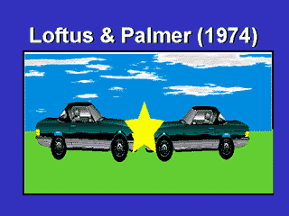
Enghraifft
Estimate of speed experiment
Dangoswyd ffilm fer o ddamwain car.
  Dau gar yn gwrthdaro ar gyflymder isel
  Yn syth ar ôl hynny, holwyd i’r cyfranogwyr i amcangyfrif cyflymder y ceir adeg y ddamwain
Ar gyfer gwahanol gyfranogwyr defnyddiwyd geiriau gwahanol yn y cwestiwn

Slide 16
Example
Estimate of speed experiment
Subjects were shown a short film of an auto accident
  two cars colliding at low speed
  Immediately afterward participants were asked to estimate the speed of the cars at the time of the accident
For different participants different words were used in the question

Slide 17
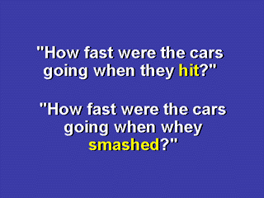
Defnydd o ‘eiriau’ yn y cwestiwn
Yn yr arbrawf hwn, mae’r gair a ddefnyddir i ddisgrifio’r ddamwain yn awgrymu lefel gwahanol o drais (a chyflymder)
Defnyddiwyd y geiriau gwahanol fel newidyn annibynnol:
  “smashed”
  “hit”
  “bumped”
  “collided”
Newidyn dibynnol: amcangyfrif cyflymder y ceir

Slide 18
Use of ‘Words’ in the Question
In this experiment the word describing the accident implies a different level of violence (and speed)
For subjects, the words bumped or collided were used as Independent variable:
  “smashed”
  “hit”
  “bumped”
  “collided”
Dependent variable : the estimation of car speed

Slide 19
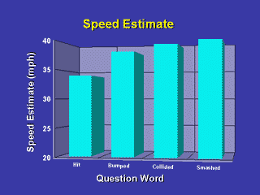
Yr Astudiaeth
Dylanwadwyd ar amcangyfrifiadau cyflymder y cyfranogwyr gan
  Y gair a ddefnyddiwyd i ddisgrifio grym y ddamwain
  Dydi’r rhifau ar yr echel –y ddim yn gywir, ac yn dangos gwerth cymharol yr amcangyfrifon
Mae’r uchod yn dangos y cyflymder canolig a amcangyfrifwyd gyda’r geiriau ar waelod y graff.

Slide 20
The Study
Participants' speed estimates were clearly influenced by
  the choice of word used to describe the force of the accident
  Numbers on the y-axis are not accurate, and only illustrate the relative value of the estimates
This figure above shows
the average speed estimate of subjects asked
with the words listed
at the bottom of the figure

Slide 21
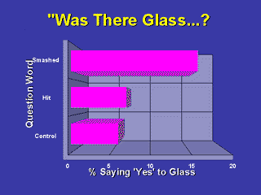
Wythnos yn ddiweddarach
Holwyd i'r cyfranogwyr os oedd gwydr lle oedd y ddamwain
  Roedd cyfranogwyr yn fwy tebygol o ddweud ‘oedd’
    Hyd yn oed os nad oedd gwydr yn y cwestiwn gwreiddiol os oedd y cwestiwn cyflymder gwreiddiol wedi defnyddio’r gair “smashed” yn hytrach na “hit”
Ni ofynnwyd y cwestiwn cyflymder i’r grwp rheolydd yn yr wythnos gyntaf

Slide 22
A Week Later
Participants were asked if there was glass at the scene of the accident?"
  Participants were more likely to say 'yes‘
    even though there was no glass if the original speed question had used the word “smashed” than if it had used the word “hit”
The control condition group had not been asked about speed the previous week

Slide 23
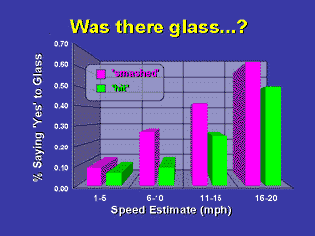
Ateb i’r cwestiwn gwydr
Yn cael ei ddylanwadu gan amcangyfrif cyflymder gwreiddiol y cyfranogwyr
  Heb ystyried y gair a ddefnyddid i holi am yr amcangyfrif cyflymder
  Cynyddodd yr amcangyfrifon cyflymder
    Ac hefyd y tebygolrwydd hwyrach o ddweud bod gwydr lle oedd y ddamwain

Slide 24
Answer to the Glass Question
influenced by the subjects' original speed estimates
  regardless of the word used to elicit those speed estimate
  The original speed estimates increased
    so did the later probability of saying there was glass at the scene of the accident

Slide 25
Tasg 2 / Task 2
Beth fyddai’r
Newidyn Annibynnol (IV)
Newidyn Dibynnol (DV)
mewn arbrawf lle roedd y cyfranogwyr naill ai
Yn newynnu
Neu yn cael pryd o fwyd
Ac wedyn yn cael eu hasesu am gofio geirfa am fwyd
What would be the
  Independent variable (IV)
  Dependent Variable (DV)
in an experiment where participants were either
  kept hungry
  or given a meal
  and then assessed for their recall of food words

Slide 26
Gweithgaredd: Atebion Cywir
Activity: Correct Responses
Gan taw ‘newyn’ oedd yn cael ei drafod er mwyn arsylwi ar unrhyw effaith ganlynol…..
IV
yw lefel y newyn
DV
yw’r nifer o eiriau bwyd a gofir
As ‘hunger’ was being manipulated to observe any consequent effect on recall …..
IV
  is the level of hunger
DV
  number of food words recalled

Slide 27
Rheoli’r Newidyn Allanol
Controlling Extraneous Variables
Er mwyn cynyddu dibynadwyedd a dilysrwydd eich astudiaeth/arbrawf:
mae’n holl bwysig ceisio rheoli cynifer o agweddau o’r astudiaeth â phosib
Mewn astudiaethau, lle’n bosib
dylid defnyddio gweithdrefn strwythuredig
dyma lle mae’r holl gyfranogwyr yn cael eu profi
Yn yr un lle
O dan yr un amgylchiadau
Gan ddefnyddio’r un cyfarfpar
In order to increase the reliability and validity of your study/experiment
  it is essential to try and control as many aspects of the study as possible
In studies wherever possible,
  a standardised procedure should be used
  this is where all participants are tested
    In the same place
    Under the same conditions,
    Using the same equipment

Slide 28
Rheoli’r Newidyn Allanol
Controlling Extraneous Variables
Dylai hyn fod yn wir am yr ymchwilydd hefyd.
Darganfuwyd bod
  ymchwilwyr benywaidd a gwrywaidd
  yn treulio mwy o amser yn caslu data oddi wrth gyfranogwyr o’r rhyw arall (Rosnow & Rosenthal 1997)
Medrai hyn gael yr effaith o wahaniaethau dryslyd yn y newidyn dibynnol
This should also apply to the researcher
  it has been found that both
    male and female researchers
    take longer to collect data from a participant of the opposite sex (Rosnow and Rosenthal 1997)
This could have the effect of confounding differences in the dependent variable

Slide 29
Y Newidyn Allanol: Gogwydd
Extraneous Variables: Bias
  Gellir darganfod gwahaniaethau mewn arbrofion o ganlyniad i newidynnau gyda chyfranogwyr
  sydd yn ffactorau ynom i gyd
    Gallu
    Rhyw
    Oed
Differences may be found in experiments as a result of participant variables
  that are pre-existing factors among people
    Intelligence
    Gender
    Age

Slide 30
Y dull arferol i rheoli hyn yw
  Dyrannu’r cyfranogwyr ar hap i amodau amrywiol yr arbrawf
  Fe fydd y gwahaniaethau wedyn yn cael eu gwasgaru’n gyson ar hyd yr arbrawf
The usual way to control for this is to
  randomly allocate all participants to the various experimental conditions
  in this way any such differences would be spread evenly across the conditions of the experiment

Slide 31
Ystadegau / Statistics

Slide 32
Cymedr /Mean
Os adiwch grŵp o rhifau a rhannu’r cyfanswm gyda’r nifer o rifau yn y set, fe gewch chi’r cymedr.
2 5 3 7 5 8 9
2 + 3 + 5 + 5 + 7 + 8 + 9 = 39
39 ÷ 7 = 5.57 (6)
6 yw’r cymedr
Ymarfer
A group of numbers added together and divided by the number of numbers in the set - this is the mean.
  2 5 3 7 5 8 9
  2 + 3 + 5 + 5 + 7 + 8 + 9 = 39
  39 ÷ 7 = 5.57 (6)
  6 is the mean
Practice

Slide 33
Modd / Mode
Y modd – rhif ffasiynol!
Y rhif sy’n digwydd amlaf
2 5 3 7 5 8 9
Rhowch eich rhifau mewn trefn
2 3 5 5 7 8 9
5 yw’r modd
Ymarfer
The mode - a fashionable figure!
  The number that occurs most often
  2 5 3 7 5 8 9
  Order your numbers
  2 3 5 5 7 8 9
  The mode is 5
  Ymarfer
Notes:
Often useful for seeing trends
indications of a normal or usual figure
Mode is often used as the notion of an ‘average person’
useful for when numbers are not evenly spread
All three averages are know as measures of central tendency

Slide 34
Canolrif / Median
The central point of a set of numbers
  2 5 3 7 5 8 9
  Next sort in ascending order
  2 3 5 5 7 8 9
  Then select the middle number
  5 is the median
  Practice
Y rhif canol mewn set o rifau
2 5 3 7 5 8 9
Rhowch nhw mewn trefn esgynnol
2 3 5 5 7 8 9
Yna dewiswch y rhif canol
5 yw’r canolrif
Ymarfer

Slide 35
Gwasgariad ac Amlder
Distribution and Frequency
Gwasgariad Normal
  Amlder - y nifer o weithiau mae rhywbeth yn digwydd
  Gwasgariad – pa mor eang ydynt
The normal distribution
  Frequency - the number of occurrences
  Distribution - the spread

Slide 36
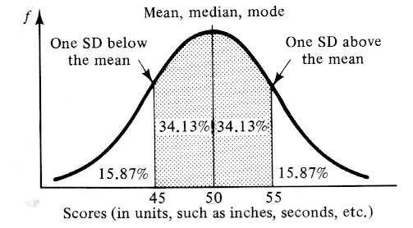
Mean - Mode - Median
The normal distribution

Slide 37
e.e./ e.g.
Taldra pobl
Bydd y rhan fwyaf o gwmpas y canol,
Bydd rhai yn llawer talach a rhai yn llawer byrrach
Height
Most people will be around the mean / mode/ median
Some will be much taller and some will be much shorter

Slide 38
Gwyriad Safonedig
Standard Deviation
Number which indicates how much, on average, the scores in a distribution differ from a central point, the mean.
Y rhif sy’n dangos faint, ar gyfartaledd, mae’r sgoriau mewn dosbarthiad, yn gwahniaethau o’r man canol, y cymedr.

Slide 39
Amrediad / Range
Mae’r amrediad o’r sampl neu set o ddata
  yn fesur o’r lledaeniad o’r arsylwadau
Y gwahaniaeth rhwng y gwerth uchaf a’r gwerth isaf a arsylwyd o nodwedd rhifol
The range of a sample or a data set
  is a measure of the spread or the dispersion of the observations
The difference between the largest and the smallest observed value of some quantitative characteristic

Slide 40
Cohen,L., Manion. L & Morrison, K. ( 2011) Research Methods in Education , 7th Edition. Oxon: Routledge
Loftus, E. F., and Palmer, J. C. (1974) Reconstruction of Automobile Destruction, Journal of Verbal Learning and Verbal Behavior, 13 , 585–589, 1974.

