Slide 1
Current Issues
ACAA6007
Lara Hopkinson
Senior Lecturer
lara.hopkinson@uwtsd.ac.uk

Slide 2

Referencing 101

Slide 3

Why do we reference?

Slide 4
When do we reference?

Slide 5
What referencing scheme do we use?

Slide 6

Harvard referencing system

Slide 7
A quick quiz…..
Fill in the table below with example citations, as outlined:
Author​ | Citation​
Single person ​ | e.g.
Two or three people​ | e.g. ​
Four or more people​ | e.g.
Organisation​ | e.g. ​
Web page​ | e.g.

Slide 8
A quick quiz…..
Fill in the table below with example citations, as outlined:
Author​ | Citation​
Single person ​ | e.g. Smith, 2018​
Two or three people​ | e.g. Smith & Havers, 2019​ e.g. Havers, Fielding & Jones, 2022
Four or more people​ | e.g. Smith et al, 2020
Organisation​ | e.g. NASA, 2022​
Web page​ | e.g. BBC, 2021​ e.g. UK Government, 2019​ e.g. Designing Buildings Wiki, 2018​

Slide 9
Some guidance…
Try to avoid using the came citation over and over​
  Why could this be important?​
You can name the author in text – how do you cite this?​
  Smith (2014) suggests that xyz​
  NASA (2022) how that xyz​
  It is noted in the work of Jones (2020) that using waste as a by product is a good use of resources.​

Slide 10
Some more guidance…
The citation can be used where needed, or at the end of the sentence​
  Construction is a wasteful process (Jones, 2019), using a great deal of resources.​
  Construction is deemed an important sector of the economy (HM Government, 2013).​
If you use multiple sources, list these at the end of the sentence in publication year order​
  Several researchers agree (Hughes, 2024; Kelvin, 2022; Smith, 2020).​

Slide 11
What about multiples of the same author and year?
This can happen e.g. Government documents​
  At broader strategy level, the UK Government has indicated its ambition to lead in the clean growth of the economy as a whole (lowering carbon emissions and using resources more efficiently) (HM Government, 2018; HM Government,2017a; HM Government, 2017b). ​
Suffix with a, b, c, etc. in the text​
Make sure these are also in the reference list​

Slide 12
Quotations
Useful where paraphrasing is difficult​
Should be used sparingly​
  Why do you think this is important?​
Needs clear definition​
Always ask the question:​
  Could I paraphrase this?​

Slide 13
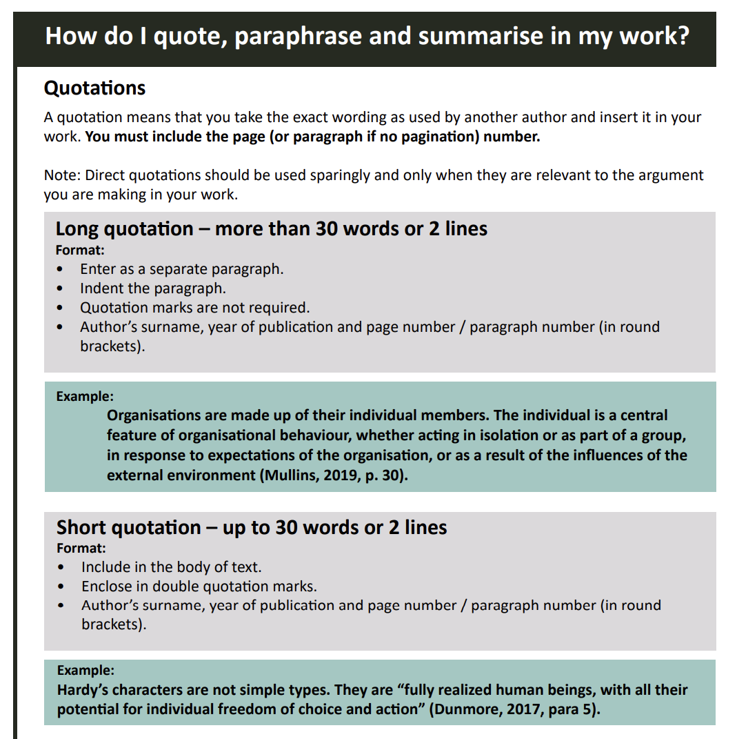
Source: UWTSD Harvard referencing guide, 2025

Slide 14
The reference list…
How should you present this?
What information is required?
Use the Harvard referencing guide to help you!
If using software, ensure it is set correctly
  Also, correct entry of information is critical

Slide 15
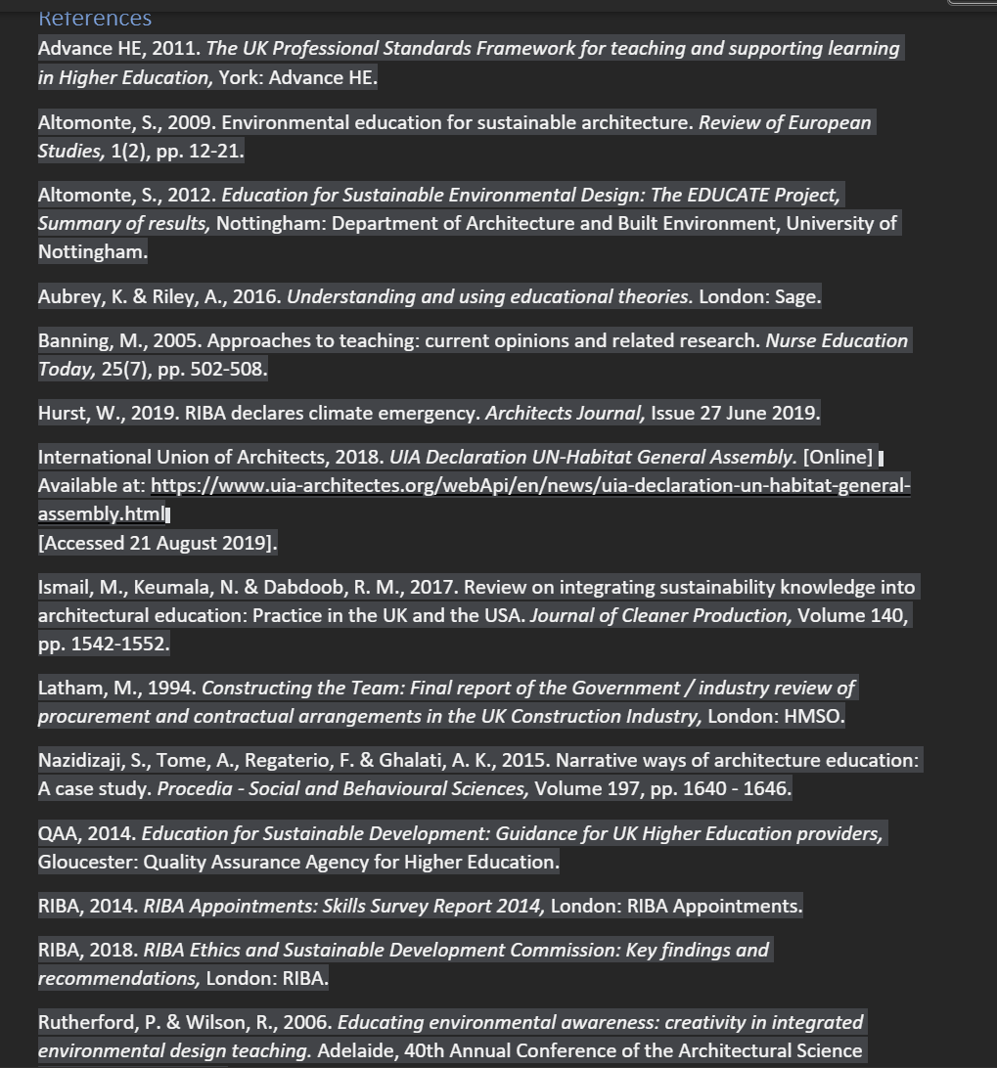
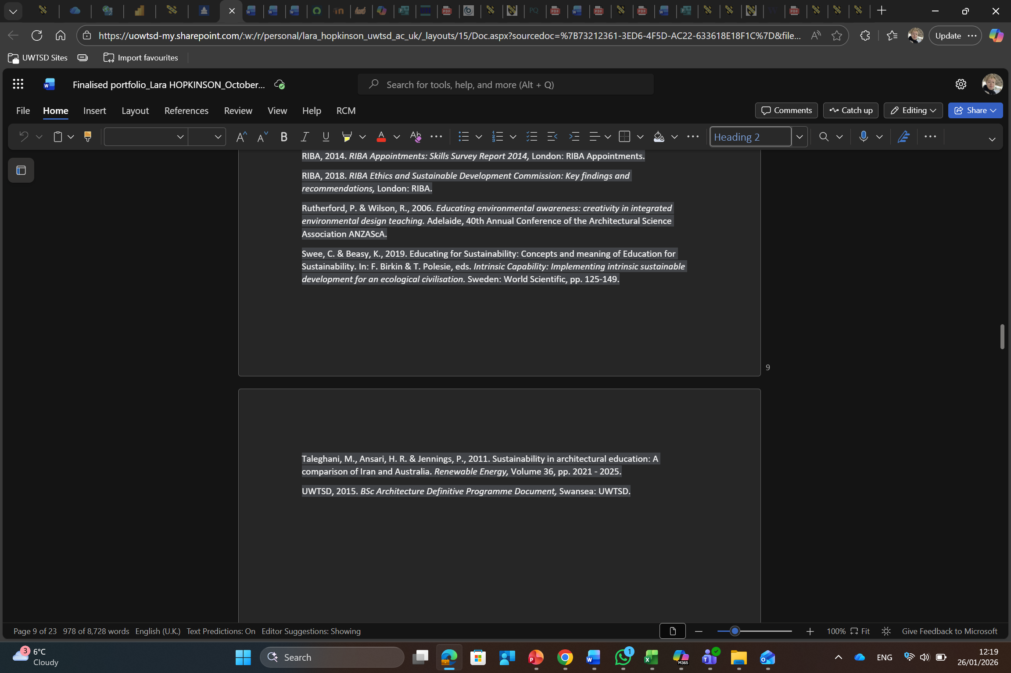
An example

Slide 16
How do you search for sources?

Slide 17
Some guidance…..
Use the UWTSD online library!
Ensure more engagement with academic literature
Use databases accordingly
  ScienceDirect is very good for this module!
Ask tutors
Talk to the Academic Liaison Librarian
  Emily Wild, emily.wild@uwtsd.ac.uk

Slide 18
How to label a figure?

Slide 19
How to label a figure?
What do you already know?
Label applies under the figure used
Begin at figure 1
Provide a relevant title to your figure
Finally, provide the valid citation of its source
OR if you designed this yourself, cite yourself

Slide 20
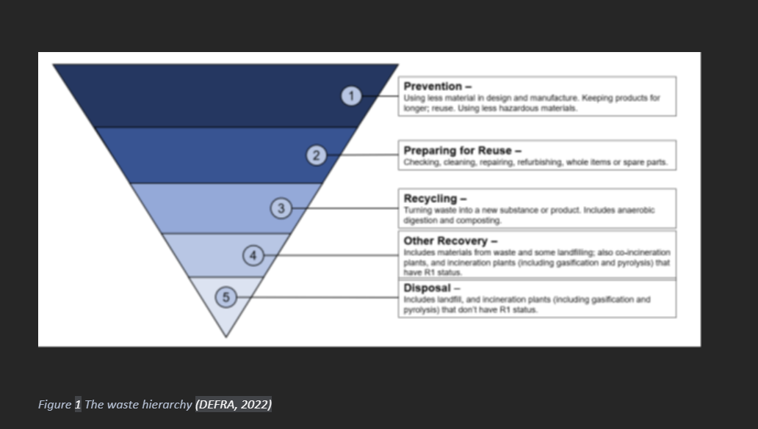
An example….

Slide 21
What about labelling a table?
What do you already know?
Label applies above the table
Begin at table 1
Provide a relevant title for your table
Provide a relevant citation, OR ensure citations are provided throughout

Slide 22
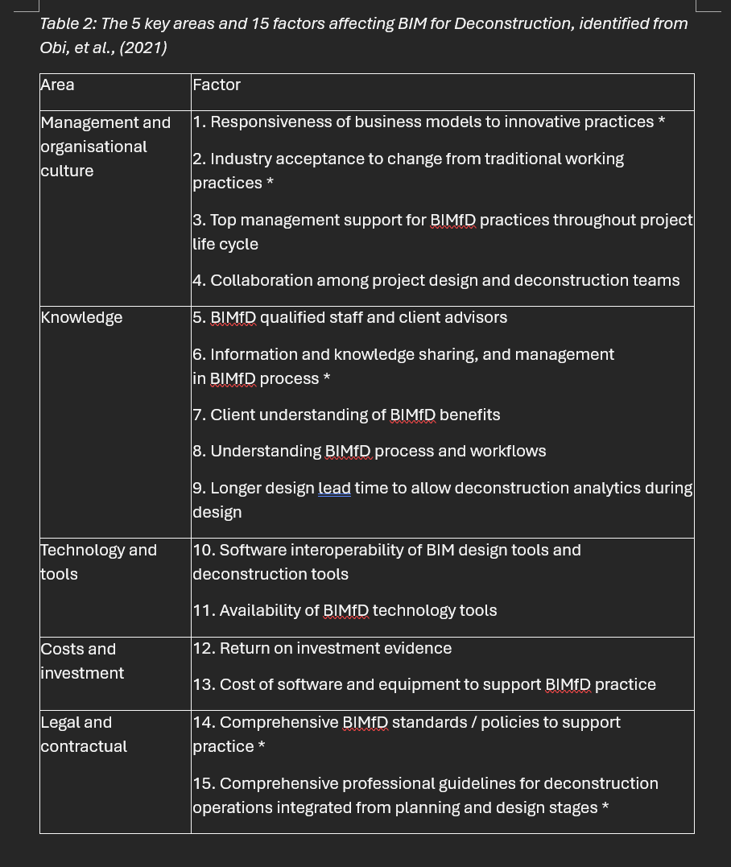
An example…

