Slide 1


THEORIES AND
IDEAL VICTIM
BMLC5014
WEEK- 3
Nerys Musgrove
n.musgrove@uwtsd.ac.uk

Slide 2
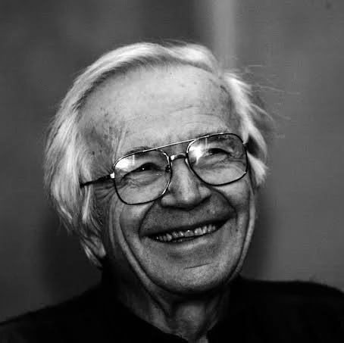
Nils Christie
A Norwegian Sociologist and Criminologist.
He pioneered the ‘ideal victim’ theory in 1986 where he describes a socially constructed status where certain people who experience crime are most readily granted complete and legitimate sympathy and support from society and the media

Slide 3
‘Ideal Victim’ Theory
Core Definition
Legitimate Status: An Ideal Victim is a person or group who easily receives full social and legal recognition as a true victim.
Social Construct: Victimhood is not just about the event itself, but how society perceives the morality and vulnerability of the person involved.

Slide 4
‘Ideal Victim’ Theory
Five Key Characteristics
The Victim is Weak: The person is physically, socially, or age-wise vulnerable, such as being very young, elderly, or sick.
Carrying Out a Respectable Project: The victim was doing something normal, moral, and approved by society (like going to school or work) when the crime occurred.
Blameless Location: The victim was in a place where they could not be blamed or accused of asking for trouble.
The Offender is "Big and Bad": The perpetrator is seen as dangerous, menacing, or alien to normal society.
The Offender is Unknown: The attacker has no personal or prior relationship to the victim, ensuring a clear division between good and bad.

Slide 5
‘Ideal Victim’ Theory
Impact and the Hierarchy of Victimhood
Undeserving Victims: When victims do not match these traits (such as individuals involved in drug use or gang activity), society often blames them, creating a hierarchy where they receive less empathy.
Role of the Media: News outlets and storytelling amplify cases matching the ideal victim criteria because they evoke strong emotional reactions from the public.

Slide 6
Class Task
In groups look for real cases that validate and challenge the ‘ideal victim’ theory. Also consider whether the media played a part in the cases you are looking at.

Slide 7

From this theory alone, can you identify any barriers to reporting for some victims?

Slide 8
Why does is matter?
A victim is a victim regardless of who they are, what their background is or how they look
There is no specific characteristic that can pinpoint an actual victim
Humans are naturally judgemental - Can impact on recognising victims
Impact on how they are treated by both society and CJS
Can lead to victims being unsupported, not believed and or revictimised.
which is why we need to understand victimology and the concept of an ideal victim

Slide 9
Why do we make assumptions and create stereotypes?
Basically….
From the moment we are born our brains are bombarded with information 24/7 and to cope, our minds compartmentalise aspects
To conserve mental capacity, the brain creates shortcuts to retrieve certain information at a moments notice to ‘survive’ the environment and or to anticipate what comes next
The brain uses its senses and previous experiences and social norms to create these shortcuts to make snap decisions, and in turn assumptions

Slide 10

Stereotypes
A stereotype is a widely held but fixed and oversimplified image or idea about something or someone
It is a belief system based on a few perceived characteristics – e.g. the way they look or behave
Example
Poor people are just lazy
People who wear glasses are nerds

Slide 11
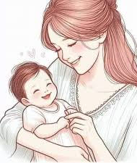

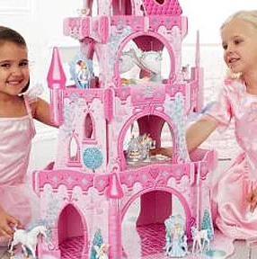
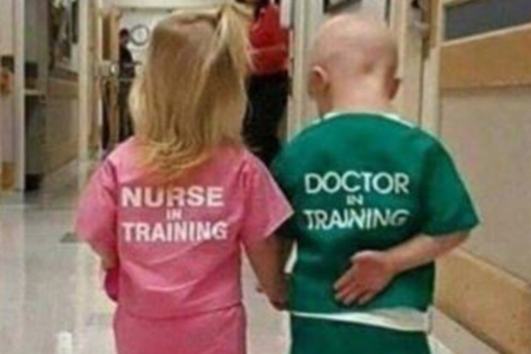
Gender role stereotypes
These are often held, but unconscious beliefs about gender roles.
Boys don’t cry
Women can’t drive
Men are breadwinners
Men are strong, women are emotional
Housewife
Women are nurses
Men are doctors

Slide 12
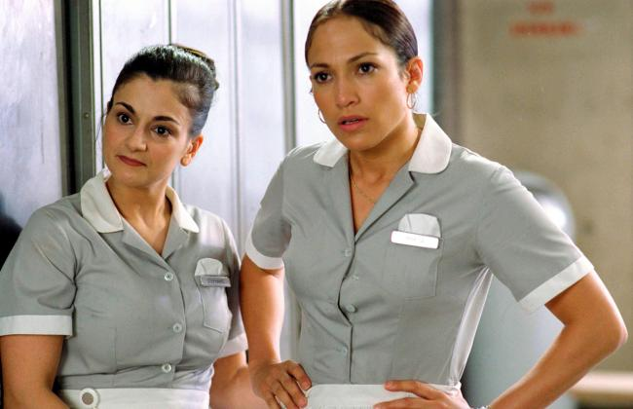

Racial stereotypes
All Asians are smart
Latino/Spanish people are cleaners or janitors

Slide 13
Class Task
In groups discuss the impact stereotyping can have on individuals.

Slide 14
What are the negatives of stereotypes or assumptions?
Stereotypes assume that a whole group is the same and doesn't factor for individuality
Can limit a person’s world
Create prejudice
Divides people- fosters an ‘Us and them’ mentality e.g. in schools
  Bullying
  Harassment
  Depression
  Anxiety
Can create a threat for people
E.g. Muslims, Jews, Christians, Trans people
It creates an excuse for people e.g. I can’t do it because I am a woman, child, too old, too young.

Slide 15

Unconscious bias
Unconscious bias is when a person unintentionally/involuntarily makes judgements or holds a belief system about others, based on previous experiences, assumptions or interpretations
The term refers to attitudes and beliefs we hold towards social groups that occur outside of our conscious awareness yet influence our responses

Slide 16
Different types of bias
Halo/horns bias- where we allow a single trait, action, event or behaviour, halo (good) or horns (bad), to overshadow all others that follow.
Beauty bias- When a person judges another based on how attractive they are
Affinity bias- The tendency to favour individuals who are similar to ourselves, whether through shared background, experiences, or interests.
Confirmation bias- The inclination to seek out and interpret information in a way that confirms one's existing beliefs or ideas, while disregarding contradictory evidence

Slide 17
Can you think of a time where you have unknowingly been biased?
Care to share?

Slide 18

Theories of victimology

Slide 19
What is victimology?
It is the scientific study of crime victims, coined by Benjamin Mendelsohn in 1947
Much like criminology is the study of criminals, What they do and why, victimology is the study of causes of victimisation (how people become victims)
Its consequences
How the CJS assists and treats victims
It also incorporates how society, such as the media, deal with victims of crime – how they are portrayed etc

Slide 20
Positivist perspectives
Coined by Hans von Hentig and Benjamin Mendelsohn in the 1940s and 1950s
Focus is on identifying characteristics, patterns or behaviours that increase a person's risk of being victimised.
Focus is on the relationship between the offender and victim and how the victim may have contributed to the crime
Victim proneness and victim precipitation
e.g. initiating sexual assault or domestic violence
Burglary, victim left their door unlocked which allowed the offender access

Slide 21
Core ideas
Miers (1989) identified three key features of positivist victimology:
  -Identifies factors and patterns of victimisation, focusing on who is more likely to be victimised across age, gender, class, and ethnicity
  -Concentrates on interpersonal crimes of violence
  - Aims to identify victims who may contribute to their own victimisation through behaviour or lifestyle
Example
Wolfgang (1958)
A study of 588 homicides in Philadelphia found that 26% involved victim precipitation, where the victim triggered the event (e.g., by starting a fight)

Slide 22
Strengths of this perspective
Highlights patterns of victimisation
  Draws attention to the fact that some groups are more at risk (e.g. women, the poor, and minorities)
  Makes it possible to design crime prevention policies targeting at-risk groups
Identifies interactions in crimes
  Wolfgang’s homicide study shows that victim–offender relationships can play a role in triggering violence
  In some violent encounters, it is largely by chance which party becomes the victim

Slide 23
Criticism of Positivist perspective
It places blame on a victim as though they had a part to play in their crime
- e.g. victims of sexual crimes can be seen as on trial too
It doesn’t account for corporate and state crimes, this approach fails to adequately address forms of victimization where the harm is perpetrated by institutions, such as corporate negligence or environmental crimes
It overlooks outside factors such as poverty, inequality and patriarchy
It doesn’t explain why some are consistently more at risk than others

Slide 24
Critical Victimology
Born from the limitation of the positivist perspective
Examines how social structures (e.g., patriarchy, capitalism) and power imbalances shape victimization.
It acknowledges that victimhood is socially constructed (e.g. race, class and gender)
It focuses on how the state defines who counts as a victim: the state has the power to grant or deny victim status
  E.g., police choosing not to prosecute a man for domestic abuse effectively denying the woman recognition as a victim

Slide 25
The role of the media in critical victimology
Christie (1986) argued that the media have the ability to shape public perception of victimhood, that some victims are seen as more ‘ideal’ than others
Victims from poorer backgrounds (low socioeconomic standing) or those are from minority backgrounds are often ignored or devalued.

Slide 26
Why do people become victims of crime?
Usually a combination of personal, social, and environmental factors:
Vulnerability: Certain groups, such as the elderly, children, and individuals with disabilities, may be more vulnerable to crime due to their physical or social limitations
Socioeconomic Status: People living in poverty or in economically disadvantaged areas are often at higher risk of becoming victims of crime. Limited resources and opportunities can increase exposure to criminal activities
Lifestyle and Routine Activities: Engaging in certain activities or frequenting specific places can increase the likelihood of victimisation.
Previous Victimisation: Individuals who have been victims of crime before are sometimes more likely to be victimised again. This can be due to various factors, including psychological impacts and changes in behaviour
Social Environment: Being part of a social network that includes individuals involved in criminal activities can increase the risk of becoming a victim.
Lack of Awareness: Not taking necessary precautions, such as securing one's home or being aware of surroundings, can make individuals more susceptible to crime

Slide 27

What are the theories?
What are the theories that explain why people become victims?
Here are some theories to explain why:
-Victim Precipitation Theory
-Lifestyle Theory
-Deviant Place Theory
-Routine Activities Theory
We’ll do a quick recap of these theories before looking at some new ones.

Slide 28
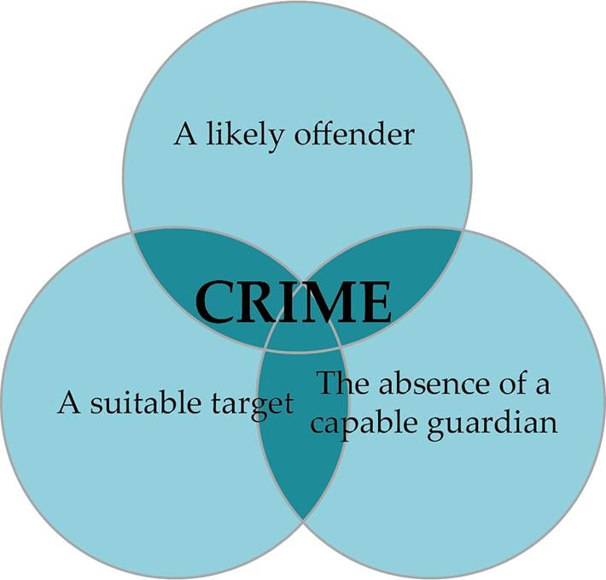
Routine Activities Theory
Cohen and Felson (1979)
A crime requires 3 elements
Its focus is on situations where crimes can happen rather than offenders.
The availability of suitable targets, such as homes containing easily saleable goods.
The absence of capable guardians, such as police, homeowners, neighbours & home security.
The presence of motivated or likely offenders, ready to engage in criminal behaviour.

Slide 29
Theory limitations
It is a narrow view, it doesn’t factor in social context
It is built on the idea of rational choice – doesn’t account for impulsive crimes
It risks placing an element of blame on the victim – wrong place, wrong time

Slide 30
Lifestyle Theory
Hindelang, Gottfredson, and Garofalo (1978)
Lifestyle choices e.g. Drug use, sex work, Visiting dangerous places/people
Increases your exposure to risk
Raises probability of becoming a victim
Closely related to Routine Activity Theory, this theory also suggests that crimes occur when 3 aspects converge –
Suitable target
Absence of protection
Motivated offender
However, this theory emphasises that the ‘victim’s’ life choices contribute to their victimisation.

Slide 31

Deviant place theory- Rodney Stark(1987)
Has an overlap with lifestyle theory
Posits that individuals are more likely to become victims if repeatedly exposed to areas of high disorganisation (Deviant places)
This exposure increases their risk of being victimised.
Does not focus on the person or their lifestyle, but their location

Slide 32
Victim Precipitation Theory
This theory argues that a victim's actions can contribute to or instigate the crimes or harms done to them
Their characteristics can precipitate the crime
E.g. a hate crime against a minority person, their minority played a part so to speak.
This theory does not only involve hate crimes directed at specific groups of people. It might also involve occupations or activities.

Slide 33
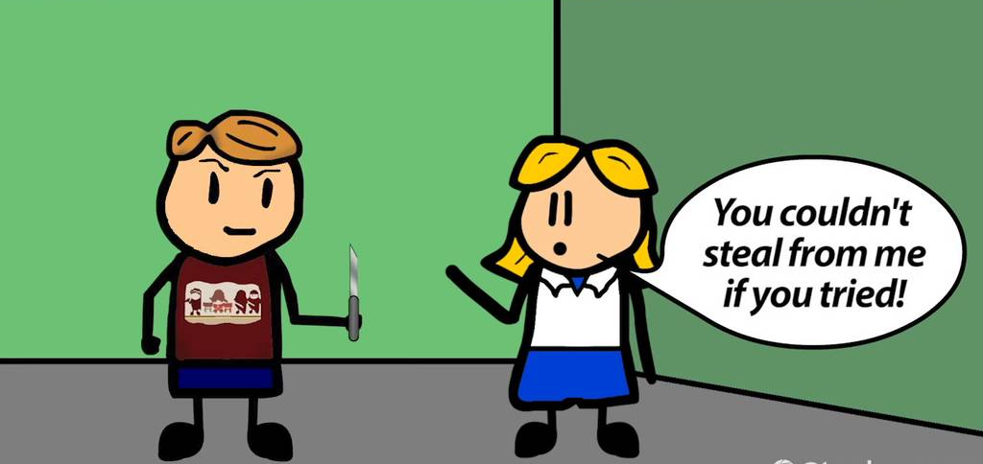
Victim precipitation theory cont
The victim is viewed as an active participant in the crime
2 elements of this theory
The victims acts first
The victim encourages or provokes the offender
Example
A man starts and argument with another, not a crime, and the other responds by hitting him (is a crime)
A woman stays with their partner even though they abuse them
NB the theory does not blame the victim, it simply explores what the potential cause of the crime were

Slide 34
Critical/Radical Victimology
Critical and radical victimology shifted the focus of crime studies away from individual behaviour—such as where a person walks at night—and onto structural power dynamics, state institutions, and social inequalities.
While traditional (positivist) victimology often faced criticism for "victim-blaming" by investigating how a person's actions precipitated a crime, critical and radical victimologists argue that society and the state dictate who becomes a victim and who is granted that official status.

Slide 35
Critical/Radical Victimology
Structural Powerlessness
Rooted heavily in Marxist, feminist, and conflict theories, this perspective argues that victimisation is unevenly distributed across society. Rather than being random or purely behavioural, vulnerability is a product of structural powerlessness.
Socio-economic Status: The poorest in society and the working-class proletariat are disproportionately the victims of both conventional street crime and corporate exploitation by the powerful.
Marginalised Groups: Homeless individuals, ethnic minorities, and young people experience significantly higher rates of physical and systemic harm due to their lack of economic and political leverage.

Slide 36
Critical/Radical Victimology
The Hierarchy and Social Construction of Victimhood
A central concept in critical victimology is that "victim" is a social label, and the state holds the ultimate power to apply or deny that label.
The "Ideal Victim": Criminologist Nils Christie introduced the concept of the Ideal Victim, a person who is automatically granted public sympathy and institutional legitimacy. This is typically someone viewed as weak, blameless, and engaged in respectable activities (e.g., an elderly woman attacked by a stranger).
The Hierarchy of Victimisation: Those who do not fit the "ideal" mold find themselves lower on the hierarchy. For example, homeless individuals or drug users who experience violence are frequently denied official victim status or blamed for their circumstances by police, courts, and the media.

Slide 37
Critical/Radical Victimology
State "De-labelling" and Institutional Violence
Critical victimology highlights how state institutions often engage in de-labelling—refusing to classify systemic harms or state failures as crimes to protect those in power.
Historical Failure: Criminologists often point to historical laws, such as the fact that marital rape was not legally recognised as a crime in the UK until 1991, meaning thousands of women were systemically denied the status of crime victims by the state.
Corporate and State Harm: It draws attention to "invisible" or ignored harms, such as corporate manslaughter, workplace health and safety violations, and institutional negligence.

Slide 38
Feminist Victimology
Feminist victimology emerged in the 1970s and 1980s as a direct challenge to the "gender-blind" nature of traditional criminology. It operates as an extension of critical victimology, arguing that you cannot understand victimisation without examining patriarchy, gender roles, and systemic inequalities.

Slide 39
Feminist Victimology
Key points of feminist victimology:
The Gendered Nature of Victimisation
Men and women experience entirely different patterns of victimisation. While men are statistically more likely to be victims of violent street crimes by strangers, women are disproportionately the targets of intimate partner violence (IPV), coercive control, sexual assault, and stalking. This framework highlights how the home—traditionally viewed by mainstream society as a place of safety—is often the most dangerous environment for women

Slide 40
Feminist Victimology
Violence as an Informal Form of Social Control
Feminist theorists argue that gender-based violence (and the persistent threat or fear of it) functions as a mechanism of social control. The fear of being assaulted dictates how women navigate public spaces, what they wear, and how they behave. This systemic fear reinforces unequal power dynamics and limits women's freedom and autonomy.

Slide 41
Feminist Victimology
The "Feminist Pathways" Perspective (Victim-Offender Overlap)
Traditional criminology historically treated "victims" and "offenders" as two completely distinct groups. Feminist victimology pioneered the Pathways Perspective, which shows that a vast majority of incarcerated women have histories of severe childhood physical or sexual abuse, domestic violence, and trauma. In this framework, female offending is often a direct survival mechanism or coping strategy (such as running away from an abusive home, substance abuse, or self-defence) resulting from their initial victimisation.

Slide 42
Feminist Victimology
Linguistic Shift: From "Victim" to "Survivor"
Feminist scholars and advocates deliberately pushed to replace the passive term "victim" with "survivor". This linguistic shift emphasises an individual’s agency, resilience, and recovery, actively resisting the societal stereotype that those who experience abuse are permanently broken or helpless

Slide 43
Debrief
Thoughts?
How can this link with barriers to reporting?

Slide 44

Any questions?

