Slide 1
Developing Relationships and Workplace Achievement
STUDENT NAME: Radu Alexandru Nitu
STUDENT ID: 2109427

Slide 2
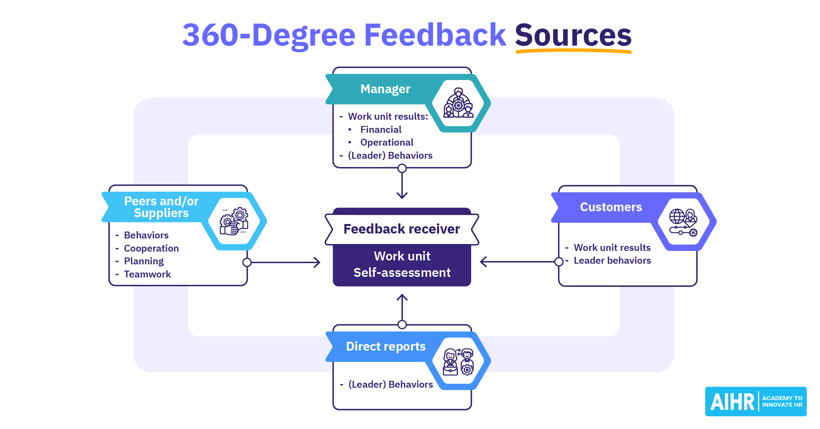
Introduction
The presentation begins by exploring the idea of 360-degree feedback and highlighting its multi-perspective technique to task evaluation (Oonk, 2022).
This strategy entails gathering feedback from coworkers, subordinates, and leaders within an organization.
Notes:
This approach promotes personal and professional development by giving a thorough understanding of one's abilities and shortcomings. It is emphasized how crucial constructive criticism is for companies and employees alike, emphasizing how it may improve self-worth, match competencies with company objectives, and foster open discussion. The talk also addresses the main concerns that can come up when putting this idea into practise, including balancing excessive feedback and subjective.

Slide 3
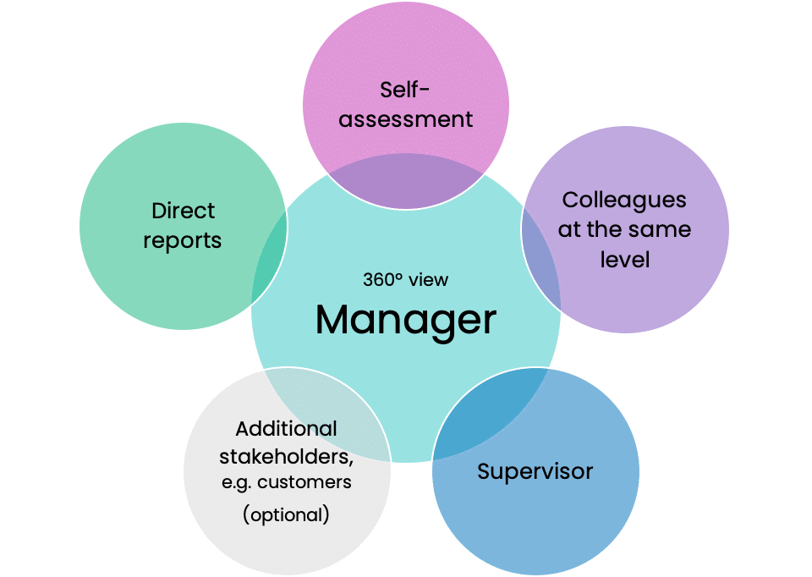
The concept of 360 – degree feedback
Multi-perspective evaluations of performance technique called 360-degree feedback collects opinions from a variety of people, including peers, subordinates, and superiors (Ellison et al., 2022).
It offers a complete picture of a person's abilities, flaws, and overall performance.
Notes:
This feedback process encourages a comprehensive grasp of a worker's aptitudes, abilities to communicate, traits of leadership, and other qualifications. The variety of viewpoints supports growth both personally and professionally by pointing out areas that need correction. The use of 360-degree feedback for worker evaluations, coaching for leadership, as well as being aware of one increases a person's ability to adapt, gain knowledge, and perform well in the position across an organization.

Slide 4
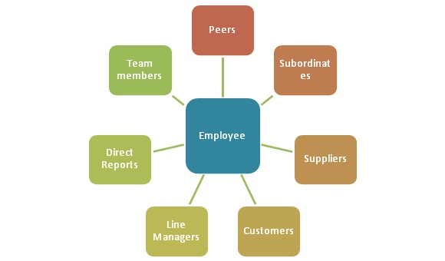
The importance of 360 concept to employees
Employees place a high value on the 360-degree feedback idea because it provides a comprehensive and all-encompassing assessment of the way they do and progress (Balakayeva et al., 2023).
It gives staff members insightful information from a range of sources, allowing them to fully grasp the regions of strength and development need.
Notes:
This feedback encourages self-awareness, makes it easier to acquire certain skills, and supports professional and personal growth. Additionally, it promotes a sense of responsibility and participation in one's personal growth as a professional, which boosts drive and fulfilment in work. Employees are empowered by the 360-degree criticism to take ownership of their development, adjust to shifting dynamics at work, and flourish in their professions.

Slide 5
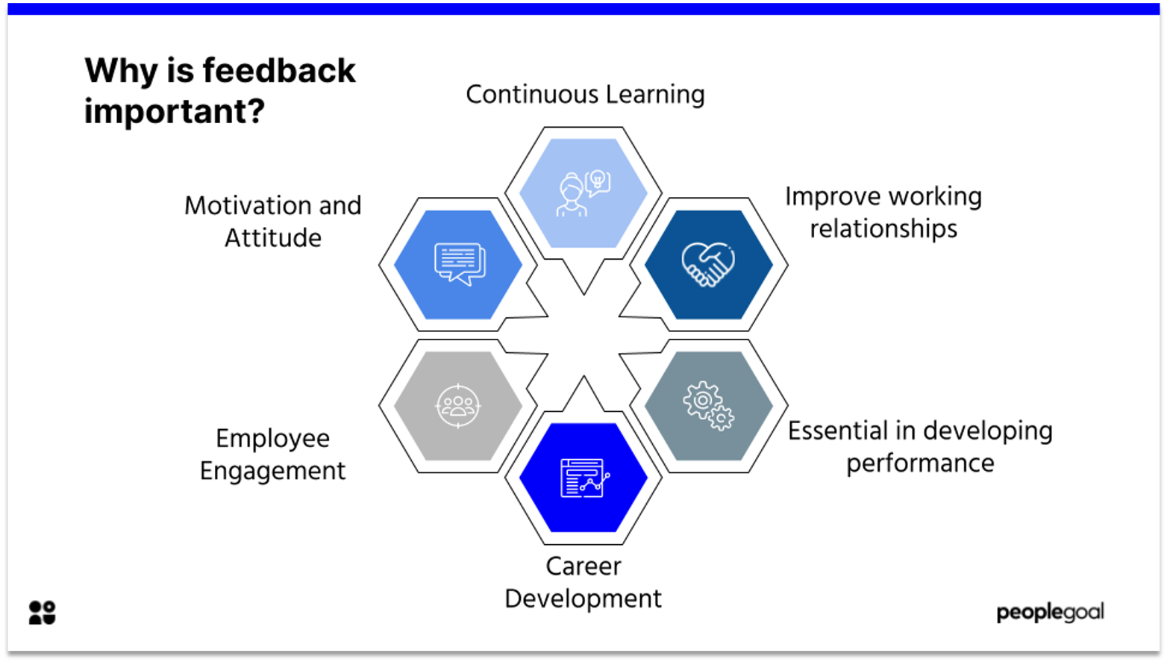
The importance of 360 concept to employees
The idea of 360-degree feedback is very beneficial to employees for a variety of reasons.
First off, it offers a more comprehensive while balancing viewpoint on the way they perform, assisting them in identifying areas for strength and development (Yli-Jaakkola, 2022).
This promotes personal as well as career development.
Second, it increases self-awareness, enabling people to match the behaviours and skill set with the objectives of the company.
Notes:
Additionally, by including others, subordinates, and bosses in the review process, it fosters open dialogue and teamwork. In the end, feedback from all angles encourages career advancement, fulfilment in work, and an atmosphere of personal improvement, making it an essential tool for staff members who want to excel, change, and and flourish in their positions within the company.

Slide 6
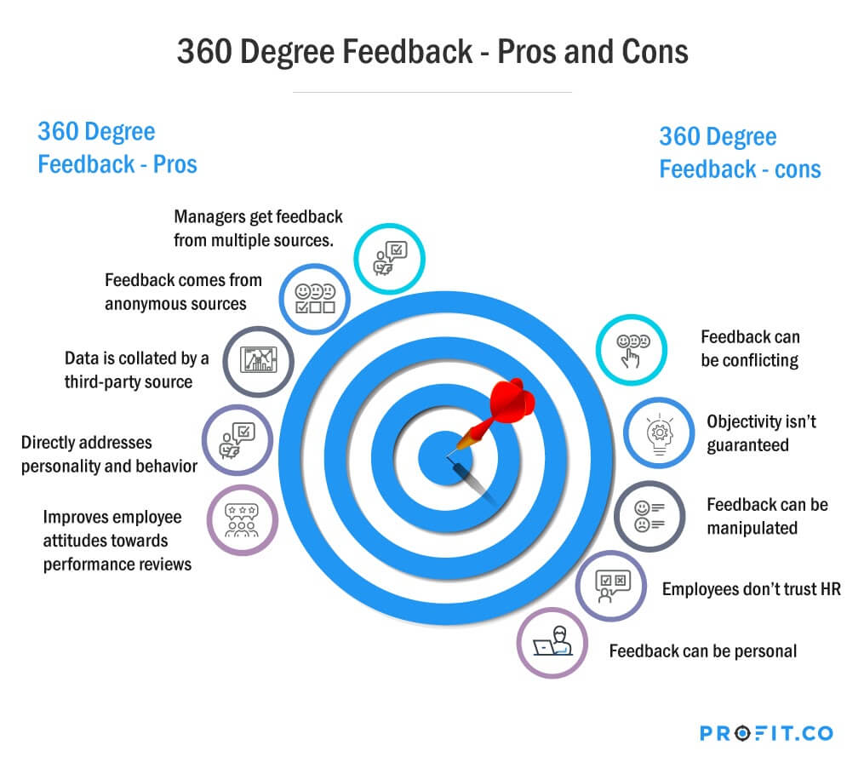
The benefits of concept of 360 implementation to employees
Employees can benefit greatly from the 360-degree feedback approach when it is implemented. First off, it offers a complete picture of their performance, encouraging awareness of oneself and personal development (Li et al., 2023).
It gives workers the freedom to recognise and successfully address their positive and negative qualities.
Notes:
Through this feedback method, staff members and supervisors are encouraged to collaborate and speak openly, which improves friendships and cooperation. By assisting individuals in matching their abilities with organisational goals, it also aids career growth. Additionally, it improves satisfaction with work by giving individuals a sense of responsibility over their own personal development and advancement. Implementing a 360-degree strategy benefits employees' overall growth, job satisfaction, including effectiveness.

Slide 7
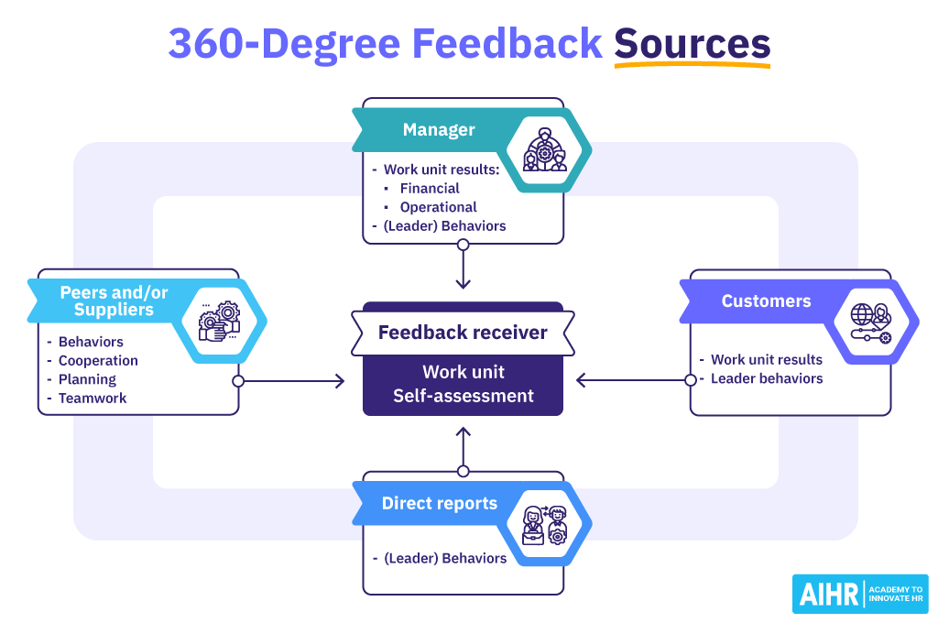
The benefits of concept of 360 implementation to employers
Employers can benefit from the use of 360-degree feedback in several ways. First of all, it offers a thorough understanding of worker efficiency, assisting in well-informed choices about training, advancement, and work administration (Ranieri et al., 2022).
It highlights areas that require skill improvement and raises organizational leadership potential.
Notes:
Second, it promotes an atmosphere of open discourse and helpful criticism, creating a productive workplace. This raises satisfaction with work and retention, which eventually lowers the cost of hiring and training new employees. In addition, it harmonizes personal aspirations with organizational goals, enhancing overall performance. Implementing a 360-degree strategy can help organizations increase productivity of employees, retain a happy and engaged staff, and make strategic decisions.

Slide 8
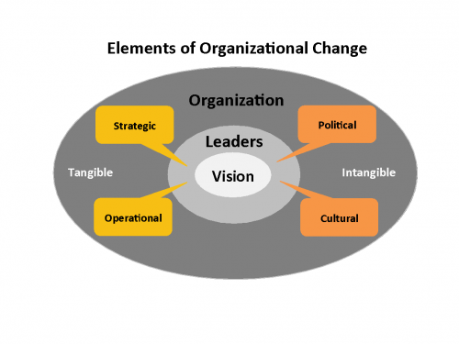
Key issues involve whilst implementing the concept
Subjectivity and Rater Bias:
When raters are swayed by individual biases, favouritism, or other arbitrary variables, the outcome can be skewed (Pinnington et al., 2022).
In order to ensure a uniform grasp of the rating criteria, it is essential to train users in giving unbiased criticism and to take into account creating calibrate sessions.
Notes:
Maintaining precision and equity in the feedback can be achieved by routinely evaluating the method, keeping an eye out for any biases, and dealing with these problems.

Slide 9
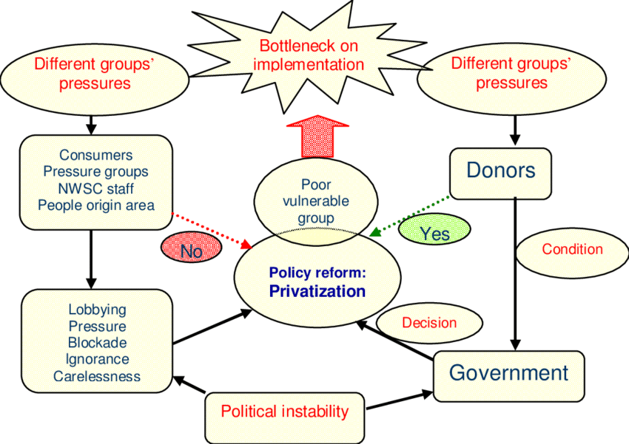
Contd
Accuracy and dependability of feedback
Assuring the reliability and correctness of the feedback gathered is one of the main considerations.
This depends on how truthful and impartial the respondents are (Ranieri et al., 2022).
Employees may be reluctant to offer candid criticism regarding their managers or coworkers due to possible negative consequences.
Notes:
Establishing a climate of trust, maintaining anonymity, and emphasising the constructive versus the punitive character of criticism are crucial in addressing this. This problem can be reduced with appropriate instruction for both individuals providing and receiving comments.

Slide 10
Contd
Overwhelming Feedback and Actionability:
The excessive amount of input participants might receive is another problem.
It might be overwhelming to sort out a lot of comments, and if it's not organised effectively, it might prevent you from finding any useful information (Ramdhan et al., 2022).
Notes:
In order to tackle this, precise, behavior-based input and practical recommendations should be the main focus of the process of feedback, with clear parameters set forth. The usefulness of the feedback can also be increased by giving staff the tools and assistance they need to understand it and take action on it.

Slide 11
Conclusion
In summary, the idea of 360-degree feedback is a potent tool that provides an in-depth look at worker productivity, helping both workers and managers (Behery, 2022).
It promotes awareness of me, evolution on both a personal and professional level and an environment that values cooperation and open interaction.
Notes:
It gives workers the confidence to take charge of their growth, adjust to shifting work environments, and succeed in their positions. Organizations acquire knowledge about worker productivity, enabling businesses to make wise choices about organizational leadership, learning, and advancement in employment. Incorporating 360-degree feedback can improve decision-making, job happiness, and performance at work. However, resolving important challenges including subjective nature, information reliability, and information deluge is essential to its effectiveness.

Slide 12


Slide 13
References
Balakayeva, G., Zhanuzakov, M. and Kalmenova, G., 2023. Development of a digital employee rating evaluation system (DERES) based on machine learning algorithms and 360-degree method. Journal of Intelligent Systems, 32(1), p.20230008.
Behery, M., 2022. Single-rating, multi-rating 360 performance management and organizational outcomes: evidence from the UAE. International Journal of Organizational Analysis, 30(1), pp.47-83.
Ellison, L.J., Steelman, L.A., Young, S.F. and Riordan, B.G., 2022. Setting the stage: Feedback environment improves outcomes for a 360-degree-feedback leader-development program. Consulting Psychology Journal, 74(4), p.363.
Li, J., Han, L., Zhang, C., Li, Q. and Liu, Z., 2023. Spherical convolution empowered viewport prediction in 360 video multicast with limited FoV feedback. ACM Transactions on Multimedia Computing, Communications and Applications, 19(1), pp.1-23.
Oonk, H.B., 2022. Quality of 360-degree performance feedback: a matter of social exchanges (Bachelor's thesis, University of Twente).
Pinnington, A., Aldabbas, H., Mirshahi, F. and Pirie, T., 2022. Organisational development programmes and employees’ career development: the moderating role of gender. Journal of workplace learning, 34(5), pp.466-496.
Ramdhan, R.M., Kisahwan, D., Winarno, A. and Hermana, D., 2022. Internal corporate social responsibility as a microfoundation of employee well-being and job performance. Sustainability, 14(15), p.9065.
Ranieri, M., Luzzi, D., Cuomo, S. and Bruni, I., 2022. If and how do 360 videos fit into education settings? Results from a scoping review of empirical research. Journal of Computer Assisted Learning, 38(5), pp.1199-1219.
Ranieri, M., Luzzi, D., Cuomo, S. and Bruni, I., 2022. If and how do 360 videos fit into education settings? Results from a scoping review of empirical research. Journal of Computer Assisted Learning, 38(5), pp.1199-1219.
Yli-Jaakkola, N., 2022. VIBES: a multi-perspective tool to break complex problem spaces into concrete action plans.

