Slide 1
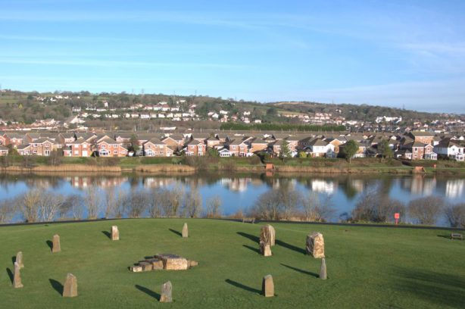
Landscape and Sense of Place

Slide 2
Activity 1: What does ‘Landscape’ mean to you?
In groups, consider the meaning of landscape – discuss as a group and create a spider diagram of all the elements that make up ‘landscape’

Slide 3
“Landscape, I shall argue, is an ideological concept. It represents a way in which certain classes of people have signified themselves and their world through their imagined relationship with nature, and through which they have underlined and communicated their own social role and that of others with respect to external nature.”
(Cosgrove, 1984, p15)

Slide 4
Urry (1995):
A person’s wish to visit a particular environment is something that is socially constructed and depends on developing a ‘cultural desire’ for a particular landscape
The shift in perception of desirability is associated with social & cultural changes in society

Slide 5
18th Century
Mankind was conquering nature through industrial exploitation:
“More than any other identifiable experience, the emergence of industrial capitalism is responsible for setting contemporary views and visions of nature.” (Smith, 1990, p1)

Slide 6
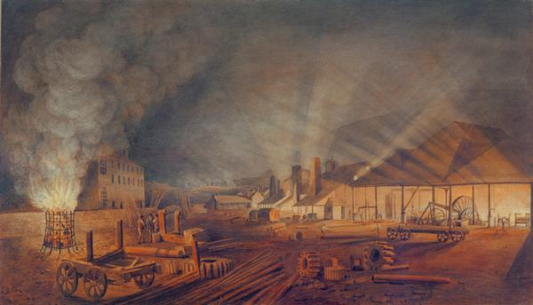
Rolling Mills, Merthyr Tydfil
Thomas Hornor, 1817

Slide 7
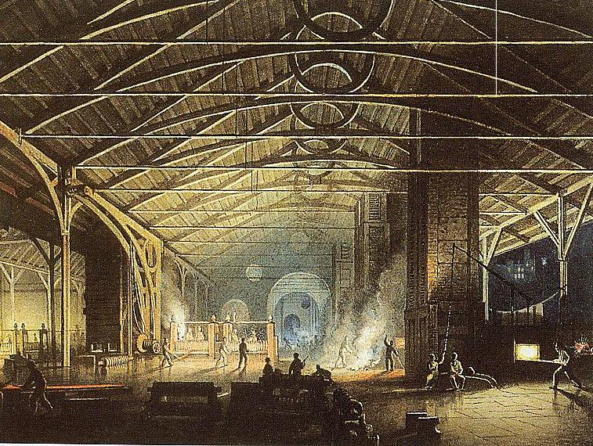
Cyfarthfa Ironworks Interior at Night, Penry Williams, 1825.

Slide 8
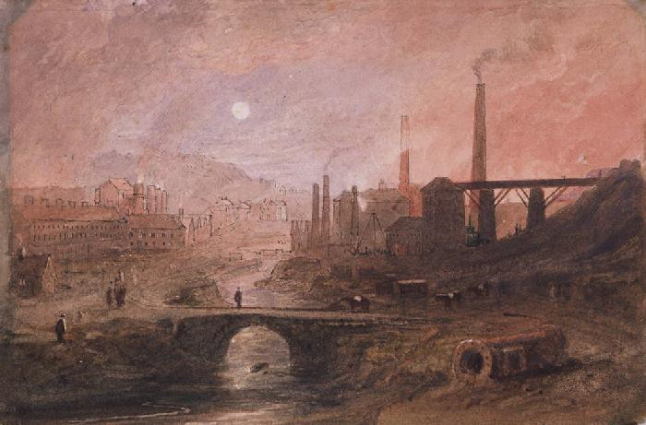
Ironworks Nantyglo unknown artist nineteenth century

Slide 9
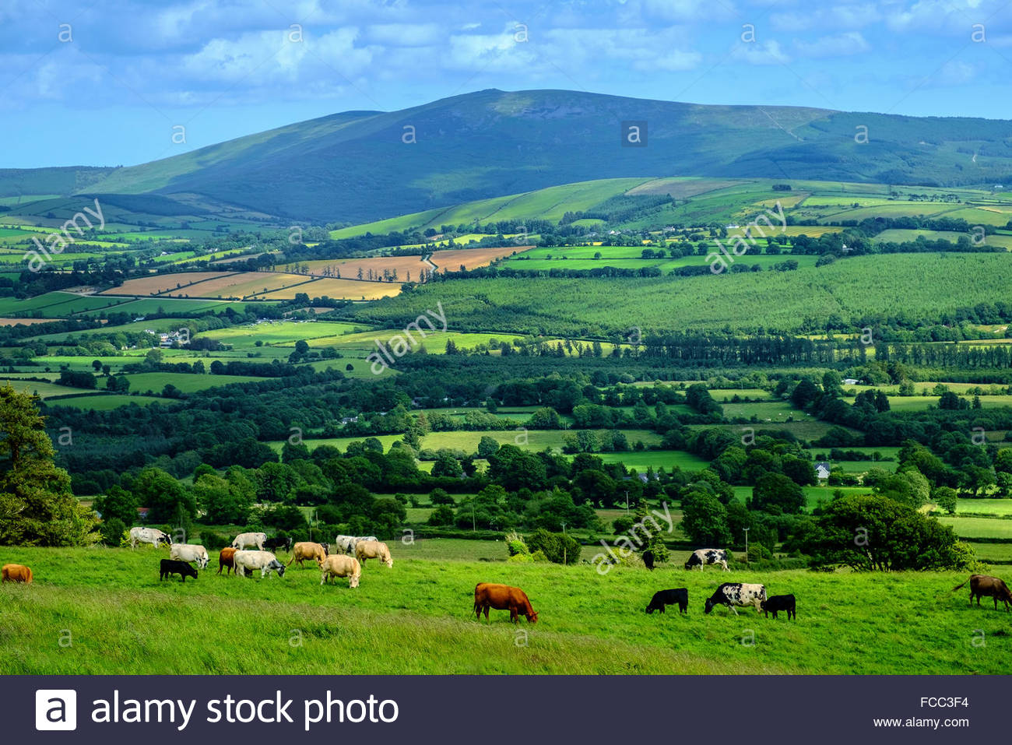

Slide 10
Activity 2: Your Landscape Preferences
Conduct some basic research using your phones or laptops, gather examples of landscapes you like and landscapes you don’t like. Share these with your group.
As a group, write a list of all the factors that affect whether you like or dislike particular landscapes

Slide 11
Lowenthal (1967, p1) believes that:
“we respond to and affect the environment not directly, but through the medium of a personally apprehended milieu. This milieu differs for each of us according to his personal history; and for each of us it varies also with mood, with purpose and with attentiveness. What we see, what we study, and the way we shape and build in the landscape is selected and structured for each of us by custom, culture, desire and faith.”
Greenbie (1988, p65) suggests:
“what we perceive as the environment is, in fact a synthesis in which our current perceptions of what is actually out there are combined with a complex tapestry of associations based on our experience both of the physical world and of other people.”

Slide 12
Visitor or resident
- tourist sees the landscape with a fresh eye
- a commuter is likely to ignore larger landscape features
Visions evoked by artists, novelists or the media
- pre-conceived ideas derived from images
Familiarity
- greater familiarity may generate greater knowledge
- a regular observer may overlook an element of landscape
- people like what they know, but familiarity also breeds contempt
- childhood memories

Slide 13
Role of the observer – profession, interests
“Every river is more than just one river. Every rock is more than just one rock. Why does a real estate developer look across an open field and see comfortable suburban ranch homes nestled in quiet cul-de-sacs, while a farmer envisions endless rows of waving wheat…the open field is the same physical thing, but it carries multiple symbolic meanings that emanate from the values by which people define themselves.”
(Greider and Garkovich, 1994, p1)
- a botanist, geologist or artist would pick out different facets of the same environment

Slide 14
Mood and Circumstance
- weather and light
- time of day, time of year
- views on foot, cycle or vehicle
Rural and Urban Residence
- ‘natural’ landscape to a city dweller may be an area of cultivated parkland
- to a rural dweller ‘natural’ may mean wilderness
Length of Residency
- newcomers may have different perceptions to those with stronger community attachment
Individual Characteristics
- upbringing and education
- socio-economic status
- religion

Slide 15
Blaenafon
https://www.youtube.com/watch?v=XQItrV74wis

Slide 16
Sense of Place
‘a way of seeing, knowing and understanding the world’ (Creswell, 2008, p.11)
‘Sense of place’ refers us, on the face of it, both to a sense of the character or identity that belongs to certain places or locales, as well as to a sense of our own identity as shaped in relation to those places—to a sense of ‘belonging to’ those places.’ Malpas (2008, p. 199)
Notes:
16

Slide 17
Activity 3: What does sense of place mean to you?
Spend about five minutes thinking about what sense of place means within your own context – think of a place that means something to you.
Prepare to report back to the group – tell us about the place you are thinking about and what sense of place means within that context

Slide 18
Activity 4: What elements comprise Sense of Place
In groups of 3-4 consider the following:
Following on from the video, what is the sense of place of Blaenafon?
Discuss what elements comprise the sense of place of Blaenafon – as well as the historical aspects that you have learnt about, think in terms of all the senses that you have used to interpret it as a place.
You may use your hones to conduct some further research.
Your group should report back in 15 minutes.

Slide 19
Components of Sense of Place
(Kudryavtsev et al. 2011, p231)
Place Attachment
The bond between people and places/ degree to which a place is important to people
Place Dependence - The potential of a place to satisfy an individual’s needs by providing settings for his or her preferred activities
Place Identity - The extent to which a place becomes part of personal identity or embodied in the definition of self
Place Meaning
Symbolic meanings people ascribe to settings

Slide 20
Activity 5: Apply Kudryavtsev et al’s model to Llanelli
Place Attachment |  | Place Meaning
Place Dependence | Place identity

