Slide 1

Arrest:
What does it mean?

Slide 2

What does it mean? Arrest
JPLANE
An arrest is the taking of a person’s liberty and preventing them from going about their lawful business
Occurs when a police officer states to an individual that they are arresting them, or when they use force to restrain the individual concerned
Also occurs when, by words or conduct, they make it clear that they will, if necessary, use force to prevent the individual from going where they may want to go.
***Arrests MUST be NECESSARY!***

Slide 3
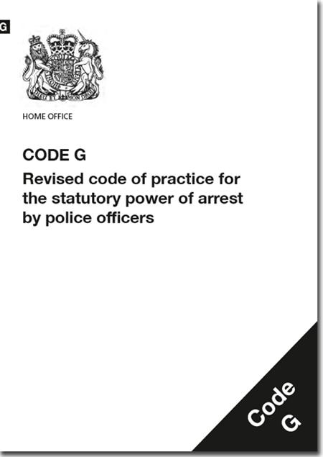
Always ask yourself…
Is there a power to arrest?
Are there grounds to arrest?
Is there a necessity to arrest?
What happens first then?

Slide 4
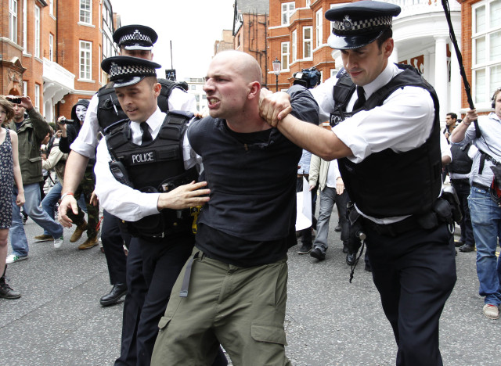

What is a ‘Lawful Arrest’?
A person’s involvement
or
suspected involvement
or
attempted involvement
in the commission of a criminal offence
AND
reasonable grounds for believing that the person’s arrest is ‘necessary’
Notes:
PACE Code G states that these two elements must be satisfied for a Sec 24 arrest to be lawful:
If the provisions of the Act and this Code are not observed, both the arrest and the conduct of any subsequent investigation may be open to question.
The law requires a person is informed of the 'grounds for the arrest'
(e.g. "I am arresting you on suspicion of stealing a stereo from a Ford Fiesta car in Acacia Ave yesterday").

Slide 5
Prior to Making an Arrest
Officers should consider information about:
5 W’S & H
The event: What has happened?
The individual’s involved
Any offence?
SHACKS
Any physical or mental ill health which requires medical attention?
NDM
Any needs of the investigative process?

Slide 6
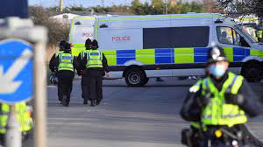
What makes a ‘Lawful Arrest’?
(Best Practice)
Information to be given:
That they are under arrest (even if it is obvious)
The grounds for the arrest
(offence for which they have been arrested)
Time
AND
The Necessity for the arrest
Caution - ‘When Questioned’
Sec. 28 PACE & Code G
-An arrest is not lawful unless at the time, or as soon as practicable (the officer) informs the person they are under arrest.

Slide 7

Reasonable grounds?
Knowing
Believing
Suspecting

Slide 8

Reasonable Grounds – Suspicion
Behaviour
Actions
Intelligence
Time
Place

Slide 9
Section 24(1) PACE 1984
A constable may arrest without a warrant anyone who:
is about to commit an offence.
is in the act of committing an offence.
They have reasonable grounds to suspect to be:
a) about to commit an offence or
b) in the act of committing an offence.

Slide 10
Section 24(2) PACE 1984
If an officer has reasonable grounds for suspecting
that an offence has been committed
they may arrest anyone whom they have
reasonable grounds to suspect
of being guilty of it.

Slide 11
Section 24(3) PACE 1984
If an offence has been committed, an officer may arrest anyone who:
a. Is guilty of the offence
b. they have reasonable grounds for suspecting
to be guilty of it.

Slide 12
Think!
PC WILLIAMS is on patrol with her tutor when they hear a woman shout, ‘Stop that man! He has just stolen my purse!’
What power of arrest do the officers have to deal with this situation?
Answer: Section 24(2) PACE 1984

Slide 13

Think!
Officers are on patrol when they see Billy Evans with a brick in one hand about to throw it through the window of a local jewellers.
What power of arrest do the officers have to deal with this situation?
Answer: Sec 24(1) PACE
Notes:
They can arrest Eddie Smith.
Sec 24(1) An officer may arrest anyone whom they have reasonable grounds to suspect to be about to commit an offence

Slide 14
Two Types of Caution
1. The ‘When Questioned’ caution
2. The ‘Now’ caution

Slide 15
The ‘When Questioned’ Caution
You do not have to say anything.
But it may harm your defence if you do not mention when questioned something which you later rely on in court.
Anything you do say may be given in evidence.

Slide 16
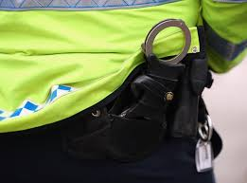
What does it mean? Simplified…
You have the right not to say anything if you do not wish to
If there is something you do not tell me now when I ask you questions and you later you decide to tell the court, then the court may be less likely to believe you
Anything you do say can be given in evidence, this means that if you do attend court, the court can be told what you have said

Slide 17
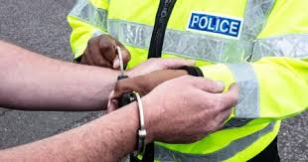

When to caution…
When you have grounds to suspect an offence has been committed
You want to ask questions regarding their involvement or suspected involvement in that offence as the offender

Slide 18

When not to caution…
You ask questions not relating to the offence
To obtain information they are required to provide by law
To establish their identity
To seek verification of a written record

Slide 19
The ‘Now’ Caution
We’ll study this more later…
You do not have to say anything.
But it may harm your defence if you do not mention now something which you later rely on in court.
Anything you do say may be given in evidence.

Slide 20

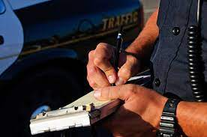
Cautions – The Difference
‘When Questioned’
Indicates an intention to ask questions about an offence
‘Now’
At the conclusion of the process, when a person is reported or charged with an offence

Slide 21

Necessity to arrest – Why?
Section 24 PACE 1984 & PACE Code G

Slide 22
I | - Investigation | To allow prompt and effective investigation of the offence or of the conduct of the person in question
D | - Disappearance | To prevent any prosecution for the offence from being hindered by the disappearance of the person in question
C | - Child | To protect a child or other vulnerable person from the relevant person
O | - Obstruction | To prevent the relevant person causing an unlawful obstruction of the highway
P | - Physical Injury | To prevent the relevant person causing physical injury to himself or any other person or prevent him suffering physical injury
P | - Public Decency | To prevent the relevant person committing an offence against public decency
L | - Loss or Damage | To prevent the relevant person causing loss of, or damage to property
A | - Address | To enable the address of the relevant person to be ascertained
N | - Name | To enable the name of the relevant person to be ascertained

Slide 23
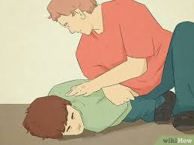
Section 24A(3) Police & Criminal Evidence Act 1984
A person other than a constable may arrest without warrant anyone who:
Is in the act of committing an indictable or triable either way offence
OR
They have reasonable grounds for suspecting to be committing an indictable offence or triable either way offence.
Where such an offence has been committed, a person other than a constable, may arrest without warrant anyone who:
Is guilty of the offence
OR
They have reasonable grounds for suspecting
to be guilty of it.

Slide 24
When can a member of the public arrest someone?
The power of arrest is ONLY exercisable if:
It appears to the person making the arrest that it is not reasonable practicable for a Constable to make it instead
AND
The person making the arrest has reasonable grounds for believing that the arrest is necessary to prevent the person being arrested:-
Causing physical injury to themselves or any other person
Suffering physical injury
Causing loss of or damage to property
Making off before a police officer can assume responsibility for them

Slide 25

De-Arrest
‘A person arrested by a constable at a place other than a police station shall be released without bail if a constable is satisfied at the time before the person reaches a police station that there are no grounds for keeping him or her under arrest releasing him/her on bail. The constable must record the fact that this has happened’
Sec 30(7) P.A.C.E.1984

Slide 26

Alternatives to Arrest…
No further action- discretion
Persuade, Advise & Warn
Caution
Out of court disposal (fixed penalty notice)
Youth Referral
Community Resolutions
Restorative Justice
Postal Charge Requsition
Report for summons
Voluntary interview

