Slide 1
Social Research for Professional Practice
ECYW5001
Lecture 1
27.03.2025

Slide 2
Module timeline
27 March Campus
3 April Teams
Easter
1 May Campus
8 May Teams
15 May Campus
22 May
Assignment Submission 29 May

Slide 3
Lecture Overview
Aims of the Module
Module Learning Outcomes
Module Indicative Content
Module Learning and Teaching Strategy
Module Assessment
What is Research with Young people
Questions
What to expect in future lectures
Self directed study

Slide 4
Module Aim
To develop knowledge, understanding and skills of social research methodologies and research methods appropriate to youth work practice and other related fields.

Slide 5
Learning Outcomes
Upon the successful completion of this module, the student should be able to:
Critically evaluate the nature of both quantitative and qualitative research methodology and methods including their strengths and weaknesses.
Demonstrate a critical understanding of participatory research methodologies and methods with young people.
Critically analyse the role of research ethics and reflection when carrying out research in a range of young people contexts.
Organise their knowledge and learning through use of a range of information resources, and present their work appropriately.

Slide 6
Indicative Content
An overview of the various theories and philosophy of qualitative and quantitative research methodology utilised in social science research.
Analysis of the methods and tools used to collect qualitative and quantitative data.
Evaluation of the appropriateness of research methodologies and methods when carrying out research in a range of settings with young people as ‘participants’.
Exploration of the principles and practices of adopting participatory research methodologies that allows young people’s voices to be heard in the research process.
Critical analysis of ethical issues that need to be considered when undertaking research in particular with young people.
Discussion on the role of reflective practice for developing self and professional practice – including analysis of action research as a methodology as an extension of practice.

Slide 7
Module learning and teaching strategy
Lectures will introduce students to the concepts, principles and practices of applied research for practitioners.
Tutorials and seminars will introduce practical examples which will be used to support the application, discussion and evaluation of techniques learned.
Case studies will also be used to develop understanding and application of techniques.
Directed Reading to reinforce the ideas discussed in lectures.

Slide 8
In this module
Youth workers as researchers
What is social research
Methods and methodology
Ethics
Thematic analysis
Assignment discussion

Slide 9
Assessment
4000 word Assignment
Due: 29th May 2025
Provisional Grade and Feedback: 26th June 2025
Question:
Part 1: 2000 words
Students are required to critically consider the strengths and weaknesses of the research article, with a particular focus on the methodology and methods used, and the ethics of the study.
Part 2: 2000 words
Consider critically the steps necessary in undertaking a successful small scale research project with young people, on a subject that is relevant to them. Consider your role in the process including ethical considerations and how your results can be shared.

Slide 10
Any Questions so far…
This is an opportunity to begin to explore your understanding of the module.
As youth and community workers we are often not confident in social research.
This module is an opportunity for you to get to grips with an important aspect of youth work practice that is increasingly important in the field.

Slide 11
What is research?
Group activity (20 minutes)
In two groups find the definition of research?
What is the definition of social research?
Is research and social research different?

Slide 12
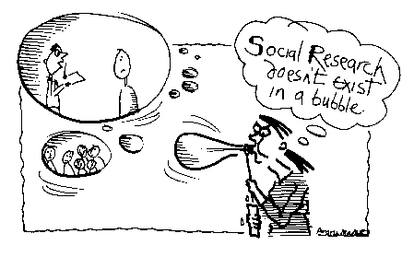
  ‘Social research does not exist in a bubble’ (Bryman 2001)
  Real world problems need real
world enquiry and research

Slide 13
Social Research is a method used by social scientists and researchers to learn about people and societies so that they can design products/services that cater to various needs of the people. Different socio-economic groups belonging to different parts of a county think differently.
‘Purposive and rigorous investigation that aims to generate new knowledge.
An intellectual tool of social scientists which allows them to enter contexts or personal and/or public interest that are unknown to them, and to search for answers to their questions.
Social research is about discovery, expanding the horizons of the known, of confidence, new ideas and the conclusions about all aspects of life’
Sarantakos, S. (2012) Social Research, Red Globe Press: London (Pg. 4)

Slide 14

Where does knowledge come from?
Cited in Sarantakos, S. (2012) Socail Research, Red Globe Press: London (Pg. 6)

Slide 15





Research and your thoughts
NOOOOOOOOOOOOOOOOOOOOOO

Slide 16






Or…
Yes please

Slide 17
Youth work as research
Can you think of any times you have been researchers as youth workers?
Notes:
Community profiles
Needs assessments
Surveys with young people

Slide 18
Youth work as research cont…
Sapin (2013) has suggested that ‘most (Youth Work) projects will involve some form of research, the type of research will depend on the information that is needed and at what stage the research is being undertaken’ (Sapin, 2013: 168).

Slide 19
Youth work as research cont…
Some of the many links between research and Youth Work are spelled out explicitly in the National Occupational Standards for Youth Work (CLD Standards Council Scotland, 2019), specifically in standards YW23 ‘Investigate the needs of young people and the community in relation to youth work’ , but also implicitly in other standards including ‘initiate, build and maintain purposeful relationships with young people’, ‘engage with communities to promote the interests and contributions of young people’, and ‘support young people to identify and achieve aims’, ‘identify and secure funding and resources for youth work’.
In fact most of the National Occupational Standards (CLD Standards Council Scotland, 2019) are underpinned by knowledge and understanding that can be enhanced through sound research.

Slide 20
Youth work as research cont…
Sapin (2013, p. 168) advocates types of research which include:
  Exploratory research – finding out about something unknown
  Feasibility study – identifying whether a project or intervention will work
  Baseline research – establishing a starting point for comparison during and at the end of a project or intervention
  Experimental research – trying out something new and analysing and evaluating its effects
  Evaluation – identifying the outcomes, quality and effectiveness of a project or intervention to identify ways to improve its effectiveness or appropriateness

Slide 21
Youth work as research cont…
Good practice in Youth Work is informed by a commitment to Children’s Rights and to the principles of empowerment and participation. One of the ways that Youth Workers can implement this approach is through involving young people as partners in the research process. For example Sapin (2013) again offers some types of research with young people
Peer-led research – where young people manage the project
Peer research – young people representing the target group are the researchers
Participatory or emancipatory research – young people as managers and researchers
Action research – young people carry out research alongside youth workers
Participatory evaluation – young people evaluate youth work to inform development and future work.

Slide 22
Youth work as research cont…
As with all research it is important to respect the dignity and autonomy of research participants. Research involving children and young people may give rise to particular sensitivities and particular thought and care is needed when conducting research with young people.
For the purposes of the Youth Work Programme anyone under the age of 18 is regarded as a child or young person, only at age 18 do individuals attain full legal maturity under UK law.

Slide 23
Youth work as research cont…
When undertaking research with young people the following issues need to be taken into account:
  Ensure that appropriate regard is given to ensuring the safety and wellbeing of children and young people at all times.
  Any possible impact which inclusion in the research may have upon the young people at a later date.
  The securing of informed consent to their involvement in the research.
  Ensuring compliance with legal requirements relating to working with children or young people within the UK.
  Use of rewards/inducements for participation.
  The use of images of young people.

Slide 24
Further guidance
Young people may possess decision-making capacity if they are deemed to have sufficient maturity – they may have capacity to make a decision regarding inclusion in a particular piece of Youth Work while not have decision-making capacity in other aspects of their life (being able to vote for example).

Slide 25
Consent
In 2 groups, take 20 minutes (and a cup of tea) to discuss the two questions below…
Who do you think we should gain consent from when doing research with young people?
Does it matter what the research is?

Slide 26
Consent cont…
The UN Convention on the Rights of the Child (UNICEF, 1989) states that children (young people) who are capable of forming their own views should be granted the right to express them freely in all matters affecting them, commensurate with their age and maturity.
As a Youth Work student you should obtain informed consent from young people involved in any research. Most research you will be called upon to undertake within your studies will have minimal ethical risk, and as such the young person themselves should be able to understand the purposes of your research and as a result make an informed decision about whether they choose to take part.

Slide 27
What about parents?
What do you think about parents and their consent in research?
In examples of research where young people may address sensitive or personal issues then consent should be gained from a parent or another with parental responsibility.
However parental/guardian consent will be required for any research which will involve young people under the age of 18.

Slide 28
Information and consent
Young people should be provided with sufficient information in order to make an informed decision regarding their participation. Information should be provided in a clear and accessible written form using appropriate language to the age and maturity of the young person.
As a matter of good practice students should provide an information sheet alongside a consent form which should include contact details for the parent to contact the student to raise questions/anxieties with him or her.

Slide 29
Can anyone withdraw consent?
What is your view on this within research?
Consent can be withdrawn at any time.
As a student you should understand and respect the young person’s wish to withdraw, and the student should see to it that this wish is respected and that the young person has no further involvement in the research.

Slide 30
Distress and harm due to research
If a young person becomes distressed as a result of being involved in the research then s/he should be withdrawn immediately.
As a Youth Work student you should be vigilant and aware whether a young person is withdrawing consent to take part and be sensitive to signs of unhappiness/distress.

Slide 31
Confidentiality
Confidentiality can rarely be absolute, therefore do not guarantee it. In some cases disclosure of personal information to third parties may be legally required or may be otherwise justified in the public interest.
There are a number of excellent sources of guidance on research, confidentiality and ethics to guide you in your work – please see Moodle.

Slide 32
DBS
All students within the Youth Work programme must complete a DBS application prior to beginning the programme. If further information is required please contact the Faculty Office.

Slide 33
Rewards for participation
In some cases the provision of nominal rewards/inducements for participation may be regarded as ethical.
However it is appropriate for researchers to ensure any inducements must ‘avoid choices which in themselves have an undesirable effect’ (BERA, 2004).

Slide 34
Use of Images
Images should only be used with informed consent and in a purposeful manner with the greatest sensitivity.
Careful use should be given to potential inappropriate use of images of young people, with care being paid to identification of young people, the type of image, and who might have access to the images.
Images of young people should not reveal their identity.

Slide 35
What does research in youth work look like
Practical Considerations
Methodology
Ethics
Research Design
Philosophy
Context
Methods
Values
Theory

Slide 36
Why research in youth work?
Why do you think we conduct research in youth work?
What is the aim?

Slide 37
Why research in youth work?
  Inform Policy
      Political slant
  To Inform Practice:
      your own…
      Youth Work,
      Social Work,
      Education,
      Nursing,
      Community Development,
      Evidence based practice
      And so much more…

Slide 38
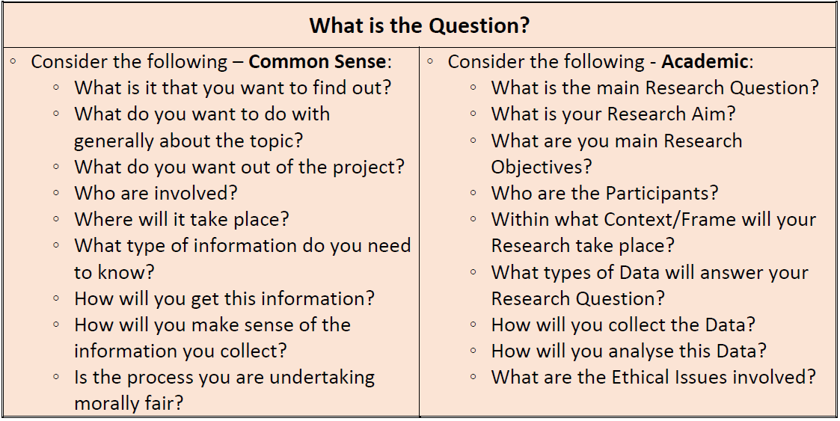

Slide 39

Texts to Consider
  Punch K, (2013) Introduction to Social Research Methods: Quantitative and Qualitative Approaches, London: Sage.

Slide 40

  Oliver P, (2010) The Students' Guide to Research Ethics, Buckingham: Open University Press.

Slide 41

  Creswell J (2013) Qualitative Inquiry and Research Design: Choosing among Five Approaches, LA: SAGE Publications.

Slide 42

  Cresswell J (2014) Research Design: Qualitative, Quantitative, and Mixed Methods Approaches, LA, CA: SAGE.

Slide 43

Kate Sapin, K. (2013) Essential Skills for Youth Work Practice, 2nd Edition, Sage: London

Slide 44
Any Questions?

Slide 45

Self directed study
Read Kate Sapin’s discussions on Research – feedback your findings next week.
On Moodle under this ppt

