Slide 1
Judaism in Berlin
International Study Tour 2018
Notes:
© Copyright PresentationGo.com – The free PowerPoint library

Slide 2
Jewry in Western Europe before the Enlightenment
Throughout Western Europe, Jews were forced by law to wear distinctive clothing and to live in walled enclaves or ‘ghettos’.
Jews were often regarded with suspicion, so much so that they were eventually expelled from many parts of Europe (in addition to suffering great violence).
Expelled en masse from Berlin (numerous times). In 1571, for example, the Jews were told to leave so that the government could confiscate their property.
Notes:
© Copyright PresentationGo.com – The free PowerPoint library

Slide 3
Jewry in Western Europe before the Enlightenment
There was at least one positive outcome of this maltreatment. The Jewish community was forced to become self-reliant.
There were approx. 400,000 Jews in Western Europe at the beginning of the 18th century, segregated from non-Jewish society, but with complete autonomy within their own communities.
Notes:
© Copyright PresentationGo.com – The free PowerPoint library

Slide 4
The Emancipation
Enlightenment thinkers advocated reason and science as more credible alternatives to faith.
This emphasis on reason and science led to the creation of democratic societies and the extension of civil rights to all – even to the Jews.
Notes:
© Copyright PresentationGo.com – The free PowerPoint library

Slide 5
The Emancipation
1781: The Jewish badge, as well as taxes imposed on Jewish travellers, abolished by Joseph II.
1782: Jews of Vienna granted the freedom to trade and the right to live outside the Jewish quarters. Jews also permitted to send their children to state schools.
1784: Jewish judicial autonomy abolished.
Notes:
© Copyright PresentationGo.com – The free PowerPoint library

Slide 6
The Emancipation
1791: Citizenship rights granted to all Jews in France.
1796: Dutch Jews granted full citizenship rights.
1797: The ghettos of Padua and Rome abolished.
Notes:
© Copyright PresentationGo.com – The free PowerPoint library

Slide 7
The Emancipation (Berlin)
1671: 50 prominent Jewish Viennese families allowed into Berlin as Schutzjuden (protected Jews who had paid for their residency).
1714: the first synagogue established in Mitte.
1737: the number of Jews permitted to settle in Berlin is limited to 120 families.
1743: approx. 2000 Jews from 333 families are registered in Berlin.
11 March 1812: Jews of Prussia declared equal citizens.
Notes:
© Copyright PresentationGo.com – The free PowerPoint library

Slide 8
The Jewish Question
Upon accepting civil and political equality, it was expected that Jews would give up their communal and cultural identities in order to integrate into wider society.
The Emancipation raised the question of whether Jews could keep their identity as Jews while becoming members of civil society.
Notes:
© Copyright PresentationGo.com – The free PowerPoint library

Slide 9
The Jewish Enlightenment (Haskalah)
The Haskalah was an adaptation of the European Enlightenment.
The ideals of this movement included the elimination of medieval superstition, and the promotion of human reason and tolerance.
An attempt at modernizing Jewish life and thought.
Notes:
© Copyright PresentationGo.com – The free PowerPoint library

Slide 10
The Haskalah: The Influence of Moses Mendelssohn (1729-1786)
Considered the father of the Haskalah.
Involved in defending the legitimacy of Judaism on the one hand and in reforming Judaism on the other.
Put Berlin at the centre of the Jewish Enlightenment.
Notes:
© Copyright PresentationGo.com – The free PowerPoint library

Slide 11
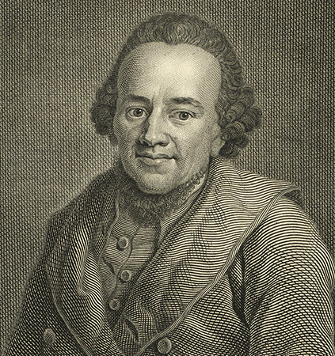

The Haskalah: The Influence of Moses Mendelssohn (1729-1786)
Notes:
© Copyright PresentationGo.com – The free PowerPoint library

Slide 12
Moses Mendelssohn – Defending the Legitimacy of Judaism
Challenged by Swiss theologian Johann Lavater with the argument that a Jew could never be truly ‘enlightened’.
Jerusalem, or on Religious Power and Judaism (1783).
In the work, he states his commitment to Judaism and his pride in his Jewish identity.
Notes:
© Copyright PresentationGo.com – The free PowerPoint library

Slide 13
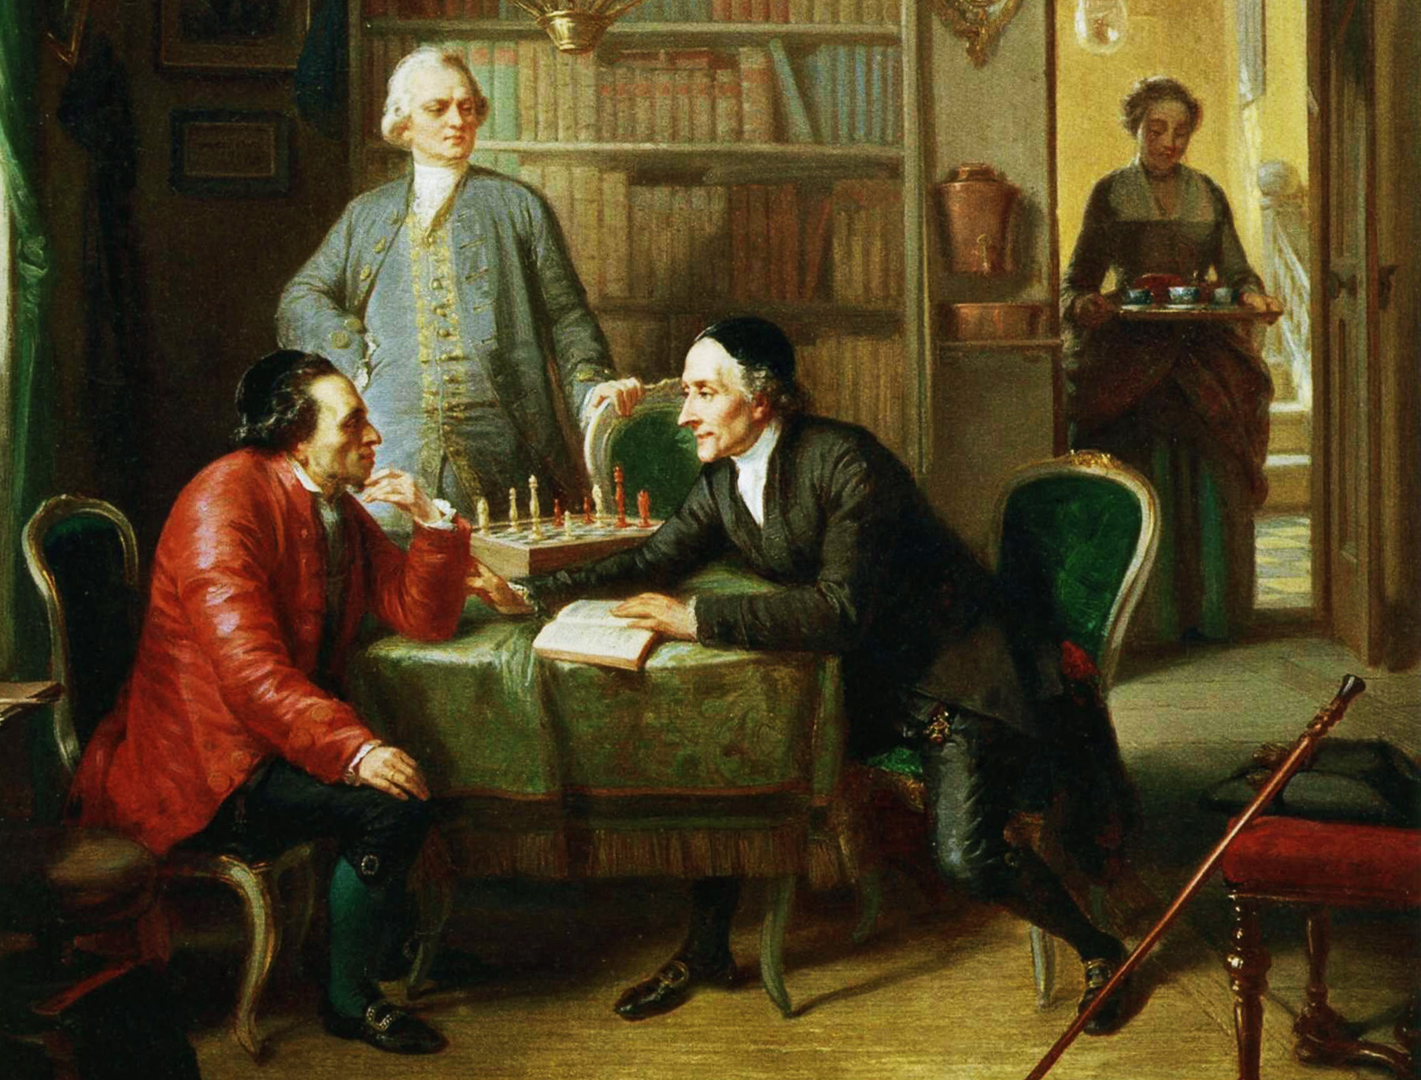
Moses Mendelssohn – Defending the Legitimacy of Judaism
Notes:
© Copyright PresentationGo.com – The free PowerPoint library

Slide 14
Moses Mendelssohn – Defending the Legitimacy of Judaism
Mendelssohn argues that Judaism is more consistent with modern values than Christianity.
Judaism consists of three elements: general truths, historical truths, and commandments. The second and third elements concern the Jews as a nation, while the general truths have been revealed to all rational beings.
‘According to the tenets of Judaism, all inhabitants of the earth have a claim to salvation, and the means to attain it are as widespread as mankind itself’.
Notes:
© Copyright PresentationGo.com – The free PowerPoint library

Slide 15
Moses Mendelssohn – Reforming Judaism
Mendelssohn advocated extensive reforms and educational projects within the Jewish community itself.
Translated the Torah into literary German, teaching Jews to communicate in German as opposed to Yiddish.
Initiated a new commentary on the Torah (the Biur) which combined Jewish scholarship with secular thought.
Helped to found the Jewish Free School in Berlin in 1778.
Notes:
© Copyright PresentationGo.com – The free PowerPoint library

Slide 16
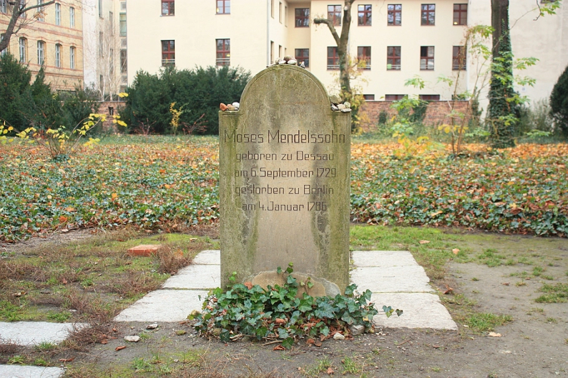
The Influence of Moses Mendelssohn
Notes:
© Copyright PresentationGo.com – The free PowerPoint library

Slide 17
The Maskilim
Following Mendelssohn’s example, the Maskilim (adherents of the Haskalah) pushed forward with their reform of Jewish society.
The Maskilim placed a huge emphasis on education; they established a number of new Jewish schools that taught secular subjects and they produced new textbooks for study.
The Maskilim also produced the first Jewish literary magazine, The Gatherer, in 1783.
Notes:
© Copyright PresentationGo.com – The free PowerPoint library

Slide 18
The Legacy of the Haskalah
The ideas of Moses Mendelssohn and the Haskalah had far-reaching consequences for Jewish life and society.
The Enlightenment and Emancipation brought about major changes in Jewish life. This transformation of Jewish existence led many Jews to seek a modernization of Jewish worship.
Notes:
© Copyright PresentationGo.com – The free PowerPoint library

Slide 19
The Beginnings of Reform Judaism
The first Reform chapel was built by Israel Jacobson (1768-1828) in 1810.
After the Napoleonic Wars, Jacobson moved to Berlin where he established the Berlin Reform Temple.
Berlin became a major centre for the new ‘liberal’ Judaism.
Notes:
© Copyright PresentationGo.com – The free PowerPoint library

Slide 20
The Beginnings of Reform Judaism
A Reform Temple was opened in Hamburg in 1818 where a number of innovations were made to the liturgy (services in German, prayer books opening from right to left, mixed-gender choir).
‘These people have no religion at all. All they want to do is show off before the Christians as being more learned than other Jews’.
Notes:
© Copyright PresentationGo.com – The free PowerPoint library

Slide 21
The Beginnings of Reform Judaism
In 1842, the Society of the Friends of Reform was established in Frankfurt. The Society rejected the validity and authority of the Talmud outright, as well as the belief in messianic redemption.
A similar group, The Association for the Reform of Judaism, was founded in Berlin 1844. Hebrew was rejected completely, together with head-covering for men and the blowing of the shofar.
In 1844, the first Reform synod was held in Brunswick in which those present advocated the modification of Sabbath and dietary laws, as well as the traditional liturgy.
Notes:
© Copyright PresentationGo.com – The free PowerPoint library

Slide 22
Adass Yisroel
In reaction to the increasing liberalization of the Jewish community of Berlin, the Orthodox Jewish society Adass Yisroel was founded in 1869.
Its first Rabbi, Ezriel Hildesheimer (1820-1899), was one of the most important leaders of the neo-Orthodox movement in Germany.
Aimed to combine living in accordance with halakhah with an openness for the culture of the non-Jewish world.
Notes:
© Copyright PresentationGo.com – The free PowerPoint library

Slide 23

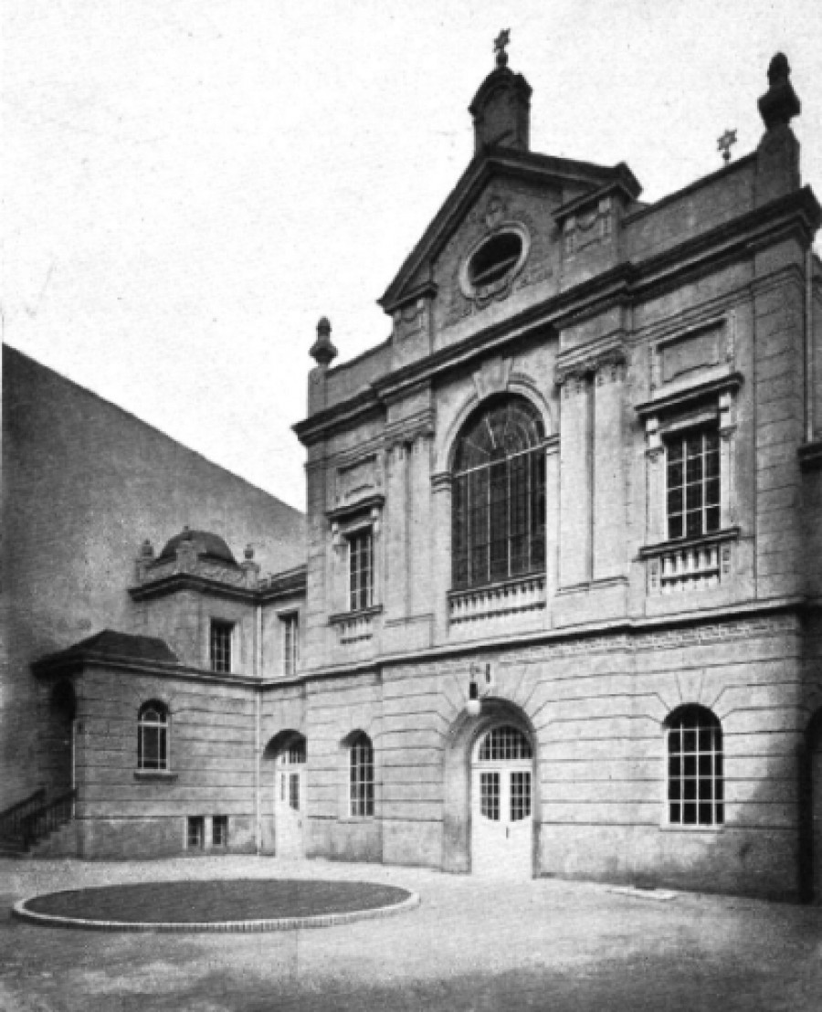
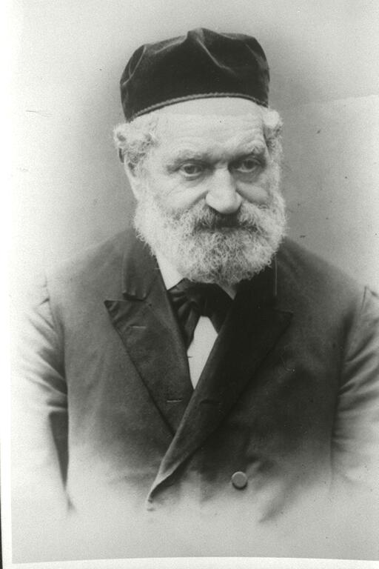
Adass Yisroel
Notes:
© Copyright PresentationGo.com – The free PowerPoint library

Slide 24
Reform Judaism Goes Stateside
Mass movement of Jews from Germany to the United States following the American Civil War.
1869: Philadelphia played host to the first conference of Reform Rabbis.
1873: Union of American Hebrew Congregations established.
1875: First Reform seminary founded.
1885: The principles of American Reform Judaism are set out in the Pittsburgh Platform.
Notes:
© Copyright PresentationGo.com – The free PowerPoint library

Slide 25
Timeline of Berlin’s Jewish Community (1850 onwards)
31 Jan 1850: Legal equality of all Prussians, including Jews, is guaranteed by the revised Prussian constitution. Jews still denied access to public posts.
5 Sep 1866: The liberal ‘New’ Synagogue (Neue Synagoge) on Oranienburger Strasse is dedicated.
1910: 144,043 Jewish residents are registered in Greater Berlin.
Notes:
© Copyright PresentationGo.com – The free PowerPoint library

Slide 26
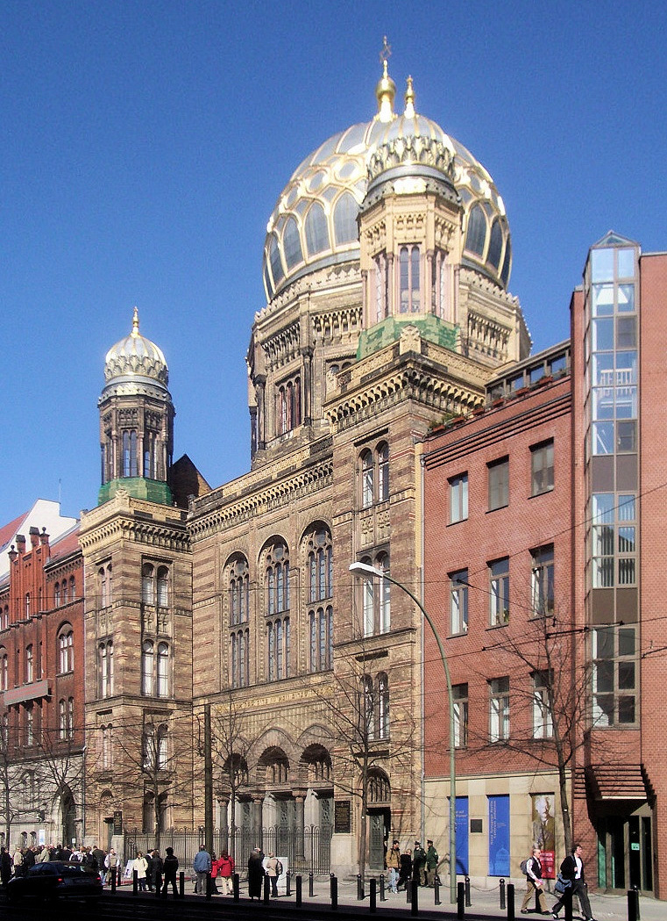
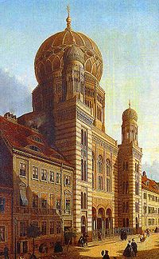
Timeline of Berlin’s Jewish Community (1850 onwards)
Notes:
© Copyright PresentationGo.com – The free PowerPoint library

Slide 27
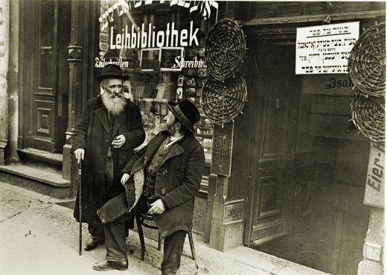
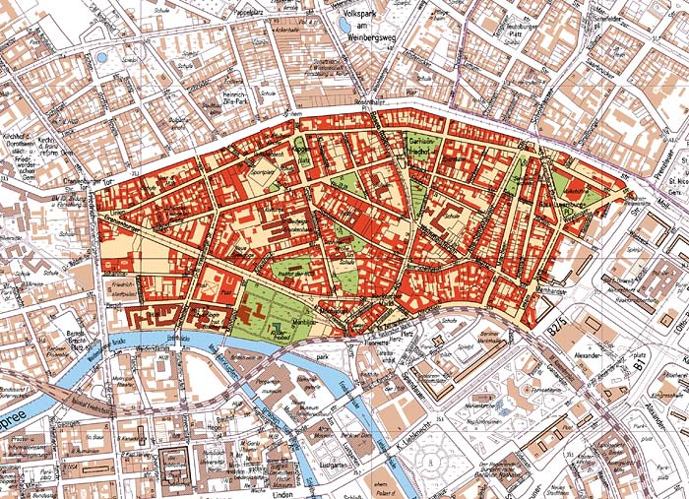
Timeline of Berlin’s Jewish Community (1850 onwards)
Notes:
© Copyright PresentationGo.com – The free PowerPoint library

Slide 28
Timeline of Berlin’s Jewish Community (1850 onwards)
1933: Jewish community has 160,000 members when the National Socialists come to power under Hitler.
9-10 Nov 1938: ‘Kristallnacht’.
18 Oct 1941: the first deportations from Berlin mark the beginning of the systematic genocide of German Jews. Before the war ends, 55,000 Berlin Jews are deported.
Notes:
© Copyright PresentationGo.com – The free PowerPoint library

Slide 29
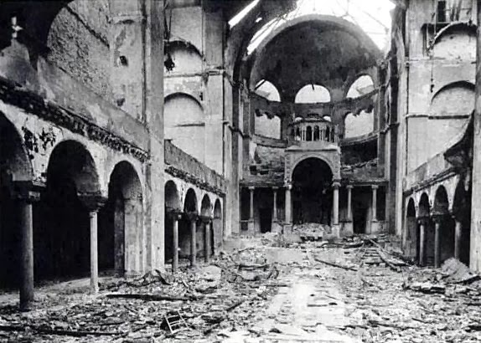
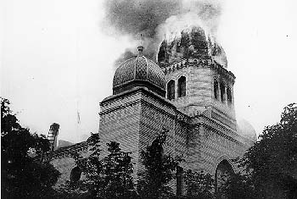
Timeline of Berlin’s Jewish Community (1850 onwards)
Notes:
© Copyright PresentationGo.com – The free PowerPoint library

Slide 30
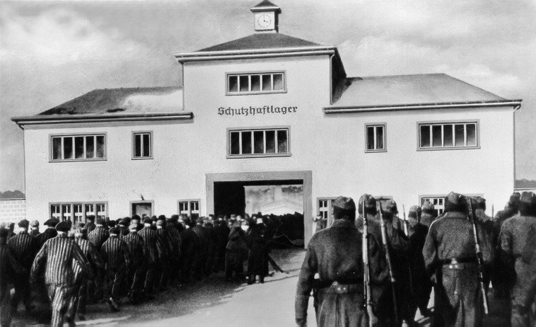
Timeline of Berlin’s Jewish Community (1850 onwards)
Notes:
© Copyright PresentationGo.com – The free PowerPoint library

Slide 31
Timeline of Berlin’s Jewish Community (1850 onwards)
7 July 1942: all Jewish schools and educational institutions are closed down.
28 Jan 1943: the Berlin Jewish community is disbanded.
27 Feb 1943: Rosenstrasse demonstration.
Notes:
© Copyright PresentationGo.com – The free PowerPoint library

Slide 32
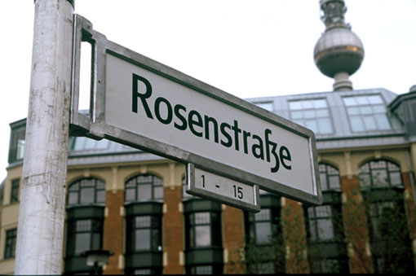
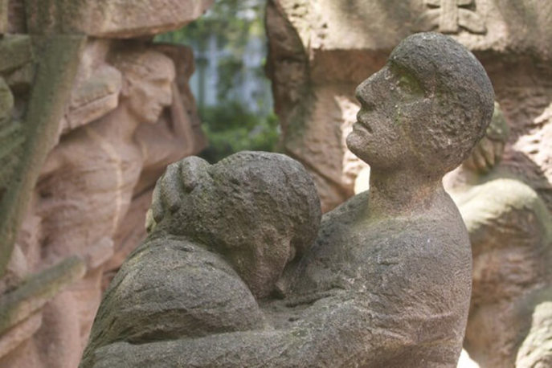
Timeline of Berlin’s Jewish Community (1850 onwards)
Notes:
© Copyright PresentationGo.com – The free PowerPoint library

Slide 33
Timeline of Berlin’s Jewish Community (1850 onwards)
Feb 1946: the Jewish community is again recognized as a public body.
19 Jan 1953: as a result of intense anti-semitic persecution in East Germany, many members of the Jewish community flee to the western part of the city or to West Germany.
Notes:
© Copyright PresentationGo.com – The free PowerPoint library

Slide 34
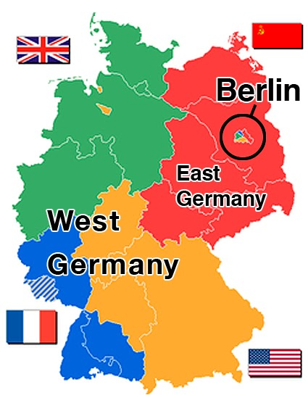

Timeline of Berlin’s Jewish Community (1850 onwards)
Notes:
© Copyright PresentationGo.com – The free PowerPoint library

Slide 35
Timeline of Berlin’s Jewish Community (1850 onwards)
10 Sep 1971: a ceremony is held to celebrate the 300th anniversary of the founding of the Jewish community of Berlin.
1990: the two Berlin Jewish communities are united.
13 Sep 2001: the Jewish Museum opens with a permanent exhibition.
10 May 2005: the ‘Memorial to the Murdered Jews of Europe’ is officially opened.
Notes:
© Copyright PresentationGo.com – The free PowerPoint library

Slide 36
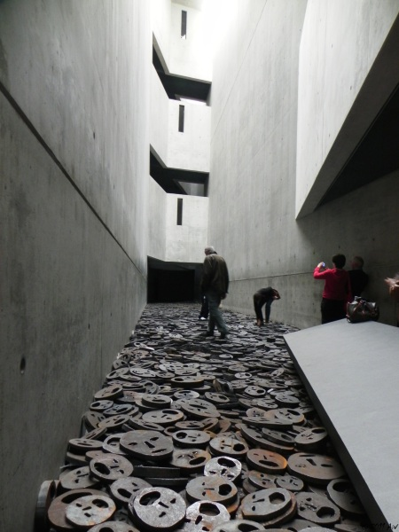
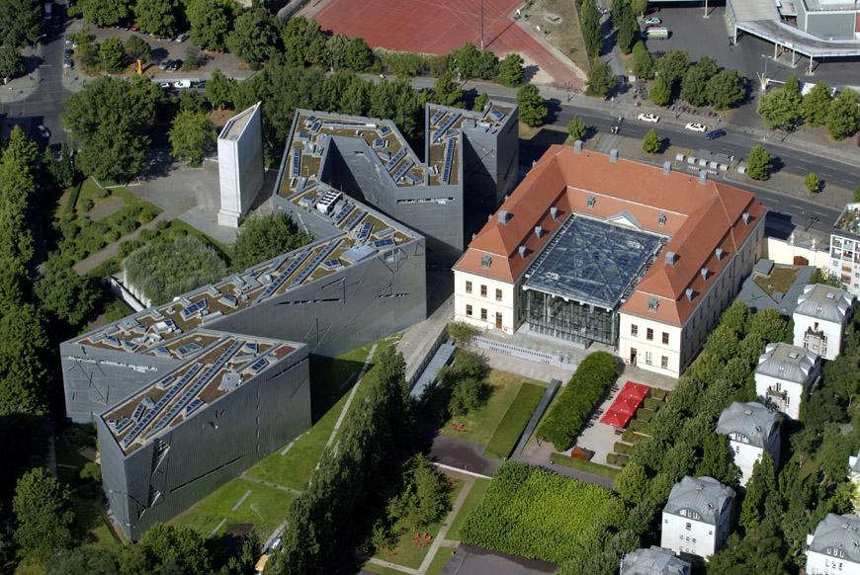
Timeline of Berlin’s Jewish Community (1850 onwards)
Notes:
© Copyright PresentationGo.com – The free PowerPoint library

Slide 37
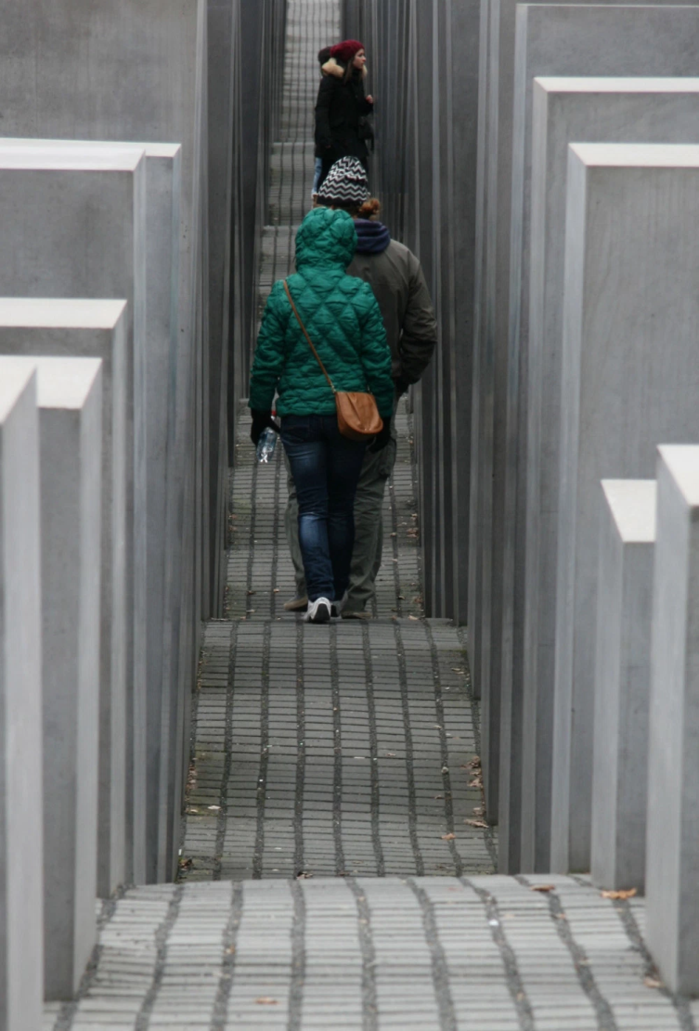

Timeline of Berlin’s Jewish Community (1850 onwards)
Notes:
© Copyright PresentationGo.com – The free PowerPoint library

Slide 38
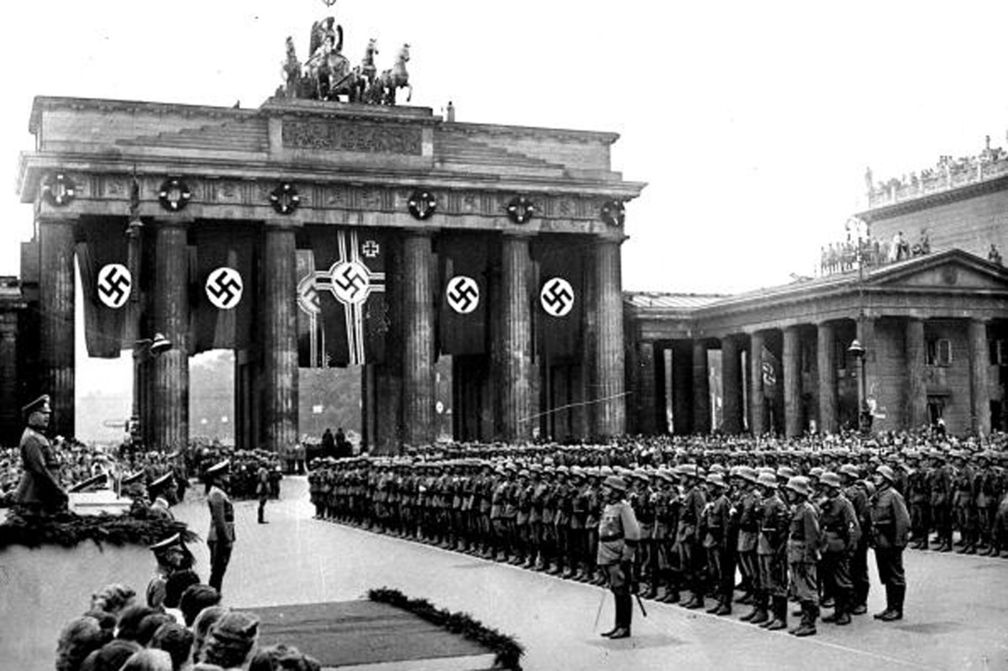
Timeline of Berlin’s Jewish Community (1850 onwards)
Notes:
© Copyright PresentationGo.com – The free PowerPoint library

Slide 39
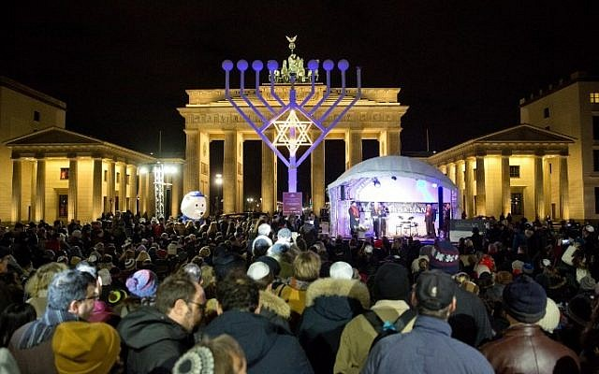
Timeline of Berlin’s Jewish Community (1850 onwards)
Notes:
© Copyright PresentationGo.com – The free PowerPoint library

Slide 40

‘Vaterland’ – Günther Schäfer (East Side Gallery)
Notes:
© Copyright PresentationGo.com – The free PowerPoint library

