Slide 1
Compassionate Leadership
Julie Thomas

Slide 2
Learning Outcomes for Today
Useful articles on wellbeing (from your research)
More on how emotional intelligence is linked to wellbeing
The tenets of compassionate management
The importance of self-compassion

Slide 3
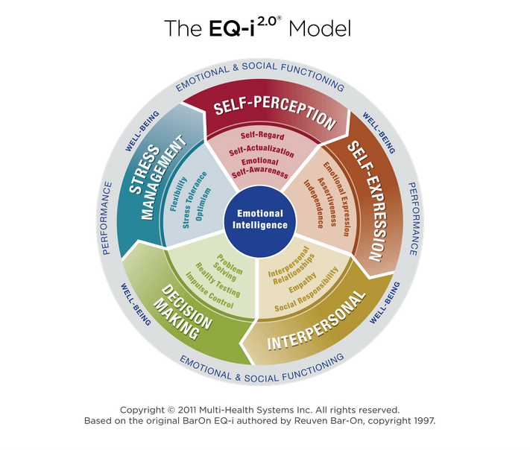

Slide 4
Activity
https://mhs.com/developing-emotional-intelligence-to-boost-employee-wellness/
Please read the above blog.
Choose one competency and state how developing that competency would have an effect on your own wellbeing, as well as the wellbeing of others.

Slide 5
Definition- Compassionate Leadership
Leaders who listen, understand and help
This creates a supportive environment that encourages the greater wellbeing of staff, leading to higher levels of innovation, engagement and ultimately performance
(West, 2019)
A good source – www.kingsfund.org.uk
Notes:
Move from top-down, controlling leadership to compassionate, collaborate leadership.

Slide 6
Four Behaviours of Compassionate Leaders
Attending (listening with fascination)
Understanding (needs of staff)
Empathising (caring for staff)
Helping (enabling staff to do their jobs)
The most important skill is listening and the most important task is helping staff to do their jobs.
Emotional Intelligence skills!

Slide 7
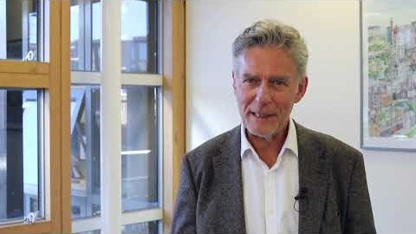
Michael West on Compassionate Leadership

Slide 8
Group Discussion
What issues might there be in the NHS that affect wellbeing? e.g. long working hours.
Notes:
Long hours
Stress
Not having time to attend to basic needs – eating, toilet
Dealing with aggressive patients
Afraid of speaking up
Command and control leadership
Blame culture
Dealing with negative patient outcomes such as death and disability
Presenteeism
Absenteeism
High turnover of staff
Bullying
Harassment

Slide 9
Group Discussion
How might compassionate leadership help?

Slide 10
The ABC of Staff Needs
Autonomy and control over what they do
Belonging (part of a team, feeling cared for)
Contribution (being able to do your job)
Notes:
Nurse and midwives have three core work needs that must be met to ensure wellbeing and motivation at work, and to minimise workplace stress.

Slide 11
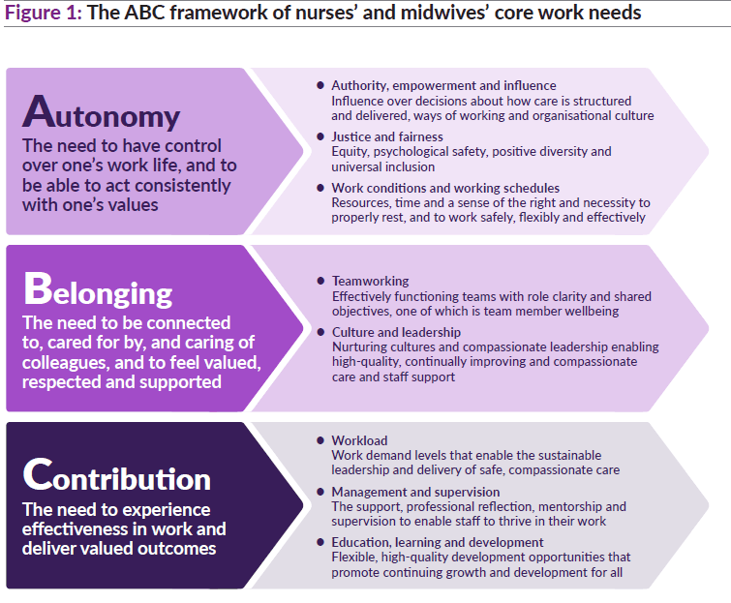
Notes:
Compassionate leadership provides an environment in which these staff needs can be met.

Slide 12
Recommendations (The KingsFund, 2020)
1: Authority, empowerment and influence
2: Justice and fairness
3: Work conditions and working schedules
4: Teamworking
5: Culture and leadership
6: Workload
7: Management and supervision
8: Learning, education and development
Notes:
Key recommendation 1: Authority, empowerment and influence
Introduce mechanisms for nursing and midwifery staff to shape the cultures and processes of their organisations and influence decisions about how care is structured and delivered.
Key recommendation 2: Justice and fairness
Nurture and sustain just, fair and psychologically safe cultures and ensure equity, proactive and positive approaches to diversity and universal inclusion.
Key recommendation 3: Work conditions and working schedules
Introduce minimum standards for facilities and working conditions for nursing and midwifery staff in all health and care organisations.
Key recommendation 4: Teamworking
Develop and support effective multidisciplinary teamworking for all nursing and midwifery staff across health and care services.
Key recommendation 5: Culture and leadership
Ensure health and care environments have compassionate leadership and nurturing cultures that enable both care and staff support to be high-quality, continually improving and compassionate.
Key recommendation 6: Workload
Tackle chronic excessive work demands in nursing and midwifery, which exceed the capacity of nurses and midwives to sustainably lead and deliver safe, high-quality care and which damage their health and wellbeing.
Key recommendation 7: Management and supervision
Ensure all nursing and midwifery staff have the effective support, professional reflection, mentorship and supervision needed to thrive in their roles.
Key recommendation 8: Learning, education and development.
Ensure the right systems, frameworks and processes are in place for nurses’ and midwives’ learning, education and development throughout their careers. These must promote fair and equitable outcomes.

Slide 13
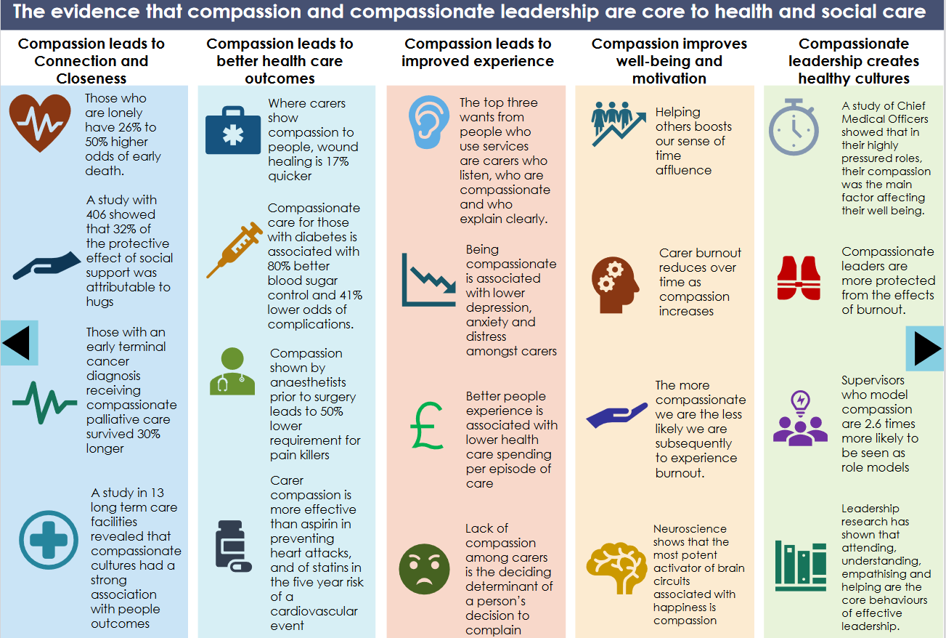
Notes:
Taken from the Draft leadership principles for health and social care in Wales.

Slide 14
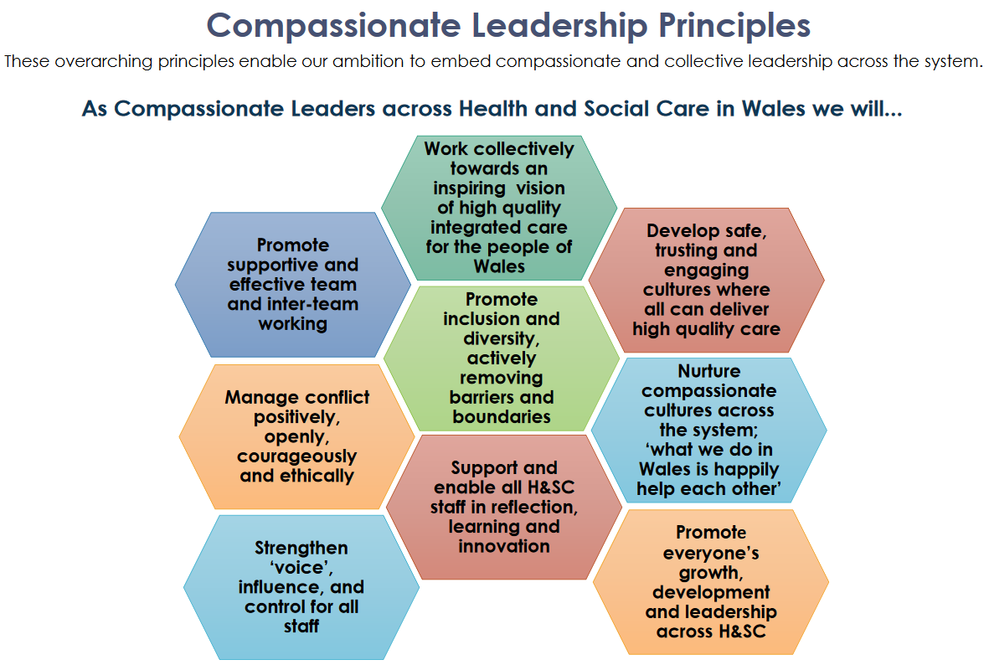
Notes:
HEIW, 2020
For more information, please visit the HEIW website.

Slide 15
Leaders need to start with Self-compassion
What are your stressors?
What are your needs?
You need to be a good role model and also be in a good place yourself to lead others
Also important to show vulnerability, which breeds trust

Slide 16
Insights from Webinar (Netigate, 15/10/2020)
Speaker - Catherine de la Poer, Halcyon Coaching
EI is our superpower, but it’s a muscle and we need to work it
Need to be emotionally effective (not just know about EI)
Need to be agile, able to adapt to change
Fear trumps logic – emotions have capacity to overwhelm, so need to control emotions to make better decisions
EI underpins trust (building relationships)
Your thoughts affect how you feel, which affects what you do

Slide 17
Insights Continued:
To increase self-awareness – ask others for feedback
Embed purpose in work
Word ‘culture’ derives from Latin ‘cultus’ which means care
Our ability to connect and be kind build trust which contributes to performance
Be present for people – listen
Move away from competition to co-operation.
Notes:
Ask for feedback from your boss:
What is the one thing you value about me?
What is the one thing I can change for my own benefit?

Slide 18
Activity
Form pairs
Play one round of ‘rock, paper, scissors’ in your pair
If you lose, your job is to support (cheer on!) the winner in the next round
Winners keep on playing each other and losers keep on supporting the winners, until there is an overall winner
Purpose of activity – to practice healthy competition and an overall supportive culture which supports wellbeing.

