Slide 1

Reflective Practice/Ymarfer Myfyriol
ECEY4002

Slide 2
Life can only be understood backwards; but it must be lived forwards. (Soren Kierkegaard)
“competent practitioners usually know more than they can say. They exhibit a kind of knowing-in-practice, most of which is tacit.” (Donald Schon)
https://librarysearch.uwtsd.ac.uk/permalink/44WHELF_UWTSD/11c0l68/alma99100357409202421
Dim ond yn ôl y gellir deall bywyd; ond rhaid byw ymlaen. (Soren Kierkegaard)
"mae ymarferwyr cymwys fel arfer yn gwybod mwy nag y gallant ei ddweud. Maent yn arddangos rhyw fath o wybod yn ymarferol, y rhan fwyaf ohonynt yn dactegol." (Donald Schon)

Slide 3
Professional understanding
There are those who choose the swampy lowlands. They deliberately involve themselves in messy but crucially important problems and, when asked to describe their methods of inquiry, they speak of experience, trial and error, intuition, and muddling through.
Other professionals opt for the high ground. Hungry for technical rigor, devoted to an image of solid professional competence, or fearful of entering a world in which they feel they do not know what they are doing, they choose to confine themselves to a narrowly technical practice
(Schon, 2016)
Mae yna rai sy'n dewis yr iseldiroedd cyfnewid. Maent yn ymwneud yn fwriadol â phroblemau blêr ond hollbwysig a, phan ofynnir iddynt ddisgrifio eu dulliau ymchwilio, maent yn siarad am brofiad, treial a gwall, greddf, a dryswch.
Mae gweithwyr proffesiynol eraill yn dewis y tir uchel. Llwglyd ar gyfer rigor technegol, wedi'i neilltuo i ddelwedd o gymhwysedd proffesiynol cadarn, neu'n ofni mynd i fyd lle maent yn teimlo nad ydynt yn gwybod beth y maent yn ei wneud, maent yn dewis cyfyngu eu hunain i arfer technegol cul
(Schon, 2016)

Slide 4
We are already reflective!/Rydym eisoes yn fyfyriol!
We learn through experience.
What happened?
How did I react?
Will I act differently next time?
Discuss this in your groups.
Rydym yn dysgu drwy brofiad.
Beth ddigwyddodd?
Sut wnes i ymateb?
A fyddaf yn gweithredu'n wahanol y tro nesaf?
Trafodwch hyn yn eich grwpiau.

Slide 5
Models of Reflection.
Models of reflection - Reflective Practice Toolkit - LibGuides at University of Cambridge Subject Libraries
In Groups we will look at and explore some Models.
Mewn Grwpiau byddwn yn edrych ar rai Modelau ac yn eu harchwilio.

Slide 6
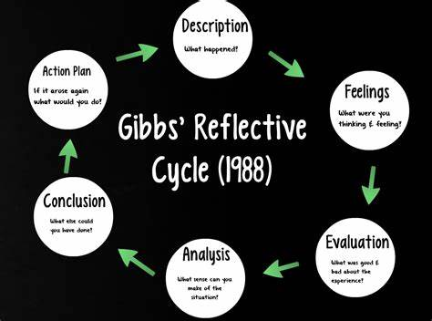
Gibbs Model of Reflection.

Slide 7
Application to professional Practice.
Continuous Professional Development.
Mindful/Critical Awareness
Effective Communication
Teamworking
Knowledge and skills development
Datblygiad Proffesiynol Parhaus.
Ymwybyddiaeth Ymwybyddiaeth Ofalgar/Beirniadol
Cyfathrebu Effeithiol
Gwaith tîm
Datblygu gwybodaeth a sgiliau

Slide 8
Developing your Skills.
Notes:
Use the template and in groups discuss and try an example.

Slide 9
Communication.
Good communication is central to working with children, young people, their families and carers. It is a fundamental part of the Common Core. It involves listening, questioning, understanding and responding to what is being communicated by children, young people and those caring for them.
(Dunhill, 2009)
Mae cyfathrebu da yn ganolog i weithio gyda phlant, pobl ifanc, eu teuluoedd a'u gofalwyr. Mae'n rhan sylfaenol o'r Craidd Cyffredin. Mae'n cynnwys gwrando, cwestiynu, deall ac ymateb i'r hyn sy'n cael ei gyfathrebu gan blant, pobl ifanc a'r rhai sy'n gofalu amdanynt.

Slide 10
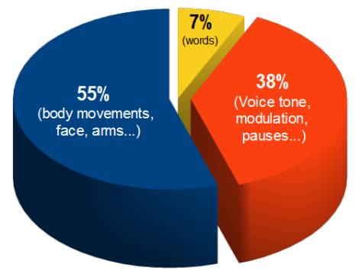
Cyfathrebu Di Lafar
Non Verbal Communication
Human communication
Tone and Pitch
Nonverbal body language
Eye contact
Posture
Body positioning
others ?
(Orey, 2014)

Slide 11
Inclusive Practice/Ymarfer Cynhwysol
Listening effectively
Developing relationships
Observing and assessing
Respecting diversity
Defining terms
Teamwork and inclusive leadership.
(Brodie and Savage, 2015)
Gwrando'n effeithiol
Datblygu perthnasoedd
Arsylwi ac asesu
Parchu amrywiaeth
Diffinio termau
Gwaith tîm ac arweinyddiaeth gynhwysol.

Slide 12
Essential Communication.
https://librarysearch.uwtsd.ac.uk/permalink/44WHELF_UWTSD/11c0l68/alma99121835502421
Chapter 2 Explore and discuss in groups.
Pennod 2 Archwilio a thrafod mewn grwpiau.

Slide 13
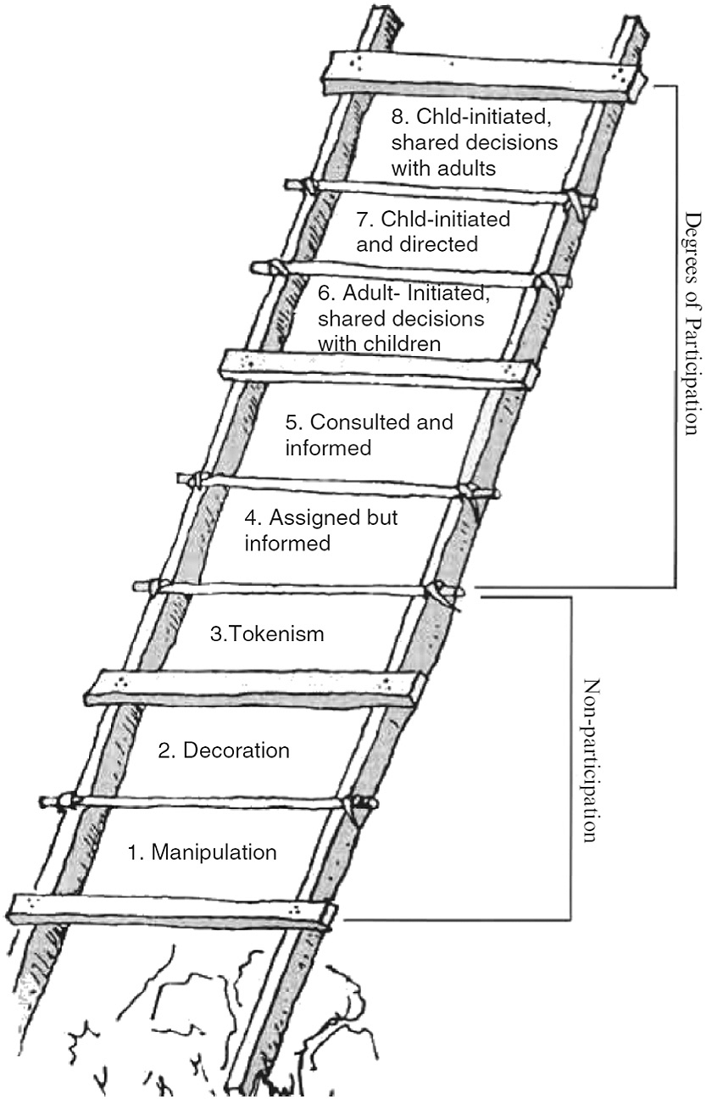
Hart (1992) 'Ladder of Participation'

Slide 14
Summary/Crynodeb
Reflective practice enables us to critically evaluate our skills and knowledge.
Communication is enhanced through peer reflection.
Understanding the needs of others and team working is enhanced.
The reflective practitioner continually develops mindful and critical awareness or themselves and others.
Mae ymarfer myfyriol yn ein galluogi i werthuso ein sgiliau a'n gwybodaeth yn feirniadol.
Mae cyfathrebu'n cael ei wella drwy fyfyrio gan gyfoedion.
Mae deall anghenion pobl eraill a gweithio mewn tîm yn cael ei wella.
Mae'r ymarferydd myfyriol yn datblygu ymwybyddiaeth ystyriol a beirniadol yn barhaus neu eu hunain ac eraill.

Slide 15
References
Brock, A. (2015). The early years reflective practice handbook. Routeldge. https://doi.org/10.4324/9780203117248
Brodie, K and Savage, K. (2015) Inclusion and Early Years Practice. London: Routledge https://ezproxy.uwtsd.ac.uk/login?url=https://search.ebscohost.com/login.aspx?direct=true&db=nlebk&AN=958635&site=ehost-live&ebv=EB&ppid=pp_4
Dunhill, A., Elliott, B., & Shaw, A. (2009). Effective communication and engagement with children and young people, their families and carers. Learning Matters. Available at: https://search-ebscohost-com.ezproxy.uwtsd.ac.uk/login.aspx?direct=true&db=nlebk&AN=411650&site=ehost-live (Accessed: 17 September 2021). . https://doi.org/10.4324/9781315237473
Hart (1992) Ladder of Participation. Hart (1992) 'Ladder of Participation'. | Download Scientific Diagram (researchgate.net)
Klein, G. (n.d.). Intuition or experience? Tacit knowledge in decision making.
Orey, M. (2014) Communication Skills Training. Virginia: ATD Press.
Paige-Smith, A., & Craft, A. (2011). Developing reflective practice in the early years (2nd ed.). McGraw Hill.
Petrie, P. (2011) Communication Skills for Working with Children and Young People : Introducing Social Pedagogy. London: Jessica Kingsley Publishers. Available at: https://search-ebscohost-com.ezproxy.uwtsd.ac.uk/login.aspx?direct=true&db=nlebk&AN=387979&site=ehost-live (Accessed: 16 September 2021).
University of Cambridge Libraries (No Date). Models of Reflection. Available at: Models of reflection - Reflective Practice Toolkit - LibGuides at University of Cambridge Subject Libraries

