Slide 1


Effective Communication
Student name: Karen Tobin
Student number: 2129244
Professional Development in Health & Social care
Module code: LCHS4005-BIRM
Lecturer: Dr. Fouziya Farheen

Slide 2


Communication is...
Verbal either spoken or written
Non-verbal including eye contact, expression, gesture, and touch
It is actively listening as well as speaking and questioning
It is professional, respectful, sensitive and empathic
Written communication -documentation should be specific, factual, accurate, measurable and written in standardised medical or English terminology as well as being legible, errors should be crossed through neatly with one line & Record keeping should be clear, accurate and timely
(Gault et al, 2017)
This Photo by Unknown author is licensed under CC BY.

Slide 3

Why is effective communication essential in health and social care?
Creates understanding between patient and healthcare professional and ensures that what needs to happen is clearly understood
Inspires trust in healthcare professionals and faith in the healthcare system.
Assist healthcare professionals to work effectively with other healthcare professionals, service user's, families and the public
Vital to the quality of care received
Positive impact on patient outcomes
Reducing the use of emergency and inpatient services, therefore, reducing the burden of cost on healthcare systems
(Ratna,2019)

Slide 4
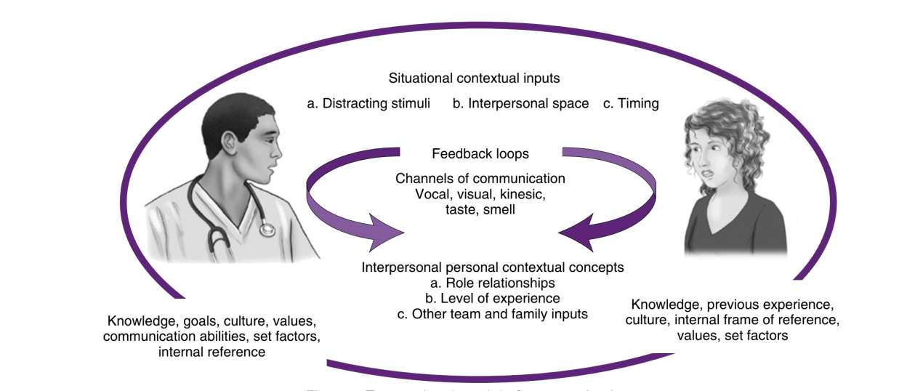
Transactional model of communication
-A two-way interactive process during which information is passed between individuals.
-Both receiver and sender are involved and influence each other’s messages and responses.
-Both form opinions on the other’s attitude and potential reactions to the message received
-Both exchange feedback and understanding and the communication is considered effective when both receiver and sender understand one another
Arnold & Boggs, 2019, page 11

Slide 5
To effectively communicate in a transactional manner
Speak slowly and clearly
Maintain eye contact
When speaking or listening turn toward the patient,
Actively listen
Pay attention to the non-verbal communication both your own and the patients
Avoid medical jargon
Show respect, sensitivity and empathy
Give and receive feedback to ensure the message conveyed is comprehended
Get the patient to repeat back/clarify what they have understood

Slide 6
Ways effective communication may be used in a health and social care context
It influences the patient and healthcare professional's relationship and so influences the patient outcomes and satisfaction
Allows for the treatment plan to be a mutual decision and so is a requirement of patient-centred care
Can facilitate adherence to treatment
(Silverman & Rosenbaum, 2013)

Slide 7
Reference List
Arnold, E.C. and Boggs, K.U., 2019. Interpersonal relationships e-book: professional communication skills for nurses. Elsevier Health Sciences.
Bing images
Gault, I. et al. (2017) Communication in nursing and healthcare : a guide for compassionate practice. London: SAGE Publications Ltd.
Ratna, H., 2019. The importance of effective communication in healthcare practice. Harvard Public Health Review, 23, pp.1-6.
Silverman, J.D. and Rosenbaum, M.E. (2013) ‘Training for Effective Communication in Healthcare Settings’, in The Oxford Handbook of Health Communication, Behavior Change, and Treatment Adherence. Oxford University Press. Available at: https://doi.org/10.1093/oxfordhb/9780199795833.013.022.

