Slide 1



CAROLYNE LEIGH WILLIAMS
1704726
Personal Development and Professional
Profile
Seminar Presentation:

Slide 2
INTRODUCTION
REVISITING “WHO AM I?”
MY BIGGEST LESSON
THEMES AND LEARNINGS
PERSONAL THERAPY
STRENGTHS AND WEAKNESSES
FUTURE PROFESSIONAL GROWTH
CONCLUSION
REFERENCES

Slide 3

INTRODUCTION
This presentation is going to examine my personal and professional development during my time as a university student. Personal development is a challenging ongoing process. It involves us making changes deep within us whilst exposing ourselves emotionally.

Slide 4
I have to tell you that I was not prepared for what has happened on this journey.
There were two things said to us that have stuck with me that I wasn't comfortable with, and they were:
I was going to change doing this course
There are going to be conflicts and arguments.

Slide 5
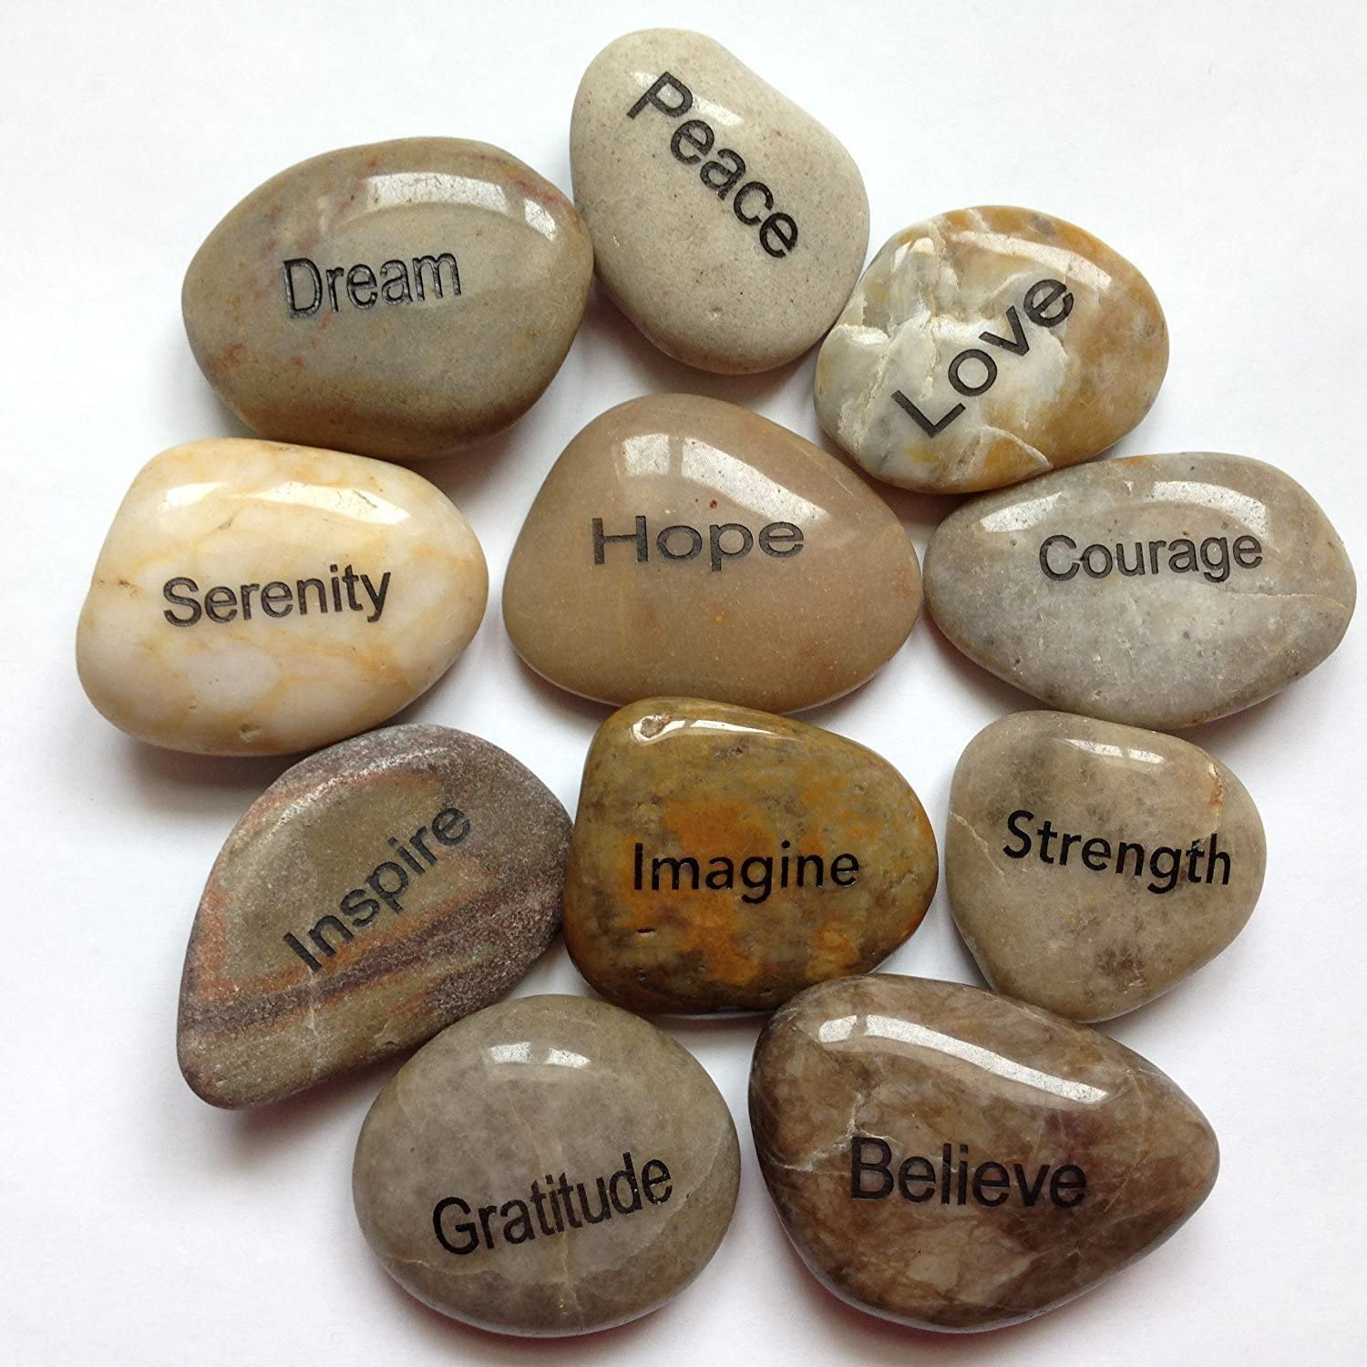
REVISITING “WHO AM I?”
I can remember us doing a presentation on "Who am I?" very early on in our work in 2018 and the subsequent 'Reflection on the concept of self' essay.
"I have revisited this piece of work, and it was interesting. I remembered that I was very confident within myself starting University.
This confidence was after many years of long hard work because of my past and the abuse I received and brutal comments in school, for example, "Leigh will never do well".
NatureExpression.com

Slide 6
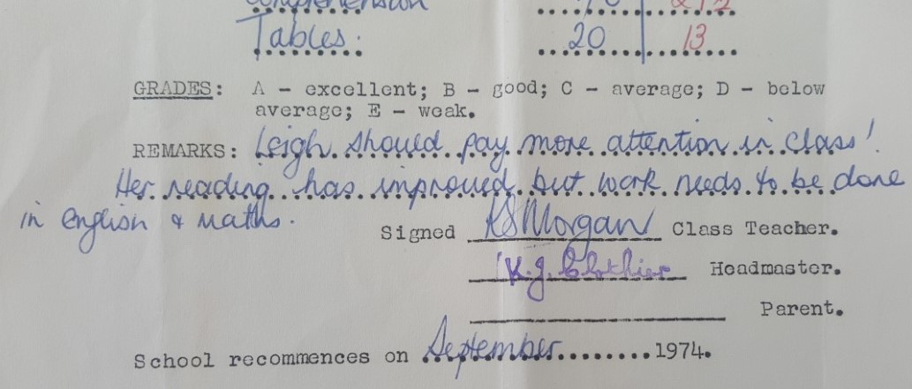
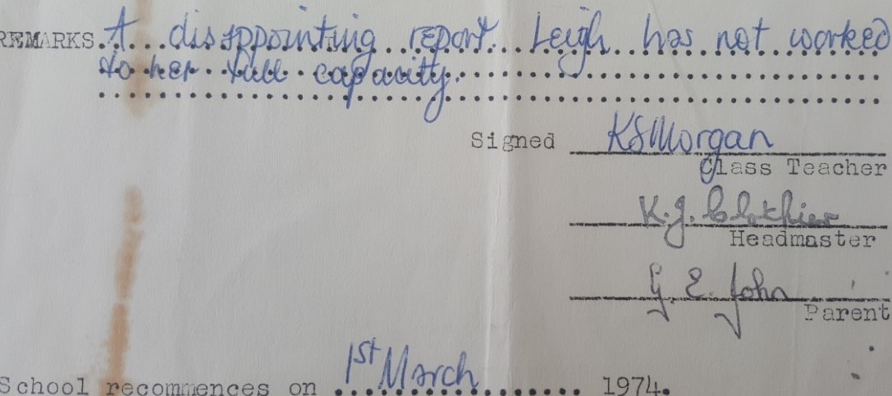
REPORTS

Slide 7
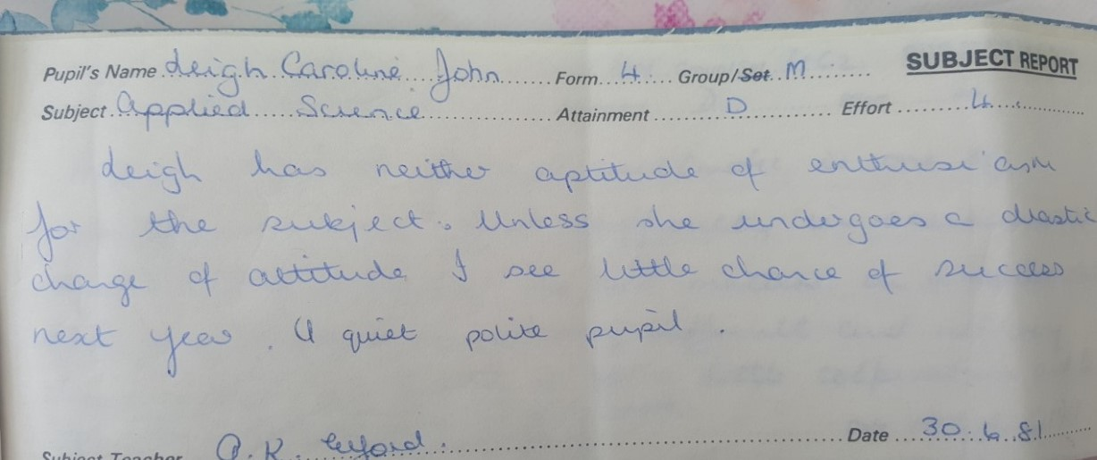
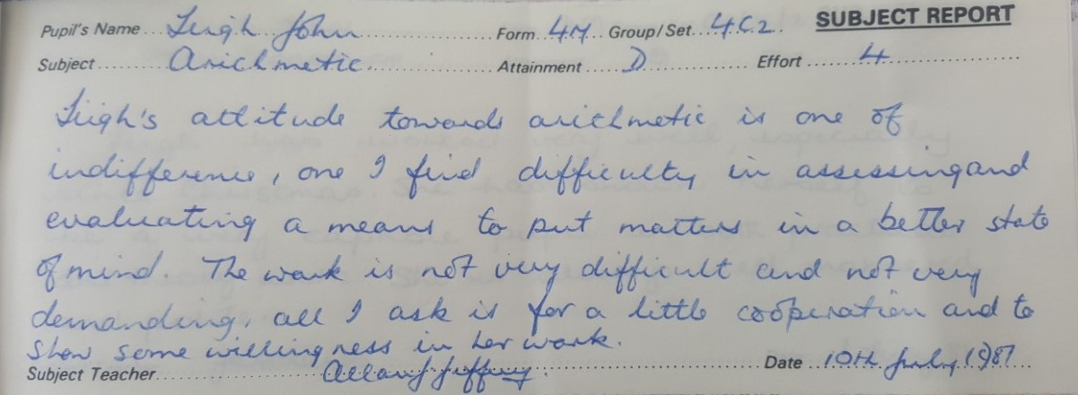
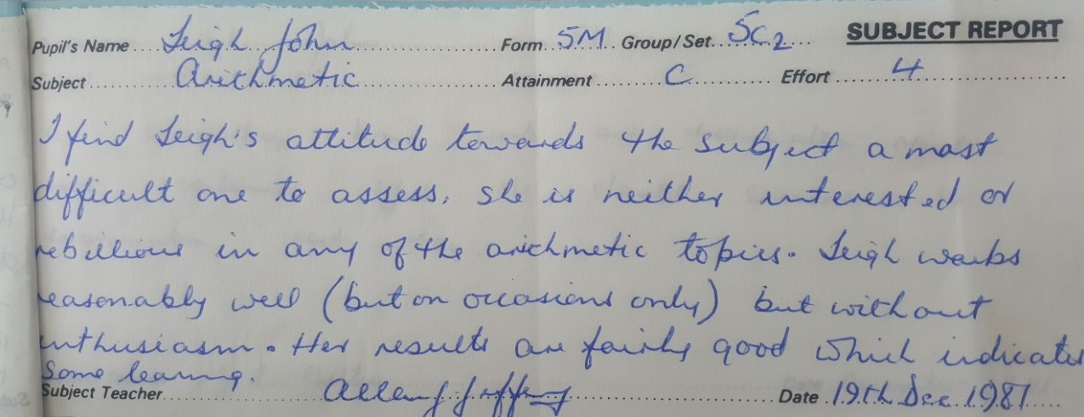
REPORTS

Slide 8
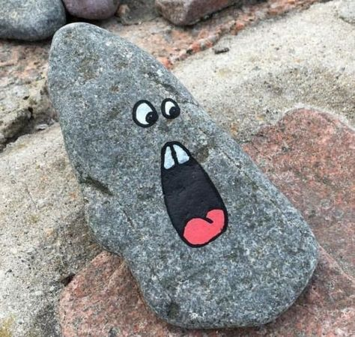
I can remember my feelings doing the “who am I” presentation and how much I feared doing it. I was petrified. Doing presentations has still not changed, and I do not think it ever will.
I can only describe it now as a deeply embedded phobia. I am not sure how I come across it now but believe me, it is not comfortable; I have just learnt how to fake it.
Pinterest

Slide 9
MY BIGGEST LESSON
I cannot do this presentation without including something I experienced at University in my first year that affected me in a traumatic way and which I will never forget.
However, it has taught me one thing in life: "Words can destroy people". After just one 20-minute one-to-one meeting as I was left feeling completely broken. I felt stripped of all my hard work and insecurities rebuilding my life.
My confidence had disappeared.
My self-worth was gone again.
The trust in University had gone entirely.
I knew what being bullied felt like for the first time.
I felt like a child again.

Slide 10
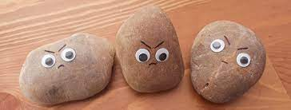
I’m not going to stand here and go over everything that happened and point fingers or name anybody because it’s over, but it had a massive effect on the way I felt about myself.
I did not know what to do about what happened to me, and I started to have severe panic attacks so, I asked the University and my GP for help, and they were both fantastic and provided me with the support I needed.
Angrypebble.com

Slide 11
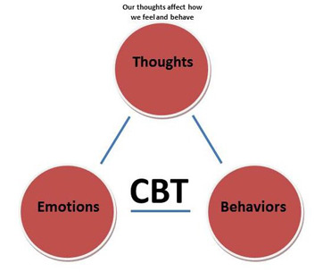
THEMES AND LEARNINGS
The first thing that was put in place for me by the University in 2018 was a 6-week course of CBT (Cognitive Behavioural Therapy). As you all know, CBT is a type of therapy that helps you change and manage your problems by looking at your behaviour, feelings, and thoughts (BACP, 2019).

Slide 12

PERSONAL THERAPY
Personal therapy helped me enormously with my personal and professional development. I was always looking at it from two directions which were as a client and a student.
My therapist was patient with me as I would completely take over 50 minutes without her even saying anything.
I completely trusted my therapist straight away and found it easy to express my emotions and fears.

Slide 13
STRENGTHS AND WEAKNESSES
STRENGTHS
WEAKNESSES
Caring
Empathic
Natural ability to listen
Give people time
Non-judgemental
Acceptance of what people tell me
Genuineness
Sense of humour
Open to new experiences
Open to new learnings
Professional
Too critical of myself
Underestimate my abilities
Lack confidence
Can be too brutally honest
Spontaneous with my words?
Extremely emotional

Slide 14
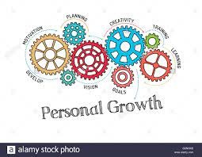
FUTURE PROFESSIONAL GROWTH
I’ve been very independent in my learning in the past year and feel that my placement provider at Swansea Mind has been very unprofessional. There has been no ongoing training from them. There is no excuse that there has been a pandemic as other placement providers have managed to support their volunteers and give them the training needed.
Alamy.com

Slide 15

PROFESSIONAL DEVELOPMENT PLAN
I have already made a professional development plan and a list of actionable steps to achieve my career goals. My goals are going to be measurable, achievable, relevant and timely. At the moment, it is a brief typed document with a structured table. When each goal is reached, I am going to set new goals. I am going to take my time and at a pace that is achievable for me. After each future learning, I will reflect on it and how it will impact my career personally and professionally (BACP, 2021).
Hudson

Slide 16
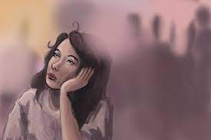
NEXT STEPS
Reflect on the last three years of learning.
Look for good learning opportunities.
What is going well for me, and are there any areas for development?
Explore where I want to be in one year, five years and ten years.
Continue keeping a journal and monitor my thoughts and feelings.
Keep a professional log of all my learnings and achievements.
Studybreaks

Slide 17

MOVING FORWARD PERSONALLY
The first thing I am going to do is clean my house. I am now officially a slob and have turned into a typical stereotype student, living off pot noodles, doing no washing up and living in the same clothes for days on end.
Regarding my health, I have to sort out my diabetes and blood pressure which is now quite severe. In addition, I need to reduce my smoking which has lately become a problem.
Also, my weight since lockdown has to be addressed. I have to tell myself that I do not need to eat the entire contents of my fridge in one day.
Dreamstime.com

Slide 18
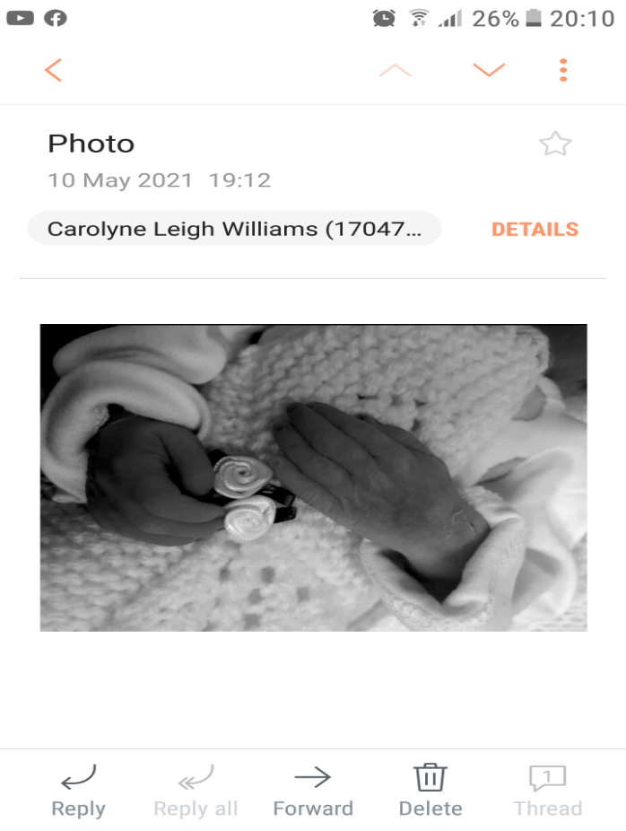
I WANT YOU TO READ THIS SLIDE YOURSELVES
I now have to go into recovery emotionally. In the next few months, I will get some help with losing my beautiful granddaughter Bonnie-Leigh who I delivered and cut the cord. I lost my daughter and granddaughter on that day. I have not had any help until now as I have been supporting my daughter with her horrendous trauma. I have put it off as well because if I had addressed it, there is no way I could have continued on this course.

Slide 19
CONCLUSION
She Amazed herself at how far she’d come
As she looked back on the past year
The issues that kept her up at night
Were no longer issues to fear
Everything seemed to fall into place
She was finally on the right track
She embraced the way her happiness shone
And decided to never look back
Her life was far from perfect still
Some days were harder than the rest
But each new day promised personal growth
And the chance to keep doing her best
Tumblr

Slide 20
Thankyou Ruth for getting me through the last year with my numerous problems. And my buddies here today. Thank you so much for always having my back and reaching out to me. Love you all xxxx.

Slide 21
REFERENCES
Alamy.Com, (2016) Gears and Professional Growth Mehanism. Available at: https://www.alamy.com/stock-photo-gears-and-personal-growth-mechanism-104965602.html. (Accessed 17th May 2021)
Angry Pebble, (2021) Available at: https://www.facebook.com/angrypebble/photos/a.102775171523202/102800498187336/?type=1&theatre. (Accessed 13th May 2021)
Bager-Charleson, (2012) Personal Development in Counselling and Psychotherapy. London: SAGE Publications Ltd.
BACP, (2019) What is cognitive behavioural therapy (CBT)? Available at: https://www.bacp.co.uk/about-therapy/types-of-therapy/cognitive-behavioural-therapy/. (Accessed 9th May 2021).
BACP, (2021) Reflective practice criterion 6 - continuing professional development. Available at: https://www.bacp.co.uk/membership/accredited-membership/apply-for-accreditation/criterion-6/. (Accessed 11th May 2021).
Dreamstime.com, (2021) Exhausted girl lying on couch resting at home. Available at: https://www.dreamstime.com/exhaustion-exhausted-girl-lying-couch-tired-end-day-resting-home-image186825346 . (Accessed 17th \may 2021.
Nature Expression (2021) Available at:- https://www.naturesexpression.com/Inspiration-River-Stones--Assorted-24_p_6332.html. (Accessed 13th May 2021)
NHS, (2018) Mindfulness. Available at: https://www.nhs.uk/mental-health/self-help/tips-and-support/mindfulness/. (Accessed 9th May 2021).
Pinterest, (2021) Pebble Rock Faces. Available at: https://www.pinterest.co.uk/helmut11/painted-rock-faces/. (Accessed13th May 2021)
Stefan, Simona et al., 2019. Cognitive‐behavioral therapy (CBT) for generalised anxiety disorder: Contrasting various CBT approaches in a randomised clinical trial. Journal of clinical psychology, 75(7), pp.1188–1202.
Studybreaks, (2019) 4 ways maladaptive daydreaming is destructive. Available at: https://studybreaks.com/thoughts/maladaptive-daydreaming-dangers-and-info/. Accessed 13th May 2021)
Tumblr, (2021) 26 letters and a whole lot of nothing. Available at: https://lovestrong.tumblr.com/post/158464877310 (Accessed 11th May 2021).

Slide 22
THE END

