Slide 1

Recruitment and Development of a Finance Assistant at HSBC UK
Module:LCLM5002
Module: Developing and Managing Individuals and Teams
Name: Estera Filip
2415106

Slide 2
Content
Introduction
Overview of HSBC UK.
Recruitment Process.
Job Analysis, Description and Person Specification.
Selection Methods.
Learning and Development needs.
Application of Learning Theories.
Performance Management and Training Evaluation.
Critical Analysis.
Conclusion.
References.

Slide 3



Introduction
Recruitment plays a strategic role in organisational sustainability.
Effective HR planning ensures operational efficiency and compliance.
Financial institutions require accurate and reliable employees.
This presentation analyses the recruitment and development of a Finance Assistant at HSBC UK.
Recruitment contributes to competitive advantage and long-term organisational performance ( Armstrong and Taylor, 2020).

Slide 4
Overview of HSBC UK
HSBC UK is a major banking institution operating within a highly regulated financial environment.
The organisation places strong emphasis on compliance, governance and risk management.
High ethical standards are essential in banking operations.
Banking institutions face strict regulatory requirements, making structured HR practices essential ( CIPD, 2023)

Slide 5
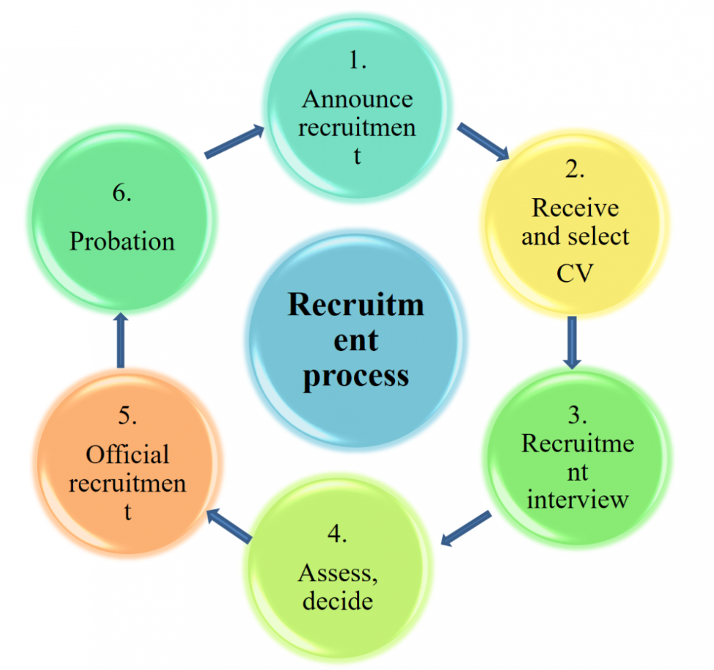
Recruitment Process.
To ensure smooth organisational functioning, recruitment must follow structured HR planning:
Workforce planning
Job description
Person specification
Selection process
A structured recruitment process helps make hiring more fair and clear for everyone.
(Taylor, 2022)

Slide 6
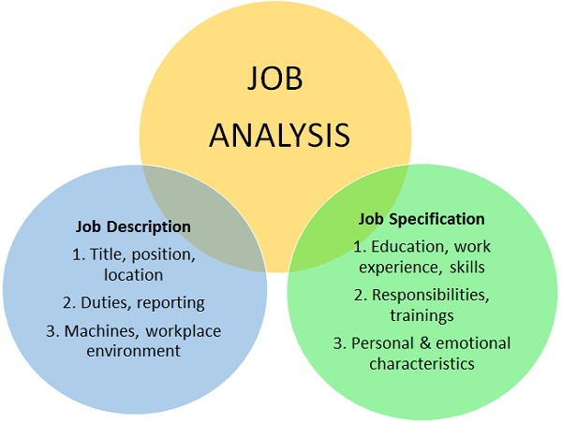
Job Analysis, Description and Person Specification
Job Analysis
Job analysis identifies the duties, responsibilities and required competencies for the role.
Identification of tasks.
Required knowledge and skills.
Reporting structure
Job analysis reduces selection errors and improves clarity
Job Description
Main duties of a Finance Assistant include:
Financial reporting
Account reconciliation
Regulatory compliance
Administrative financial support

Slide 7
Person Specification- Financial Data Analyst
Prepare reports analysing the organisation’s financial performance and accounting data.
Provide support to auditors during audit activities when required.
Put together and summarise information to make reports on risk and financial status.
Help write reports for upper management and for filing with the SEC.
Clear criteria increase objectivity in recruitment decisions.
(Wassel and Bouchard, 2020)

Slide 8
Selection Methods
Appropriate selection methods for HSBC UK include:
Structured interviews
Competency- based questions
Reference checks
Background screening
Structured interviews increase reliability and validity in selection. ( Armstrong and Taylor,2020)
Bias reduction and equal opportunity are essential in UK recruitment ( CIPD, 2023)

Slide 9

Identifying L&D Need
Training needs arise from:
Skills gap analysis
Regulatory requirements ( e.g., AML compliance)
Performance review
Organisational objective
Training in banking is strongly linked to compliance and risk reduction. (CIPD, 2023)
L&D supports sustainable business performance. (Schroder et al., 2023)

Slide 10
Behaviourist Theory (Skinner, 1953)
Behaviourism suggests that people learn when actions are repeated after rewards.
Employees repeat behaviours that are positively reinforced.
Application at HSBC:
Reinforcing correct financial reporting procedures
Repetition of compliance procedures
Monitoring and feedback

Slide 11

Behavioural reinforcement improves procedural accuracy in structured financial tasks (Skinner, 1966).
Cognitivist Theory (Piaget, 1952)
Cognitivism focuses on the development of analytical thinking and problem-solving skills.

Slide 12

Critical Analysis
No single learning theory is sufficient in isolation.
Behaviourism is effective for compliance and procedural training.
Cognitivism supports analytical thinking and problem-solving.
Experiential learning strengthens practical financial skills.
A blended learning approach is most suitable in the banking sector.
(Armstrong and Taylor, 2020)

Slide 13
Conclusion
Structured recruitment improves organisational stability.
Job analysis reduces selection risks.
Targeted training enhances financial accuracy and compliance.
Learning theories support employee development and competence.
HR contributes directly to sustainable organisational performance.

Slide 14
References
Armstrong, M. and Taylor, S. (2026) Armstrong’s Handbook of Human Resource Management Practice. A Guide to the Theory and Practice of People Management. 17th end. London: Kogan Page
CIPD (2023) Recruitment and selection factsheet. London: Chartered Institute of Personnel and Development. Available at: https://www.cipd.co.uk ( Accessed: 20 February 2026).
Kirkpatrick, D.L., and Kirkpatrick, J.D. (2006). Evaluating training programs: The four levels. San Francisco: Berrett-Koehler.
Schroder, S. et al. (2023)’ Toward holistic corporate sustainability: Developing employees’ action competence for sustainability in small and medium- sized enterprises through training’. Business Strategy and the Environment, 32 (4), pp. 1650-1669. Available at:
https://doi.org/10.1002/bse.3219
Skinner, B. F. (1966). Science and human behaviour. New York: The Free Press.
Wassel, S. and Bouchard, M.(2020) ‘Rebooting strategic human resource management: integrating technology to drive management’, International Journal of Human Resource Development and Management, 21(4), pp. 95-113. Available at: https://doi.org/10.1504/IJHRDM.2020.106275

Slide 15




Thank you!

