Slide 1
Strategies for Resilience and Prosperity (BMSP6006)
Callum Cresser

Slide 2

Strategy
Strategic management involves utilizing a company's resources to achieve goals.
Strategic management involves setting goals, assessing the competitive environment, examining the internal organization, evaluating plans, and implementing them across the business (Kenton, 2022).
Companies, universities, non-profits, and other organizations can utilize strategic management to set and achieve goals.
Strategic management theorists include Peter Drucker, Henry Mintzberg, Johnson and Scholes.

Slide 3
Strategic Theorists
Peter Drucker
Peter Drucker transformed the approach to business management.
He believed that effective leaders should prioritize people and ethics over revenues, strict rules, and organizational structures (Reckmann, 2022).
Henry Mintzberg
Developed his 5 Ps of strategy:
Plan
Ploy
Pattern
Position
Perspective
Johnson and Scholes
Define strategy as the direction and scope of an organization over the long-term
It creates advantage for the organization by its arrangement of resources in a demanding environment, to satisfy market demands and fulfil stakeholder expectations (1999).

Slide 4
Overview of Adidas
Adidas is a German sportswear company based out of Bavaria
Founded by Adolf Dassler in 1949 after a disagreement with his brother.
Adidas is known globally by its ‘Three Stripes’ (AboutAdidas, 2015).
The sportswear industry is saturated
Adidas has a large number of competitors such as Nike, Puma, Under Armour and New Balance.
Adidas is the largest sportswear producer in Europe and the second largest worldwide, behind only Nike (Tighe, 2022).

Slide 5
Porters 5 Forces
Porters 5 Forces is a model that finds and analyses the forces that shape business.
Helps companies find their strengths and weaknesses.
Competition in the industry | Potential of new entrants into the industry | Power of suppliers | Power of customers | Threat of substitute products

Slide 6
Porters 5 Forces - Adidas
Competition in the industry High level of competition in the sportswear industry Massive competitors | Potential of new entrants into the industry Big companies have control of the industry High market share Reputation is key | Power of suppliers Outsourcing of suppliers Hundreds of different companies used Suppliers power is low | Power of customers High sales High number of customer Customer power is low | Threat of substitute products High threat of substitution Rivals making similar style of products

Slide 7
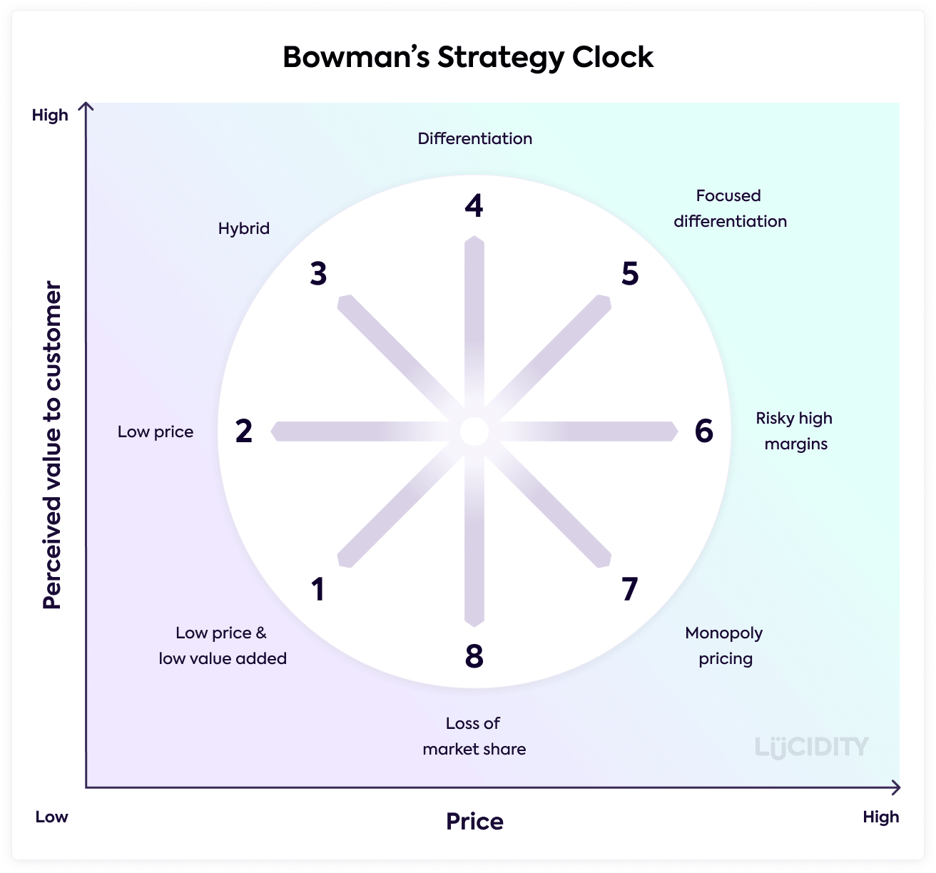
Bowman’s Strategic Clock
Bowman’s Strategic Clock is a tool used for positioning a business on a scale, based around both price and value (Lucidity, 2022).
8 positions on the clock.
Companies are not restricted to fit within just one area

Slide 8



Bowman’s Strategic Clock - Adidas
Hybrid
Wide choice of products
Competitive with rivals
Wide range of prices
Differentiation
Distinguished from rivals
Strategic partnerships with celebrities

Slide 9
New Strategic Direction
Strategic direction refers to the plans required for an organization to realize its vision and achieve its objectives. A good strategic direction will lead to Adidas gaining a competitive advantage:
Push For Economic Sustainability
Aims for carbon neutral
Develop more sustainable products and materials
Support supply chains
Use their standing in the market
A Shift To The Digital Age
Adidas has a need to move with the times
Increase their tech teams
Expand their online presence
Utilise new technology to upgrade the customer experience.

Slide 10
References
Bibliography
AboutAdidas. (2015). ABOUT HISTORY. Retrieved from adidas-group.com: https://www.adidas-group.com/en/about/history/
Kenton, W. (2022, October 2). What Is Strategic Management? Retrieved from investopedia.com: https://www.investopedia.com/terms/s/strategic-management.asp
Lucidity. (2022). Introduction to Bowman’s Strategy Clock. Retrieved from https://getlucidity.com/strategy-resources/introduction-to-bowmans-strategy-clock/
Reckmann, N. (2022, June 29). 4 Ways to Implement Peter Drucker’s Theory of Management. Retrieved from businessnewsdaily.com: https://www.businessnewsdaily.com/10634-peter-drucker-management-theory.html
Scholes, J. a. (1999). Exploring Corporate Strategy. London.
Tighe, D. (2022, August 31). adidas - Statistics & Facts. Retrieved from statista.com: https://www.statista.com/topics/1257/adidas/#dossierKeyfigures
Pictures
https://fabrikbrands.com/adidas-logo-history-and-meaning/
https://getlucidity.com/strategy-resources/introduction-to-bowmans-strategy-clock/
https://1000logos.net/nike-logo/

