Slide 1
Shaping Cultures
Rhiannon Akers, January 2025

Slide 2
Recap of last week
Theories about human behaviour:
Commitment theory
Perceptions of behaviour
Discretionary behaviour
Nudge theory - Nudge Theory Explained with Examples (youtube.com)
Notes:
Three component conceptualisation of organisational commitment was developed by Meyer and Allen (1991):
Affective
Continuance
Normative
Affective commitment refers to the affective or emotional attachment to the organisation, such that a strongly committed employee identifies with, is involved in, and enjoys being a member of the organisation.
Continuance commitment is viewed as the employee’s perceived costs of quitting.
Normative commitment is defined as an ‘internalised normative pressure to act in a way that meets organisational goals and interests’ due to the belief that it is the ‘right’ and ‘moral’ thing to do (Allen and Meyer 1990).

Slide 3
Today’s learning outcome
How to motivate and engage employees:
  What is employee engagement?
  What are the benefits?
  How to build an engaged and motivated workforce
  Work motivation theories

Slide 4
Employee Engagement
No common understanding
MacLeod Review (2009) found over 50 definitions
Gallup definition – the involvement and enthusiasm of employees in their work and workplace
Kahn (1990) identified 3 dimensions – Physical, Cognitive, Emotional
Notes:
How to Improve Employee Engagement in the Workplace - Gallup

Slide 5
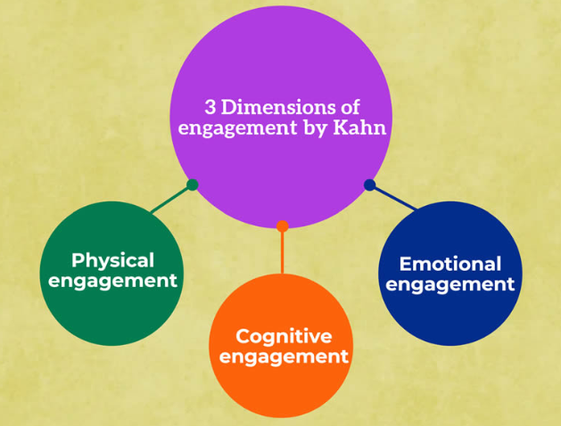
Kahn’s 3 dimensions of employee engagement
Notes:
Physical engagement ​
This is a measure of how much effort individuals put in while doing their duties, both physically and mentally.
Kahn cited examples of employees who said they felt like they were 'flying about' while at work because they were so engaged.
Confidence can be boosted by being able to use both physical and mental energy at work, according to him.
Cognitive engagement ​
Employees need to know what their employer's vision and strategy are, and what performance they need to give in order to contribute to them as much as possible, in order to be engaged at this level.
In addition, Kahn emphasized the significance that people connected to their profession, believing that more information stimulated more creativity and confident decision making.
Emotional engagement ​
Employees' emotional attachment to their employer is the foundation for this.
The organization must learn how to foster a feeling of community among its employees so that they may put their faith in and support the company's core values and mission.
Kahn emphasized the importance of positive interpersonal relations, group dynamics, and management styles in creating a safe and trusting workplace.

Slide 6
Employee Engagement: An evidence review (CIPD, 2021)
4 key areas commonly associated:
Work engagement: whether people feel vigorous, dedicated and absorbed in their work, and other measures carrying the label ‘engagement’
Organisational commitment: in particular looking at employees’ psychological feelings (‘affective’ commitment)
Organisational identification: how employees psychologically associate with their organisations
Work motivation: factors that lead people to be interested and committed to their job.
Notes:
Employee engagement: an evidence review | CIPD | CIPD
Further details from discussion report

Slide 7
Why is Employee Engagement important?
https://youtu.be/KZjKY9I6UYE
The way an organisation treats employees and how employees treat one another can positively affect their actions or can place your organisation at risk.
Gallup found that engaged employees produce better business outcomes.
23% of employees worldwide fall into the “engaged” category.
Notes:
Employee engagement helps you measure and manage employees' perspectives on the crucial elements of your workplace culture.
You can find out if your employees are actively engaged with their work or simply putting in their time. You can discover if your team building activities and human resources practices influence positive business outcomes or if there's room to grow.
And with the right approach, you can learn how to improve your employees' connection to their work and your company.
CIPD (2021) - Research literature generally assumes a causal mechanism to explain why engaged workers perform better. Bakker and Demerouti outline this assumption: There are at least four reasons why engaged workers perform better than non-engaged workers. Engaged employees often experience positive emotions, including happiness, joy, and enthusiasm; experience better health; create their own job and personal resources; and transfer their engagement to others. (Bakker and Demerouti 2008, p215)
Links with performance From the above research, we can fairly conclude that there is a positive relationship between employee and work engagement and (generally individual-level) task and contextual performance. While there exists some evidence to suggest that engagement predicts performance, some of the studies analysed simply suggested a correlational relationship between the two variables. Moreover, throughout the review, studies consistently reported small effect sizes, meaning the relationship is merely weak to moderate. Thus, employees who are more work engaged are likely to see an increase in performance, but we should also recognise that those who perform better are likely to become more engaged in their work.

Slide 8
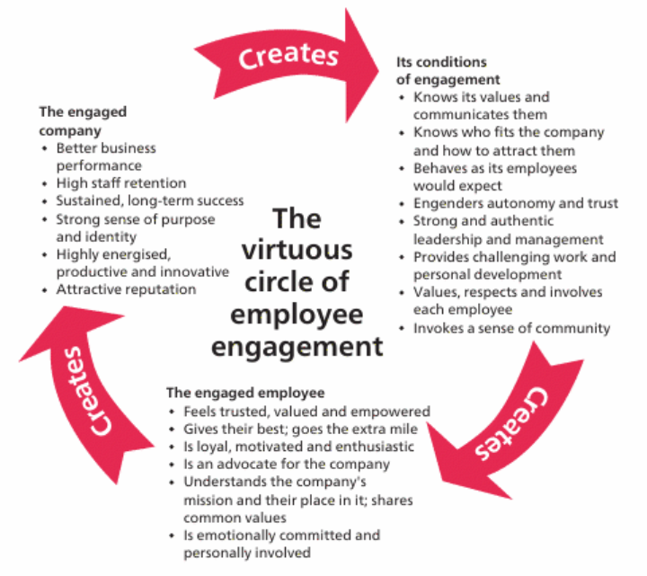
Notes:
De Vita (2007)

Slide 9
Management responsibility
Managers are in charge of ensuring that employees know what work needs to be done, supporting and advocating for them when necessary, and explaining how their work connects to organisational success.
Managers need to be quipped to have ongoing coaching conversations with employees.
Unfortunately, most managers don't know how to make frequent conversations meaningful, so their actions are more likely to be interpreted as micromanaging without providing the right tools and direction.

Slide 10
Key benefits
Most definitions of engagement describe employees who are healthier, happier, more fulfilled or more motivated.
Some research does show a causal relationship, with work engagement predicting both task performance and contextual performance or contributing to the organisation beyond one’s core job.
To some extent there’s a two-way relationship, with work engagement and performance influencing each other. So more engaged workers will go on to perform better, but an improvement in performance will also lead to more engaged workers.
                CIPD (2023)

Slide 11
Group activity

Slide 12
How to build an engaged workforce
The MacLeod Review (2009) summarised four key ‘enablers’ of employee engagement:
Leadership that gives a ‘strong strategic narrative about the organisation’.
Line Managers who motivate, empower and support their employees.
Employee voice throughout the organisation, to involve employees in decision making.
Organisational integrity that stated values are reflected in the actual organisational culture; what we say is what we do.

Slide 13
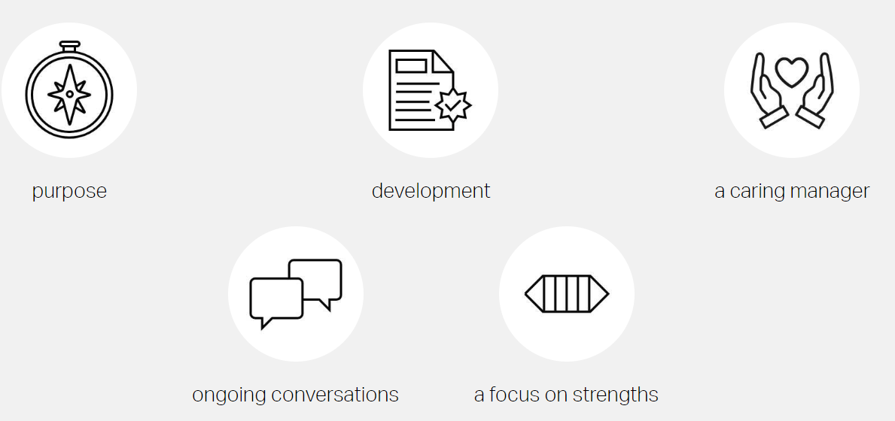
Key drivers
Notes:
One of Gallup's biggest discoveries: the manager or team leader alone accounts for 70% of the variance in team engagement.

Slide 14
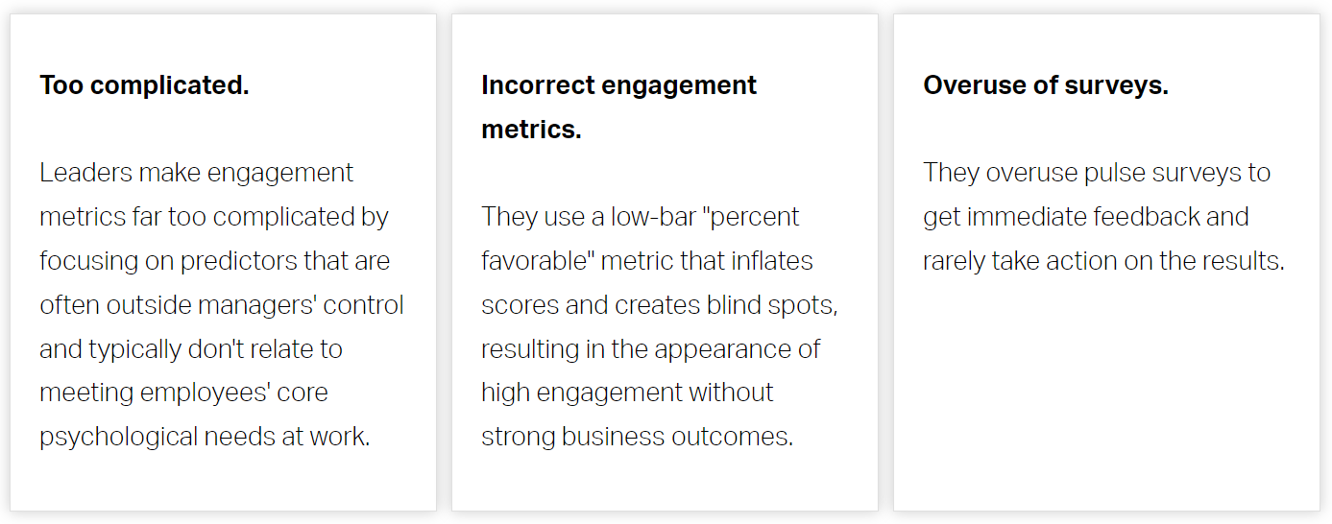
Common mistakes
Notes:
How to Improve Employee Engagement in the Workplace - Gallup

Slide 15
Employee Engagement strategies
Adopt a bottom-up approach
Promote two-way communication
Encourage community participation
Recognise good work
Invest in personal growth
Hire competent managers
Create a sense of purpose
Transparent succession planning
Notes:
Employee Engagement Strategy #1 – Adopt a Bottom-Up Approach
The construction of a house starts by building the right foundation at the bottom—not the roof! With any major decision in the organization, it is warranted that it starts at the lowest tiers—your employees. Conduct questionnaires and surveys that permit your employees to express their opinions and concerns. This research shows that 1 in 6 employees are so unhappy they are looking for a new job. A survey might be the best way to spur your employee engagement strategy. The more you ask for their opinions, the more they feel esteemed, entitled, respected, and like they belong to the organization.
Employee Engagement Strategy #2 – Promote Two-Way Communication
To promote employee engagement, the first requirement is to keep the employees out of the dark. If organizations act secretive and only divulge information on a “need-to-know” basis, it will likely cause lower engagement rates among their employees. Transparency begets trust when employees get to understand how corporate decisions will affect the workplace or how they should deal with situations.
But is disseminating information enough? No, communication should go two ways—the employees should be encouraged to share their concerns so they don’t feel ignored or unvalued. Top business leaders generally believe in the open door policy and do not use “top-secret” information to their advantage.
Employee Engagement Strategy #3 – Encourage Community Participation
An organization is essentially a community; each member fulfills a specific task and serves the community as a whole. To encourage this community spirit among your employees, any engagement activity can help, from organizing a big annual event to simply taking a team out to lunch.
Not withstanding the hierarchy present in the organization, it is better to maintain a certain level of equality and unbiasedness where everyone feels they are important to the community.
This philosophy is typical in the new-age technology startups where they adopt a more casual, no-walls organizational policy. Though sustaining this new business approach might be tricky, it can lead to highly engaged staff.
Employee Engagement Strategy #4 – Recognize Good Work
Two out of three employees feel they do not get enough recognition for their work. As a result, most employees will not deliver their maximum potential and may engage in unwanted behavior. Also, highly-trained and qualified talent is always looking for better options out there.
For this reason, it is wise to create a recognition-rich environment where good work is rewarded with perks and incentives. At the very least, a few good words and a certificate of appreciation can go a long way in letting others feel valued for their work.
It’s worth noting here that every form of recognition should conform to the organization’s mission, goals, and philosophy. It is about steering the human capital in the right direction, after all.
Employee Engagement Strategy #5 – Invest in Personal Growth
This is part of the nurturing phase of human capital management. Every human asset that you acquire should be fostered and polished to assist in the long-term growth of the organization. Whether it is by running a proprietary training program or sponsoring higher education for your employees, you are not only investing in the future of your company but also creating a sense of loyalty among your employees.
Remember, every employee loves a company that supports them in their professional career and adds value to their personal lives. Want to retain top-notch talent in your organization? Do not act selfish or dismissive. Ensure their personal growth and you will reap the benefits.
Employee Engagement Strategy #6 – Hire Competent Managers
Your secret weapon to spur employee engagement is the managers—they are the middlemen between boardroom members and the employees. In most cases, the employees interact with the top-level executives rarely, if ever, but have daily interactions with their immediate bosses. Whether they are feeling secure, angry, or ignored depends on the tact of the respective manager.
Are they capable of handling the employees? If not, what can they do better?
Gallup’s chairman, Jim Clifton, once said:
“Employees—especially the stars—join a company and then quit their manager. It may not be the manager's fault so much as these managers have not been prepared to coach the new workforce.”
While organizations can choose to educate their managers on how to better engage their employees, it is always better to hire a capable manager first. Check their professional background and try to see if they are suited for the tricky job waiting for them.
Employee Engagement Strategy #7 – Create a Sense of Purpose
Employees are not robots; they are human. Organizations that tend to see employees as a commodity that can be bought at a certain price have not woken up to the true essence of human capital, unfortunately. Your employees are not another factor of production, but prospective champions of your organization’s values and principles.
Although a hefty paycheck definitely helps, when an employee feels an emotional connection to your brand they will be able to provide higher personal investment and contribute in far greater measure.
One of the ways to ensure this is to let your employees know how significant their contribution is. Tell them how it is helping in achieving the organization’s business objectives. Simply speaking, organizations need to start making their employees feel that they matter.
Employee Engagement Strategy #8 – Sketch a Success Roadmap
This applies most if you hire millennials in your organization. For many millennials, just coming to the office, doing the work assigned, and taking the paycheck back home is not enough. They are more conscious about where they will stand in the next five or ten years. They need to know there are sufficient growth prospects for the role they are fulfilling.
Sketching a proper roadmap of success is yet another pillar to a successful employee engagement strategy. Holding regular career counseling sessions or chalking out a clear career advancement path might help a lot when it comes to millennial employee engagement.

Slide 16
The role of HR
Develop holistic strategies focussing on employee motivation and wellbeing.
Help employees understand their contribution to the purpose, objectives and culture of the organisation.
Align communications, HR policies and systems, learning and development and cross-organisational events.
Gain active buy in and support senior leaders and line managers.
Recruitment practices and performance management also important to ensure person-job fit.
Harrods case study.

Slide 17
Case study

Slide 18
Work Motivation (CIPD report, 2021)
3 key theories of work motivation:
Social exchange theory (Blau, 1964)
Social identity theory (Tafjel, 1978)
Self-determination theory (Deci and Ryan, 1985)

Slide 19
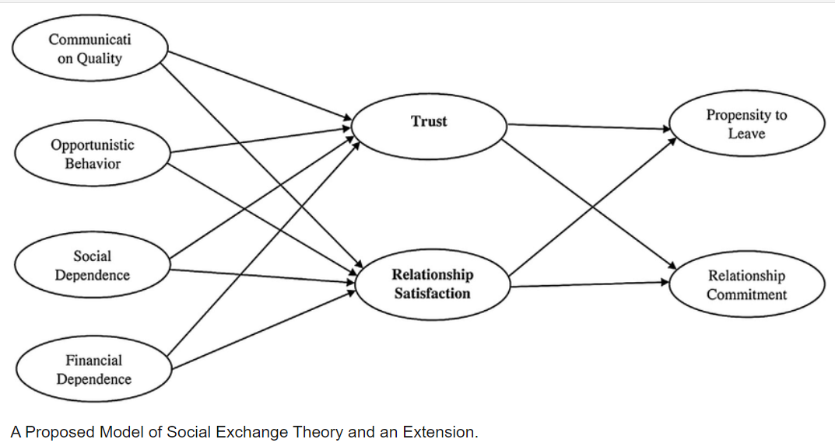
Social exchange theory (Blau, 1964)

Slide 20
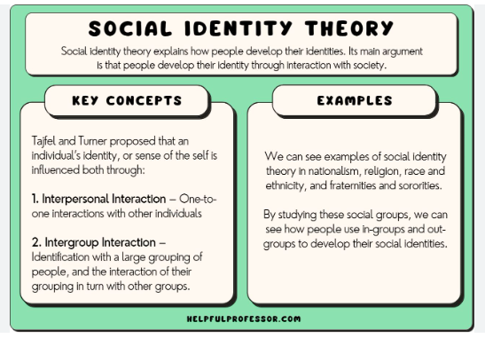
Social identity theory (Tafjel, 1978)

Slide 21
Self-determination theory (Deci and Ryan, 1985)
Autonomy: People need to be (or feel that they are) the master of their own destiny and have control over their own lives. In addition, people want to feel that they are in control of their own behaviour. Note that this does not mean that people have a need to be independent of others.
Competence: People have a need to build their competence and develop mastery over tasks and activities important to them.
Relatedness: People need to feel a sense of belonging and connectedness with others – they need to interact with, be connected to, and share meaningful experiences with others.

Slide 22
Group activity

Slide 23
Today’s learning outcomes
How to motivate and engage employees:
  What is employee engagement?
  What are the benefits?
  How to build an engaged and motivated workforce
  Work motivation theories

