Slide 1
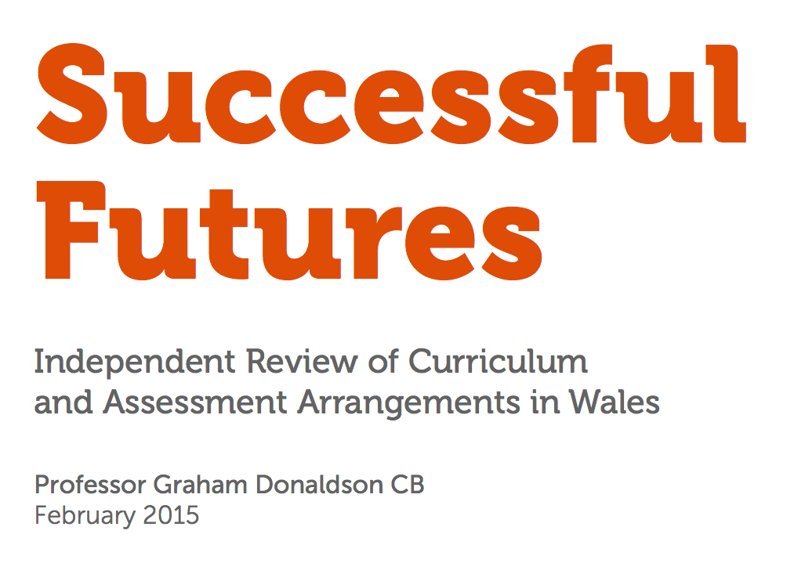

Slide 2
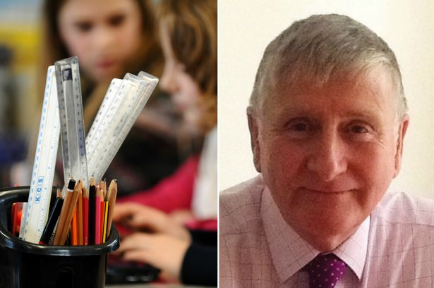
http://www.walesonline.co.uk/news/education/scotland-can-inspiration-wales-new-10701587

Slide 3
Pwy ydy Professor Graham Donaldson?
Following his retirement from HMIE Professor Graham Donaldson was asked to undertake a personal review of teacher education in Scotland.
‘Teaching Scotland’s Future’ (2011) made 50 recommendations which have all been accepted by the government and a major implementation programme is now under way.
Professor Graham Donaldson, was commissioned by the Welsh Government to consider new assessment and curriculum arrangements.

Slide 4
In a nut-shell
4 purposes
6 Areas of Learning and Experiences
3 Cross-curricular responsibilities
Incorporates all learners aged 3 to 16, from Foundation Phase to Key Stage 4 (GCSE)
Replaces existing key stages with “progression steps”, relating broadly to expectations at ages 5, 8, 11, 14 and 16

Slide 5
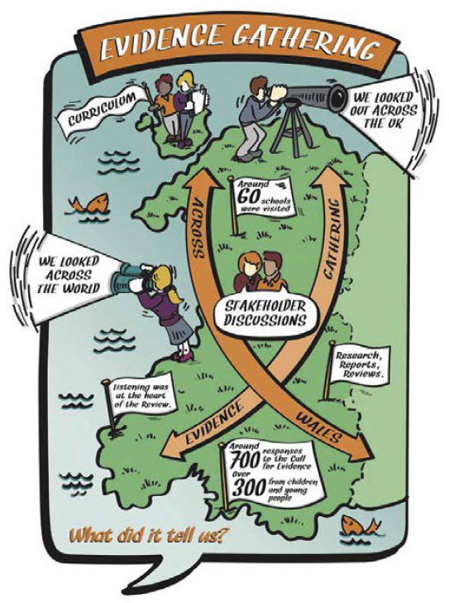
Evidence
Gathering (Pg 16)
Looked at best practice in in the UK
Look at best practice over seas
Stakeholder discussions
60+ schools visited
700+ response received
300+ child responses
Gathering evidence from across Wales
Listening was at the heart of the research

Slide 6
Cymraeg yn yr adroddiad
Teaching of the Welsh language remains compulsory up to the age of 16
Expectation that learners gain “transactional competence” by end of studies
Welsh-medium schools to act as hubs for the Welsh language, supporting teachers and practitioners in English-medium schools

Slide 7
The ‘best things’ from the current curriculum (pg15)
The Foundation Phase
The Welsh language and bilingualism (especially with younger respondents)
Focus on the Welsh identity and the Curriculum Cymreig

Slide 8
Developing Distinctive Purposes (Pg 24)
The principles enshrined in the the United Nations Convention on the Rights of the Child (UNCRC)
The Welsh language and culture
The community roles of schools
The health and well-being of young people
Independent review of W2L at KS3&4
YCC

Slide 9
Desired purposes in other WG policy statements (p.26)
Welsh Medium Education Strategy (WG,2010) – a country where WM education and training are integral
Response to a ‘public demand for an increase in Welsh-medium provision’
Increase the use of Welsh - i.e. personal, social & workplace
A living language: A language for Living (2010) – plan to increase the number of people who speak and use the language
Since the ‘A living language, a language for living’ document in 2012, the WG has published a further strategy which outlines how it will ensure that there will be a 1,000,000 speakers (one million) by the year 2050.

Slide 10
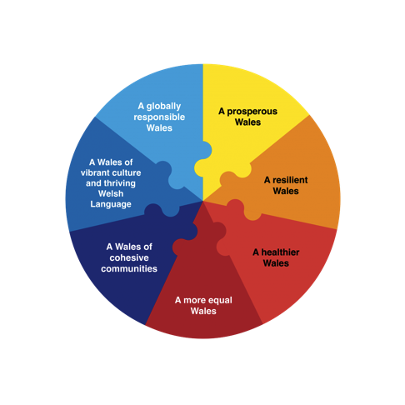
The Well-being and Future Generations (Wales) Bill (p.27)
Shared vision for the long-term economic, environmental and social well-being of Wales.
A prosperous, resilient, healthier and more equal Wales
Cohesive communities, a vibrant culture and a thriving Welsh language

Slide 11
The most recent Census
When was the last census in Wales
What was the headline regarding the Welsh language?
What is the percentage of Welsh speakers in Wales?
What is the class’ view on the definition of a Welsh speaker?
Is the question ‘are you a Wels speaker’ a straightforward question?
Notes:
Q: When was the last census in Wales
A: 2011
Q: Does anyone know what was the headline vis a vis WL?
A: decline (with e.g. Carmarthenshire for the first time falling below 50%)
Q: Does anyone know roughly the % of WS?
A: approximately just fewer than 20%
Q: But what is the class’ view on the definition of a WS?
Is the question ‘are you a WS’ a straightforward question?

Slide 12
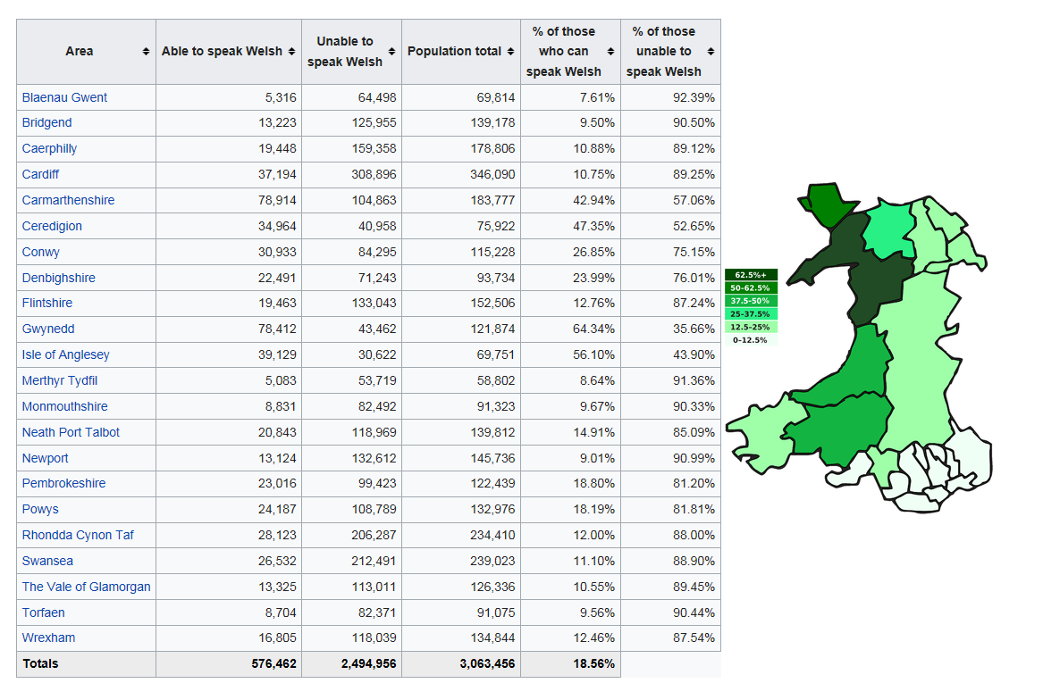
Notes:
7% of WS in Blaenau Gwent
<10% - Blaenau Gwent, Bridgend, Merthyr, Monmouthshire, Newport, Torfaen
Highest percentages in Carmarthenshire, Gwynedd (64%), Anglesey (56%)

Slide 13
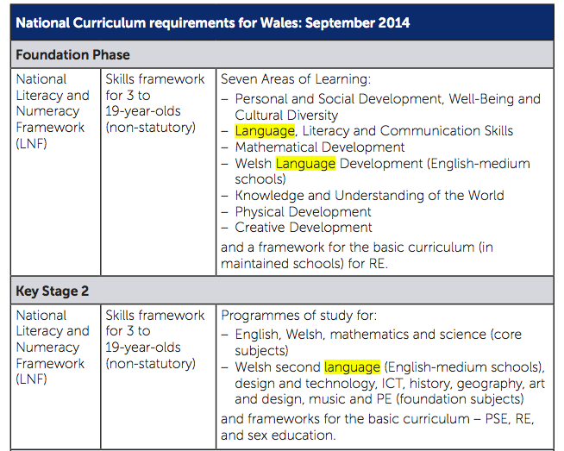
Notes:
p.34
Last week’s session looked at language in the FPh – but it’s worth reminding ourselves that the WL is right up there in the very first bullet points for both FPh and KS2

Slide 14
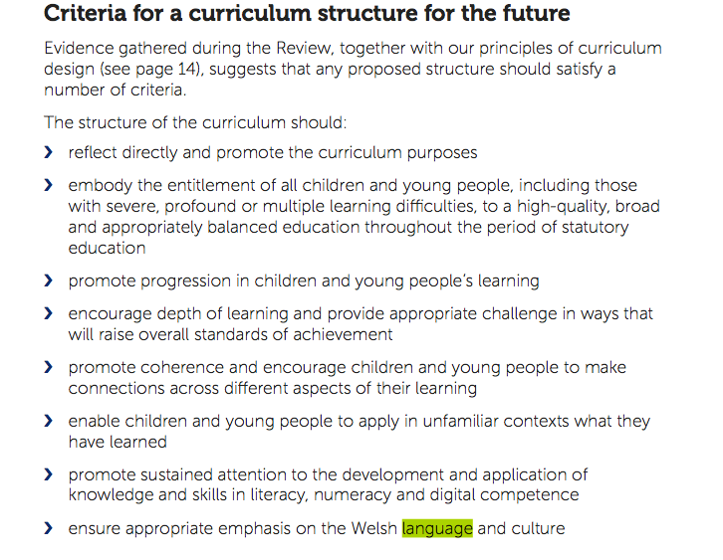
???
Notes:
p.35
What do we make of the word ‘appropriate’ here in the final arrow?
(annog y myfyrwyr i ddeall bod y math hyn o ieithwedd yn gofyn am ‘ddehongli’ – bydd angen sicrhau bod dehongliad dealledig gyda ni, a hwnnw’n cael ei rannu gydag e.e. byrddau arholi, Estyn ayb os ydym ni’n mynd i gyrraedd yr uchelgais a nodir mewn mannau eraill o’r ddogfen)

Slide 15
An International Context (Pg 36)
An international trend in recent years towards ‘areas of learning’ as curriculum organisers
Australia
New Zealand
The Netherlands
Northern Ireland
Scotland
England (remain with subjects)

Slide 16
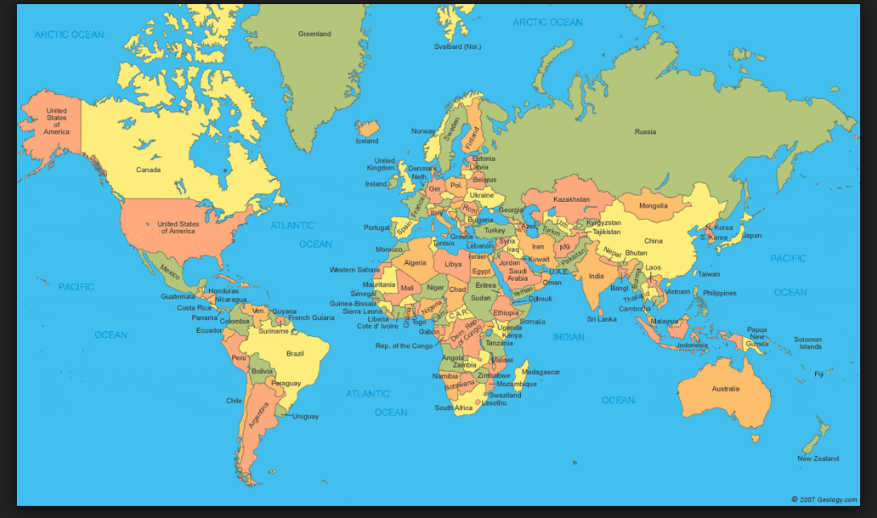
Have a guess!
Roughly how many languages are there in the world?
How many countries?
Percentage of bi-multilingual world population?
The Ethnologue catalogue of world languages, currently lists 6909 living languages. About 6% of them have more than a million speakers each, and collectively account for 94% of the world population.
There are 195 countries in the world today.
54 countries are in Africa
48 in Asia
44 in Europe
33 in Latin America and the Caribbean
14 in Oceania
2 in Northern America
Monolingual: 40% of world population
Bilingual: 43% of world population
Trilingual: 13% of world population

Slide 17
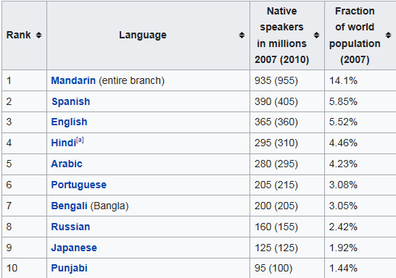
What are world’s ten most widely spoken languages in 2017?
Notes:
https://en.wikipedia.org/wiki/List_of_languages_by_number_of_native_speakers

Slide 18
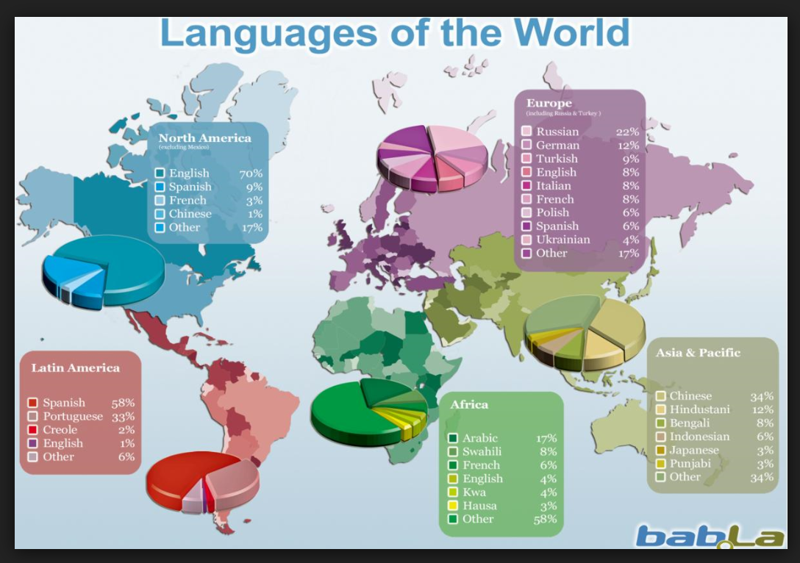

Slide 19
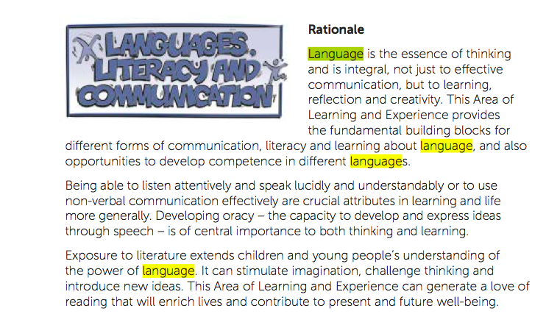
Pg 48
3 nouns - a more dynamic approach to languages, which, in turn will call for a more dynamic pedagogy, i.e. teaching methods that go beyond learning words-for-words and ‘patterns-for-patterns’.
Communication, learning, reflection & creativity
Literature – the power of language
Links with digital competence
Obvious connections with all Areas of Learning & Experience
Notes:
P.48
Note the three nouns in the title of this area of learning and experience.
What does this suggest?
(Darllenwch yr erthygl – Curo ar y Drws Tri Enw – dylai roi arweiniad i chi ar sut i dynnu ymateb y myfyrwyr ar y pwynt hwn. Yn syml, mae’r 3 gair yn awgrymu bod iaith yn fwy na ‘chyfrwng’ (communication) ac yn fwy na ‘llythrennedd’ (cywirdeb), mae hefyd yn wyddor ynddi hi ei hunan, gyda’i rheolau a’i rhesymeg.)
The three names suggest a more dynamic approach to languages, which, in turn will call for a more dynamic pedagogy, i.e. teaching methods that go beyond learning words-for-words and ‘patterns-for-patterns’.
Can you recall any effective language teaching/learning from your days in school?
What was effective about it?

Slide 20
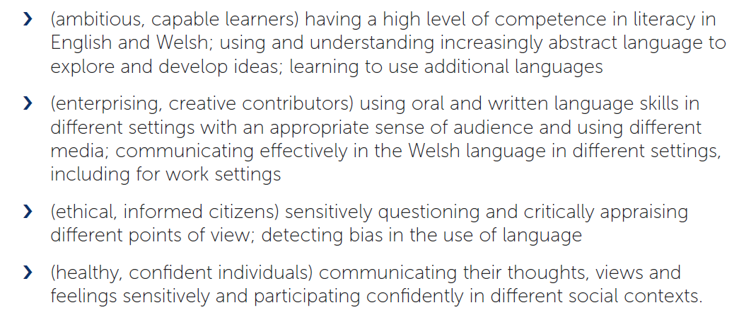
Illustrative Examples
How can LL&C contribute to the 4 purposes? Pg 49

Slide 21
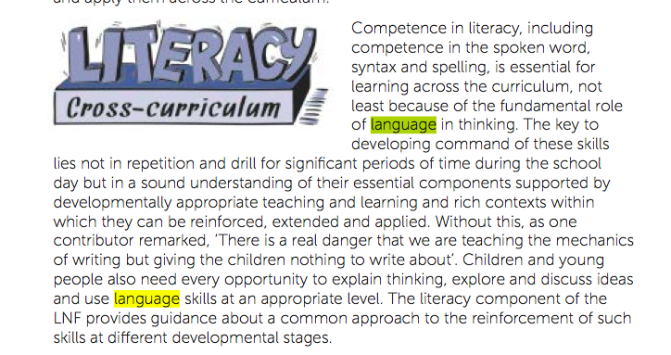
Notes:
p.40
What do we know about the ‘fundamental role of language in thinking’?
Can you think without language?
Discuss!
What does stronger language aptitude give us?

Slide 22
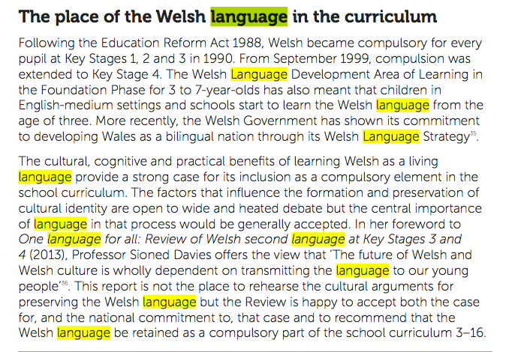
Notes:
p.58

Slide 23
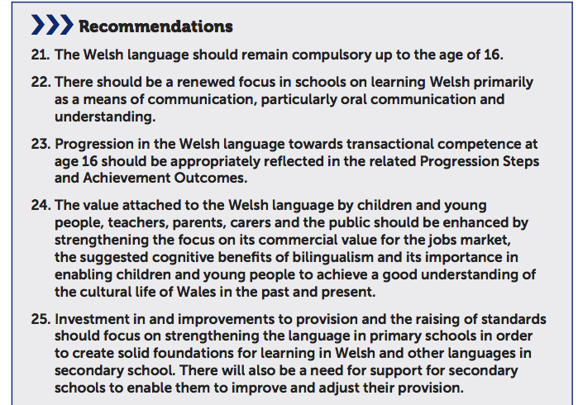
Notes:
p.60
Of the 68 Recommendations, 10 are DIRECTLY to do with WL.
‘Transactional competence’ – a curious term.
What might that mean?
How might it be achieved?

Slide 24
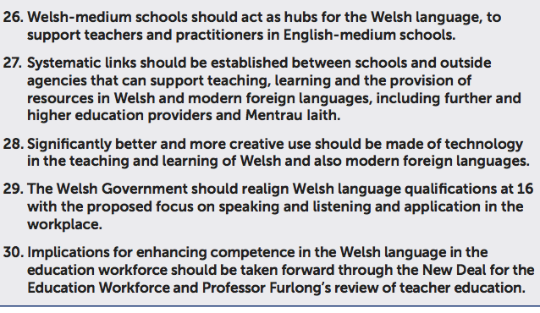
Notes:
p.60
Let’s take a long hard look on 30.
If you were designing an ITE programme, how would you structure it to meet this?

Slide 25
i) progression
ii) language as ‘skill’??
For children and young people, the new arrangements will help to ensure that they experience the full benefits of primary education.
The curriculum purposes will help ensure that they are developing as well-rounded individuals with strong literacy and numeracy skills and the ability to acquire and deploy digital competences in creative settings.
Their Welsh language skills will develop progressively as they move through primary.
P. 88
Notes:
P 88
In keeping with the philosophy of Successful Futures, here we see emphasis on progression.
What can you say, from your experience, are the obstacles to progression from primary to secondary as far as learning languages is concerned?
What do you understand to be the difference between language ‘acquisition’ and language ‘learning’?

Slide 26
For young people, the new arrangements will provide an education that is directed towards curriculum purposes that are designed to equip them for future life and work.
They will experience a broad and challenging curriculum within which their skills in literacy, numeracy and digital competence will be developed consistently.
They will engage with Welsh culture across the curriculum and develop their Welsh language skills to at least a functional standard.
‘functuional standard’?
Notes:
p.90
Here we come across the concept of speaking a language to a ‘functional standard’.
Discuss.
Mae hwn yn ymadrodd rhyfedd iawn, oherwydd mae ‘functional’ yn dibynnu’n llwyr ar y cyd-destun. Gallwch chi fod yn deall dau air yn unig ‘stop’ and ‘go’ i gyflawni function pwysig iawn ar y ffordd, ond mae angen llawer mwy o afael ar iaith er mwyn bod yn ‘functional’ os mae eich gwaith chi yw holi’r prifweinidog yn fyw ar y teledu e.e….
This is a very strange phrase as ‘functional’ depends totally on the context. You could only undersatnd ‘stop’ and ‘go’ to execute a very important function on the road, but there needs to be far more ‘grip’ on the language in order to be ‘functional’ if you are going to interview the first minister on TV for example!

Slide 27
Teaching and leadership capacity
The new curriculum and assessment arrangements will have significant implications for teaching and learning and therefore for the ways in which teachers’ skills, and those of the wider workforce, are developed.
In particular the cross-cutting digital competence responsibility, the enhanced focus on the Welsh language in pre-school/primary, and the greater emphasis on the use of the Welsh language in secondary will have wide implications for teaching.
Notes:
p.96
We have already discussed the implications of this enhanced emphasis on developing WL skills for ITE students, but here we see a challenge for the qualified workforce.
If you were Minister for Education – how would you make this possible?

Slide 28
The place of the Welsh language in the curriculum needs to be strengthened
All children should continue to learn the Welsh language to the age of 16.
Evidence points to confidence in the work of Welsh-medium schools to successfully develop language skills.
There remains a need to improve the quality and relevance of teaching and learning of the Welsh language in English-medium schools, particularly for older children.
Propose greater focus on children and young people’s ability to communicate confidently in everyday settings in the Welsh language, with an emphasis on its increasing role in workplace settings.
Welsh-medium schools employ specialists and have a wide range of available Welsh language resources and are well placed to act as hubs for the Welsh language and to provide support for teachers and other practitioners in English-medium schools.
P. 108
Notes:
p.108
Tynnu sylw at ‘strengthened’

Slide 29
Recommendations have major implications for the professional development of practitioners.
A need to extend teachers’ capacity in Welsh language, health and well-being, digital competence and computer science, as well as broader matters such as curriculum planning and assessment.
The Welsh Government’s New Deal for the Education Workforce and the review being undertaken by Professor John Furlong are well timed to address many of these issues but there will also be a need for more immediate action to build the confidence and capacity of teachers and school leaders in taking forward the Review’s recommendations.
P.112
Notes:
p.112
Tynnu sylw at ‘major implications’

