Slide 1
BMIH5013/D Financial Management
Financial Statements

Slide 2
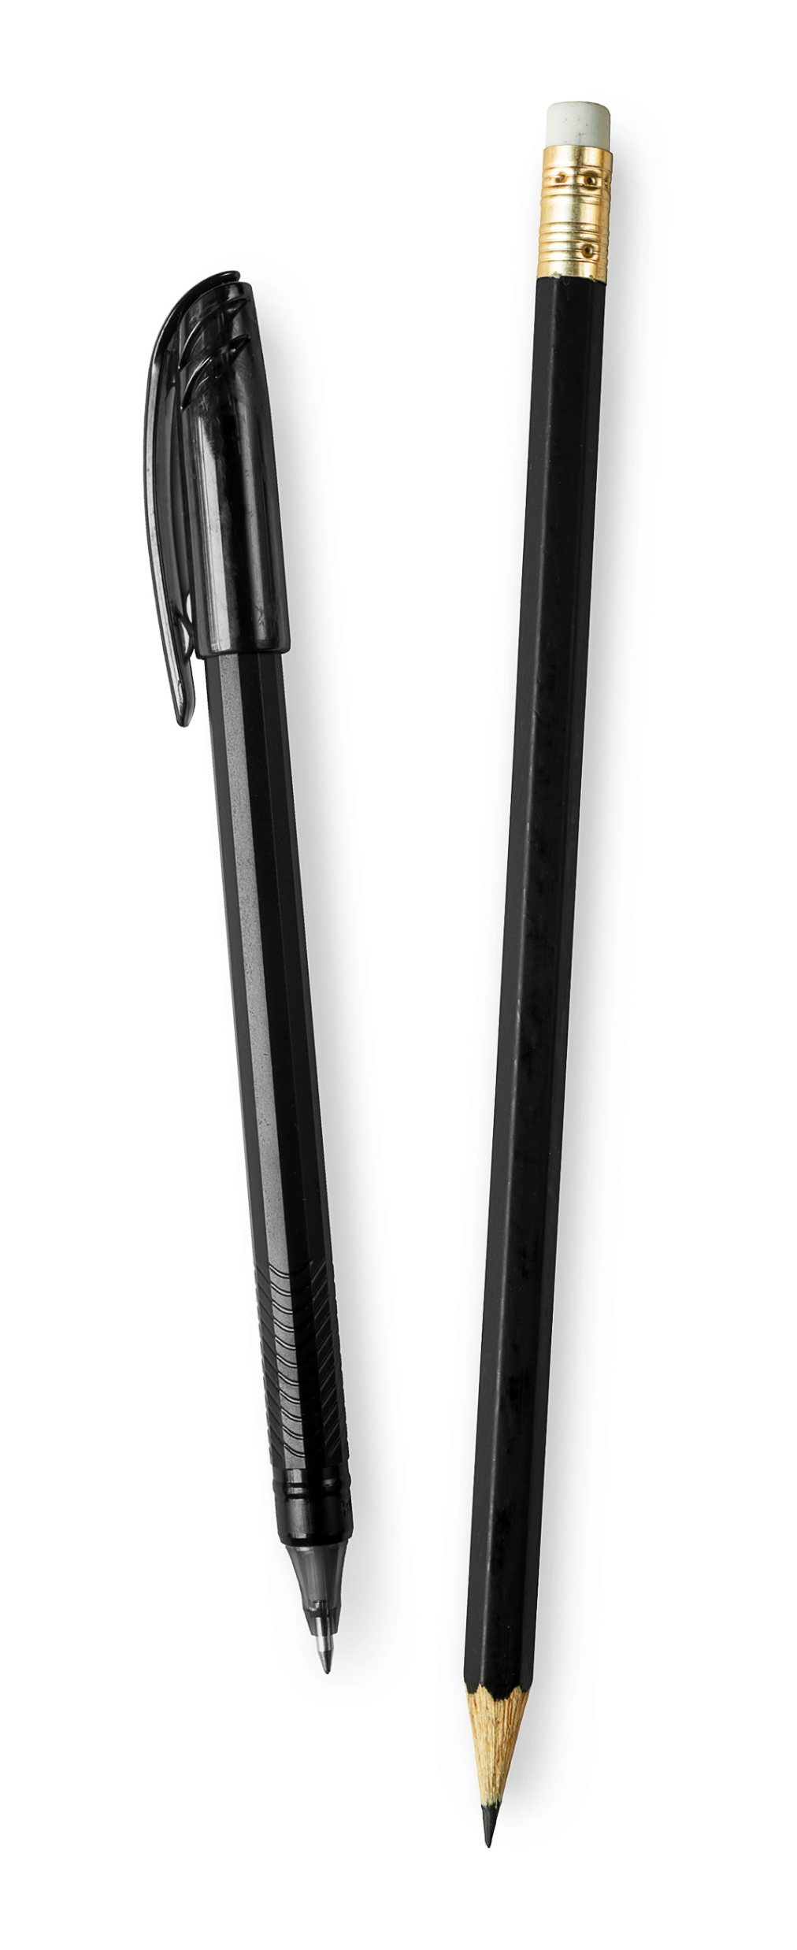


Slide 3
Where Are We Now?
Module: | Contemporary Themes for the Hotel and Hospitality Sector
Week | Lecture Topic
1 | Induction
2 | Introduction to the Module, Financial Terminology, and assessment overview
3 | Introduction to Supply, Demand & Price Setting Market Position
4 | Key Characteristics of the Hospitality Industry and Financial Management Implications Role of Finance Manager and Finance Team
5 | Cost structure Assessment one (1) support
W/C 28th Oct | READING WEEK-NO CLASSES / MID-SEMESTER BREAK
6 | Introduction to budgeting and Working Capital Management
7 | Risk Management and Financial Strategies
8 | Revenue Management
9 | Balance Sheet and Income Statement
10 | P&L and Financial Stability Break even analysis
11 | Module Feedback

Slide 4
Recap-What did we learn last week?

Slide 5
Revenue Management (RM)
What is RM?

Slide 6
Today’s Objectives
Balance Sheet
Assignment 2
Notes:
Read out the objectives for today.

Slide 7
What is a Balance Sheet?

Slide 8
Balance Sheet
A Balance Sheet is a financial statement that shows a company’s financial position at a specific point in time.
It summarizes what the business owns (assets), owes (liabilities), and the owners’ equity (capital).
Formula:
Assets = Liabilities + Owners’ Equity

Slide 9
Purpose of a Balance Sheet in Hotels
Measures the hotel’s financial strength and stability.
Helps managers understand resource allocation, debt levels, and
investment needs.
Used by owners, investors, lenders, and hotel management for
decision-making.
Essential for evaluating liquidity, solvency, and overall financial health.

Slide 10
Components of a Balance Sheet
A. Assets
Resources owned or controlled by the hotel that provide future economic benefits.
1. Current Assets (convertible to cash within 12 months)
  Cash & cash equivalents
  Accounts receivable (guest bills, corporate accounts)
  Inventory (food & beverage, linen, supplies)
  Prepaid expenses (insurance, rent)
  Marketable securities
2. Non-Current (Fixed) Assets
Property, Plant & Equipment (PPE)
  Hotel buildings
  Land
  Furniture & fixtures
  Kitchen equipment
  Laundry equipment
Intangible assets
  Franchise rights
  Brand names
  Goodwill
Long-term investments

Slide 11
Components of a Balance Sheet
B. Liabilities
Financial obligations the hotel must settle in the future.
1. Current Liabilities (due within 12 months)
  Accounts payable (suppliers)
  Short-term loans
  Accrued expenses (salaries, utilities)
  Taxes payable
  Unearned revenue (advance room bookings)
2. Long-Term Liabilities
  Long-term bank loans
  Mortgage on hotel property
  Bonds payable
  Deferred tax liabilities

Slide 12
Components of a Balance Sheet
C. Owners’ Equity (Shareholders’ Equity)
Claims of the owners after liabilities are deducted from assets.
This includes:
  Capital contributed by owners/shareholders
  Retained earnings (accumulated profits)
  Reserves
  Owner withdrawals (in proprietorship/partnership hotels)

Slide 13
Example of a Balance Sheet structure in a Hotel
Assets |  | Liabilities & Equity
Current Assets |  | Current Liabilities
Cash |  | Accounts Payable
Accounts Receivable |  | Accrued Wages
Inventories |  | Advance Bookings
Non-Current Assets |  | Long-Term Liabilities
Building |  | Mortgage Loan
Furniture & Equipment |  | Bank Loan
Total Assets | = | Total Liabilities + Equity

Slide 14
Importance of Balance Sheet analysis in hotels
Liquidity Analysis: ability to meet short-term obligations.
Current Ratio, Quick Ratio
Solvency Analysis: long-term financial stability.
Debt-to-Equity Ratio
Asset Management:
Evaluates efficiency of property and equipment usage.
Working Capital Management:
Ensures smooth operations (room division, F&B, housekeeping).

Slide 15
Characteristics of Hotel Balance Sheets
Asset-heavy due to large investments in land, buildings, and equipment.
High fixed costs mean solvency and debt management are critical.
Revenue seasonality affects current assets and liabilities.
Frequent use of advance deposits (unearned income).

Slide 16
Prepare a Balance Sheet for Sunrise Luxury Hotel (as of 31st March 2025)
Case Study
Sunrise Luxury Hotel is preparing its annual financial statements. You have been provided with the following account balances. Your task is to classify each item into Assets, Liabilities, or Equity, identify current vs. non-current, and prepare a properly formatted Balance Sheet.

Slide 17
Sunrise Financial Data
Account Balances (in £)
Cash in Hand – 75,000
Bank Balance – 4,50,000
Accounts Receivable (Guests/Travel Agents) – 3,25,000
Food & Beverage Inventory – 1,80,000
Linen & Housekeeping Supplies – 95,000
Prepaid Insurance – 40,000
Land – 50,00,000
Hotel Building – 1,20,00,000
Furniture, Fixtures & Fittings – 18,50,000
Laundry & Kitchen Equipment – 12,00,000
Accumulated Depreciation – 15,20,000
Accounts Payable (Suppliers) – 3,95,000
Salaries Payable – 2,25,000
Long-Term Bank Loan – 40,00,000
Advance Room Bookings (Unearned Revenue) – 1,55,000
Owner’s Capital – 1,20,00,000
Retained Earnings – 18,50,000

Slide 18
Instruction
Classify each item as:
Current Asset
Non-Current Asset
Current Liability
Long-Term Liability
Equity
And provide Subtotals
Then Calculate:
Total Current Assets
Total Non-Current Assets (less depreciation)
Total Current Liabilities
Total Non-Current Liabilities
Total Equity

Slide 19
Instruction
Prepare the Balance Sheet
Prepare a structured Balance Sheet for Sunrise Luxury Hotel as of 31st March 2025 using the format:
Assets
Current Assets
Non-Current Assets (Net)
Total Assets
Liabilities & Equity
Current Liabilities
Non-Current Liabilities
Equity
Total Liabilities & Equity
Check Equation
Ensure
Total Assets = Total Liabilities + Equity

Slide 20
Balance Sheet of Sunrise Luxury Hotel
As of 31st March 2025
Assets
Current Assets
Cash in Hand – 75,000
Bank Balance – 4,50,000
Accounts Receivable – 3,25,000
Inventory (F&B) – 1,80,000
Linen & Supplies – 95,000
Prepaid Insurance – 40,000
Total Current Assets = 11,65,000

Slide 21
Balance Sheet of Sunrise Luxury Hotel
As of 31st March 2025
Non-Current Assets (Net)
Land – 50,00,000
Hotel Building – 1,20,00,000
Furniture & Fixtures – 18,50,000
Laundry & Kitchen Equipment – 12,00,000
Less: Accumulated Depreciation – (15,20,000)
Net Non-Current Assets = 1,85,30,000
Total Assets = 1,96,95,000

Slide 22
Balance Sheet of Sunrise Luxury Hotel
As of 31st March 2025
Liabilities & Equity
Current Liabilities
  Accounts Payable – 3,95,000
  Salaries Payable – 2,25,000
  Advance Room Bookings – 1,55,000
  Total Current Liabilities = 7,75,000
Long-Term Liabilities
Long-Term Bank Loan – 40,00,000
Total Long-Term Liabilities = 40,00,000
Equity
Owner’s Capital – 1,20,00,000
Retained Earnings – 18,50,000
Total Equity = 1,38,50,000
Total Liabilities + Equity = 1,96,25,000
Balanced?
There is a small discrepancy:
Assets = 1,96,95,000
Liabilities + Equity = 1,96,25,000
A difference of £70,000 (likely due to rounding).

Slide 23

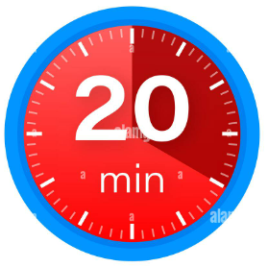
Notes:
20 minutes.

Slide 24
Assessment 2 sessment 2
DEADLINE: Tuesday 16th January 2026 by 23.59
2000 words Report
Report structure:
Title/Cover page
Generative AI Acknowledgement
Executive Summary
Table of contents
Introduction
Main body (with all the individual subheadings)
Recommendations
Conclusion
Reference list

Slide 25
Quiz
Questions
Which of the following is a current asset of a hotel?
a) Land
b) Laundry equipment
c) Accounts Receivable
d) Mortgage loan
Advance room bookings (guest deposits) should be classified as:
a) Current asset
b) Current liability
c) Long-term liability
d) Equity
Which one is a non-current asset?
a) Linen & supplies
b) Prepaid insurance
c) Hotel Building
d) Salaries payable

Slide 26
Quiz
Questions
4. Given:
Current Assets = £1,165,000
Current Liabilities = £775,000
What is the Working Capital?
5. If a hotel has:
Total Assets = £19,695,000
Total Liabilities = £4,775,000
What is Equity?
6. True or False:
Accumulated Depreciation increases the value of non-current assets.

Slide 27
Quiz
Questions
7. A hotel purchased kitchen equipment for £1,200,000.
How should this be classified?
a) Current asset
b) Non-current asset
c) Current liability
d) Expense
8. Which equation must always balance?
a) Assets = Revenue + Expenses
b) Assets = Liabilities + Equity
c) Cash = Profit
d) Equity = Cash – Liabilities

Slide 28
Quiz Answers
1. c
2. b
3. c
4. £390,000
5. £14,920,000
6. False
7. b
8. b

Slide 29
Any questions?

Slide 30
I look forward to seeing you next week.
If you have any questions in the meantime, please send an email from your student account
e.wavei@uwtsd.ac.uk
Next week…………….
Income Statement
Please have a look at the material on Moodle, which will be made available this Friday.

