Slide 2
Plan for today
Recap on last week
Design Thinking
Design Thinking in Health and Social Care
Class exercise

Slide 3
What is a problem?
A problem is a situation where there is a gap between the current state and a desired state. In other words, something is not working as well as it could—or someone’s needs are not being met

Slide 4
Problems in Health and Social Care
In health and social care, a problem often emerges when:
People experience unsafe, inequitable, or ineffective care.
A service is unable to meet demand or needs.
Systems, processes, or environments create barriers to care.
Individuals or communities experience harm, risk, or inequalities.

Slide 5
How to Identify a Problem?
What is happening?
Who is affected?
When and where does it occur?
What is the impact?

Slide 6
Evidence
Avoid opinion or assumptions!
Use credible sources to demonstrate the problem is a problem:
NHS or Public Health Wales reports
Research articles
Local authority datasets
Patient feedback
Service performance data

Slide 7
Define the Problem Clearly
A good problem definition should:
Focus on a specific issue
Describe who is affected
Indicate why it matters
Avoid jumping to solutions too early
Avoid generalising

Slide 8
Problem Statement
❌ People can’t access digital healthcare
✔️ Adults aged 65+ in rural Wales face barriers accessing digital GP services due to limited broadband coverage and low digital literacy, resulting in delayed care

Slide 9
What Makes a Problem ‘Wicked’?
A wicked problem is a complex issue with no single cause and no single solution. These problems are messy, interconnected, and heavily shaped by social, political, cultural, and economic factors

Slide 10
Key Features of a Wicked Problem
Have multiple causes and involve many stakeholders
Are deeply interconnected with other issues
Cannot be solved with one simple intervention
Often lack clear boundaries
Change over time
Have no “right” or “wrong” solution—only better or worse ones
Require ongoing adaptation and testing

Slide 11
Wicked Problems in Health and Social Care
Health and social care is full of situations where needs are complex, resources are limited, and stakeholders have different perspectives. Many issues naturally become wicked problems—problems that are difficult to define, constantly changing, and impossible to solve with a single, simple solution.

Slide 12
Why Problems in Health and Social Care are ‘Wicked’
Wicked problems often:
Cut across health, social care, education, housing, and community services.
Are influenced by personal behaviour and wider social, political, and economic factors.
Affect different groups in different ways.
Require ongoing adaptation rather than a “once‑and‑done” fix.

Slide 13
Why Are They So Difficult to Solve?
Different stakeholders may see the same issue differently
A solution for one stakeholder may cause an issue to another
There are multiple causes at multiple levels
Solutions are never final

Slide 14
Design Thinking
Design thinking is a human‑centred, creative, and iterative approach to solving problems—particularly those that are complex, ambiguous, and deeply rooted in real human experience
Traditional problem‑solving methods often focus on processes, policies, or efficiency.Design thinking starts with people—their needs, experiences, frustrations, and aspirations

Slide 15
What is Design Thinking?
Design thinking is a structured approach to innovation that prioritises:
Understanding people and their lived experience
Challenging assumptions
Generating creative ideas
Rapidly testing potential solutions
Iteratively improving them based on feedback

Slide 16
Design Thinking in Health and Social Care
Addresses issues that cannot be solved with a single intervention
Requires creativity, collaboration and continuous adaptation
Centres on the voices of service users, patients, families and frontline staff
Reduced risk of failure by testing early
Promotes collaboration

Slide 17
The Five Stages of Design Thinking
Empathise
Define
Ideate
Prototype
Test

Slide 18
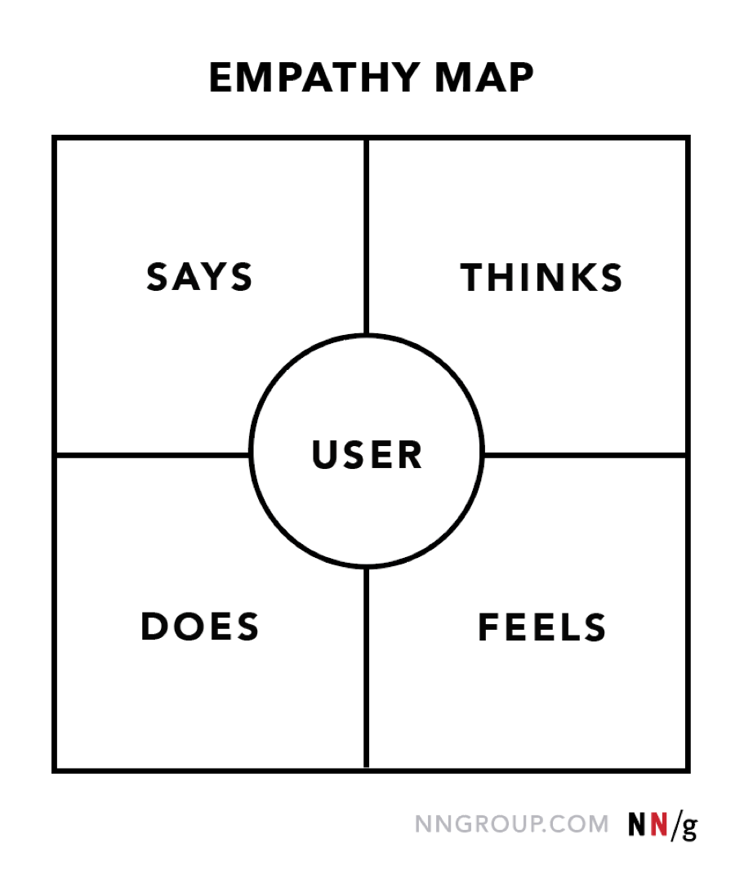
Stage 1 - Empathise

Slide 19
Stage 2 - Define
In design thinking a good problem definition is;
Specific
Human-centred
Evidence based
Free from assumptions or solutions

Slide 20
Stage 3 - Ideate
Collaborative
‘How might we…’ questions
Mind-mapping
Workshops
Scenario exploration
Select the solution by looking at the opportunities, risks and other outside influences

Slide 21
Stage 4 - Prototype
A prototype is a ‘rough’ version of a solution
It needs to be presented to show you have considered:
  Benefits to the group this is focussed on
  How, when, where this will be introduced
  Any risks have been considered e.g. funding, lack of buy in, facilities
  How this will be communicated

Slide 22
Stage 5 - Test
How will you know this will work?
What is your measure of success?
Who will you test this with?
Is it ethical and safe?
Is it inclusive?
Remember this stage is theoretical for your assignment!

Slide 23
Strengths of Design Thinking
Human-centred
Creative
Collaborative
Low risk testing
Adaptable
Promotes a culture of innovation

Slide 24
Limitations of Design Thinking
Time intensive in the early stages
Requires strong stakeholder engagement
Needs organisational willingness to experiment
Risk of tokenism if user involvement isn’t genuine
Prototypes may oversimplify complex systems

Slide 25
Exercise (Part 1)
In groups select a simple real or observed problem in a health and social care setting
Map out the user experience and consider:
  Who is affected
  What are they trying to achieve
  What emotions might they experience
  What barriers or inequalities might exist
Turn these insights in a clear definition statement

Slide 26
Exercise (Part 2)
In your groups brainstorm possible solutions to your problem
Build on each other’s ideas
No idea is silly - the smallest thought can spark a great idea
Facts not assumptions
Build a prototype
Come up with a method to test your prototype

