Slide 1
The successors
Project planning company
Notes:
Welcome to our meeting. We are a project planning company called THE SUCCESSORS. So we would like to thank Doreen, Denise, Suha and Umar for taking the time to listen to our presentation. Over the next few minutes we will show you how we will how we would organise your move from the shop in Shirley to the new warehouse in Sparkhill.

Slide 2




Our team
Sadia Anjum 1708775
Shaera Miah 1711954
Nusrat Yasmin 1712117
Amino Begum 1709433
Notes:
We are the project managers and this is our team. I am Nusrat this is Sadia Amina and Shaera. Our contact details are on the screen now. We have already share our PowerPoint using moodle turitin. We have already emailed you some of the documents we have used in this presentation. If you need to contact us again please do so via Skype or Outlook by typing our ID numbers that you can see on the screen.

Slide 3
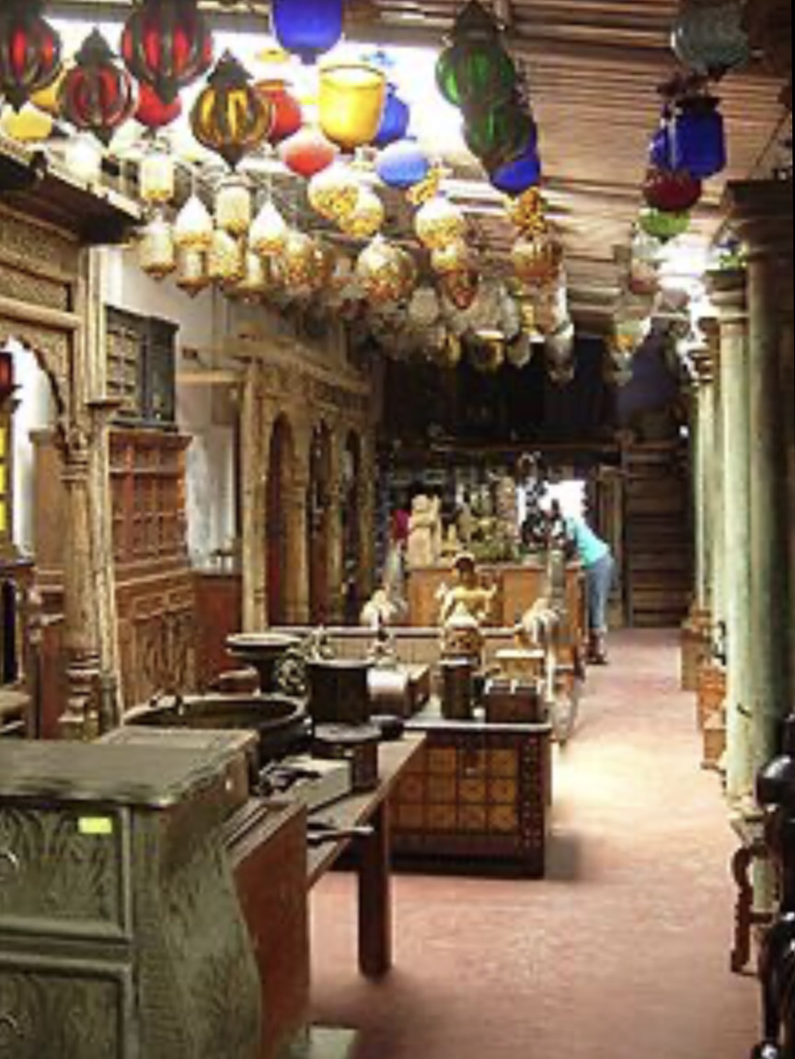
Overview the information from the case study
Setting up new business process
Refit the new warehouse in Sparkhill
Transfer contents from the shop in Shirley
Notes:
The aim of this project is to shift your business from the current location to the new warehouse. This is divided into three parts:
Refit the new warehouse
Set up new business process
Transfer contents from the shop in Shirley
We have learned in our class a technique which is based on PRINCE2 (PRojects IN Controlled Environments). It is a process-based method for effective project management. This technique helps to try to reduce the risk of project by working on intuitive framework. Many projects fail but following this framework will reduce the risk and increase the possibility to deliver the project successfully.

Slide 4
The project life cycle
DISCOVERY
INITIATION
DELIVERY
CLOSURE
REALISATION
Notes:
This is the life cycle of the project. We should understand that every project follows a life cycle as displayed in this chart. We have created this by using smart art taught in our class.
A project should have a discovery phase where we learn what is required. and then we estimate the time and effort wended to put in the project. It is an essential stage for the life cycle. If this stage is avoided it can cause the project to fail. After the project discovery is done we develop a plan that starts the initiation phase. This presentation is the results of the discovery and initiation phase. Now if you agree to this plan then we will go on to the deliver and then close the project. When the project has been closed then we will organise a meeting to assess if it has met your expectations. This phase is called realisation.

Slide 5
Stakeholders
 | Sponsor
 | Decision
 | Steering group
Commercial | Specialist | Manager
 | Project manager
Plan 1 | Plan 2 | Plan 3
Notes:
This is a stakeholders map
Denise is the sponsor, she does the account already so sh has got a clear idea about the financial side of their company. After our presentation she will decide whether our proposal is convenient for them or not.
He is an antique expert and passionate about them. He is the specialist so he will know how to handle the antiques, e.g. How to pack the antiques, how to store them, how to move them, or if any problem how to deal with those problems (damages).

Slide 6
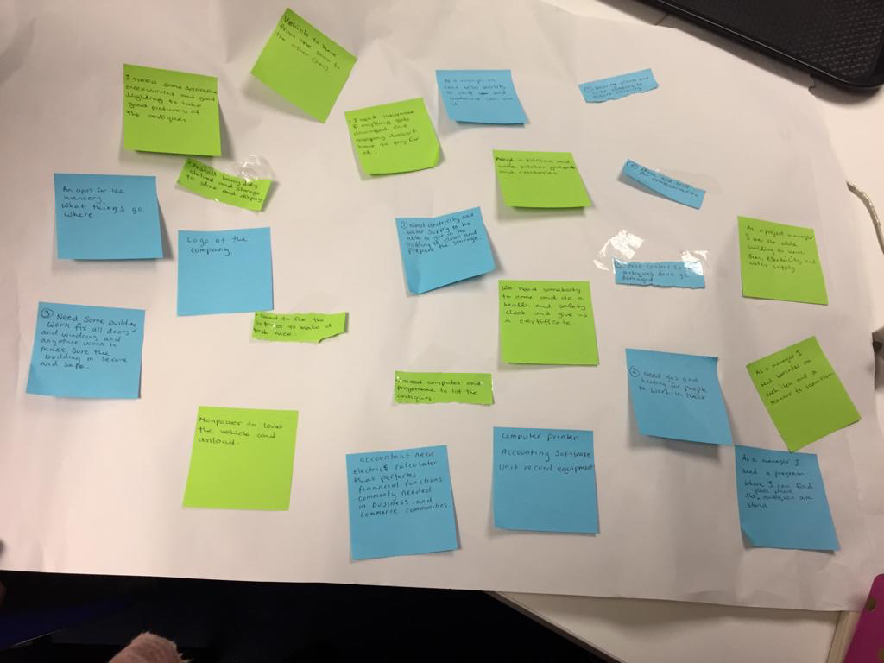
User story
What it is
Notes:
Brown paper planner user story

Slide 7
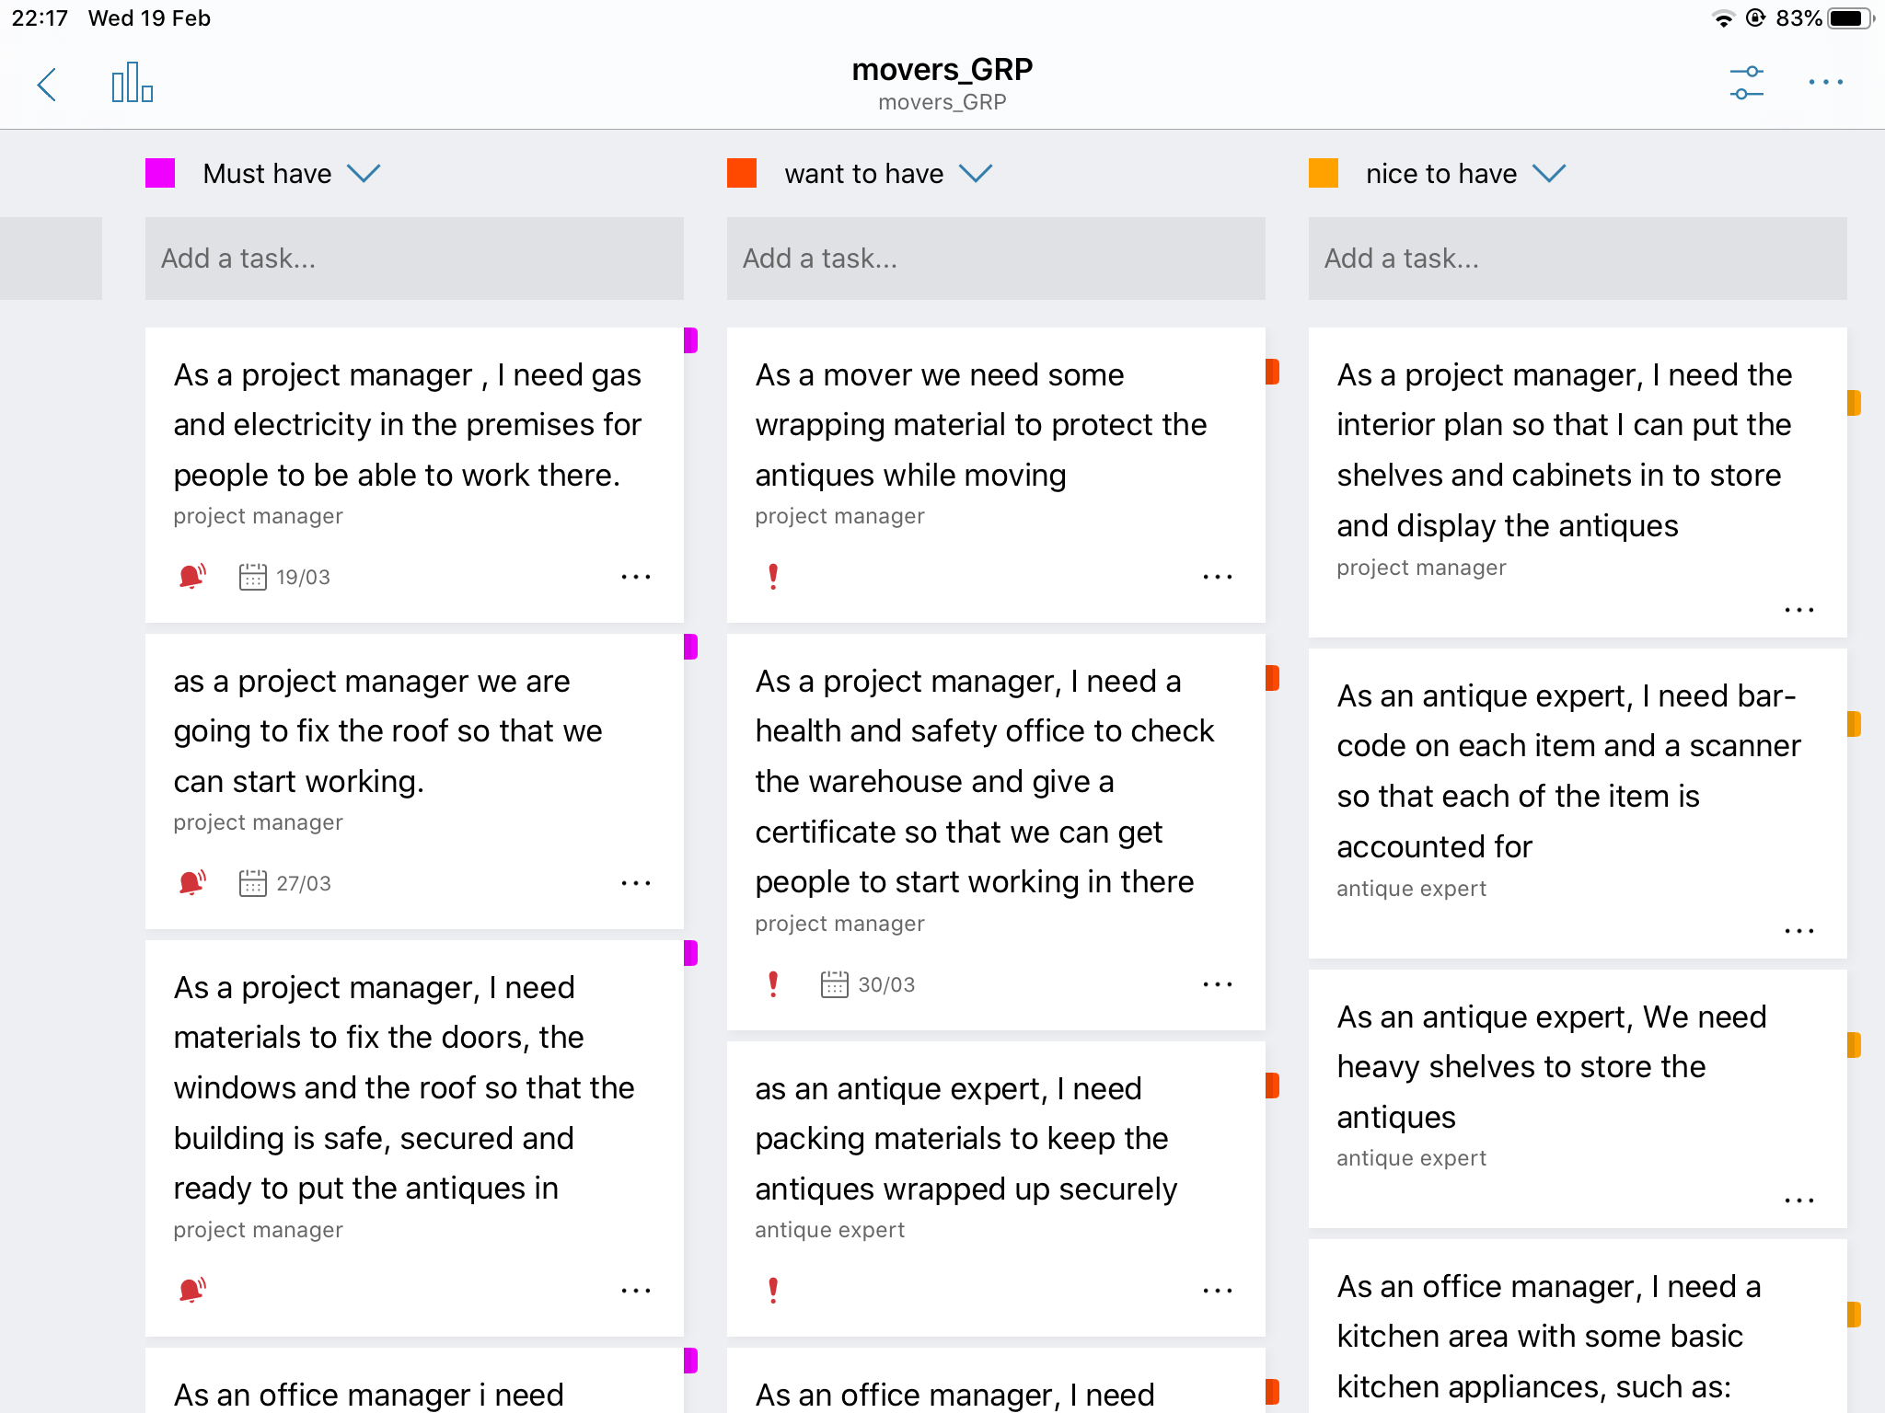
User story
Our one
Notes:
This is our digital user story. We have used MoSCoW method to prioritise the user stories.

Slide 8
Estimating using product project technique
Delphi technique
Task | Estimated cost | Actual cost
Fix roof | £3,000
Connection of electricity water and gas | £1,500
Health and safety check | £300
Interior walls | £4,000
Toilet | £3,000
Kitchen appliances | £800
Paint external walls | £1,200
Paint internal walls | £1,500
Shelves | £2,500
Wrapping materials | £800
Vehicle fuel | £300
Labour | £6,500
Bills | £800
Telephone and wifi | £100
Phone, computer and other technology | £2,000
Total | £28,300
Notes:
We used the Delphi technique to estimate the prices for tasks

Slide 9
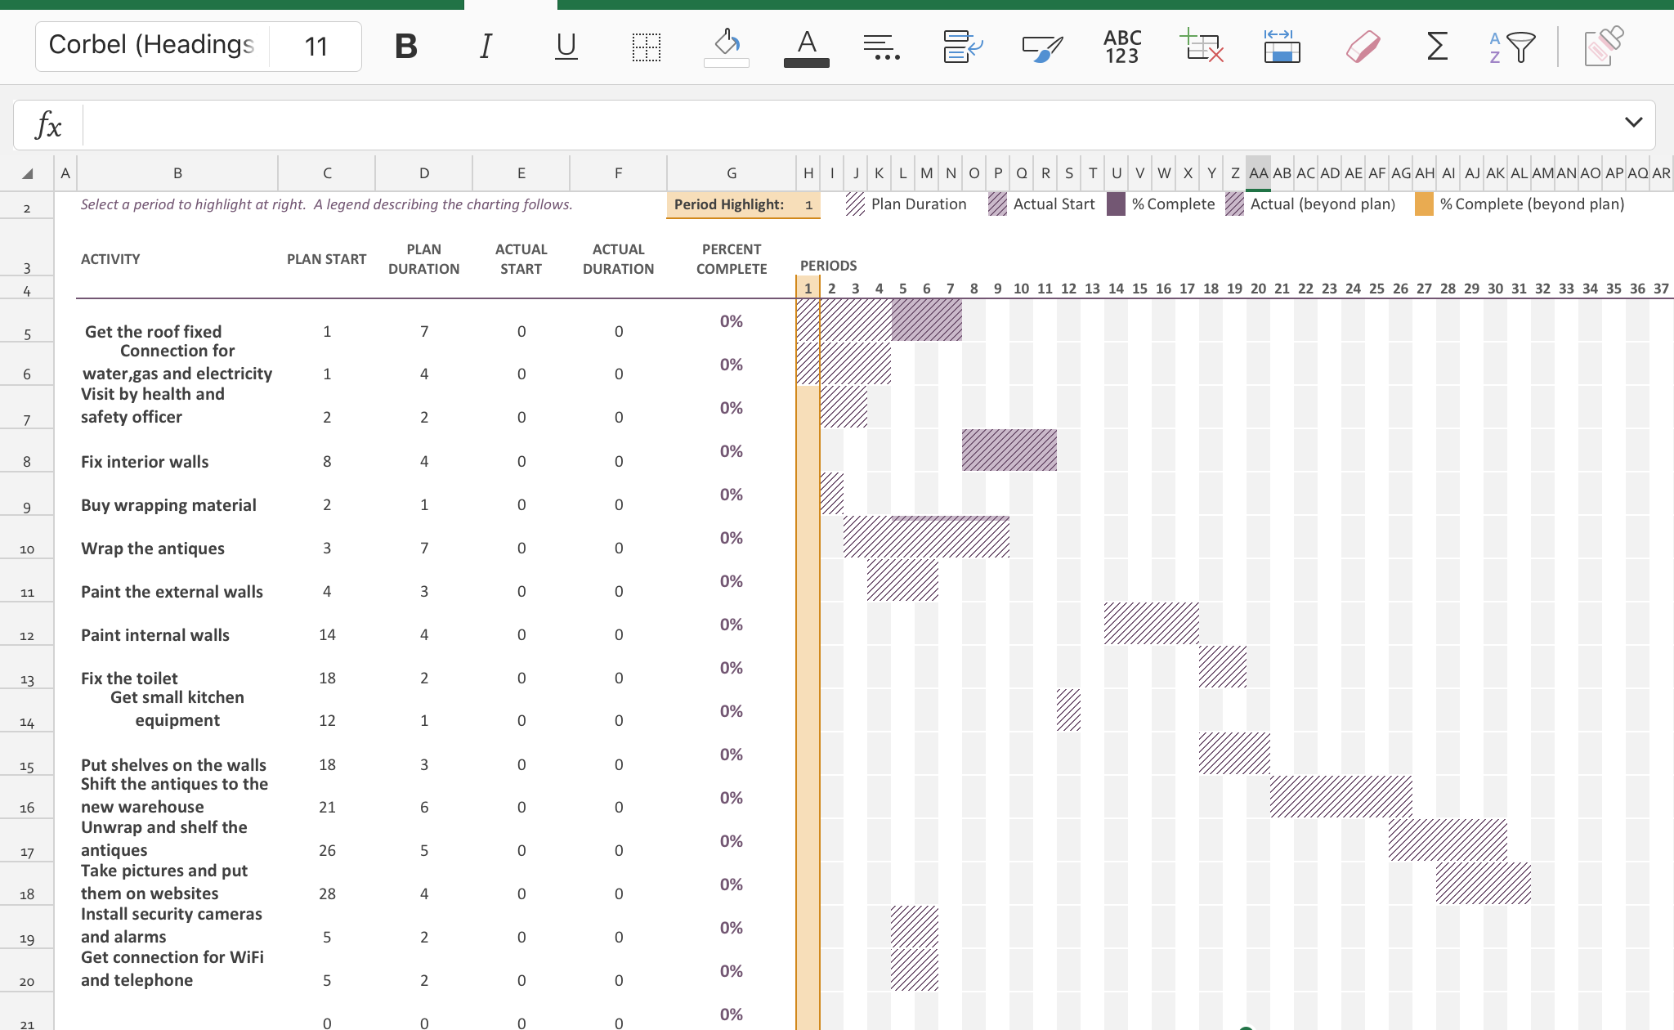
Gantt chart
Our one
Notes:
This is a screenshot of the Gantt chart we have created for you. We have used Gantt chart to estimate the time required for this project.

Slide 10
Price and time estimation
Estimated time: 31 days
Estimated cost: £28,300.00
Notes:
This is only an estimation, we will know the exact figures as we go along

Slide 11
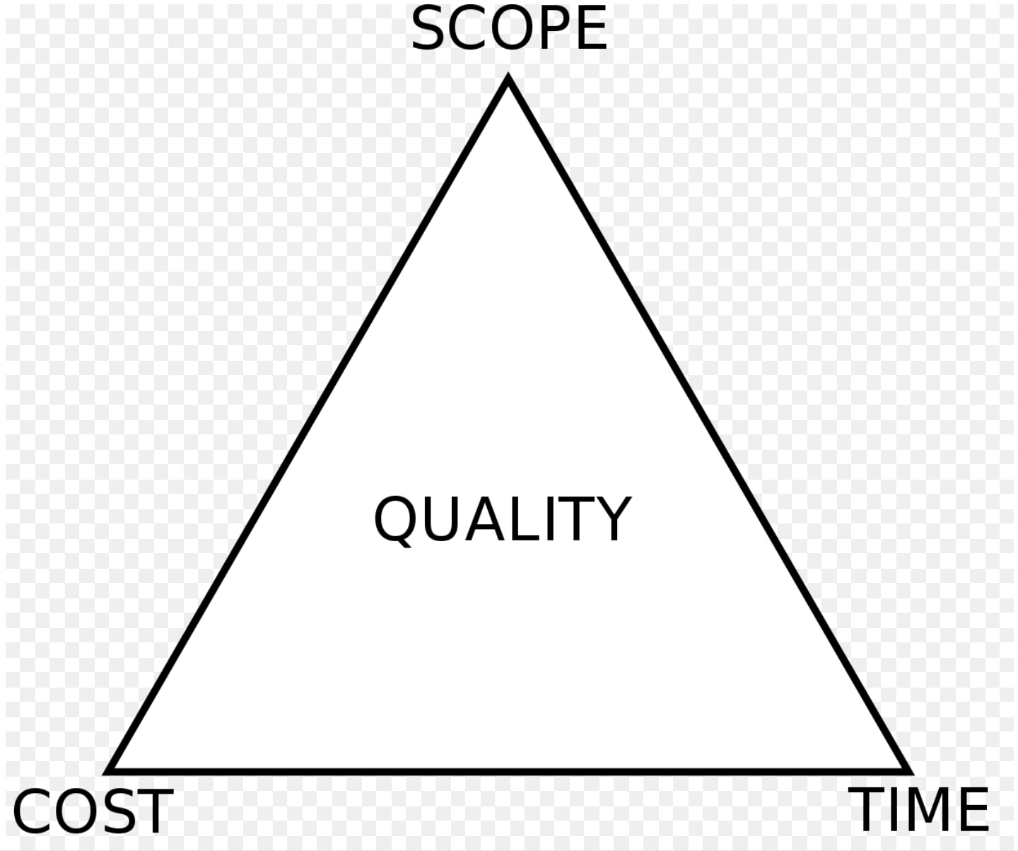
The iron triangle
Notes:
This is the iron triangle. There are three factors that the well-known attributes of scope, schedule, and cost. Scope refers to the total amount of work involved in delivering the project, cost refers to the sum of all resources required to deliver that work, and time reflects the amount of time estimated or allotted to the project's delivery. The overall quality of the project depends on these three factors. This matrix indicates that these three factors can, and should be, linked together.
A project with many tasks becomes increasingly difficult to complete so the time and cost to complete increases.
A project with poor fund will not have as many features as we would like

Slide 12
References

Slide 13
Thank you for listening
Is there any questions?

