Slide 1
Nursing research project: Food safety and hygiene
Student name: Ionela Valaentina Lazar
Student number: 1905285
Lecturer name: Ben Duxbury

Slide 2
Table of Contents
Introduction:………………………………………………………………………………Slide No 3
Chronic conditions and integrated working:………………………………………….. Slide No 4-5
Determinants of integration…………………………………………………………….Slide No 6-7
The impact of integration……………………………………………………………….Slide N0 8-9
Conclusion and recommendations………………………………………………………..Slide No 10
Appendices
References and bibliography………………………………………………………… ......Slide No11

Slide 3
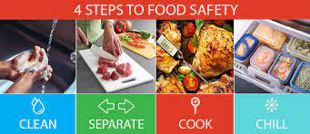
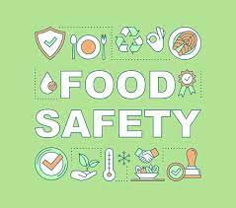
Introduction
In England, Northern Ireland, and Wales, 350,348 food hygiene interventions were documented over the 2017–18 year. In Wales, 4,979 cases of food poisoning were reported to Public Health Wales in 2010
Any disease which can be acute or chronic of an infectious or toxic developed after consuming the food is known as foodborne disease (Food Safety and Hygiene, 2022).
The assurance an individual will not be harmed by the consumption of that particular food is known as Food safety
The research in nursing has a significant influence on the recent and future professional practice of nursing (UNCW, 2016).
Notes:
Any disease which can be acute or chronic of an infectious or toxic developed after consuming the food is known as foodborne disease (Food Safety and Hygiene, 2022). The assurance an individual will not be harmed by the consumption of that particular food is known as Food safety. The research in nursing has a significant influence on the recent and future professional practice of nursing (UNCW, 2016). Nurses are responsible for caring for the patients directly on a regular basis and which require adjustment. Nursing Research helps to advance the practice of nursing. The outcome of a good scientific examination will influence health policy and global healthcare. The aim of nursing professionals is to promote the health and well-being of each and every individual. The research that they perform has long lasting consequences (Aveyard, 2019). The nursing research covers the sound knowledge to strengthen the foundation of clinical practice and paves the way for avoiding illness and infirmity, handling symptoms and improving care for those who are at end of life care. “Evidence Based Practice(EBP)” provides nurses with the technique to utilise the scientifically proven for importing quality services to a particular population. More than 65% of the nurses reflected a positive behaviour towards EBP (Majid et al., 2022). The nurses understood that EBP training, availability and guidance by nurses with expertise knowledge of EBP would motivate them to incorporate EBP. The presentation will cover the chronic conditions and integrated conditions of food safety and hygiene. The study will outline the impact of integration in food safety and hygiene. The presentation will conclude by providing recommendations to improve the conditions.

Slide 4
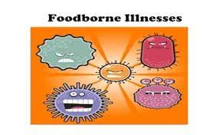
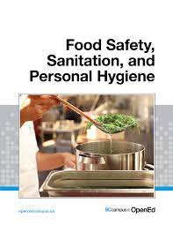
Chronic conditions and integrated working
The Topic Food Safety and Hygiene is chosen for the presentation as it is of great significance in the Food safety and hygiene are inseparably linked with each other to attain maximum human health and well-being.
Every individual should be well nourished and free from any kind of foodborne disease (Food Safety, 2023)
Food hygiene standards outline various rules and regulations to save any kind of cross contamination resulting in foodborne diseases (Abebe, 2020).
Notes:
The Topic Food Safety and Hygiene is chosen for the presentation as it is of great significance in the Food safety and hygiene are inseparably linked with each other to attain maximum human health and well-being. Every individual should be well nourished and free from any kind of foodborne disease (Food Safety, 2023). In Spite of these connections the current frameworks for food systems are largely ignored among food safety and hygiene. Food safety should have an effective standard to develop nutritious and safe food which is accessible to each of us. Consumption of unhealthy food and beverages like sugar sweetened drinks can result in weight gain, obesity and other chronic conditions inclusive of cancer. The aim of food safety is to prevent food spoilage due to dirty environmental conditions and hygiene practices caused due to lack of safety awareness. It orients and trains people involved in handling the product in safe handling and hygiene. It extends the shell life of the product with the help of clean processing. It prevents unsafe food from entering the market which causes foodborne illness. Food hygiene standards outline various rules and regulations to save any kind of cross contamination resulting in foodborne diseases (Abebe, 2020). Traceability and correct labelling are the essential food safety management but they are not always included in hygiene standards.
In England, Northern Ireland, and Wales, 350,348 food hygiene interventions were documented over the 2017–18 year. In Wales, 4,979 cases of food poisoning were reported to Public Health Wales in 2010 (Food Safety and Hygiene, 2022). The Topic Food Safety and Hygiene is chosen for the presentation as it is of great significance in the Food safety and hygiene are inseparably linked with each other to attain maximum human health and well-being. Every individual should be well nourished and free from any kind of foodborne disease (Food Safety, 2023). In Spite of these connections the current frameworks for food systems are largely ignored among food safety and hygiene. Food safety should have an effective standard to develop nutritious and safe food which is accessible to each of us. Consumption of unhealthy food and beverages like sugar sweetened drinks can result in weight gain, obesity and other chronic conditions inclusive of cancer (Aveyard and Sharp, 2017). The aim of food safety is to prevent food spoilage due to dirty environmental conditions and hygiene practices caused due to lack of safety awareness.
In England, Wales, and Northern Ireland, food safety and food hygiene are handled by the Food Standards Agency (FSA) (Gov.uk, n. d). It works with regional authorities to enact laws governing food safety, and its employees work in meat processing factories to ensure that requirements are being fulfilled. It orients and trains people involved in handling the product in safe handling and hygiene. It extends the shell life of the product with the help of clean processing. It prevents unsafe food from entering the market which causes foodborne illness. Food hygiene standards outline various rules and regulations to save any kind of cross contamination resulting in foodborne diseases (Abebe, 2020). Traceability and correct labelling are the essential food safety management but they are not always included in hygiene standards.
Chronic diseases are diseases of long term durations and it can result from any kind of genetic, environmental and behavioural factors. The common types of chronic diseases are cardiovascular diseases which account for 18 million deaths across the world annually, cancers and chronic respiratory disease (Agricultural Review, 2022). The various chronic diseases led by food are chronic hyperglycemia often leading to short and long term complications resulting in serious implications. There are nearly 1.65 million deaths annually due to diabetes. The infectious diseases have significantly decreased and there has been a significant rise in life expectancy in different countries in recent years. But there has been a sharp rise in chronic diseases. Obesity and overweight which is so symbolic of the evolutions have affected more than 50 % of the populations of OECD countries. Largely impacted by lifestyle evolution, it is reflected that 80% of the occurrence of heart diseases, strokes and type 2 diabetes and one third cancer can be safeguarded by the elimination of shared risk factors. Out of these factors, food consumption attitudes play a significant role and governments are incorporating essential nutrition policies to reduce the sharp rise of chronic diseases.

Slide 5
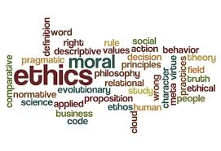

. Nursing research is carried out by maintaining ethical standards (Beauchamp and Childress, 2019). The declaration of Helsinki in 1964 outlines the various ethical principles and it was initially applied to medical research.
It protects the helpless group and other participants from any type of harm in association with the experimental intervention
It prevents the participants from exploitation by researchers
Found the risk-benefit ratio for the subjects
Make sure that the participants are treated in a fair way and with respect, decency and privacy.
Increasing the participant’s capacity in order to accept or reject study participants and to possess the information and written consent
Notes:
Ethics in nursing can be stated as the behaviour of moral principles that the researcher has to abide by carrying out the nursing research to make sure that the rights and welfare of individuals are maintained. Nursing research is carried out by maintaining ethical standards (Beauchamp and Childress, 2019). Nurses are required to apply the ethical standards in their own research while reviewing research. The declaration of Helsinki in 1964 outlines the various ethical principles and it was initially applied to medical research.
It protects the helpless group and other participants from any type of harm in association with experimental intervention
It prevents the participants from exploitation by researchers
Found the risk benefit ratio for the subjects
Make sure that the participants are treated in a fair way and with respect, decent and privacy.
Increasing the participants capacity in order to accept or reject study participants and to possess information and written consent

Slide 6
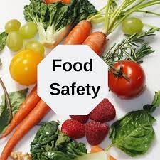
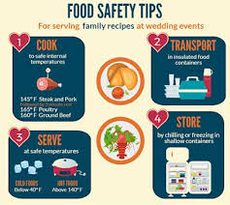
Determinants of Food safety and hygiene
Food Contamination: It is calculated that every year in the United Kingdom about 1 million people experience from foodborne illness and out of which 20,000 obtain hospital treatment and it accounts to about 500 deaths. There are certain guidelines which could be maintained to decrease the risk of food poisoning (Guo et al., 2019).
Demographics :The individuals who are at danger of falling ill, including infants, young children, pregnant and those who are under medications and other diseases such as “AIDS, cancer and diabetes” will weaken the immune system.
Notes:
Food Contamination: It is calculated that every year in the United Kingdom about 1 million people experience from foodborne illness and out of which 20,000 obtain hospital treatment and it accounts to about 500 deaths. There are certain guidelines which could be maintained to decrease the risk of food poisoning (Guo et al., 2019).
Demographics :The individuals who are at danger of falling ill, including infants, young children, pregnant and those who are under medications and other diseases such as “AIDS, cancer and diabetes” will weaken the immune system.

Slide 7
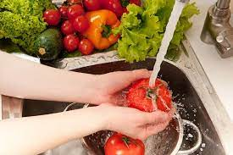
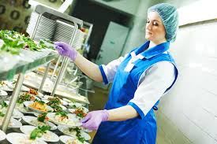
Consumer lifestyle :The pace of life nowadays is much faster nowadays as people often skip meals and spend less hours on food and often like to consume restaurant made food and packaged foods (Liguori et al., 2022). Often mishandling of food occurs in those types of food and it can cause illness
Food Production :The epidemic of foodborne diseases was local in the past. But today food is procured and cooked in various ways and it has changed considerably from the past.
Notes:
:The pace of life nowadays is much faster nowadays as people often skip meals and spend less hours on food and often like to consume restaurant made food and packaged foods (Liguori et al., 2022). Often mishandling of food occurs in those types of food and it can cause illness
Food Production :The epidemic of foodborne diseases was local in the past. But today food is procured and cooked in various ways and it has changed considerably from the past. Food which is grown and produced on a local basis are now centralised on a large scale. So, if there is a mistake in handling it will be experienced nationwide.

Slide 8


The Impact of Integration
Impact of hygiene
“Food hygiene” is an important element in community health for safeguarding the public and preventing illness caused by the consumption of unhealthy food due to absence of good quality from manufacture to consumption.
The World Health Organisation (WHO) have revealed that 1 out of 10 individuals feel sick from foodborne illness (Food hygiene, 2023).
Cleaning- Necessary to clean and disinfect food areas among various tasks particularly for handling raw food. If something is spilled it is necessary to clean it immediately . It is necessary to disinfect products which are suitable for the job and follow the instructions of the manufacturers.
Cooking - It is to ensure that food must be cooked properly to kill the harmful bacteria.
Chilling- Ensuring that foods are stored at an appropriate temperature to safeguard the harmful bacteria.
Notes:
“Food hygiene” is an important element in community health for safeguarding the public and preventing illness caused by the consumption of unhealthy food due to absence of good quality from manufacture to consumption. The World Health Organisation (WHO) have revealed that 1 out of 10 individuals feel sick from foodborne illness (Food hygiene, 2023). It is very hard to evaluate the weight of foodborne diseases as maximum of the illnesses are not exactly transmitted by food. Food handlers with poor own sanitation and lack of consciousness of essential issues in safeguarding foodborne diseases executing jobs in food establishment is the potential source of inflections of different “intestinal protozoa and pathogens” (Ekici and Dümen, 2019). Food safety specialists are often charged with the interventions to existing proceeds to manage the potential microbial hazards. The strategy is utilised to satisfy the performance and internal standards. This particular approach is taken into consideration to reach the regulations of the government like Salmonella reduction in poultry farms and abide by the performance standards and internal standards. Food hygiene is necessary for reducing the spread of bacteria while cooking, preparation and storage of food. The four essential things to be taken into account while considering good hygiene and they are
Cleaning- Necessary to clean and disinfect food areas among various tasks particularly for handling raw food. If something is spilled it is necessary to clean it immediately . It is necessary to disinfect products which are suitable for the job and follow the instructions of the manufacturers.
Cooking - It is to ensure that food must be cooked properly to kill the harmful bacteria.
Chilling- Ensuring that foods are stored at an appropriate temperature to safeguard the harmful bacteria.
Cross contamination - It is necessary to avoid cross contamination to prevent the spread of bacteria and they are ready to be consumed.

Slide 9
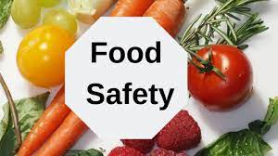
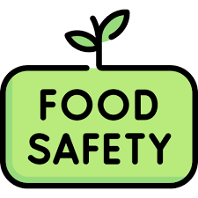
Impact of Food safety on public health
Food safety is ensuring that food is not harmful to be consumed.
Business handling business must not mislead people by the process that it is labelled, advertised and promoted
Businesses must keep records from the source of the food and reflect the information on urgent basis and it is often refer to as “traceability”
Business should withdraw any kind of unsafe food and accomplish an incident report
It is necessary to reflect the food hygiene rating
Notes:
Food safety is a notable issue for every one of us and prevention of foodborne diseases is one of the primary goals for various public health cares. There are about 250 kinds of different foods present in the world. Foodborne diseases are generally infectious or toxic and they are accused by the transmission of bacteria, viruses and parasites (Kamboj et al., 2020). The chemical contamination often leads to acute positioning and long lasting diseases like cancer. Many food borne diseases can lead to disability and death. Governments must mandate food safety as a priority for public health as they are applying a significant role for enacting policies and regulations and incorporating food safety standards (Food Safety and Hygeine, 2022) . Food handlers and consumers are required to comprehend the process of handling food and practising WHO Five keys to safe food at home. The food producers will grow fruits and vegetables by utilising WHO Five keys to grow safe fruits and vegetables.
Food safety is ensuring that food is not harmful to be consumed.
Business handling business must not mislead people by the process that it is labelled, advertised and promoted
Businesses must keep records from the source of the food and reflect the information on urgent basis and it is often refer to as “traceability”
Business should withdraw any kind of unsafe food and accomplish an incident report
It is necessary to reflect the food hygiene rating
.
Washing hands: Germs mainly spread with the help of hand and so it is very necessary to wash them with soap and water before food is handled and touched. Hands must be washed after it gets contact with pets and after the usage of the toilet and particularly children or pets with diarrhoea to assist in decreasing the spread of detrimental germs.
Meat and poultry: Raw meat inclusive of poultry that possess potential bacteria can outspread conveniently. This involves food, areas of work, tables and knives. So, every counter, utensils should be regularly cleaned with warm water and detergent after it is used for raw meat and if conceivable it is one of the essential to possess a chopping board which it is to be used for raw meat.
Food must be cooked appropriate temperature will make sure that every detrimental bacterium is damaged. It is to be checked whether the piping is hot before it is consumed. It is especially essential in the case of poultry, pork , sausages and rolled joints of meat and kebabs which are always fully cooked with no meat remaining. As long as they are sealed adequately and they are cooked at high temperature to destroy any germs on the surface of meat.
Salad, fruit and vegetables
Vegetables and fruits should be well rinsed under the running water and this is very crucial if they are consumed properly. Fruits and vegetables could be cleaned from hazardous germs with the help of peelings and cooking.
Cans and jars
Foodborne botulism is a potentially dangerous form of food positioning. When the bacteria “clostridium botulinum” often multiplies and generates botulinum toxin. The toxin is generated when Clostridium botulinum develops in an oxygen free environment.

Slide 10
Conclusion and Recommendation
Despite numerous efforts to fight against the foodborne diseases it has remained a significant issue in both developed and developing countries. Poor food safety is one of the main reasons for foodborne diseases across the globe
Specialists in food safety are frequently tasked with making changes to current processes to handle potential microbiological dangers. The tactic is used to meet internal and performance standards.
Improving food safety and hygiene requires utilising a national health promotion strategy within the healthcare industry..
Notes:
Despite numerous efforts to fight against the foodborne diseases it has remained a significant issue in both developed and developing countries. Poor food safety is one of the main reasons for foodborne diseases across the globe. Food handlers and food workers are one of the crucial mediums for introducing pathogens and hazards to the clients.
It is necessary to abide by the Food Safety standards in order to keep safe and prevent from transmission of potential hazards.
Improving food safety and hygiene requires utilising a national health promotion strategy within the healthcare industry. A strong national health promotion plan can aid in educating the public and medical professionals about the significance of handling food safely and preventing the spread of foodborne infections.
Every food cooked should be prepared with utmost care and safety. Before handling or touching food, it is imperative to wash your hands with hand cleanser and water to prevent the spread of germs. By cooking food at the proper temperature, all harmful germs will be eliminated. Before consuming the piping, it must be confirmed that it is hot. Specialists in food safety are frequently tasked with making changes to current processes to handle potential microbiological dangers. The tactic is used to meet internal and performance standards.

Slide 11
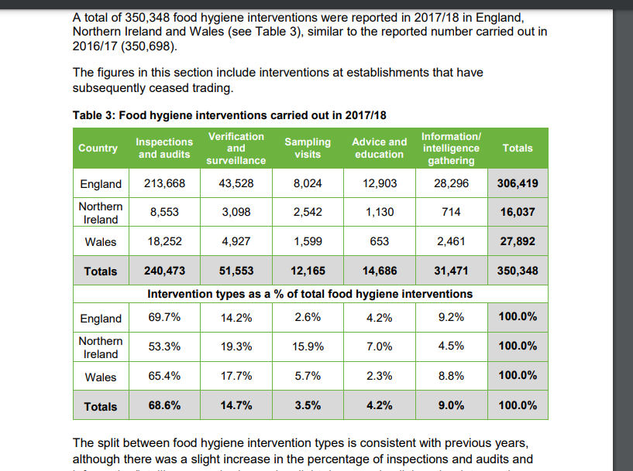
Appendix

Slide 12
References
Abebe, G.M. (2020) ‘The role of bacterial biofilm in antibiotic resistance and food contamination’, International journal of microbiology, 2020.
Agricultural Review (2022) Citeseerx.ist.psu.edu. Available at: https://citeseerx.ist.psu.edu/document?repid=rep1&type=pdf&doi=b3bf6373ff41a115197cb5b30e57830c16130c2c (Accessed: March 16, 2023).
Ekici, G. and Dümen, E. (2019)Escherichia coli and food safety. In The universe of Escherichia coli. IntechOpen.
Food hygiene (2023) Food Hygiene for Your Business, Food Standards Agency. Available at: https://www.food.gov.uk/business-guidance/food-hygiene-for-your-business (Accessed: March 16, 2023).
Food Safety (2023) Food Safety, World Health Organization. World Health Organization. Available at: https://www.who.int/news-room/fact-sheets/detail/food-safety#:~:text=Unsafe%20food%20containing%20harmful%20bacteria,children%2C%20elderly%20and%20the%20sick. (Accessed: March 16, 2023).
Food Safety and Hygiene (2022) Food Safety and Hygiene, Public Health Wales. Available at: https://phw.nhs.wales/topics/food-safety-and-hygiene/ (Accessed: March 16, 2023).
Notes:
Abebe, G.M., 2020. The role of bacterial biofilm in antibiotic resistance and food contamination. International journal of microbiology, 2020.
Agricultural Review (2022) Citeseerx.ist.psu.edu. Available at: https://citeseerx.ist.psu.edu/document?repid=rep1&type=pdf&doi=b3bf6373ff41a115197cb5b30e57830c16130c2c (Accessed: March 16, 2023).
Ekici, G. and Dümen, E., 2019. Escherichia coli and food safety. In The universe of Escherichia coli. IntechOpen.
Food hygeine (2023) Food Hygiene for Your Business, Food Standards Agency. Available at: https://www.food.gov.uk/business-guidance/food-hygiene-for-your-business (Accessed: March 16, 2023).
Food Safety (2023) Food safety, World Health Organization. World Health Organization. Available at: https://www.who.int/news-room/fact-sheets/detail/food-safety#:~:text=Unsafe%20food%20containing%20harmful%20bacteria,children%2C%20elderly%20and%20the%20sick. (Accessed: March 16, 2023).
Food Safety and Hygeine (2022) Food Safety and Hygiene, Public Health Wales. Available at: https://phw.nhs.wales/topics/food-safety-and-hygiene/ (Accessed: March 16, 2023).
Guo, W., Pan, B., Sakkiah, S., Yavas, G., Ge, W., Zou, W., Tong, W. and Hong, H., 2019. Persistent organic pollutants in food: contamination sources, health effects and detection methods. International journal of environmental research and public health, 16(22), p.4361.
Insfran-Rivarola, A., Tlapa, D., Limon-Romero, J., Baez-Lopez, Y., Miranda-Ackerman, M., Arredondo-Soto, K. and Ontiveros, S., 2020. A systematic review and meta-analysis of the effects of food safety and hygiene training on food handlers. Foods, 9(9), p.1169.
Kamboj, S., Gupta, N., Bandral, J.D., Gandotra, G. and Anjum, N., 2020. Food safety and hygiene: a review. International Journal of Chemical Studies, 8(2), pp.358-368.
Liguori, J., Trübswasser, U., Pradeilles, R., Le Port, A., Landais, E., Talsma, E.F., Lundy, M., Béné, C., Bricas, N., Laar, A. and Amiot, M.J., 2022. How do food safety concerns affect consumer behaviors and diets in low-and middle-income countries? A systematic review. Global Food Security, 32, p.100606.
Majid, S. et al. (2022) Adopting evidence-based practice in clinical decision making: Nurses' perceptions, knowledge, and barriers, Journal of the Medical Library Association : JMLA. U.S. National Library of Medicine. Available at: https://www.ncbi.nlm.nih.gov/pmc/articles/PMC3133901/#:~:text=Evidence%2Dbased%20practice%20(EBP),care%20to%20a%20specific%20population (Accessed: March 15, 2023).
UNCW (2016) Importance of research in Nursing: UNCW online, University of North Carolina Wilmington Online. Available at: https://onlinedegree.uncw.edu/articles/nursing/importance-of-research-in-nursing.aspx (Accessed: March 15, 2023).
Ruby, G.E., Abidin, U.F.U.Z., Lihan, S., Jambari, N.N. and Radu, S., 2019. A cross sectional study on food safety knowledge among adult consumers. Food Control, 99, pp.98-105.
Abebe, G.M., 2020. The role of bacterial biofilm in antibiotic resistance and food contamination. International journal of microbiology, 2020.
Agricultural Review (2022) Citeseerx.ist.psu.edu. Available at: https://citeseerx.ist.psu.edu/document?repid=rep1&type=pdf&doi=b3bf6373ff41a115197cb5b30e57830c16130c2c (Accessed: March 16, 2023).
Aveyard, H. and Sharp, P., 2017. A Beginner’s Guide to Evidence-based Practice in Health and Social Care. (3 rd edn.). London: Open University Press/McGraw-Hill Education.
Aveyard, H., 2019. Doing a literature review in health and social care: a practical guide. (4 th edn.). London: Open University Press/McGraw-Hill Education.
Beauchamp, T.L. and Childress, J.F., 2019. Principles of Biomedical Ethics. (8th edn.).Oxford: Oxford University Press.
Bell, J. and Waters, S., 2018. Doing your Research Project. A Guide for First-Time Researchers. (7 th edn.). London: Open University Press/McGraw-Hill Education.
Ekici, G. and Dümen, E., 2019. Escherichia coli and food safety. In The universe of Escherichia coli. IntechOpen.
Food hygeine (2023) Food Hygiene for Your Business, Food Standards Agency. Available at: https://www.food.gov.uk/business-guidance/food-hygiene-for-your-business (Accessed: March 16, 2023).
Food Safety (2023) Food safety, World Health Organization. World Health Organization. Available at: https://www.who.int/news-room/fact-sheets/detail/food-safety#:~:text=Unsafe%20food%20containing%20harmful%20bacteria,children%2C%20elderly%20and%20the%20sick. (Accessed: March 16, 2023).
Food Safety and Hygeine (2022) Food Safety and Hygiene, Public Health Wales. Available at: https://phw.nhs.wales/topics/food-safety-and-hygiene/ (Accessed: March 16, 2023).
Guo, W., Pan, B., Sakkiah, S., Yavas, G., Ge, W., Zou, W., Tong, W. and Hong, H., 2019. Persistent organic pollutants in food: contamination sources, health effects and detection methods. International journal of environmental research and public health, 16(22), p.4361.
Insfran-Rivarola, A., Tlapa, D., Limon-Romero, J., Baez-Lopez, Y., Miranda-Ackerman, M., Arredondo-Soto, K. and Ontiveros, S., 2020. A systematic review and meta-analysis of the effects of food safety and hygiene training on food handlers. Foods, 9(9), p.1169.
Kamboj, S., Gupta, N., Bandral, J.D., Gandotra, G. and Anjum, N., 2020. Food safety and hygiene: a review. International Journal of Chemical Studies, 8(2), pp.358-368.
Liguori, J., Trübswasser, U., Pradeilles, R., Le Port, A., Landais, E., Talsma, E.F., Lundy, M., Béné, C., Bricas, N., Laar, A. and Amiot, M.J., 2022. How do food safety concerns affect consumer behaviors and diets in low-and middle-income countries? A systematic review. Global Food Security, 32, p.100606.
Majid, S. et al. (2022) Adopting evidence-based practice in clinical decision making: Nurses' perceptions, knowledge, and barriers, Journal of the Medical Library Association : JMLA. U.S. National Library of Medicine. Available at: https://www.ncbi.nlm.nih.gov/pmc/articles/PMC3133901/#:~:text=Evidence%2Dbased%20practice%20(EBP),care%20to%20a%20specific%20population (Accessed: March 15, 2023).
Ruby, G.E., Abidin, U.F.U.Z., Lihan, S., Jambari, N.N. and Radu, S., 2019. A cross sectional study on food safety knowledge among adult consumers. Food Control, 99, pp.98-105.
UNCW (2016) Importance of research in Nursing: UNCW online, University of North Carolina Wilmington Online. Available at: https://onlinedegree.uncw.edu/articles/nursing/importance-of-research-in-nursing.aspx (Accessed: March 15, 2023).

