Slide 1
This Happy Breed
Noel Coward

Slide 2
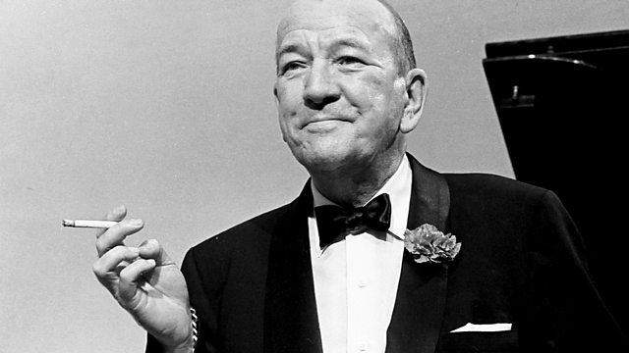
Noel Coward 1899 - 1973

Slide 3
Noel Coward
The Vortex (1924)
Hay Fever (1925)
Blithe Spirit (1941)
South Sea Bubble (1951)

Slide 4
Noel Coward
He was a Conservative
He was patriotic
He was homosexual
He was agnostic

Slide 5
Noel Coward
He was an actor, writer, song writer , playwright and painter.
He was known as ‘The Master’.

Slide 6
Noel Coward
“Work hard, do the best you can, don’t ever lose faith in yourself and take no notice of what people other people say about you.”
“You ask my advice about acting? Speak clearly, don’t bump into the furniture and if you must have motivation, think of you pay packet on Friday.”
“Work is more fun than fun!”

Slide 7

Jamaica

Slide 8
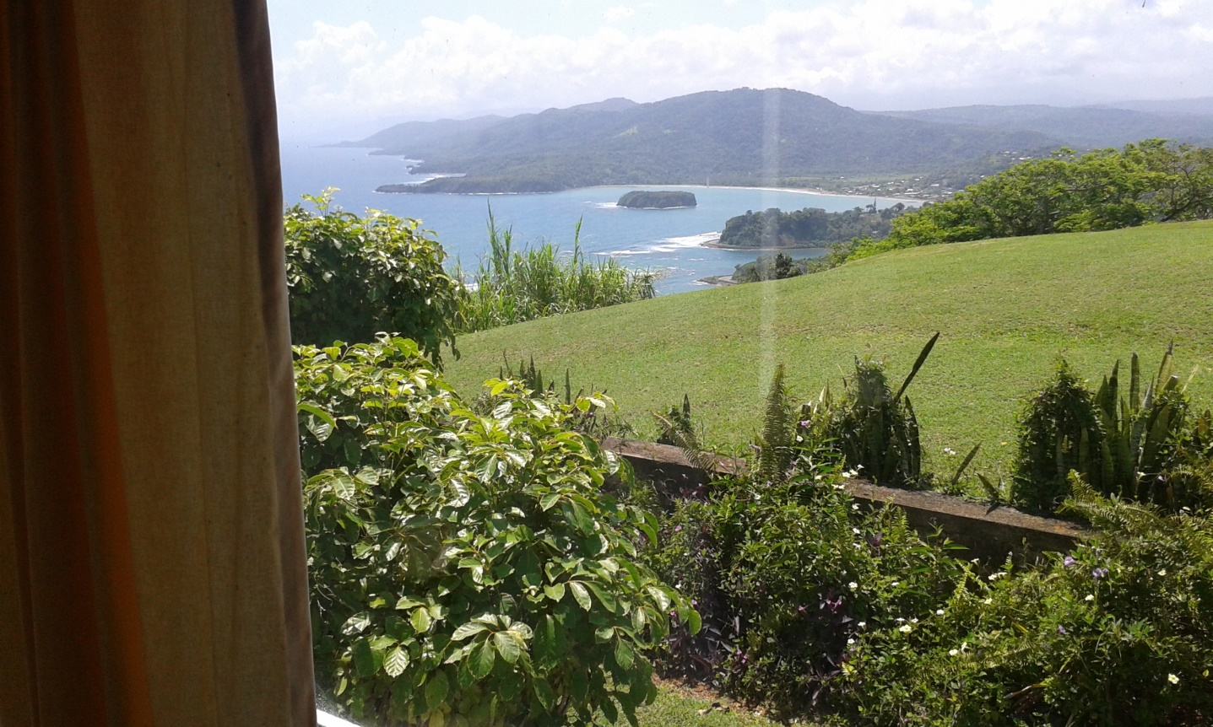
Jamaica

Slide 9

Jamaica

Slide 10
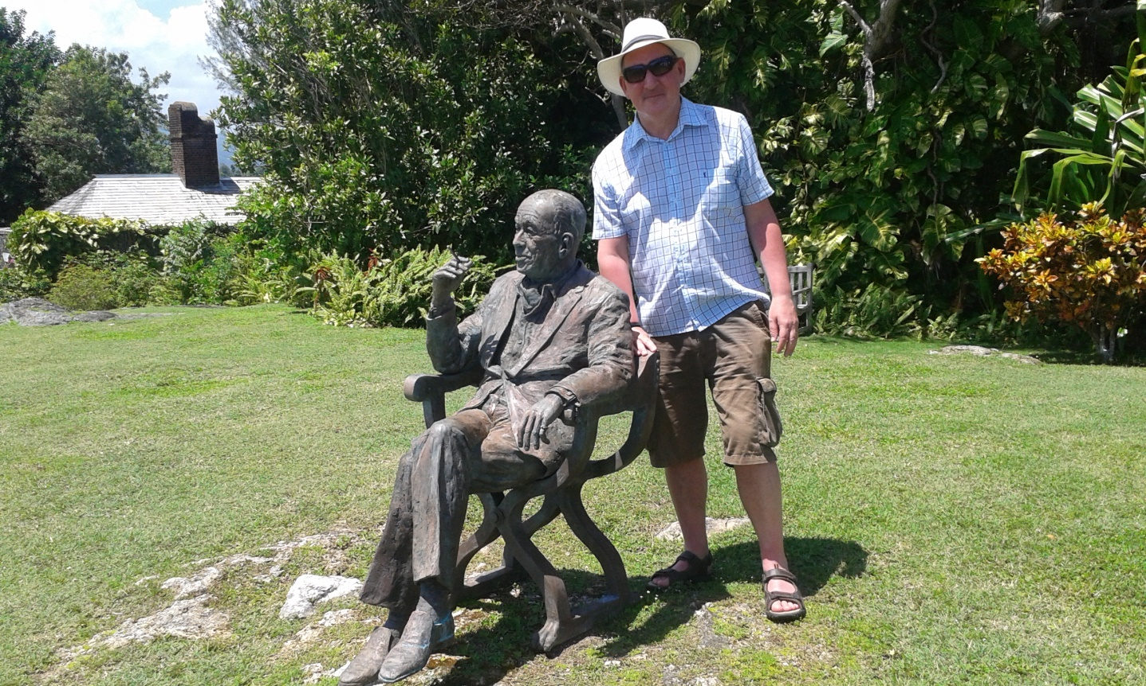
Jamaica

Slide 11
This Happy BrEed (1939)
First World War 1914 - 18
General Strike 1926
The Abdication Crisis 1936
Appeasement 1938

Slide 12
This Happy BrEed (1939)
A Play of propaganda?
The title suggests as much……

Slide 13
This Happy BrEed (1939)
John of Gaunt: | This royal throne of kings, this scepter'd isle, This earth of majesty, this seat of Mars, This other Eden, demi-paradise, This fortress built by Nature for herself Against infection and the hand of war, This happy breed of men, this little world, This precious stone set in the silver sea, Which serves it in the office of a wall, Or as a moat defensive to a house, Against the envy of less happier lands, This blessed plot, this earth, this realm, this England,

