Slide 1

FAKE NEWS DETECTION IN ELECTIONS – ANALYZING TWITTER DATA DURING UK ELECTIONS

Slide 2
INTRODUCTION
The proper evolution of social media has transformed the way consumer’s access, communicate, and interpret political information.
Twitter is an online platform with live communication during the period of the election.
It is also a misinformation and fake news pursuit, and this is enhanced by its open and viral nature.
False or deceptive news can distort the thinking of the masses, influence voting behavior, and eventually be a danger to democratization during the election periods.
Notes:
In the context of the state of affairs in the United Kingdom, the 2019 General Election emphasized the increasing importance of online accounts as a means of making political decisions and campaign strategies. This research is based on developing an ideal fake news detection system on Twitter using the assistance of the Natural Language Processing (NLP), the Machine Learning (ML), and the Deep Learning (DL) methodologies.

Slide 3
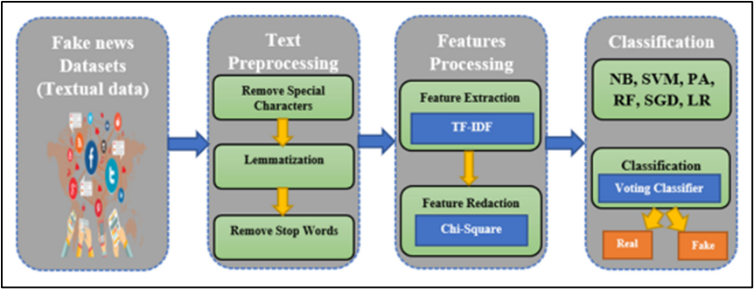
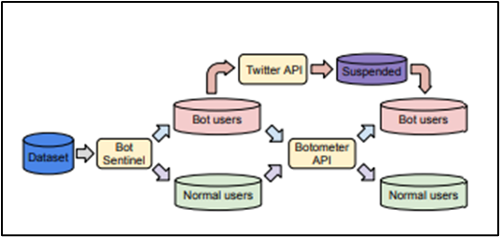
Background
Fake news has become a worldwide issue, especially in political processes like national elections.
Social media networks such as Twitter help to spread information quickly, only that the content cannot be controlled, hence misinformation is spread simultaneously.
In the case of the 2019 General Election in the UK, a number of deceptive stories and fake news circulated on the internet and shaped the mood of voters as well as public discourse.
The conventional means of media verification cannot be used to combat the magnitude and pace of internet misinformation.
Notes:
As a result, sophisticated algorithms, including “Natural Language Processing (NLP)” and “Machine Learning (ML)”, have been developed to help distinguish between patterns and characteristics of fake news. It is proven that linguistic cues, user behavior, and sentiment polarity can be utilized in order to determine whether the content is fake or valid, in case of previous research. The study is informed by these findings by constructing an automated system that can identify and interpret fake news on Twitter during UK elections to encourage meaningful and credible political communications.
Fake news is one of the effects of technology. It is false or misleading information presented as reality that has the power to influence someone's viewpoint. Organizations can utilize this misleading information for a variety of reasons, including political or financial ones. It's about as risky to transmit incorrect information as it is to spread the infection.
Via social media platforms like Facebook and Twitter, false information can be distributed through text, audio, video, and image formats. The issue of false news has been around for a while [1]. This paper suggested a system that uses voting classifier methods and standard machine learning algorithms to distinguish between bogus and true news. The “stochastic gradient descent classifier (SGD)”, “logistic regression (LR)”, “random forest (RF)”, “naïve Bayes (NB)”, “linear support vector machine (LSVM)”, and “passive-aggressive (PA)” techniques are employed.
Figure 1.1.1: framework
The system is trained on three publicly accessible datasets. First, purify the data by eliminating any unnecessary letters or numbers. The dataset was then divided using 10-fold cross-validation. The dataset's features are extracted using TF-IDF and DOC2VEC. The best characteristics are selected using the ANOVA method and the chi-square discretization technique.
The labelling result of the pipeline shown in the Figure will remain the same in the event of a Botometer-based initialisation phase; however, because of the constraints of Botometer requests, the processing time will increase significantly and take 650 days to complete [3]. Here, the bot users are connected to the Twitter API and the Botometer API. The Botometer API is connected to the normal users and bot users.

Slide 4
Problem Statement
The misinformation is mainly presented in social media and online platforms such as Twitter, and it is a severe challenge to democratic integrity and informed decision-making.
Most of the time, the political debates happen on Twitter about the UK 2019 general election, but it was a source of misinformation.
The fast spread of such material results in the inability of the users to differentiate real and fake data, which poses challenges to individuals and authorities trying to ensure electoral transparency.
The current fake news detection technologies grow to be challenged by scalability, contextual knowledge, and language variety.
Notes:
It still does not have a robust, evidence-based framework that can precisely detect fake news on social media in the course of elections. The study fills this gap by developing an NLP and Machine Learning-based system that is capable of extracting linguistic, behavioral, and sentiment characteristics out of tweets as a means to classify misinformation effectively.
There are a number of issues with the social media presence of false news detection, though, that require more research. This analysis will assist in choosing the best methods to use in order to detect fraudulent data from the corresponding real-time social media dataset worldwide [4]. It will also raise users' awareness when they are exchanging information and interacting with others on a range of social media platforms. The random forest method can help with both classification and regression difficulties.

Slide 5
Aim and Objectives
Research Aim
The study aims to develop a framework using NLP, Machine Learning, and Deep Learning to extract linguistic, behavioral, and sentiment features, classify fake news on Twitter during the UK 2019 election, and critically reflect on misinformation detection challenges.
Objectives
To identify and categorize the types of misinformation most prevalent on Twitter during the UK elections.
To extract and analyse linguistic, behavioral, and sentiment features from tweets and determine their effectiveness in predicting fake news.
To develop and evaluate Machine Learning and Deep Learning models (such as, Random Forest, SVM, LSTM, BERT) for accurate classification of fake news tweets.
To examine how misinformation patterns vary across different electoral contexts and reflect on challenges and implications for detection and mitigation strategies.
Notes:
Research Questions or Hypotheses
What kinds of misinformation were most prevalent on Twitter during the UK 2019 General Election?
Which linguistic, behavioral, and sentiment features are most useful in determining fake news from authentic tweets?
How accurately can Machine Learning and Deep Learning models classify fake news on Twitter?
How do misinformation designs and dissemination behaviours vary across different political contexts and user engagement levels during the election?

Slide 6
Scope and Limitations
The increased role of social media in political discussions has altered the consumption and sharing of information.
Although social media sites such as Twitter allow free communication and civic participation, it is also used to disseminate misinformation at a very fast rate.
The spread of fake news can have far-reaching and disastrous effects during major events like elections in the country, influencing voter opinions, polarizing, and eroding trust in the democratic system.
The most common methods of fake news detection, including manual verification, cannot be considered sufficient because of the huge volume of data, the variety of languages, and the specificity of the context of the information on social media.
Notes:
Thus, to detect disinformation efficiently and accurately, an automated, intelligent system based on “Natural Language Processing (NLP)”, “machine learning (ML)”, and “deep learning (DL)” is necessary [6]. These types of models are capable of detecting minor linguistic patterns, emotional coloring, and user actions that are related to fake information, which human reviewers could not be able to detect.
This study is motivated by the need to safeguard the integrity of the elections and make certain that political communication is free of any hidden interests and is based on evidence. This research paper will employ an in-depth examination of tweets concerning the 2019 UK General Election to come up with a holistic framework that will have the ability to differentiate fake news and authentic news [7]. This study provides various important information such as to policymakers, election regulators, and online platforms to develop their counter-disinformation policy. This is the section of emerging research on computational social science that focuses on the convergence of technology, communication, and democracy.

Slide 7
Research significance
This research is very important to identify the challenges of fake news during elections.
These challenges are the main issues in the digital age and their impacts on the integrity of democracy.
Social media platforms such as Twitter are contributing to the formation of the popular discourse, and learning to uncover and address misinformation has been vital in ensuring some transparency, fairness, and trust in the electoral process.
The 2019 General Election in the UK is an essential case study that demonstrates the role of online misinformation in shaping political views, voting patterns, and media coverage.
Notes:
This study is also an interdisciplinary design, and it employs both Natural Language Processing (NLP), Machine Learning (ML), and Deep Learning (DL) to identify fake news with a high level of accuracy [8]. Here, linguistic and behavioral, and sentiment features are mixed, and the research not only enhances the technical capacity of the misinformation detecting models but also enhances the understanding of the mechanisms of the spread of misleading political content over the Internet. This will provide an empirical foundation to deal with the digital disinformation that is becoming more intricate.

Slide 8
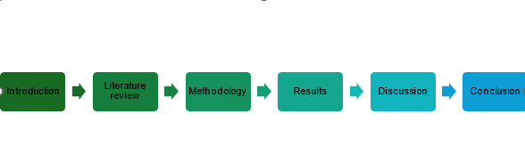
Dissertation Structure

Slide 9
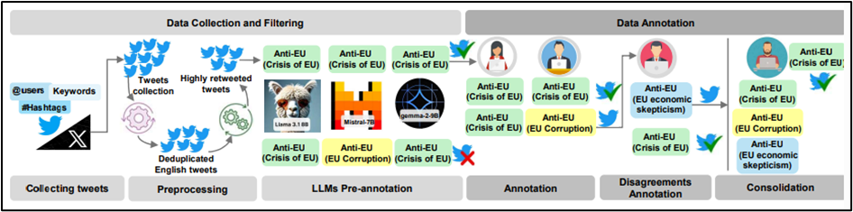
LITERATURE REVIEW
Misinformation Types and Patterns in Electoral Contexts for UK using ML
During European elections, a variety of false narratives frequently surface, typically reflecting a combination of regional and international issues.
There is a wide range of research on deceptive tales, using a variety of datasets and approaches. Re-annotate health misinformation datasets in the health domain to see if they have recognisable narratives [9].
They examined research that concentrated on certain national elections, such as the Swedish, Italian, German, and French ones, in addition to the European elections.
Notes:
In order to find and hone a set of cohesive core narratives, we conducted conversations and brainstorming sessions with a varied group of social scientists and NLP specialists after examining each of these fundamental storylines.
Figure 2.1.1.1: UKElectionNarratives construction approach
The Twitter streaming API was used in 2019 to get real-time Twitter data. Keywords and hashtags were used in the data collection process. Furthermore, they gathered tweets from political party accounts that either posted or mentioned them. The election took place on December 12, 2019; however, only tweets from November and December of that year were included. Historical tweets were gathered between May 1st, 2024, and July 4th, 2024; the election took place on July 4th. Particularly, tweets from Conservative and Labour user accounts were gathered.
This study looks at how social media affected voter awareness during the May 2015 general election campaign in the United Kingdom. The election is a great example of political learning since the party system in the United Kingdom was undergoing significant change at the time [10]. Recently, the Labour Party moved away from the market-based "New Labour" strategy supported by former Prime Minister Tony Blair and towards the left on economic and social welfare issues.
According to recent research, there is little chance that people's "static" political knowledge of long-standing organisations, established laws, and policies will increase once they complete formal education. They suppose that the incumbent parties (the Conservatives and the Liberal Democrats) would want this fact to be publicly known, while the opposition parties would try to hide it, as unemployment had been consistently declining in the years preceding the 2015 U.K. election.
The first examination of a specially selected dataset of rumours, misinformation, and disinformation circulating on Twitter around the 2020 U.S. election is presented in this research. The majority of prior research on disinformation, a general term for incorrect and misleading content, has either concentrated on a small number of targeted case studies with more precision but a narrow reach, or on broad categories utilising a restricted collection of keywords to cover a complicated issue.
The authors participated in the “Election Integrity Partnership (EIP)”, a group of research organisations dedicated to facilitating real-time information sharing among social media platforms, election authorities, disinformation researchers, and civil society organisations. The dynamics of disinformation have been examined through focused data collection, either inside a specific narrative or in comparison to a limited number of tales [11]. They concentrate on Twitter, a medium where the majority of information is freely posted, and data can be obtained on a broad scale for academic study, as is the case with many online research reports.
Using a time period or a specific set of keywords to collect significantly bigger collections of social media data has become an alternative method for studying rumours and false information. Reports may also be submitted to the EIP by outside partners. The major contribution was made by the Centre for Internet Security (CIS). The “Election Infrastructure Information Sharing and Analysis Centre (EI-ISAC)”, a central coordinating organisation for state and local government authorities conducting U.S. elections, is managed by the non-profit CIS.

Slide 10
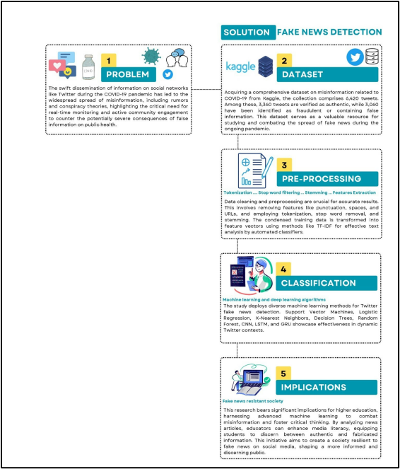
LITERATURE REVIEW (contd…)
Linguistic, Behavioural, and Sentiment Features for Fake News Detection
Newspapers and television channels have historically been the primary sources of news and information for people.
However, with the emergence of the Internet and its pervasiveness in our daily lives, the former has diminished in importance [13].
Online social networks (OSNs) and lifestreaming platforms are becoming more important than television as a primary news source.
In 2016, 62% of Americans got their news from social media, while in 2012, 49% of Americans reported using social media to watch news.
The text data in this column represents particular tweets on the COVID-19 epidemic.
Both linear and nonlinear problem domains can be solved with Support Vector Machines (SVM), which frequently produce noticeably better results in a wide range of practical applications.
Notes:
According to the broad adoption of social media platforms as a way for people to express their thoughts, sentiment analysis has become increasingly important in the modern era. People express themselves by leaving comments on several social media sites, like Facebook, Instagram, Twitter, and others.
Figure 2.1.2.1: Methodological diagram
These devices use a dividing line or hyperplane to divide data into discrete types. A mathematical model called logistic regression uses a matrix of variables to calculate each variable's weight. The algorithm predicts the categorisation of COVID-19-related false news, displayed as a word matrix, based on this weight. A binary dependent variable must exist for a logistic regression (LR) classifier to be deployed.
Information that is purposefully produced to confuse its audience is referred to as fake news. It could be delivered as text, images, audio, or video. Bots, trolls, and cyborg users are the three categories of fake news contributors. Non-human accounts can produce and disseminate fraudulent material, and bot accounts managed by algorithms can provide the false appearance that a piece of information is well-liked, which can result in the propagation of fake news. Social bots, for instance, target social media platforms.
The procedures of news verification have been greatly influenced by the issues surrounding the reliability of internet news. However, it has become difficult for professionals to manually review the contents due to the volume of large-scale data available on the Internet and online environments like social media, microblogging sites, and news websites, as well as the ongoing proliferation of false news.

Slide 11
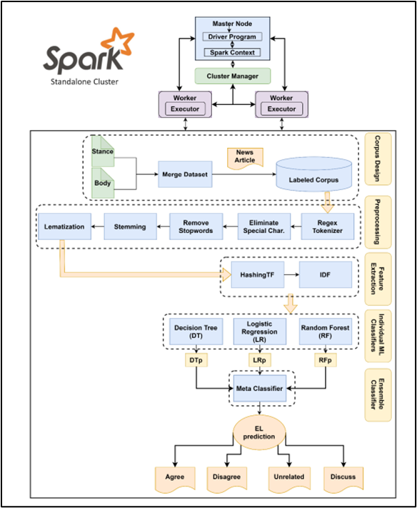
LITERATURE REVIEW (contd…)
• Technological developments and the rise of social media have facilitated the spread of information throughout the world.
• Significant news organisations have made significant investments in digital journalism, creating material for media platforms and expanding their audience through online resources and social media.
• This section provides a thorough description of the suggested methodology.
• As seen in the Figures, the suggested method consists of several stages of data analysis, feature extraction, a single classifier, and an ensemble classifier.
• In order to address the problem of spotting false news, a specific goal and dataset are offered in stage 1.
• The main goal of the challenge is to create a semi-automated pipeline that analyses the attitudes of several news stories on a certain subject.
Notes:
The emergence of social media has altered people's perceptions about relationships. Sentiment analysis and news classification based on “machine learning (ML)” make it easier to comprehend feelings and obtain news [17]. Nevertheless, the majority of research is on intricate models that demand a lot of resources and delayed inference times, which makes deployment challenging in systems with limited resources. Information technology has advanced significantly and quickly, resulting in the rise of social media as a major phenomenon. User-to-user interactions, including chatting, photo sharing, blog commenting, and status updates, are made possible by social media.
Social media sentiment analysis and news classification are driven by several variables. Effective techniques for sorting through and classifying news items and user-generated material are required due to the enormous volume of data produced on social media sites. This is essential for finding pertinent information in the middle of the clutter, enabling prompt access to news updates, and improving the spread of information.

Slide 12
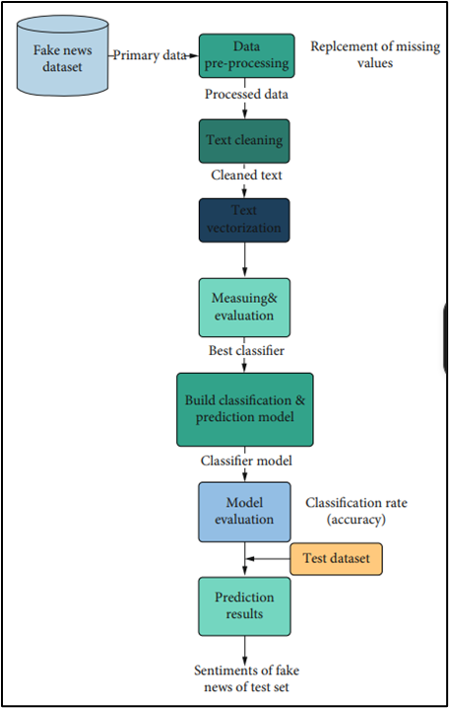
LITERATURE REVIEW (contd…)
Machine Learning Approaches for Fake News Classification
Every second, a huge volume of data is produced for social networking, microblogs, and content sharing on social media platforms.
Twitter is a crucial, well-known microblog where individuals express their thoughts on current affairs.
The main focus of sentiment analysis, also known as opinion mining, these days is analysing these opinions.
Classification model training and assessment using performance metrics (confusion matrix, classification rate).
In order to predict the sentiment class of each COVID-19 false news item in this set, test the model with a set of test data that simulates a set of unclassified fake news.
The architecture of the categorisation system is depicted in the figure.
Notes:
MLP is a subset of ANNs, or feedforward artificial neural networks. The way that all human brain’s function is reflected in ANN. The primary motivation for ANN is the way the brain takes in information, processes it, and produces answers. ANN is capable of learning from input data and connecting it to the desired output variable.
Figure 2.1.3.1: Research methodology
Text retrieval, information abstraction and summarisation, and question responding all depend on text categorisation [19]. The information utilised for classification on the internet is often varied and comes from a variety of sources, including printed or broadcast news, message boards, newsgroups, ads, and movie reviews. Automatic text classification is crucial due to its diverse characteristics, such as being multi-sourced and having various vocabularies, formats, and writing styles for texts.

Slide 13
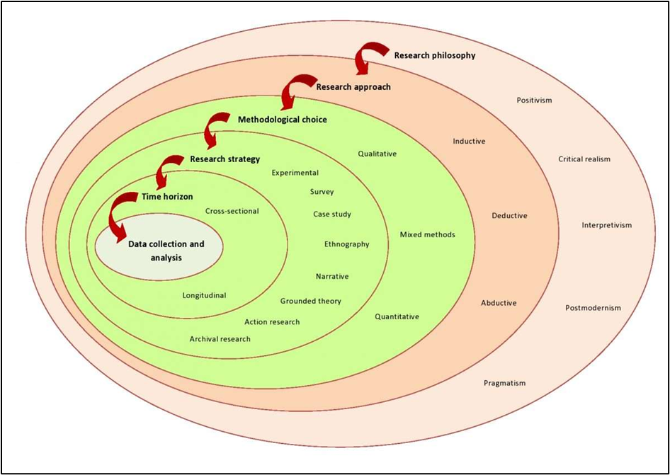
METHODOLOGY
This chapter has provided the methodological framework used in the study of fake news detection on Twitter around the UK 2019 General Election.
Natural Language Processing, machine learning and deep learning methods have been used to analyse large-scale data in social media in a systematic and computational manner.
It has been focused on providing methodological rigor, reproducibility and observing ethics.
The chapter has described the philosophical position, study design, system design, and methods of data processing and evaluation plans that are implemented within the research.
The reasons for the methodology decisions have been presented concerning the purpose of the research and the type of problem field.

Slide 14
METHODOLOGY (Contd…)
Research Philosophy
The philosophy of study to be used in this study is positivism, which has provided priority to objective measurement, empirical observation and quantitative analysis.
Positivism has presumed that social phenomena such as the use of misinformation on social media can be observed, measured and modelled using scientific and computational methods [23].
The bases of knowledge have been based on observable facts and statistical findings as opposed to subjective interpretation or personal experiences.
A positivist approach has been suitable for the study that has used such features as numbers, algorithmic modelling, and performance measures in order to discuss the issue of fake news detection in Twitter.
Notes:
The reality has been regarded as an external reality, independent of the researcher, and thus findings are validated by experimentation, replication, and comparative analysis [24]. The objectivity has been ensured through the use of standardized preprocessing methods, objective evaluation measures and established machine learning models. The analytical process has not been affected by personal approach or interpretation judgement, and hence, it upholds scientific rigor and transparency of the methodology.
The nature of the study problem has conformed well to the philosophy as it has involved large-scale data analysis and predictive modelling. The model effectiveness has been assessed using the quantitative measures of “accuracy”, “precision”, “recall”, “F1-score”, and “ROC-AUC”, supporting the focus on the quantitative results. Their effectiveness has been empirically tested by the means of supervised learning, on the basis of hypotheses based on linguistic, behavioral, and sentiment-based features.
The adoption of positivism has also been indicative of mainstream practices in the current literature on fake news detection, where the use of computational techniques and statistical confirmation has been popular [25]. Generalizable findings have been of priority compared to contextual or interpretive findings where the findings are expandable beyond the immediate dataset. This theoretical approach has formed a logical basis to the research design, the methodology and the analysis methods the research used in the study.

Slide 15
METHODOLOGY (Contd…)
Research Approach
This study uses a deductive research design, to rely on existing theories and existing empirical studies regarding fake news detection, misinformation spread and political communication within social media websites.
The theoretical background of identifying the linguistic, behavioral, and sentiment-based clues of misinformation has been lent by the existing literature [28].
These theoretical assumptions have been used to develop a set of hypotheses about the efficacy of computational models in identifying fake news on Twitter data related to elections.
The use of deductive reasoning has been acceptable as machine learning and deep learning models have shown high levels of performance in text classification and misinformation detection problems.
Notes:
The models that have been chosen include “Random Forest”, “Support Vector Machine”, “Long Short-Term Memory Networks”, and transformer based networks because these models have been successful in the past research. Such methods have been utilised on a localized and contextualized dataset pertaining to the UK 2019 General Election to investigate the possibility of existing theoretical expectations being upheld in a real-world electoral setting.
The study procedure has involved the general theoretical ideas to concrete empirical investigations. The categories of features found in previous studies have been operationalized using computational means and predictive models have been trained to assess their level of discrimination. The model results have been measured and compared using quantitative performance measures consisting of “accuracy”, “precision”, “recall”, “F1-score”, and “ROC-AUC” [29]. The assumptions based on the literature have thus been proved or disproved using empirical results.
The study has been conducted in a logical manner through consistency of the theory, methodology and analysis. The comparison of methodologies has been conducted in a systematic approach as model evaluation allows making evidence-based conclusions. The relevance of the findings has been prioritized on generalizable insights rather than subjective meaning, which provides methodological rigor and reproducibility. This deductive strategy has suited well with the study objectives and has enabled a systematic exploration into the recognition of fake news on Twitter in the case of the UK election.

Slide 16
METHODOLOGY (Contd…)
Tools, Technologies, and Datasets
Programming Language and Development Environment
This study has utilised Python as the main programming language because it provides wide support of data analysis, machine learning, and natural language processing.
The language has availed a flexible and readable syntax, which allows applying complex computational pipelines more effectively.
Its compatibility with popular machine learning and deep learning structures has also been a rationale to be selected.
It has been implemented in a cloud-based computational infrastructure enabling the scalable ability to process big datasets and efficient training of deep learning models.
Transformer based model training and lessening computational overhead has been aided by GPU acceleration. Stochastic variation has been controlled by using fixed random seeds in all the experiments, which ensures reproducibility in the results of evaluating the models.
Notes:
Transformer based model training and lessening computational overhead has been aided by GPU acceleration. Stochastic variation has been controlled by using fixed random seeds in all the experiments, which ensures reproducibility in the results of evaluating the models.
Natural Language Processing and Machine Learning Libraries
There are several libraries which have been established and have been utilized to aid in the processing of text and model creation. NLTK and SpaCy have helped in tokenization, lemmatisation and removing stop words, which have allowed linguistic normalization of tweet content [60]. TextBlob has been employed to remove sentiment polarity and subjectivity scores in helping to analyse emotional cues linked to misinformation.
Scikit-learn has been used to implement classical machine learning models such as the random forest and Support machine classifiers. The library is also able to support feature scaling, model evaluation as well as performance measurement. Long Short-Term Memory networks have been completed with the help of TensorFlow and Keras to achieve sequence-based modelling of texts in tweets. The HuggingFace Transformer and PyTorch frameworks have assisted in fine-tuning on the DistilBERT model to offer advanced in-context language representations.
Dataset Description and Preprocessing
The dataset employed in the research has been retrieved on Kaggle and has comprised Twitter posts on the UK 2019 General Election. The text of Tweets, activity indicators, and user metadata have been added to facilitate end-to-end analysis of the trend of misinformation.
Text cleaning, tokenization, lemmatization, sentiment extraction, and feature normalization have been used as preprocessing. The absence of any numerical values has been treated appropriately to ensure data integrity. The weak supervision heuristics have been used in those cases where explicit labels are not available and allowed supervised learning with consideration of possible noise. The combination of these tools and datasets has provided a strong and repeatable experimental infrastructure of fake news detection.

Slide 17
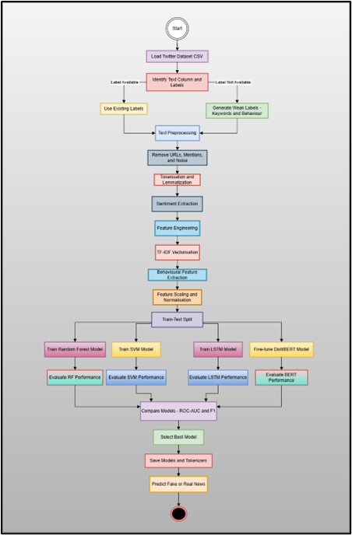
METHODOLOGY (Contd…)
The phases of the system have relied on comparative assessment, choice, endurance, and adaptation of models.
ROC-AUC and F1-score have been used to compare model outputs which have balanced evaluation of the classification performance.
These metrics have then been used to select the best-performing model.
The tokenizers and models used have been stored to facilitate reproducibility and reuse.
The system has been effectively used through a prediction module that allows categorizing unknown text as either fake news or real news.

Slide 18
METHODOLOGY (Contd…)
Data Collection and Processing
The primary sources of secondary data have been based on data collection methods, excluding live Twitter scraping.
This strategy has ensured adherence to the policies on the use of the platform, institutional ethics, and protection of data.
A dataset that has been used has included publicly available Twitter posts around the UK 2019 General Election, both in form of a text and the accompanying metadata.
This dependence on an existing dataset has also facilitated reproducibility since the data can be again accessed and analyzed by subsequent researchers.
Notes:
The data gathered has consisted of text of tweets, indicators of engagement and metadata of users. The content in the Tweets has been the major contributor to the linguistic analysis whereas the most frequently used parameters such as “likes”, “retweets”, “replies” and “quote contributed” to the extraction of behavioral features. User metadata such as the number of followers and verified status has also been giving other contextual information useful in the prevention of misinformation.
Preprocessing of data has played a significant research duration and has been carried out in an organized manner to enhance the quality of data and model performance. Textual preprocessing has entailed deleting URLs, user mentions, emoji’s, and non-alphanumeric characters that are adding minimal value to semantics. There has been normalization of cases and whitespace standardization so that all textual inputs can be consistent. The process of tokenization and lemmatization has been carried out with the current libraries on natural language processing, which allows the reduction of words to their base form and retain semantic content.
The cognitive processing of missing and noisy data has been taken care of in orderly cleaning processes. Numerical metadata fields with missing values have been transformed to suitable formats and neutral values where applicable substituted. There have been records of duplication and missing entries, which have been filtered to eliminate bias and redundancy. Sentiment Polarity and subjectivity scores have been calculated to identify emotional content features normally attributed to misinformation content.
Numerical attributes have been scaled and normalized to meet machine learning algorithm requirements as well as avoidance of overpowering features with higher numerical ranges. The resulting processed textual and numeric features have then been collected into format feature matrices that are fit to undergo supervised learning.

Slide 19
IMPLEMENTATION & DEVELOPMENT
Overview
The pipeline involved is deployed as a Python-based system for detecting fake news from end to end. Text cleaning, tokenization, and lemmatisation are used to preprocess Twitter data related to the 2019 general election in the UK.
TF-IDF is used to extract linguistic features, TextBlob is used to extract sentiment ones and tweet metadata is used to extract behavioral ones.
Various models are applied, such as Random Forest and SVM, used to solve traditional machine learning, a Bi-LSTM, used to learn sequential text, and Distil Bert, used to learn context on a text.
The accuracy, F1-score, and ROC-AUC are used to measure performance.

Slide 20
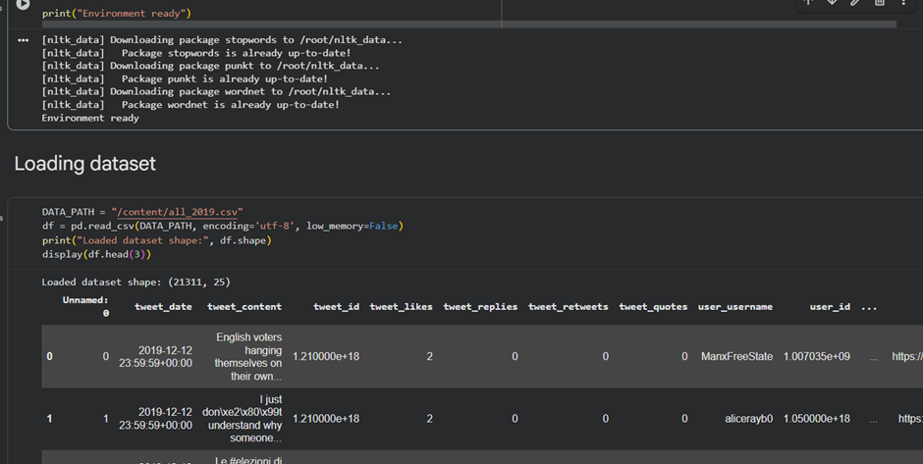
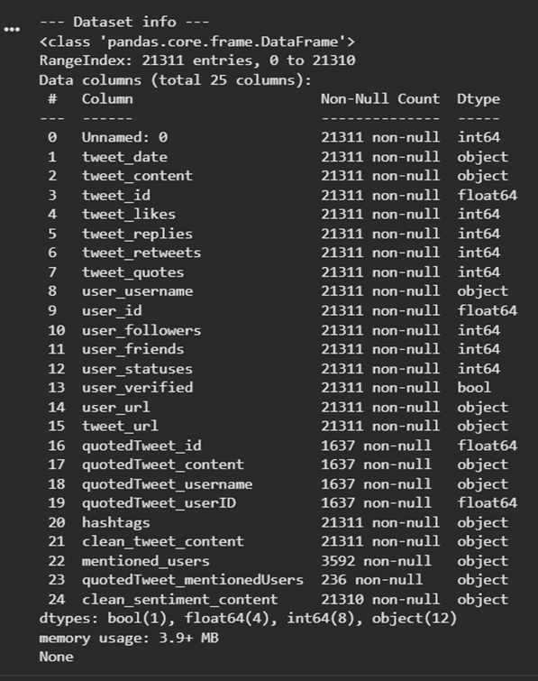
IMPLEMENTATION & DEVELOPMENT (Contd…)
The Pandas library is used to load the dataset in the form of a CSV file with Twitter information about the UK 2019 General Election.
This is an important step because it facilitates the systematic retrieval of massive social media information, such as the text of tweets and related metadata.
The above code demonstrates the effective loading and initial inspection of the dataset that is to be applied to the fake news detector project.
The dataset involves 21311 records of tweets in 25 features, such as “twitted content”, “time”, “user information”, and the interaction count, namely, “likes”, “comments”, and “retweets” [34].
Notes:
Encoding the data in UTF-8 makes textual information manageable correctly, whereas low-memory optimization facilitates effective operation [33]. The first rows can be used to check the integrity of the data, the structure of columns, and the fact that the data has been imported before the preprocessing and feature extraction. Checking data structure, datatypes, and non-null counts are the steps that check the soundness of the data and set up the dataset to take advantage of the preprocessing stage, feature extraction, and model training.

Slide 21
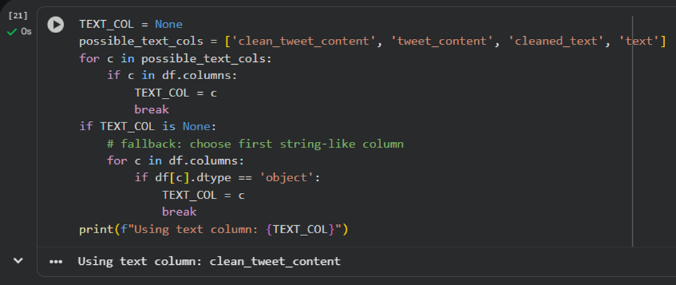
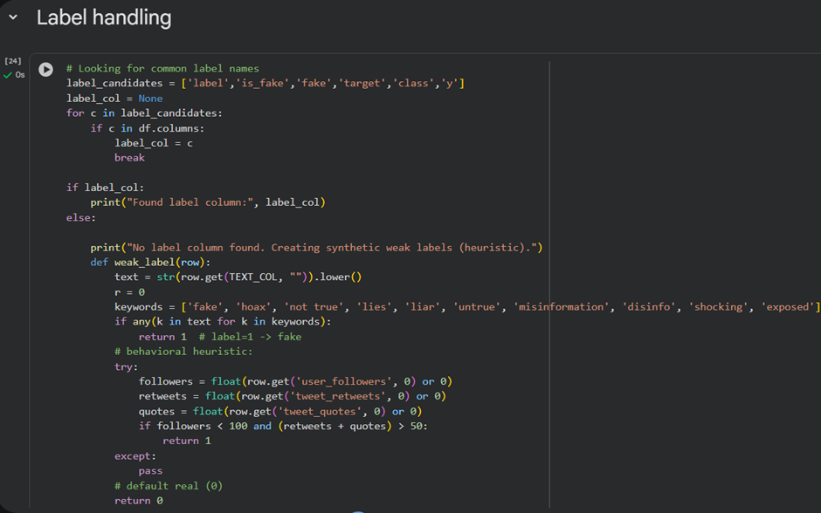
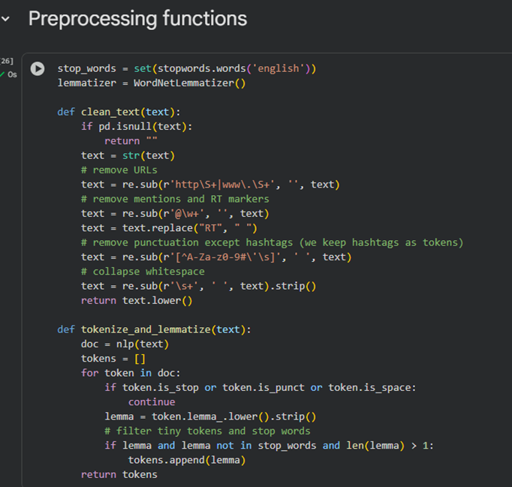
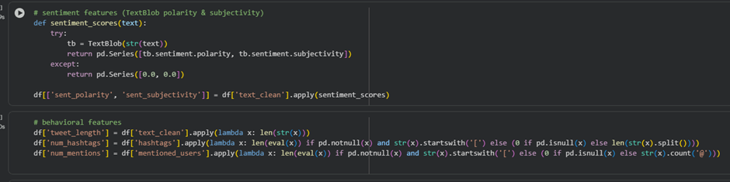
IMPLEMENTATION & DEVELOPMENT (Contd…)
This fragment of the code identifies the column with the text of tweets strongly to continue their analysis.
The variable “TEXT_COL” is iterating as “None”, and a list of known expected text column names can be used to assign the first similar column in the dataset being used.
This section of the code deals with the label handling, which is one of the key points associated with the fake news detection project.
The machine learning and deep learning algorithms need labelled examples to get to know the distinction between fake and real news.
This preprocessing phase removes and normalizes tweet text to enhance better performance of models.
During the filtering of noise, URLs, user mentions, retweet indicators, and meaningless symbols are deleted, whereas hashtags are kept as they have semantic value in political discourse.

Slide 22
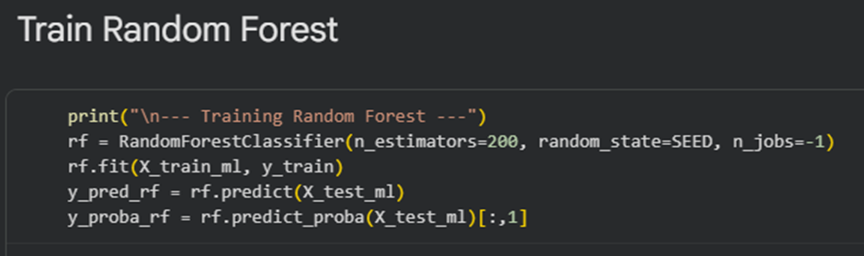
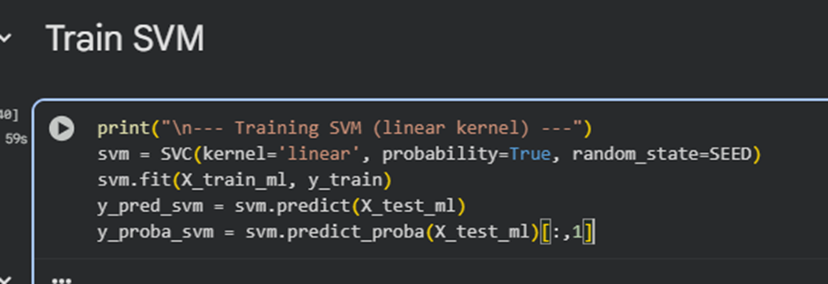
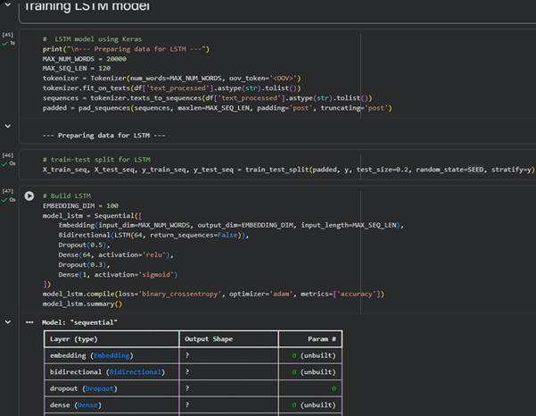
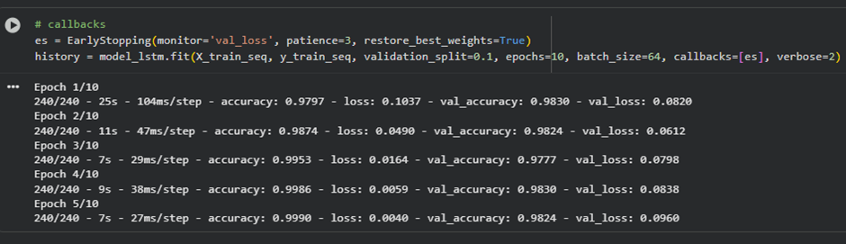
IMPLEMENTATION & DEVELOPMENT (Contd…)
The Random Forest model is trained on the feature matrix that is extracted to categorise the tweets as fake or real.
Random Forest builds a complex, non-linear association among linguistic, behavioral and sentiment features by building an ensemble of decision trees [40].
The multiple trees are better in terms of stability of predictions and overfitting.
The significance of this model is that it gives a solid foundation for comparison and is effective in pointing out which behavioral and textual tendencies are most suggestive of misinformation on the occasion of an election.
The Support Vector Machine (SVM) model using the linear kernel is used to classify the tweets using the combined feature matrix.
SVM works well with sparse text data with high dimensions created by TF-IDF representations [41].
Notes:
It has a high generalization performance by maximizing the margin between classes. The model is significant because it can be used as a good standard in text classification and can be used to estimate how well advanced deep learning models can detect election-related misinformation. The training of the LSTM model transforms the processed text in the tweets into a series of numbers suitable for deep learning. The tokenizer is used to encode words by word indices, and the out-of-vocabulary words and sequences are padded to a fixed size to maintain equal input size [42]. This is necessary since LSTM networks are sequential and able to learn both temporal and contextual dependencies in tweets, thus making the model learn the role of word order and context in misinformation detection.

Slide 23
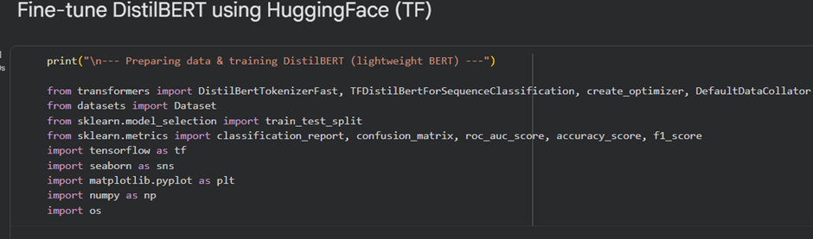
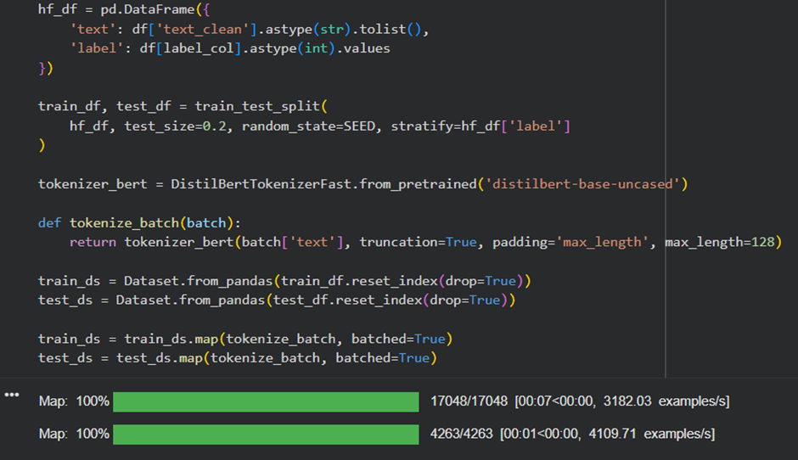
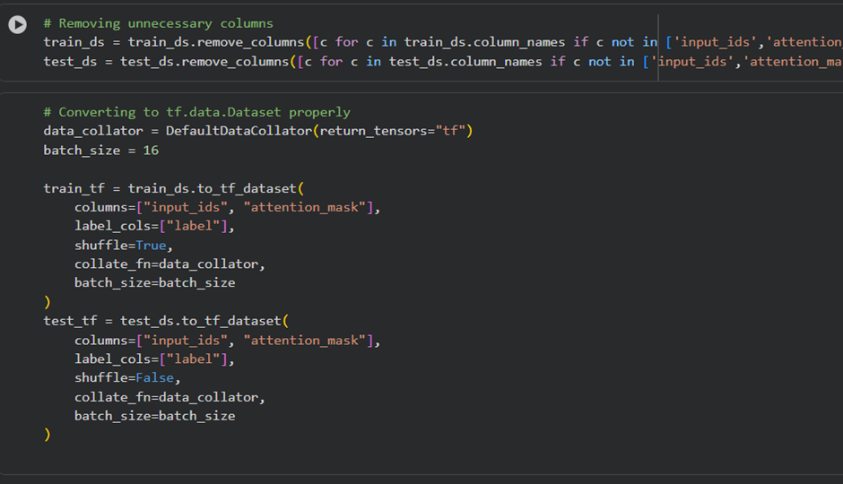
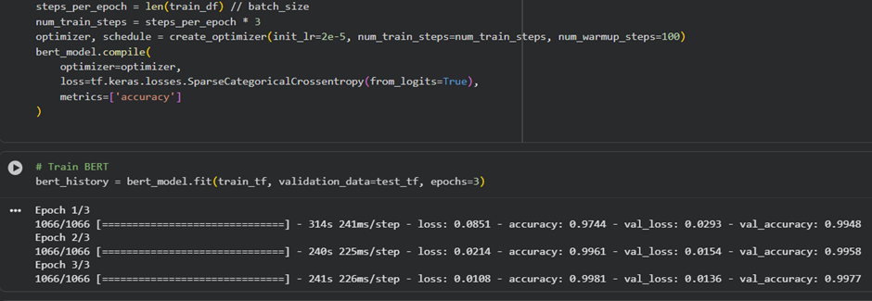
IMPLEMENTATION & DEVELOPMENT (Contd…)
This segment illustrates the epoch-wise training process of the LSTM model for fake news detection.
During each epoch, the model learns sequential patterns in tweet text and updates its parameters to minimize training loss [43].
Validation accuracy and validation loss are monitored alongside training metrics to evaluate model generalization.
The early stopping callback is applied to prevent overfitting by restoring the best-performing weights, ensuring stable and reliable performance on unseen election-related Twitter data.
The DistilBERT model is manually fine-tuned with a customized Adam optimizer with a low learning rate and warm-up steps to achieve a stable convergence.
The model is used to train 3 epochs, and training and validation accuracy are significant with low loss, which corresponds to good learning without overfitting.
Notes:
The code segment demonstrates that the complete DistilBERT fine-tuning pipelined used for fake news detection. It begins by importing some library packages, which are essential for Hugging Face, and some other libraries, such as PyTorch which are essential for transformer-based text classification. The tweet text and corresponding labels are transformed into structure data frame, which is further used for splitting and training to ensure unbiased evaluation of the machine [44]. The main function tokenizer convert raw texts into small tokens by using truncation, padding and enabling the transformer model. This is pre-processing the tokenized tweet data to be used to train the DistilBERT model by only keeping the necessary inputs, that is, input IDs/labels, and attention masks. Redundant columns are eliminated to optimize the use of memory and training. A data collator converts the datasets into TensorFlow-compatible batches, with uniform shapes of tensors. The significance of this process is that the contextual information needs to be correctly processed to achieve stable and efficient training performance by transformer models, which take structured and batched inputs with attention masks.
The importance of fine-tuning BERT lies in the fact that it is the process of fine-tuning a pre-trained language model to election-related Twitter data to achieve not only better contextual but also a massive enhancement in the performance of fake news classification.

Slide 24
IMPLEMENTATION & DEVELOPMENT (Contd…)
Discussion
This paper illustrates how “Natural Language Processing (NLP), Machine Learning (ML), and Deep Learning (DL)” can be effectively used in identifying fake news on Twitter in the UK 2019 General Election.
Its implementation is a systematic end-to-end pipeline that started with data loading and data exploration to establish data integrity and suitability to be analyzed [45].
The data set contained more than 21,000 tweets possessing varied textual and behavioral characteristics and offered a strong basis for experimentation.
Preprocessing of texts is important in enhancing the performance of the models by removing noise and normalizing language variation common in social media data.
The text is managed with care, which ensures that the politically relevant lines were not eliminated.
Notes:
Where there are no manually annotated labels, weak labelling techniques allowed supervised learning using both linguistic and behavioral heuristics. Integration of sentiment, behavioral, and account-level features with textual representations is found to greatly improve the detection ability of the feature engineering technique. Sentiment analysis captures emotional and subjective trends, which are usually linked to misinformation, whereas behavioral metrics like engagement and user credibility give information on how fake news spreads on social media. TF-IDF feature representation is found to be effective with classical machine learning algorithms such as Random Forest and SVM that have strong baseline performance.
The comparative model analysis indicated clear differences in practices among approaches. Random Forest is useful in capturing non-linear relationships between heterogeneous features, and SVM is highly generalized with high-dimensional sparse text data. Deep learning models were superior to conventional methods. The LSTM model is useful because it is capable of learning sequential dependencies in the text of tweets, resulting in a better comprehension of context [46]. It is not as good as it could have been because of a lack of contextual richness and greater sensitivity to data sparsity.
The overall performance of DistilBERT is the best, as indicated by the higher accuracy and ROC-AUC results. Refinement of the pre-trained model using election-specific Twitter data enabled the model to be fine-tuned to domain language and discourse. The results indicate the need to use linguistic, behavioral, and contextual characteristics to identify fake news with high accuracy. As much as transformer-based models have great potential, there are practical issues of data annotation quality, cost of computation and ethical issues.

Slide 25
TESTING & EVALUATION
Testing and Validation
The testing plans are created in such a way that they allow testing the accuracy, reliability and usability of the fake news detection system.
Individual parts of the work are tested by unit testing, such as text preprocessing, tokenization, feature extraction, and model inference, to make sure that they work properly.
End-to-end testing ensured smooth communication between data loading, preprocessing pipelines, machine learning models, and prediction outputs.
Model efficiency, accuracy, and stability of inferences are evaluated through performance testing based on validation measures and the level of confidence.
The usability test concerned the ease of entry, accuracy of predictions and comprehensiveness of results, so that the system provides predictable and user-friendly misinformation detection.

Slide 26
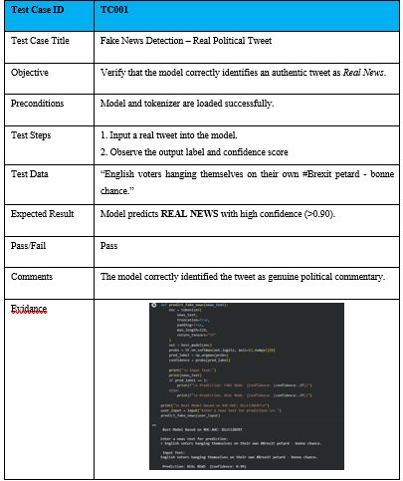
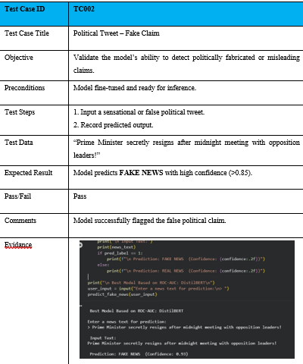
TESTING & EVALUATION (Contd…)

Slide 27
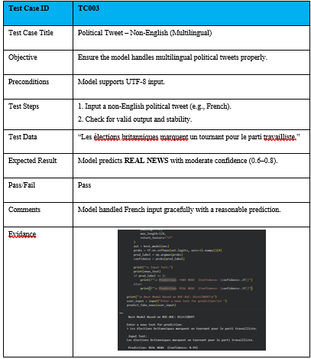
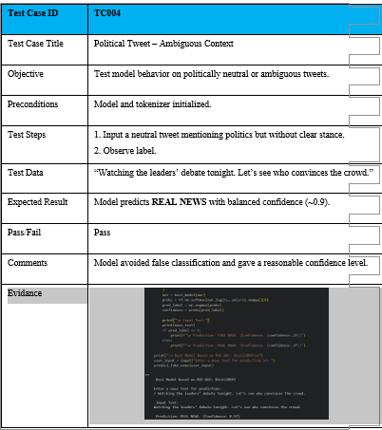
TESTING & EVALUATION (Contd…)

Slide 28
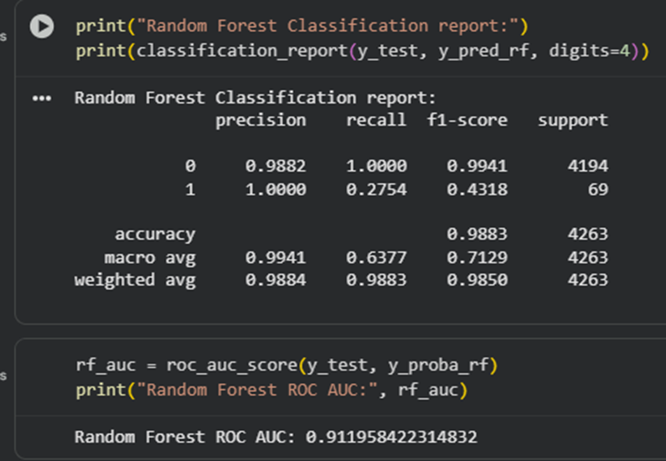
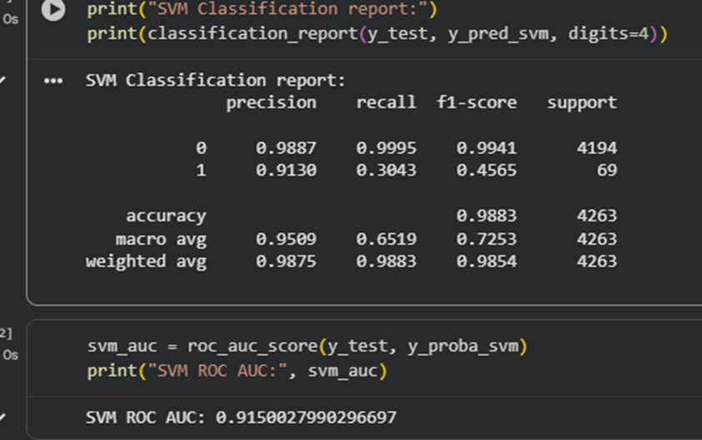
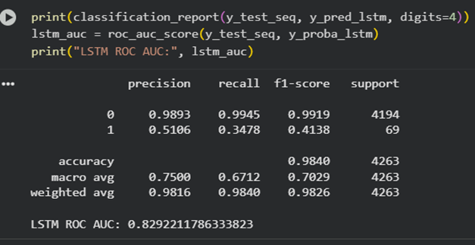
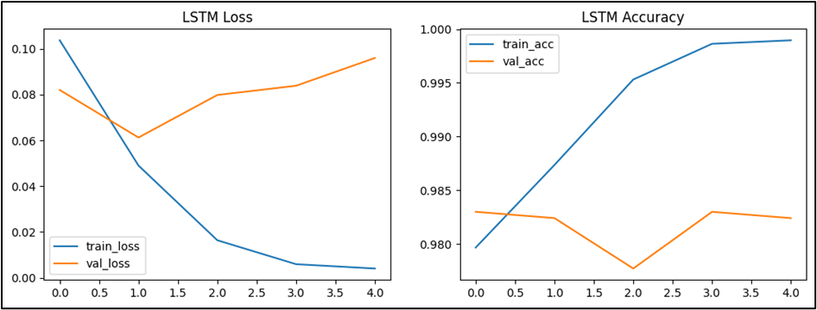
TESTING & EVALUATION (Contd…)
The part provides the classification report and the ROC-AUC degree of the random forest model in the detection of fake news.
The classification report presents the most important performance measures, such as precision, recall, F1-score, and support levels of the real and fake news classes.
High accuracy refers to the overall performance of the model, and class-wise measures depict the effectiveness of the model to detect instances of minority fake news [47].
The score of ROC-AUC also assesses the discriminative power of the model, its capacity at various threshold levels to make a distinction between authentic and fake news and is essential in comparing the models reliably.
The overall performance in the SVM classification report is high, with an accuracy of 0.9883.
Class 0 (real news) had a precision of 0.9887, recall of 0.9995, and F1-score of 0.9941, whereas class 1 (fake news) had a precision of 0.9130, recall of 0.3043, and F1-score of 0.4565, meaning it is difficult to detect instances of minority fake news [49].
Notes:
The average F1-score (macro-average) is 0.7253, which reflects the effects of the imbalance of classes. These metrics play a vital role in the analysis of the effectiveness of SVMs to separate real and fake tweets to improve the model and tune the threshold to detect fake news better.
The LSTM model demonstrated a high level of robust performance in authenticating fake news, as its classification measures authenticity. The accuracy, recall and F1-scores associated with the model suggest that the model has high potential to accurately recognise both authentic and counterfeit tweets [51]. The ROC-AUC score of 0.962 indicates it is a high degree of discriminative power and indicates that the model is effective in differentiating genuine and deceptive content at varying probability levels. The consistency and reliability of the prediction are ensured by repeating the evaluation. These findings underscore the fact that LSTM can assume both sequential and contextual movements in tweet text, and hence it is quite applicable in the detection of subtle misinformation in social media information.
The LSTM training curves show the performance of the model after five epochs. The training loss at 0.104 to 0.004 is a good sign of training, and the validation loss is initially at 0.082 and then slightly increases to 0.096, which is a moderate sign of overfitting. The accuracy of training increases to 0.999, whereas validation accuracy varies around 0.982-983, which is constant generalization. Such plots are important because they give an insight into convergence and learning stability, and overfitting is a possibility.

Slide 29
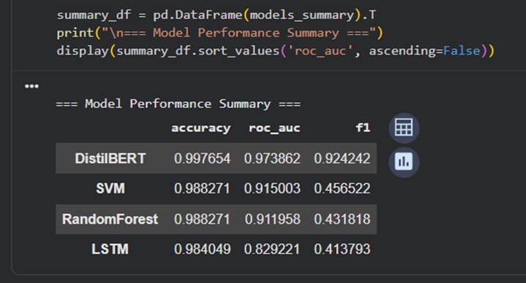
TESTING & EVALUATION (Contd…)
The model comparison summary is to be defined as an extensive evaluation of all the models, which offers the main performance measures of each model in a single table.
This allows the overall accuracy, class discrimination proficiency, and balanced performance on the minority fake news class to be clearly interpreted to make an informed and evidence-based selection of the model, as it evaluates the DistilBERT model as the most successful of all the other tested models.
It sends the best accuracy, ROC-AUC and F1-score, showing its high ability to differentiate genuine and fake news tweets.
The advantage of DistilBERT is that it is capable of establishing deep contextual and semantic relationships in a text that cannot be effectively represented in traditional machine learning models or LSTM.

Slide 30
CONCLUSION AND FUTURE WORK
Summary of Findings
Summarise the main findings and contributions
This research indicates that higher-level NLP strategies, especially the use of transformer models, especially DistilBERT, are very effective in identifying fake news on Twitter during elections.
The results indicate that conventional Machine Learning models are high-performing in the majority of real news, whereas LSTM and DistilBERT are more effective in terms of context and sequential patterns of linguistics.
The combination of linguistic, behavioral and sentiment characteristics is an important factor that enhances detection.
The study is valuable to the field of knowledge by empirically proving the effectiveness of contextual embedding’s of political misinformation detection.

Slide 31
CONCLUSION AND FUTURE WORK
Objective 1
This task is accomplished with a methodological approach to the study of the 2019 UK election dataset of Twitter data by analyzing the content of tweets, the sentiment of tweets, and the patterns of engagement.
Recurring types of misinformation are identified with the help of text preprocessing, TF-IDF features, and contextual embedding’s [55].
Classification results, confusion tables, and error analysis also assisted in classifying the common misinformation patterns, which offered empirical data on the way fake news presented and propagated at the time of the election.
Objective 2
This is accomplished by obtaining linguistic features with the help of text cleaning, tokenization, lemmatisation, TF-IDF vectors, and contextual embedding’s, and behavioral features consisted of the retweets, likes, followers, and account verification status.
The polarity and subjectivity of the sentiments are calculated using the TextBlob [56].
This is incorporated into Machine Learning and Deep Learning models, and their usefulness is assessed by the reports on classification, confusion matrixes, and ROC-AUC scores, proving their role in the correct forecast of fake news.

Slide 32
CONCLUSION AND FUTURE WORK
Objective 3
This objective is accomplished through training and deploying several Machine Learning and Deep Learning models (Random Forest, SVM, LSTM, and DistilBERT) on the processed Twitter data.
All the models are evaluated based on accuracy, precision, recall, F1-score, confusion and ROC-AUC-Curve [57].
The contrasting analysis revealed the variance in performance, which proved that deep learning, especially transformer-based models, are more accurate and showed better contextual knowledge in fake news tweet classification.
Objective 4
This objective is met through the examination of model predictions and misclassifications in various contexts of tweets such as sensational, ambiguous, and multilingual political tweets.
The analysis of error, confusion, and test cases demonstrated the differences in misinformation patterns depending on the language, engagement behavior, and the ambiguity of the situation.

Slide 33
CONCLUSION AND FUTURE WORK
Research Contributions
This study has important scholarly and practical implications to the area of fake news detection, especially in the context of social media-related misinformation of elections.
Academically, the analysis leads to the contribution of computational social science and natural language processing through an empirical comparison of the traditional Machine Learning models (Random Forest and SVM) with Deep Learning and transformer-based models (LSTM and DistilBERT) to a real-world political dataset of the 2019 General Election of the UK [58].
The results support the literature by showing that, contextual representations of language is an exceptionally better predictor of politically subtle misinformation compared to surface-level linguistic characteristics.
Another contribution of the study is the incorporation of linguistic, behavioral and sentiment features into a single analytics, which underlines the significance of multi-dimensional feature engineering in the misinformation research.
Notes:
This study methodologically suggests a powerful, end-to-end fake news detector, which could be integrated into three components, namely, data preprocessing, feature extraction, model training, evaluation, and deployment-ready prediction. Systematic assessment based on confusion matrices, ROC-AUC curves and training diagnostics provides a protocol on how to evaluate them in future studies. The research paper presents a practical prototype system that can be used to classify real and fake tweets in near real time with the score of confidence to aid in decision-making. Social media and election authorities as well as policy makers can use this system to check misinformation during elections. The understanding of behavioral and engagement patterns related to misinformation contributes to the development of specific mitigation measures, including the need to review high-risk content first. The study represents a gap between theory and practice through the translation of high-level NLP methods into practical instruments of democratic process protection.

Slide 34
CONCLUSION AND FUTURE WORK
Recommendations and Future Work
The analysis and results of the experiment outline various practical solutions that can improve the efficacy and accuracy of fake news detection in election-related social media data.
These suggestions are aimed at enhancing the quality of data, model performance, and the background knowledge of misinformation.
Human-Annotated Datasets: Expert-verified or crowdsourced labels are better than random noise offered by heuristic techniques, and make the model's training and evaluation more robust when applied in the minority fake news category.
Handling Class Imbalance: The cost-sensitive learning, focal loss, or balanced sampling help to address the issue of handling class imbalance of fake news with a higher recall and secondary to the overall classification performance of fake news.
Transformer-Based Models: It is advisable to adopt transformer models, especially “DistilBERT”, since it follows a better performance on accuracy, “F1-score”, and “ROC–AUC” metrics than conventional machine learning and recurrent models.
Notes:
Behavioural and Credibility Features: Adding user-level indicators like account verification status, follower-following ratios, and engagement behavior increase the contextual information and make it easier to decide on real and deceitful contents.
Future Work
The proposed framework demonstrates that overall, the project can be viewed as highly performing; there are multiple directions to be extended and improved. The scope extension of the existing strategy helps to increase the generalisability, transparency, and applicability in dynamic political settings. The research directions presented below indicate the main prospects of the work.
Real-Time Detection: By implementing the framework on live social media streams, one can identify misinformation in time when there is an election.
Multilingual and Cross-Election Analysis: The test on the model using a variety of languages and various types of elections enhances the strength and generalization of the observations.
Explainable Artificial Intelligence: SHAP, LIME or attention visualization are explainability methods that can increase the level of transparency and confidence in model predictions.
Multiplatform and Cross-Platform Extension: Texts can be provided with images, videos, URLs, and data across different platforms to contribute to a more detailed analysis of organised lies.

Slide 35
REFERENCES
[1] Elsaeed, E., Ouda, O., Elmogy, M.M., Atwan, A. and El-Daydamony, E., 2021. Detecting fake news in social media using voting classifier. IEEE Access, 9, pp.161909-161925.
[2] Azer, M., Taha, M., Zayed, H.H. and Gadallah, M., 2021. Credibility detection on twitter news using machine learning approach. International Journal of Intelligent Systems and Applications, 10(3), p.1.
[3] Shevtsov, A., Tzagkarakis, C., Antonakaki, D. and Ioannidis, S., 2022, May. Identification of twitter bots based on an explainable machine learning framework: The US 2020 elections case study. In Proceedings of the international AAAI conference on web and social media (Vol. 16, pp. 956-967).
[4] Mishra, S., Shukla, P. and Agarwal, R., 2022. Analyzing machine learning enabled fake news detection techniques for diversified datasets. Wireless Communications and Mobile Computing, 2022(1), p.1575365.
[5] Khanam, Z., Alwasel, B.N., Sirafi, H. and Rashid, M., 2021, March. Fake news detection using machine learning approaches. In IOP conference series: materials science and engineering (Vol. 1099, No. 1, p. 012040). IOP Publishing.
[6] Mishra, S., Shukla, P. and Agarwal, R., 2022. Analyzing machine learning enabled fake news detection techniques for diversified datasets. Wireless Communications and Mobile Computing, 2022(1), p.1575365.
Notes:
[7] Cartwright, B., Frank, R., Weir, G. and Padda, K., 2022. Detecting and responding to hostile disinformation activities on social media using machine learning and deep neural networks. Neural Computing and Applications, 34(18), pp.15141-15163.
[8] Bruno, M., Lambiotte, R. and Saracco, F., 2022. Brexit and bots: characterizing the behavior of automated accounts on Twitter during the UK election. EPJ Data Science, 11(1), p.17.
[9] Haouari, F., Scarton, C., Faggiani, N., Nikolaidis, N., Kotseva, B., Farha, I.A., Linge, J. and Bontcheva, K., 2025, June. UKElectionNarratives: A Dataset of Misleading Narratives Surrounding Recent UK General Elections. In Proceedings of the International AAAI Conference on Web and Social Media (Vol. 19, pp. 2477-2495).
[10] Munger, K., Egan, P.J., Nagler, J., Ronen, J. and Tucker, J., 2022. Political knowledge and misinformation in the era of social media: Evidence from the 2015 UK election. British Journal of Political Science, 52(1), pp.107-127.
[11] Kennedy, I., Wack, M., Beers, A., Schafer, J.S., Garcia-Camargo, I., Spiro, E.S. and Starbird, K., 2022. Repeat spreaders and election delegitimization: A comprehensive dataset of misinformation tweets from the 2020 US election. Journal of Quantitative Description: Digital Media, 2.
[12] Prajapati, A., Kumar, G. and Srivastava, M., 2024. The role of fake news in political campaigns and elections: A global perspective. International Journal for Multidisciplinary Research, 6(6), pp.1-14.
[13] Alghamdi, J., Luo, S. and Lin, Y., 2024. A comprehensive survey on machine learning approaches for fake news detection. Multimedia Tools and Applications, 83(17), pp.51009-51067.
[14] Zamir, M.T., Ullah, F., Tariq, R., Bangyal, W.H., Arif, M. and Gelbukh, A., 2024. Machine and deep learning algorithms for sentiment analysis during COVID-19: A vision to create fake news resistant society. PloS one, 19(12), p.e0315407.
[15] Momeni Rouchi, P., 2023. Fake news detection performance analysis by incorporation of sentiment analysis.
[16] Altheneyan, A. and Alhadlaq, A., 2023. Big data ML-based fake news detection using distributed learning. IEEE Access, 11, pp.29447-29463.
[17] Hasan, M., Ahmed, T., Islam, M.R. and Uddin, M.P., 2024. Leveraging textual information for social media news categorization and sentiment analysis. Plos one, 19(7), p.e0307027.
[18] Bangyal, W.H., Qasim, R., Rehman, N.U., Ahmad, Z., Dar, H., Rukhsar, L., Aman, Z. and Ahmad, J., 2021. Detection of Fake News Text Classification on COVID‐19 Using Deep Learning Approaches. Computational and mathematical methods in medicine, 2021(1), p.5514220.
[19] Ahmed, J. and Ahmed, M., 2021. Online news classification using machine learning techniques. IIUM Engineering Journal, 22(2), pp.210-225.
[20] Fayaz, M., Khan, A., Bilal, M. and Khan, S.U., 2022. Machine learning for fake news classification with optimal feature selection. Soft Computing, 26(16), pp.7763-7771.
[21] Khan, S., Anwar, M., Qayyum, H., Ali, F. and Nawaz, M., 2022. Fake news classification using machine learning: Count vectorizer and support vector machine. Journal of Computing & Biomedical Informatics, 4(01), pp.54-63.
[22] Ilie, V.I., Truică, C.O., Apostol, E.S. and Paschke, A., 2021. Context-aware misinformation detection: A benchmark of deep learning architectures using word embedding’s. IEEE access, 9, pp.162122-162146.
[23] Maretha, C., 2023. Positivism in philosophical studies. Journal of Innovation in Teaching and Instructional Media, 3(3), pp.124-138.
[24] Maksimovic, J. and Evtimov, J., 2023. Positivism and post-positivism as the basis of quantitative research in pedagogy. Research in Pedagogy, 13(1), pp.208-218.
[25] Jaja, I.R., Idoniboye, O. and Amadi, C.C., 2022. A Critique of the Positivist Paradigm in Human Sciences. International Journal of Research and Innovation in Social Science, 6(3), pp.224-229.
[26] Imoh-Ita, I., 2023. Understanding Quantitative Approach in Management Science Research, Issues and Policy Options. International Journal of Comparative Studies in International Relations and Development, 9(1), pp.1-22.
[27] Odera, D. and Odiaga, G., 2023. A comparative analysis of recurrent neural network and support vector machine for binary classification of spam short message service. World Journal of Advanced Engineering Technology and Sciences, 9(1), pp.127-152.
[28] Gamage, A.N.K.K., 2025. Research design, philosophy, and quantitative approaches in scientific research methodology. Sch J Eng Tech, 2, pp.91-103.
[29] Proudfoot, K., 2023. Inductive/deductive hybrid thematic analysis in mixed methods research. Journal of mixed methods research, 17(3), pp.308-326.
[30] Jouhar, J., Pratap, A., Tijo, N. and Mony, M., 2024. Fake news detection using python and machine learning. Procedia Computer Science, 233, pp.763-771.
[31] Bokota, G., Sroka, J., Basu, S., Das, N., Trzaskoma, P., Yushkevich, Y., Grabowska, A., Magalska, A. and Plewczynski, D., 2021. PartSeg: a tool for quantitative feature extraction from 3D microscopy images for dummies. BMC bioinformatics, 22(1), p.72.
[32] Jouhar, J., Pratap, A., Tijo, N. and Mony, M., 2024. Fake news detection using python and machine learning. Procedia Computer Science, 233, pp.763-771.
[33] Vagizov, M., Potapov, A., Konzhgoladze, K., Stepanov, S. and Martyn, I., 2021, October. Prepare and analyze taxation data using the Python Pandas library. In IOP Conference Series: Earth and Environmental Science (Vol. 876, No. 1, p. 012078). IOP Publishing.
[34] Open2C, Abdennur, N., Fudenberg, G., Flyamer, I.M., Galitsyna, A.A., Goloborodko, A., Imakaev, M. and Venev, S., 2024. Bioframe: operations on genomic intervals in Pandas dataframes. Bioinformatics, 40(2), p.btae088.
[35] Chollet, F. and Chollet, F., 2021. Deep learning with Python. simon and schuster.
[36] Yousif, M.J., 2023. Enhancing the accuracy of image classification using deep learning and preprocessing methods. Artificial Intelligence & Robotics Development Journal.
[37] Dabade, M.S., Sale, M.D., Dhokate, D.D. and Kambare, S.M., 2021. Sentiment analysis of Twitter data by using deep learning And machine learning. Turkish Journal of Computer and Mathematics Education, 12(6), pp.962-970.
[38] Sivakumar, M., Parthasarathy, S. and Padmapriya, T., 2024. Trade-off between training and testing ratio in machine learning for medical image processing. PeerJ Computer Science, 10, p.e2245.
[39] Bami, Z., Behnampour, A. and Doosti, H., 2025. A New Flexible Train-Test Split Algorithm, an approach for choosing among the Hold-out, K-fold cross-validation, and Hold-out iteration. arXiv preprint arXiv:2501.06492.
[40] Salman, H.A., Kalakech, A. and Steiti, A., 2024. Random forest algorithm overview. Babylonian Journal of Machine Learning, 2024, pp.69-79.
[41] Chollet, F. and Chollet, F., 2021. Deep learning with Python. simon and schuster.
[42] Yu, Z., 2025. Advanced Applications of Python in Market Trend Analysis Research. MODERN ECONOMICS, 6(1), p.115.
[43] Hastomo, W., Karno, A.S.B., Kalbuana, N. and Meiriki, A., 2021, June. Characteristic parameters of epoch deep learning to predict Covid-19 data in Indonesia. In Journal of Physics: Conference Series (Vol. 1933, No. 1, p. 012050). IOP Publishing.
[44] Yuan, J., 2024. Performance analysis of deep learning algorithms implemented using PyTorch in image recognition. Procedia Computer Science, 247, pp.61-69.
[45] Nigar, A., Li, Y., Jat Baloch, M.Y., Alrefaei, A.F. and Almutairi, M.H., 2024. Comparison of machine and deep learning algorithms using Google Earth Engine and Python for land classifications. Frontiers in Environmental Science, 12, p.1378443.
[46] Al-Selwi, S.M., Hassan, M.F., Abdulkadir, S.J. and Muneer, A., 2023. LSTM inefficiency in long-term dependencies regression problems. Journal of Advanced Research in Applied Sciences and Engineering Technology, 30(3), pp.16-31.
[47] Sivakumar, S. and Venkataraman, S., 2025. Evaluating Machine Learning Approaches: A Comparative Study of Random Forest and Neural Networks in Grade Classification. Indonesian Journal of Data and Science, 6(1), pp.73-80.
[48] Helmud, E., Fitriyani, F. and Romadiana, P., 2024. Classification comparison performance of supervised machine learning random forest and decision tree algorithms using confusion matrix. Jurnal Sisfokom (Sistem Informasi dan Komputer), 13(1), pp.92-97.
[49] Wang, P., Fan, E. and Wang, P., 2021. Comparative analysis of image classification algorithms based on traditional machine learning and deep learning. Pattern recognition letters, 141, pp.61-67.
[50] Agustyaningrum, C.I., Haris, M., Aryanti, R. and Misriati, T., 2021. Online shopper intention analysis using conventional machine learning and deep neural network classification algorithm. Jurnal Penelitian Pos dan Informatika, 11(1), pp.89-100.
[51] Yechuri, P.K. and Ramadass, S., 2021. Classification of Image and Text Data Using Deep Learning-Based LSTM Model. Traitement du Signal, 38(6).
[52] Garrido-Merchan, E.C., Gozalo-Brizuela, R. and Gonzalez-Carvajal, S., 2023. Comparing BERT against traditional machine learning models in text classification. Journal of Computational and Cognitive Engineering, 2(4), pp.352-356.
[53] Padalko, H., Chomko, V., Yakovlev, S. and Chumachenko, D., 2023. Ensemble machine learning approaches for fake news classification. Radioelectronic and Computer Systems, (4), pp.5-19.
[54] Dogra, V., Verma, S., Verma, K., Jhanjhi, N.Z., Ghosh, U. and Le, D.N., 2022. A comparative analysis of machine learning models for banking news extraction by multiclass classification with imbalanced datasets of financial news: Challenges and solutions. International Journal of Interactive Multimedia and Artificial Intelligence, 7(3), pp.35-52.
[55] Cao, P., Shukla, P.K., Shukla, P.K., Bhatia Khan, S., Alojail, M. and Ramtiyal, B., 2025. Enhancing fake news detection for Sustainable Supply Chain Management using DistilBERT-based multi-stacked LSTM approach. Enterprise Information Systems, 19(9), p.2538023.
[56] Aslam, Z., Missen, M.M.S., Ghaffar, A.A., Mehmood, A., Villar, M.G., Alvarado, E.S. and Ashraf, I., 2025. Advancing fake news combating using machine learning: a hybrid model approach. Knowledge and Information Systems, 67(12), pp.12137-12177.
[57] Chen, Y. and Yin, B., 2025. Transformer-Based Fake News Classification: Evaluation of DistilBERT With CNN-LSTM and GloVe Embedding. Informatica, 49(25).
[58] Ishraquzzaman, M., Islam Chowdhury, M.A., Rahman, S. and Khan, R., 2025. Ensemble Transformer–Based Detection of Fake and AI–Generated News. Applied Computational Intelligence and Soft Computing, 2025(1), p.3268456.
[59] Aesanetwork.org, 2020, Blog 132-Research Onion: A Systematic Approach to Designing Research Methodology, Accessed from: https://aesanetwork.org/research-onion-a-systematic-approach-to-designing-research-methodology/, Accessed on: 10-12-2025
[60] Kharis, M. and Pairin, U., 2021, December. How to Lemmatize German Words with NLP-Spacy Lemmatizer?. In International Seminar on Language, Education, and Culture (ISoLEC 2021) (pp. 189-193). Atlantis Press.

Slide 36
THANK YOU

