Slide 1
BSc (Hons) Cloud Computing
Module Code : ACCA5019 – Business and Web Management
Week 01 : Introduction to Business Environment & Business Function
Dr Mobolanle Bello

Slide 2
OVERVIEW OF THE MODULE

Slide 3
Know Your Module
Title – Business and Web Management
Module code – ACCA5019
Credits - 20 (Level 5)

Slide 4
Module Content
Through task-based study, you will explore the following topics (to varying degrees):
Strategy
Business environment
Business functions
Leadership & management
Structure & culture
Motivation
Business Information Systems
Cloud Computing concepts
Web design & online branding
Web Usability Guidelines and Accessibility principles
Online Marketing & Analytics
E-Commerce solutions
Professional legal and ethical issues: security, privacy, usability, accessibility

Slide 5
Aims and Learning Outcomes
AIM(S)
To enable the student to gain a broad understanding of Business & IT Management concepts, techniques and methods used within organisations today including the role of the contemporary manager in the realisation of individual and organisational potential through stakeholder relationships.
LEARNING OUTCOMES
Upon the successful completion of this module, the student should be able to:
Demonstrate a sound understanding of the principal forms of business strategy and the environment, leadership & management, motivation and business information systems.
Understand and apply essential concepts techniques and applications required to design and create a professional online presence for a business.

Slide 6
Assessment
Component 1
Website Redesign
Report (2000 words)
Component 2
E-Portfolio
Presentation (15 mins)

Slide 7
Assessment Summary
Assessment | Percentage
Component 1 | 50%
Component 2 | 50%
Total | 100%

Slide 8
Study Time Allocation
Activity Type | Hours | Percentage
Scheduled learning | 48 | 24%
Independent learning | 152 | 76%
Placement Learning | 0 | 0%
Total | 200 | 100%

Slide 9
Today’s Session
Session 1 – Business Environment and Business Function
Session 2 – Organisation Structures
Session 3 – Organisation Culture, Role of Management, Leadership Style and Stakeholder Relationship

Slide 10
SESSION 1

Slide 11
Session 1
Business Environment
Business Function

Slide 12
BUSINESS & ENVIRONMENT
Business can be seen as a specific activity e.g. a retail business in which a company is making use of the internet and social media for marketing of their products.
Business environment is a combination of dynamic, complex, and uncontrollable external factors within which a business is to be operated.
Business organisations interact and transact with the business environment.
Therefore business organisation and business environment are directly related. The business environment influences the scope and direction of business activity.

Slide 13
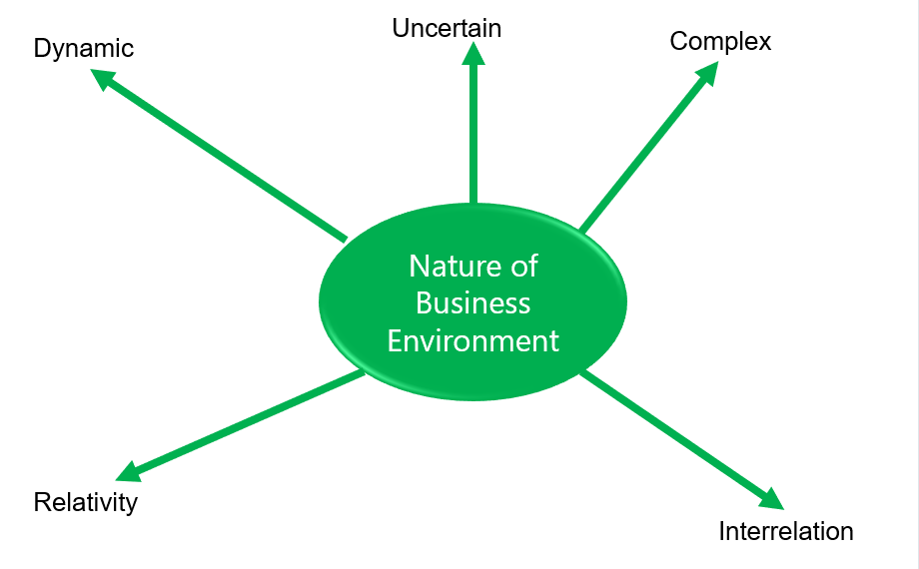
Nature of Business Environment
Every organisation operates in a certain kind of environment. Each organisation has some opportunities and threats associated with various forces which may be external or internal in nature.

Slide 14
Nature of Business Environment
1. Dynamic: Business environments such as internal and external business environments are highly flexible and keep on changing. For example, changing customer preferences, new competitors entering the market, novel technology, new marketing channels, new government policies and changing demography.
2. Uncertain: It is very difficult to pre-assume with any degree of certainty about the factors influencing the business environment because they continue to fluctuate very quickly.

Slide 15
Nature of Business Environment
3. Complex: The business environment is complex as it is continuously exposed to uncertain challenges such as technological disruptions, global competition, leadership change, shifting economic, social, and regulatory conditions etc. It may be easy to scan the environment but its impact on business decisions will be difficult to estimate. It is very difficult for a firm to survive and prosper in such an uncertain environment.
4. Relativity: The business environment is associated with societal norms and local conditions, and this is the reason, why the business environment varies from country to country, region to region which makes it more complex.

Slide 16
Nature of Business Environment
5. Interrelation: All the factors and forces of the business environment are related to each other. For example, change in political parties will result in changing monetary policy, fiscal policies, government rules, market conditions, technology, etc. Thus, all these factors are required to be scanned properly as these factors are interrelated to each other.

Slide 17
TYPES OF BUSINESS ENVIRONMENT
There are certain factors or forces internal and external to the organisation influencing it in both positive and negative ways.
These different components of the business environment have been explained below as shown in Figure below.

Slide 18
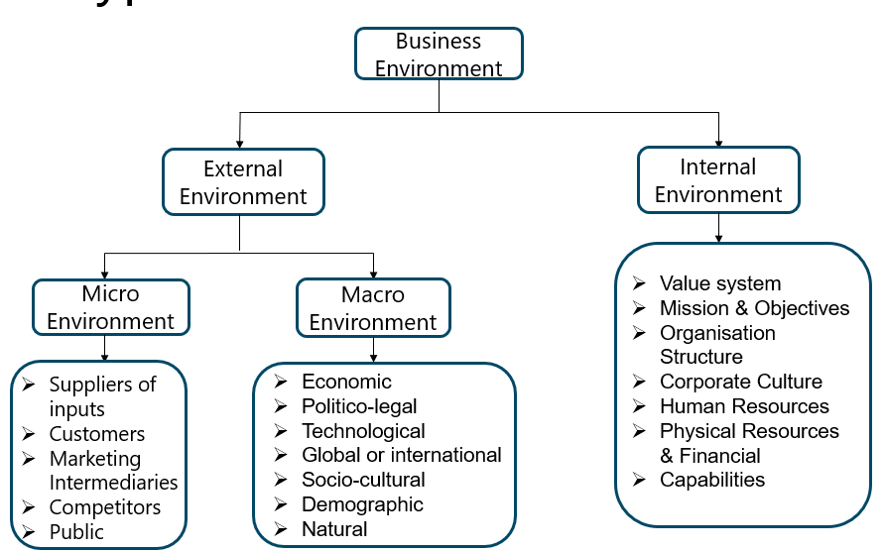
Types Of Business Environment

Slide 19
Types Of Business Environment
1. Internal Environment
This includes those factors or forces that exist within an organisation influencing the performance of an organisation. These factors are controllable in nature and organisations can attempt to change or modify these factors. Organisation’s resources like men, materials, money, and machines are part of the internal environment.
The different internal factors are given below:
Values
Mission and objectives
Organisation structure
Culture
Human resources
Physical resources and financial capabilities

Slide 20
Types Of Business Environment
i. Values: The values are defined as ethical beliefs that guide the organisation in attaining its mission and objectives. These are formulated by top-level managers such as the board of directors. The extent to which these value systems are shared by all in the organisation is a significant factor leading to its success.
ii. Mission and objectives: Mission reflects the overall purpose or reason for organisation’s existence. A mission guides and affects the decisions and economic activities of the organisation. Accordingly, an organisation can change or modify its mission and objectives.

Slide 21
Types Of Business Environment
iii. Organisation structure: The organisational structure is the hierarchical relationship explaining roles, responsibilities and supervision. The structure of the board of directors, the professionalism of management, etc., are the part of the organisation structure and are significant forces affecting business decisions. For effective management and working of a business organisation and for prompt decision making, the structure of the organisation should be conducive.
iv. Culture: Shared values and belief in an organisation determine its internal environment also known as corporate culture. Organisation having strict supervision and control reflects the lack of flexibility and unsatisfied employees. These sets of values assist the employees to understand what organisation stands for, what it considers, how it works. Cultural values of business, thus determine the direction of activities.

Slide 22
Types Of Business Environment
v. Human resources: Human quality of a firm is an important factor of internal environment. Skills, qualities, capabilities, attitude, competencies and commitment of its employees, etc., contribute to the strengths and weaknesses of an organisation. Organisations may find it difficult to carry out modernisation and redesigning because of resistance by its employees.
vi. Physical resources and financial capabilities: Physical resources, like machinery, plant and equipment facilities and financial capabilities of a firm decides its competitive strength which is the significant factor for examining its efficiency and unit cost of production. Moreover, research and development capabilities of a company decides its ability to innovate and thus increase the productivity of workers.

Slide 23
Types Of Business Environment
2. External Environment
This includes those factors or forces that exist outside an organisation influencing the performance of an organisation.
These external factors can be further classified into micro-environment and macro-environment which are defined below.

Slide 24
Types Of Business Environment
A. Micro-Environment:
Those factors have a direct impact on business. The different components of micro-environment are as follows:
Suppliers of inputs
Customers
Marketing intermediaries
Competitors
Public

Slide 25
Types Of Business Environment
i. Suppliers of inputs: The suppliers of inputs are a significant constituent of the external microenvironment of an organisation. Suppliers give raw materials and resources to the firm. A firm should have more than one supplier for efficient input inflows.
ii. Customers: Customers are the buyers of the firm's products and services. Customers are an important part of the external micro-environment as a firm’s survival and growth are dependent on sales of a product or service. Thus, it is essential to keep the customers satisfied.

Slide 26
Types Of Business Environment
iii. Marketing intermediaries: Intermediaries play an essential role in selling and distributing products to the final customers. Marketing intermediaries are an important link between a business firm and its ultimate customers. Retailers and wholesalers buy in bulk and sell business products and services to the ultimate consumer.
iv. Competitors: Competitors are the rivalry in business influencing the business strategies of the organisation. For example, Zomato and Swiggy are major competitors in food delivery business and their strategies impact each other.
v. Public: Public or groups, such as media groups, women’s associations, environmentalists, consumer protection groups, are significant factors in the external micro-environment. The public can be defined as any group affecting a company's ability to achieve its objectives.

Slide 27
Types Of Business Environment
B. Macro Environment:
These are the factors or conditions which are general to all businesses and are uncontrollable. Because of the uncontrollable nature of macro forces, a firm needs to adjust or adapt itself to these external forces. These factors are as follows:
Economic Environment
Political-legal environment
Technological environment
Global or international environment
Socio-cultural environment
Demographic environment
National environment

Slide 28
Types Of Business Environment
i. Economic environment: Economic environment refers to all those forces and factors which have an economic impact on businesses. It consists of the role of the private and public sector, monetary and fiscal policy, role of saving and investment, economic reforms, agriculture, industrial production, infrastructure, planning, basic economic philosophy, stages of economic development, trade cycles, national income, per capita income, money supply, international debt, etc. For example, an increase in Groos Domestic Product (GDP) will increase disposable income and thus further rise in demand for products.
ii. Politico-legal environment: Politico-legal environment constitutes all the factors related to the activities of legislature, executive and judiciary which play a leading role in shaping, directing, developing and controlling business activities. Higher business growth can be achieved in a stable and dynamic politico-legal environment.

Slide 29
Types Of Business Environment
iii. Technological environment: Technology is defined as the “Systematic application of scientific or other organised knowledge to particular tasks”. The technology incorporates both machines (hard technology) and ways of thinking (soft technology). These organized knowledge and innovation provide new methods of producing goods and services and latest ways of operating business. Recent technological changes such as the online sale of grocery items, online booking of air tickets, online payments, etc. have changed the business strategies. As technology is changing fast, organisations should keep a close look at these technological fluctuations for their adaptation in their business activities.

Slide 30
Types Of Business Environment
iv. Global or international environment: The global environment includes all environmental factors having a global impact which is also important for shaping business activity. In the era of globalisation, the whole world is a market. Business analyses the international environment to cope with the changes. Principles and agreements of the World Trade Organisation (WTO) and other international treaties and protocols such as crude oil prices are examples of the global environment.
v. Socio-cultural environment: The socio-cultural environment reflects customs and values which influence business practices. People’s attitudes towards work and wealth, lifestyle, ethical issues, religion, the role of family, marriage, education and also social responsiveness of business impact the business.

Slide 31
Types Of Business Environment
vi. Demographic environment: Demographic environment includes the composition and characteristics of the population. For example, Population size and growth, the life expectancy of the people, rural-urban distribution of population, the technological skills and educational levels of the labour force are part of the demographic environment. These forces also impact the organisations’ functioning.
vii. Natural environment: Natural environment includes geographical and ecological resources like minerals and oil reserves, weather and climatic conditions, water and forest resources, and port facilities. These are very important for many business activities. For example, in places where climate conditions such as temperatures are high, demand for coolers and air conditioners will also be high. Similarly, demand for clothes and building materials is also conditioned upon weather and climatic conditions. Natural calamities such as floods, droughts, earthquakes, etc. greatly affect business activities.

Slide 32
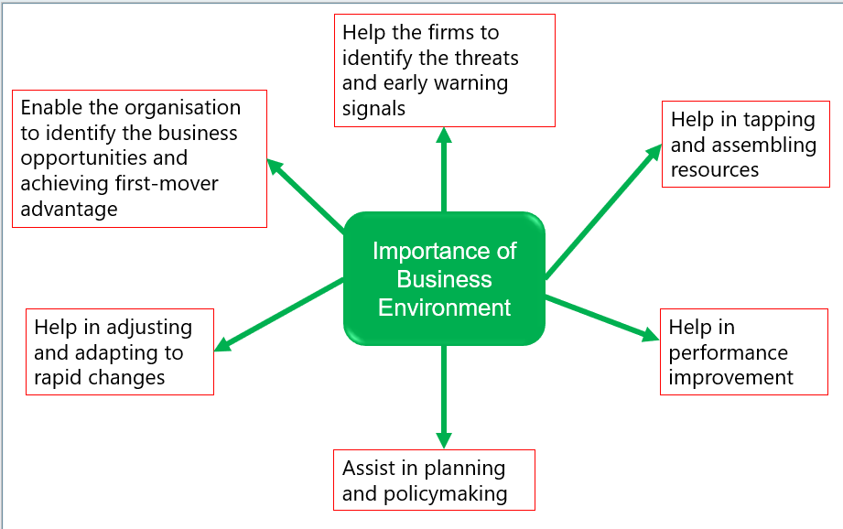
IMPORTANCE OF BUSINESS ENVIRONMENT
Business environment plays an important role in the functioning of organisations in the following ways:

Slide 33
IMPORTANCE OF BUSINESS ENVIRONMENT
I. Enable the organisation to identify the business opportunities and achieve first-mover advantage: Many opportunities are provided by the business environment to the organisation. Scanning the business environment will help the organisation to attain the first-mover advantage.
II. Help the firms to identify the threats and early warning signals: The business Enterprises that can scan the business environment and obtain qualitative information on time will be able to get a warning signal to deal with negative policies and constraints of the business environment.

Slide 34
Importance Of Business Environment
III. Help in tapping and assembling resources: Resources such as raw material, capital, money, labour, etc., are the necessary inputs to the business organisation. All these inputs are obtained through the environment to the firms for carrying out their activities and also expect something in return.
IV. Help in adjusting and adapting to rapid changes: Business environment scanning assists the firms in scanning and understanding the rapid changes in the environment and these changes have important implications on business strategies.

Slide 35
Importance Of Business Environment
V. Assist in planning and policymaking: The major strategic plans and policies in the organisation are formulated based on the business environment because the policies and strategies have to be implemented in the presence of these environmental factors.
VI. Help in performance improvement: Continuous scanning of business environments can improve their performance. By incorporating changes in the internal environment matching to external environment, business organisations can enhance and prosper in their market share.

Slide 36
BUSINESS ENVIRONMENT ANALYSIS
All organisations perform within a framework of specific factors of the business environment.
These can be internal as well as external.
A proper environmental analysis of the business environment is very important.

Slide 37
Business Environment Analysis
There are different steps involved in the environmental analysis of a business. These are:
1. Scanning the internal / external factors.
2. Grouping of the scanned factors.
3. Observation of internal factors.
4. Monitoring external factors.
5. Defining the variables for the analysis.
6. Identifying specific techniques for analysis.
7. Forecasting.
8. Strategy formulation.
9. Evaluation.

Slide 38
Tools for Analysing Business Environment
SWOT Analysis
PESTEL Analysis
Porter's Five Forces
By understanding and analysing the business environment comprehensively, organizations can make informed decisions, develop effective strategies, and navigate the complexities of the market landscape.

Slide 39
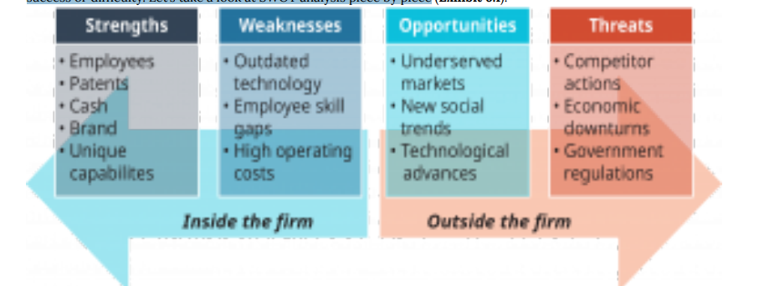
SWOT Analysis
You may already have heard of one very common tool firms use to analyse their strategic and competitive situations: SWOT, which is an acronym for strengths, weaknesses, opportunities, and threats.
Firms use SWOT analysis to get a general understanding of what they are good or bad at and what factors outside their doors might present chances for success or difficulty.

Slide 40
SWOT Analysis
Strengths
A firm's strengths are its unique strengths, such as marketing sports products, making food quickly and inexpensively, or creating beautiful cars. Analysing these strengths helps firms make plans that exploit their capabilities, such as Nike's sports marketing expertise for expanding its business into new sports.
Weaknesses
A firm's weaknesses are areas it lacks the skills or assets to excel in. They are not faults, but rather gaps in capabilities. SWOT analysis helps firms identify these gaps and develop solutions. For instance, Paychex handles payroll for over 600,000 firms, focusing on efficiency and accuracy. By leveraging its strengths, Paychex can provide services to other companies that may not have the resources or interest to develop these capabilities.

Slide 41
SWOT Analysis
Opportunities
Opportunities and threats are external to an organisation, while strengths and weaknesses are internal. Opportunities are potential situations a firm can capitalise on, while threats can arise if not fully capitalised upon. For instance, Daimler, a car manufacturer, introduced Car2Go, a car-sharing service in Europe, North America, and China, catering to part-time drivers who may not purchase their products outright.
Threats
A manager assesses the external competitive environment to identify threats that could hinder a firm's success. These threats can range from economic downturns to competitors launching better products. A thorough threat assessment helps a firm prepare for potential threats. Opportunities and threats can also be interpreted differently, such as Daimler's Car2Go service, which aimed to address declining car ownership among young urban professionals.

Slide 42
Limitation of SWOT Analysis
Although a SWOT analysis can identify important factors and situations that affect a firm, it only works as well as the person doing the analysis.
SWOT can generate a good evaluation of the firm’s internal and external environments, but it is more likely to overlook key issues because it is difficult to identify or imagine everything that could, for example, be a threat to the firm.

Slide 43
PESTEL
PESTEL is a tool for managers to analyse macro-environment categories like political, economic, sociocultural, technological, environmental, and legal factors.
It can reveal multiple impacts from a single element, such as declining car ownership among urban millennials due to sociocultural trends, or the technological connectedness of urban millennials, which allows ride-sharing services like Uber and Lyft to thrive due to their app-based and cashless transactions.

Slide 44
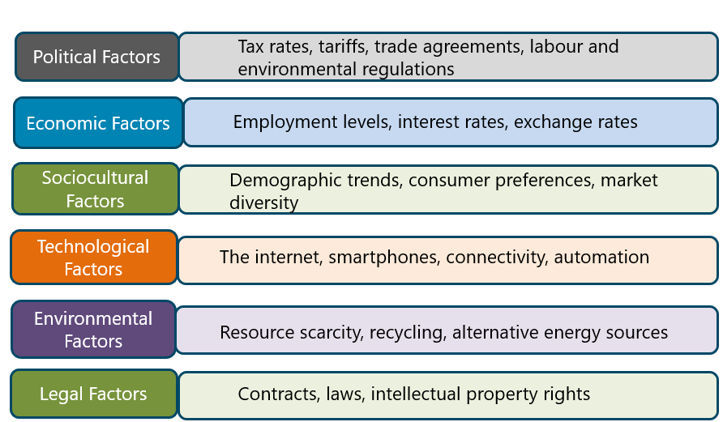
PESTEL

Slide 45
PESTEL
Political Factors
Political factors in the macro environment, such as taxation, tariffs, trade agreements, labour regulations, and environmental regulations, can either create opportunities or reduce threats for firms.
For example, American Electric Power may face negative impacts from environmental regulations, while NRG and JX Nippon developed the Petra Nova plant to capture coal emissions.
Despite not directly making government policy decisions, firms invest in lobbying efforts.

Slide 46
PESTEL
Economic Factors
Economic factors significantly impact firms, influencing decisions about market entry, expansion, and employee hiring.
Employment rates, interest rates, exchange rates, and oil prices affect various industries, making macro environment evaluations more complex.
Firms must consider these factors when making decisions about entering or exiting markets, investing in expansion, or hiring or laying off employees.

Slide 47
PESTEL
Sociocultural Factors
Sociocultural factors, including demographics, values, and interests, are the largest category of macro-environmental factors.
These factors include changing national demographics, fashion trends, income, education levels, age groups, and ethnic and racial composition.
Firms can target specific market segments by studying their needs and preferences.
Changes in values and interests, such as environmental awareness, health and fitness, and social media, create new market opportunities and communication challenges for companies entering unfamiliar markets.

Slide 48
PESTEL
Technological Factors
The Internet has revolutionised global communication, enabling faster, low-cost interactions and interconnectedness.
It has enabled entrepreneurs to reach customers globally through platforms like eBay, Alibaba, Etsy, and PayPal.
The internet has also transformed consumer shopping, business operations, and information access.
Automation has increased efficiency, MRP systems have improved collaboration, and global-positioning technology has improved project management.
This unprecedented access to information has empowered consumers and challenged businesses to analyse large amounts of data.

Slide 49
PESTEL
Environmental Factors
Environmental factors are increasingly impacting businesses as resources become scarce and expensive.
As businesses develop clean technologies and face political pressure to reduce their impact, they are developing eco-friendly practices.
This external environment category overlaps with PESTEL, as environmental concerns are also a sociocultural trend.
Political regulation on carbon emissions and natural resource use is also affecting businesses.

Slide 50
PESTEL
Legal Factors
Legal factors in the external environment often overlap with political factors, as laws are enacted by government entities.
However, other legal factors can impact business success, such as licensing fees in the streaming video industry and intellectual property rights and patents.
PESTEL can be difficult to categorise external factors, such as tariffs and internet influence, but its value as an analytical tool remains intact.

Slide 51
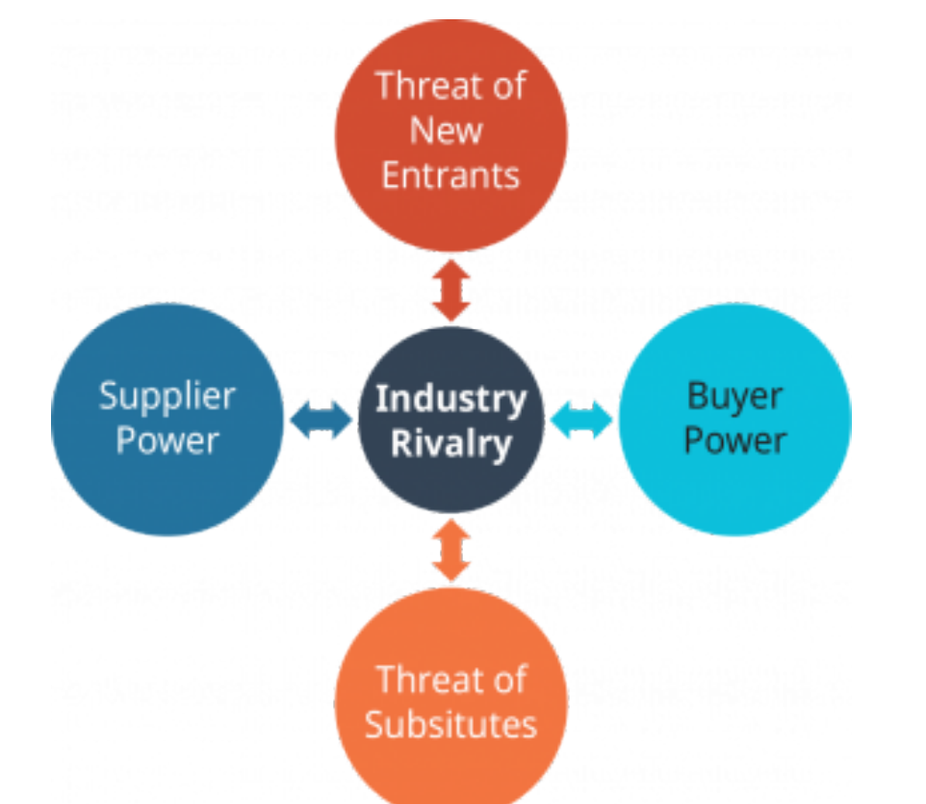
Porter’s Five Forces
This is used to analyse industry competition, bargaining power of buyers and suppliers, threat of substitutes, and threat of new entrants.

Slide 52
Porter’s Five Forces
Industry Rivalry
Industry rivalry, the first of Porter’s forces, is in the centre of the diagram. The diagram illustrates Porter's forces, with industry rivalry at the centre.
It shows two-way relationships between rivalry and other forces, affecting how firms compete to gain customers, establish supplier relationships, and defend against new firms.
The strength of rivalry affects firms' profit potential, with strong rivalry reducing profit potential.
Conversely, weak rivalry results in more customers and loyalty to firms that meet specific needs, resulting in a more balanced industry.

Slide 53
Porter’s Five Forces
The Threat of New Entrants
Industry competition can be influenced by barriers to entry, such as cost, brand loyalty, and industry growth.
In industries with growing markets or profitable businesses, new entrants may be attracted by existing firms or firms from other industries.
Barriers to entry can be external, such as lobbying politicians for regulations.
For instance, the airline industry faces challenges due to high costs for equipment, expertise, and landing rights.
Brand loyalty can also hinder new entrants. Industry growth can also influence the chances of new entrants succeeding.

Slide 54
Porter’s Five Forces
Threat of Substitutes
Porter's model defines substitutes as products or services that meet the same customer needs as an industry's offerings.
They are not rivals, who offer similar products or services.
For instance, in the fast food industry, McDonald's faces competition from grocery stores, but they can defend themselves by offering convenient, prepared food.
This approach allows customers to choose between McDonald's and Kroger, ensuring they meet their needs without having to leave their cars.

Slide 55
Porter’s Five Forces
Supplier Power
Supplier power refers to the balance of power between firms and their suppliers in an industry.
Suppliers can have the upper hand if they offer specialized products or control rare resources.
For example, Sony works with a single supplier for advanced processor chips, indicating power.
Commodity suppliers have low power, offering many options for better price or quality.

Slide 56
Porter’s Five Forces
Buyer Power
Porter's forces emphasise the balance of power between a firm and its customers.
Firms can charge premium prices for unique products while offering better prices or value for money attracting customers from multiple sources.
Switching costs protect firms from buyer power, which can be financial or practical.
For example, switching to a non-Apple smartphone would be costly, but the loss of compatibility, app transfer, and favourite features keeps many loyal to their current device.

Slide 57
BUSINESS FUNCTION
Business functions: Activities specific to a functional area of operation.
All functional areas must link together to achieve the overall aims and objectives.
This means cooperation and good communications

Slide 58
Functional Areas of Operation
These include :
Human Resources
Accounting and Finance (A/F)
Administration and IT Support
Operation
Marketing and Sales (M/S)
Customer Service
Research and Development

Slide 59
Functional Areas of Operation
Human Resource
The main responsibilities of HR function include:
Health and Safety
Recruitment, Retention and Dismissal
Working Conditions
Employee Organisations and Unions
Training, Development and Promotion

Slide 60
Functional Areas of Operation
Finance
Concerned with money and future plans
Preparing accounts eg invoices, management accounts, financial accounts for shareholders and Inland Revenue
Preparing wages and salaries
Obtaining capital and resources eg money for expansion or to pay for resources such as equipment and materials

Slide 61
Functional Areas of Operation
Administration and IT Support
The roles of administration and ICT support include:
Cleaning and maintenance
Clerical work eg mail, record keeping
Health and Safety
Support for software applications, electronic communications and electronic transactions
Security

Slide 62
Functional Areas of Operation
Operations
Concerned with the main business activities
Obtains and convert resources of the business into goods/services , ie
Buildings and land
Equipment
People
Materials

Slide 63
Functional Areas of Operation
Marketing and Sales
Boths are concerned with the customer needs.
Activities include:
Market Research
Sales
Promotion

Slide 64
Functional Areas of Operation
Customer Service
Concerned with customer relationships
Activities include :
Providing information
Giving advice
Providing credit facilities
Delivering goods
Providing after-sales service

Slide 65
Functional Areas of Operation
Research and Development
Concerned with developing new goods/services and updating old ones
Activities include:
Technological developments
Scientific research
Design features
Performance of product

Slide 66
Business Function
The use of IT
Relates to all functional areas :
Electronic communications eg email
Data sharing eg databases
Security systems eg virus protection
External communications eg internet
Online support for customer eg order tracking
Electronic transactions eg EFT

Slide 67
Business Function
Functional Variations
No two businesses are the same!
Functions will vary because of:
Size and scale of business
Activities of business
Type(s) of customers
Needs of customers
Preference of owner(s)

Slide 68
Questions & Answers

Slide 69
References
Mullins, L. J. (2019) (12th Ed.) Management & Organisational Behaviour. Pearson.
Chaffey, D. & Smith, P. R. (2017) (5th Ed.) Digital Marketing Excellence: Planning, Optimizing and Integrating Online Marketing. Routledge.
Piccoli, G. & Pigni, F. (2016) (3rd Ed.) Information Systems for Managers: Text and Cases. Hoboken. Prospect Press.

