Slide 1
LCMB7000
Human Resource Management
Week 5
Selecting New Employees

Slide 2
The Selection Process
Selection Process: Process of choosing the best qualified applicant for a job.
Focus on Fit
  Firms should always seek to hire the most highly skilled employees to maximize their output.
  The selection process is very critical to the organization.

Slide 3
The Importance of the Selection Process
Bad Hires. . .
  Cost time and money
  Result in lower productivity
  Can be negligent hires

Slide 4
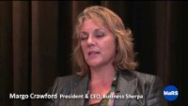
Recruitment and Selection Strategies: 5 Hot Tips
https://www.youtube.com/watch?v=hS4OtKM0PZU

Slide 5
Negligent Hire
A legal concept that says if the organization hires someone who may pose a danger to coworkers, customers, suppliers, or other third parties, and if that person then harms someone else in the course of working for the company, then the company can be held liable for the individual’s actions.

Slide 6
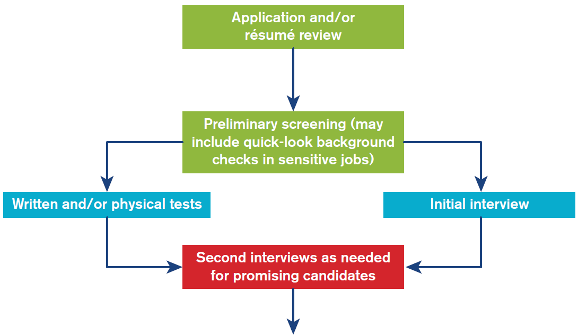
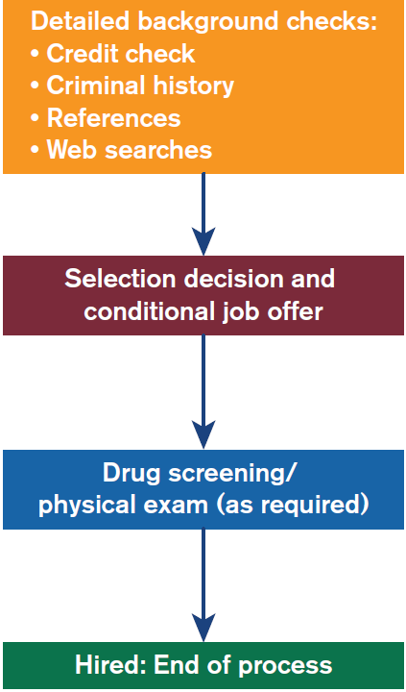
Steps in the Selection Process
Depending on organizational circumstances, steps may not be followed sequentially, or some parts may not be included.

Slide 7
Looking for Fit
Personality–Job Fit: Personality affects how people work
Ability–Job Fit: Physical and intellectual skills affect how people work
Person–Organization Fit: How individuals fit within the structure and how culture affects how they work

Slide 8
Uniform Guidelines on Employee Selection Procedure
Uniform Guidelines on Employee Selection Procedures (UGESP or “Uniform Guidelines”) were developed by the government to guide employers.
They comply with federal laws that concern employment decisions.
They provide information that avoids discriminatory hiring practices and discrimination in other employment decisions.

Slide 9
What Qualifies as an “Employment Test?”
Employment Test: Any test or selection procedure that is used as a basis for employment decisions.
Employment Decisions
    Hiring and training
    Promotion and demotion
    Membership
    Referral and retention
    Licensing and certification
    Transfer

Slide 10
Valid and Reliable Measures
To be nondiscriminatory, employment tests must have validity and reliability.
Validity is the extent to which a test measures what it claims to measure
  Criterion-related validity
  Content validity
  Construct validity
Reliability is the consistency of a test measure.

Slide 11
Applications and Preliminary Screening
Applications and Résumés
  Applicants’ information is compared to job specifications. This weeds out unqualified applicants and finds the best applicants.
  Information is verified to detect fictitious or misleading information and to protect organizations against negligent hiring claims.

Slide 12
Pre-Employment Inquiries
Information requested on job applications and during interviews must be nondiscriminatory.
Every question should be job related.
Questions of a general nature should be asked of all applicants.
Questions that may be construed as discriminatory can be asked if employers can demonstrate they are job related (BFOQs).

Slide 13
Pre-Employment Inquiries
Topic | Generally Acceptable | Generally Unacceptable or Risky
Name | Current legal name and whether the candidate has ever worked under a different name | Maiden name or whether the person has ever changed their name
Address | Current residence | Whether the candidate owns or rents their home
Age | Only whether the candidate’s age is within a certain range (if required for a particular job); for example, an employee may need to be 21 to serve alcoholic beverages | How old are you? What is your date of birth? Can you provide a birth certificate? How much longer do you plan to work before retiring?
Sex | Candidate to indicate sex on an application only if sex is a BFOQ | Candidate’s sexual preference, orientation, or gender identity
Marital and Family Status | None | Specific questions about marital status or any question regarding children or other family issues
National Origin, Citizenship, or Race | Whether the candidate is legally eligible to work in the United States, and whether the candidate can provide proof of status if hired | Specific questions about national origin, citizenship, or race

Slide 14
Pre-Employment Inquiries (Continued)
Topic | Generally Acceptable | Generally Unacceptable or Risky
Language | What languages the candidate speaks and/or writes; can ask candidate to identify specific language(s) if these are BFOQs | What language the candidate speaks when not on the job or how the candidate learned the language
Criminal Record | Whether the candidate has been convicted of a felony; if the answer is yes, can ask other information about the conviction if the conviction is job related | Whether the candidate has ever been arrested (an arrest does not prove guilt) or charged with a crime
Height and Weight | Generally none unless a BFOQ | Candidate’s height or weight if these are not BFOQs
Religion | None unless a BFOQ | Candidate’s religious preference, affiliation, or denomination if not a BFOQ
Education and Work Experience | Academic degrees or other professional credentials if information is job related | For information that is not job related

Slide 15
Pre-Employment Inquiries (Continued)
Topic | Generally Acceptable | Generally Unacceptable or Risky
References | Names of people who can verify applicant’s training and experience | A reference from a religious leader
Military Record | Information about candidate’s military service | Dates and conditions of discharge from the military; draft classification; National Guard or reserve unit of candidate
Organizations | About membership in job-related organizations, such as unions or professional or trade associations | About membership in any non-job-related organization
Disabilities | Are you capable of performing the essential tasks of the job with or without any accommodation? | General questions about disabilities or medical condition
Past Salary/Pay | For determining prior employments | How much the candidate was paid on the job

Slide 16
Testing and Legal Issues
If the EEOC investigates a complaint about an employment test being discriminatory, the company must prove the selection procedure is valid for that particular job.

Slide 17
Written Testing
Skills Tests: Measure ability to apply a particular knowledge set
Personality Tests: Measure psychological traits or characteristics to determine suitability for a specific job
Interest Tests: Measure intellectual curiosity and motivation in a particular field
Cognitive Ability Tests: Assess intelligence or aptitude for a particular job
Honesty/Integrity Tests: Can be written or use a polygraph

Slide 18
Physical Testing (1 of 2)
Physical Testing: To ensure applicants are capable of performing jobs as defined by job specifications and descriptions.
Physical Skills Tests
  Work samples
  Assessment centers
  Simulations

Slide 19
Physical Testing (2 of 2)
Physical Exams: Should be directly related to job functions
Drug Testing: For workplace safety and productivity; must be either “random” or “universal”
Fitness-for-Duty Testing: Test whether an employee is physically capable at a particular point in time of performing a specific type of work

Slide 20
Selection Interviews
Interviews are generally the most heavily weighted and one of the last steps.
Allow candidates to learn about the job and organization
Allow managers to assess factors about a candidate that cannot be obtained from other tests and to check accuracy of the application/résumé

Slide 21
Types of Interviews
Structured Interview
  Candidates are asked the same questions.
Semistructured Interview
  Interviewer follows list of questions, but also asks unplanned questions.
Unstructured Interview
  Interviewer has no preplanned questions or sequence of topics.
  The most susceptible to discrimination claims because it introduces the most interviewer bias.

Slide 22
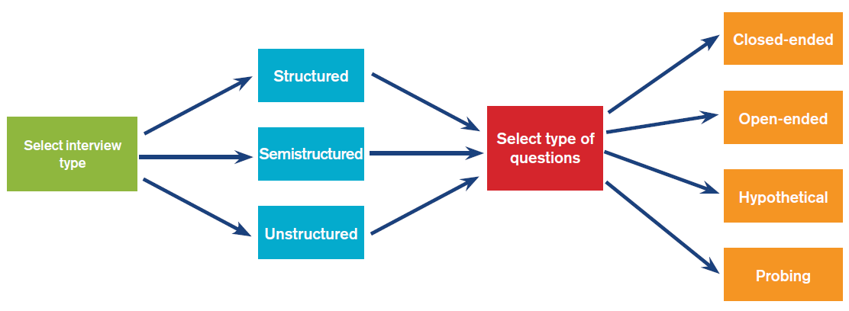
Types of Interviews and Questions

Slide 23
Types of Interviews and Questions: Common Interview Questions (Selected)
How would you describe yourself?
What do you consider to be your greatest strengths and weaknesses?
What would your last boss say about your work performance?
What motivates you to go the extra mile on a project or job?
What skills do you have?
What makes you qualified for this position?
How do you work under pressure?
What can you tell us about our company?
What do you see yourself doing 5 years from now?

Slide 24
Types of Questions
Closed-Ended: Requires a limited response (e.g., yes/no); appropriate for fixed aspects of the job
Open-Ended: Requires a detailed response; appropriate for determining abilities and motivation
Hypothetical: Requires candidates to describe what they’d do and say in a given situation; appropriate in assessing capabilities
Probing: Requests clarification; appropriate for improving interviewer’s understanding

Slide 25
Interview Preparation Steps
Interviewing Steps

Slide 26
Background Checks
Background Checks
  Prevent negligent hiring
Types
  Credit checks
  Criminal background checks
  Reference checks
  Social Media and Web searches

Slide 27

Apple’s Employee Recruiting
https://www.youtube.com/watch?v=X9SK052cF3c

Slide 28
Selecting the Candidate and Offering the Job
Multiple-Hurdle Selection Model
  Requires applicants pass a selection test to go to the next test.
  Cost-effective because unqualified applicants stop taking further tests.
Compensatory Selection Model
  Allows applicants to perform poorly on one test, but make up for that poor score by doing well on other tests or interviews.

Slide 29
Hiring
Compare candidates’ qualifications and consider diversity
Identify if candidates truly desire the job and are honest
Assess person–organization fit via coworkers’ impressions
Contact the best candidate and offer the job
If candidate refuses or accepts but soon leaves, offer job to next-best candidate

Slide 30
Trends and Issues in HRM
National Regulation Limits Selection Testing
Global Workforce and Immigration

Slide 31

Any Questions?
Thank You ☺

Slide 32
Sources:
Armstrong, M., 2014. Armstrong’s handbook of human resource management practice. 13 ed. London, Kogan Page.
Lussier, R. N. & Hendon, J. R., 2019. Fundamentals of Human Resource Management: Functions, Applications, and Skill Development. 2 ed. London: SAGE Publications, Inc.
Torrington, D., 2020. Human resource management. 11 ed. Harlow: Pearson Education.

